Slide 1
Themes
Creating Themes in SharePoint

Slide 2
Agenda
What are Themes?
Applying a Theme to a SharePoint site
Themes behind the scenes
Creating your own Theme
Modifying your Theme
Theme Tips and Tricks

Slide 3
What are Themes?
Simple styling and branding for WSS and MOSS
While master pages can change the actual “layout” of a site, Themes can only change CSS and background images
Apply styling to all of one particular SharePoint site
Including Application pages (/_layouts)
Master pages do not style Application pages
Can be used along with master pages
Notes:
Painting the house metaphor

Slide 4
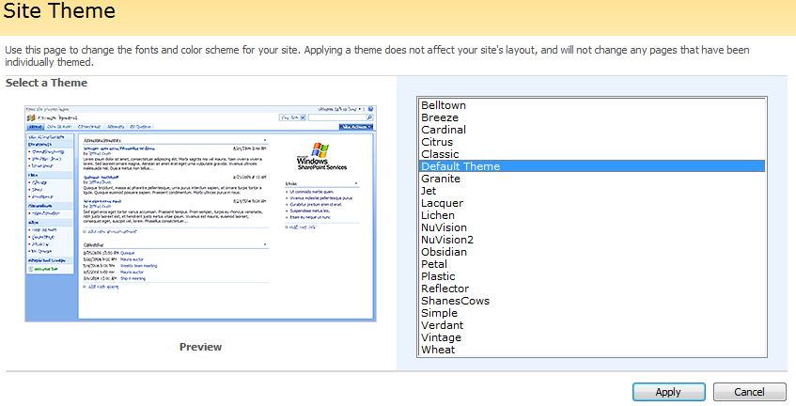
Applying a Theme to a SharePoint site
MOSS
Site Actions > Site Settings > Modify All Site Settings Look and Feel > Site Theme
WSS
Site Settings > Site Theme

Slide 5
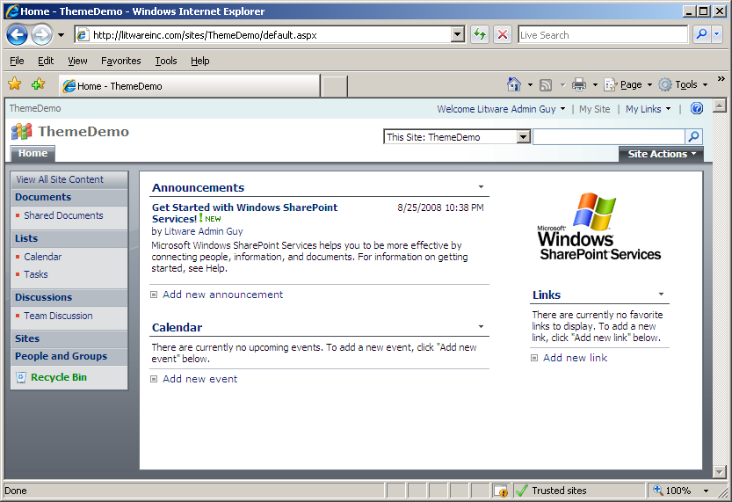
Applying a Theme to a SharePoint site
Site with Lacquer Theme applied

Slide 6
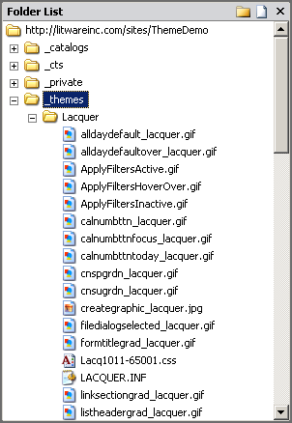
Applying a Theme to a SharePoint site
What happens when a Theme is applied?
Files provisionede in site at “_themes/Lacquer”
mossExtension.css is added to the end of theme.css and a new Theme file is created “Lacq1011-65001.css”

Slide 7
How Master Pages Refer to Themes
Master pages refer to Themes in the <head>
<SharePoint:Theme runat="server"/>
If that tag is excluded, MOSS will still add a meta tag to the end of the <head>
<meta name="Microsoft Theme" content=?Lacquer 1011, default">
Forcing a master page to NOT load Themes
http://blog.drisgill.com/2008/08/disabling-themes-on-custom-master-pages.html

Slide 8
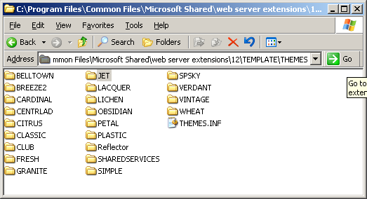
The Themes Folder
Themes Folder is located in the 12 Folder
C:\Program Files\Common Files\Microsoft Shared\web server extensions\12\TEMPLATE\THEMES

Slide 9
The Theme INF File
LACQUER.INF
[info]
title=Lacquer
codepage=65001
version=3.00
format=2.00
readonly=true
refcount=0
[titles]
1031=Lacquer
...

Slide 10
Other Files in the Theme Folder
theme.css
Most of the CSS for the Theme
mossExtension.css
Extra CSS applied to the end of the Theme CSS for MOSS sites
Supporting images and CSS

Slide 11
SPTHEMES.XML
Contains references to all Themes for SharePoint
Located in the 12 Folder:
C\Program Files\Common Files\Microsoft Shared\web server extensions\12\TEMPLATE\LAYOUTS\1033\SPTHEMES.XML
<Templates>
<TemplateID>Lacquer</TemplateID>
<DisplayName>Lacquer</DisplayName>
<Description>Lacquer has a gray background with gray control areas and orange highlights.</Description>
<Thumbnail>images/thlacquer.gif</Thumbnail>
<Preview>images/thlacquer.gif</Preview>
</Templates>

Slide 12
Thumbnail / Preview Images
Thumbnail and preview images are located in the 12 Folder:
C:\Program Files\Common Files\Microsoft Shared\web server extensions\12\TEMPLATE\IMAGES
OOTB Thumbnails are named “th*.gif”
Can be GIF, JPG, or PNG

Slide 13
Creating your own Theme
Copy an OOTB Theme that is a similar design
Make a copy of the SIMPLE folder
Name the folder and .INF file the same (“WingTip” your new Theme name)
Alpha-Numeric only, no special characters or spaces

Slide 14
Creating your own Theme
Edit WINGTIP.INF file and replace all instances of OOTB Theme name (Simple) with your Theme name (WingTip)
[info]
title=WingTip
codepage=65001
version=3.00
format=3.00
readonly=true
refcount=0
[titles]
1031=WingTip
...

Slide 15
Creating your own Theme
Edit SPTHEMES.XML, add an entry for your new Theme before </SPThemes>
<Templates>
<TemplateID>WingTip</TemplateID>
<DisplayName>WingTip</DisplayName>
<Description>Theme for WingTip Inc.</Description>
<Thumbnail>images/th_wingtip.gif</Thumbnail>
<Preview>images/th_wingtip.jpg</Preview>
</Templates>

Slide 16
Creating your own Theme
Add a placeholder preview thumbnail to \12\TEMPLATE\IMAGES
Replace later with an actual screenshot
Make a small change to theme.css

Slide 17
Creating your own Theme
Run iisreset /noforce
Obviously you will want to not do this on production until you are ready
Browse to your SharePoint site and select and apply the new Theme
Site Actions > Site Settings > Modify All Site Settings | Look and Feel > Site Theme

Slide 18
Modifying your Theme
Open the site in SharePoint Designer
Navigate to _themes > WingTip
Open Wing1011-65001.css and make some changes
Add or change images in the _themes > WingTip folder
Your changes appear immediately after browser refresh
Much nicer than changing the Theme folder in the 12 and doing an IISRESET and re-applying the Theme

Slide 19
Modifying your Theme
When you are happy with your changes move your CSS and images back to the 12 Folder in order to make them permanent
Know that your changes are not permanent until this happens, reapplying the old theme and running IISRESET could blow away your changes
Run iisreset /noforce
Reselect and apply your Theme from the browser

Slide 20
Theme Tips and Tricks
Strange errors
"Write Error on file _themes\“
Check for non typical file or folder names in the Theme folder (look for backup folders)
Importing Theme CSS
Allows for easier maintenance, no need to ResetIIS or re-apply Theme
Slightly more complicated structure and references
Add an import statement to the theme.css file
@import "/_layouts/1033/styles/WingTip/theme.css";
http://www.heathersolomon.com/blog/archive/2008/01/30/SharePoint-2007-Design-Tip-Import-your-CSS-for-SharePoint-Themes.aspx

Slide 21
Theme Tips and Tricks
IE Developers Toolbar http://www.microsoft.com/downloads/details.aspx?FamilyId=E59C3964-672D-4511-BB3E-2D5E1DB91038&displaylang=en
Firebug - http://getfirebug.com
Both allow visual inspection of applied CSS, Firebug allows you to manipulate the CSS in real time

Slide 22
Deploying Themes
Automatic deployment
http://solutionizing.net/2008/07/09/updating-spthemesxml-through-a-feature/
Feature stapling adds the Theme to the Site Definition so that the Theme is added when a new site is created
http://ablog.apress.com/?p=1367
Notes:
Demo some custom themes

Slide 23
Summary
What are Themes?
Applying a Theme to a SharePoint site
Themes behind the scenes
Creating your own Theme
Modifying your Theme
Theme Tips and Tricks

