Slide 1
Master Pages in WSS
Exploring the default.master file

Slide 2
Agenda
Overview of ASP.NET syntax used with Master Pages
Understanding default.master
Customizing Master Pages using the SharePoint Designer
Overriding standard PlaceHolders from default.master

Slide 3
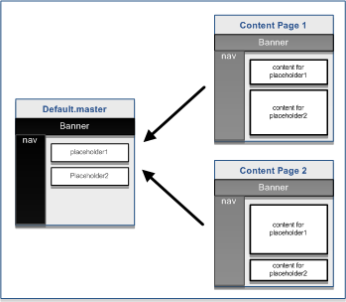
ASP.NET Background: Master Pages
ASP.NET 2.0 introduces Master Pages
Defines common layouts used across content pages

Slide 4
ASP.NET Background: Master Pages
Content Placeholders on Master Pages allow content to be overridden from content pages
Master Page:
<asp:ContentPlaceHolder id="PlaceHolderMain" runat="server" />
Content Page:
<asp:Content runat="server" ContentPlaceHolderID="PlaceHolderMain">
If a content page refers to a placeholder that doesn’t exist on the master page an error will be thrown

Slide 5
ASP.NET Background: Master Pages
User Controls (.ascx) and Server Controls (dll) are like self contained content and functionality widgets
<%@ Register TagPrefix="WingTip" TagName="Widget" Src="WidgetPanel.ascx" %>
<WingTip:Widget runat="server" />

Slide 6
ASP.NET Background: Master Pages
Demo: ASP.NET Master Page

Slide 7
Master Pages in SharePoint
Master pages allow you to change the look and feel for an entire site simply by making changes to a single file
Unlike themes, Master Pages allow full control over the HTML of the page
Can’t have a SharePoint site without it – even if you use a theme!
Notes:
Think back to the old days – if you wanted to change the look and feel for a site you had to manually update every page.

Slide 8
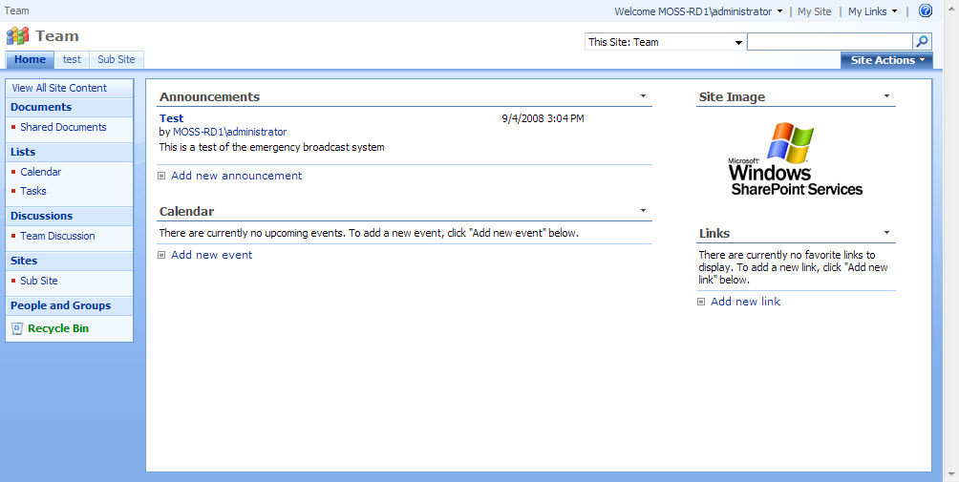
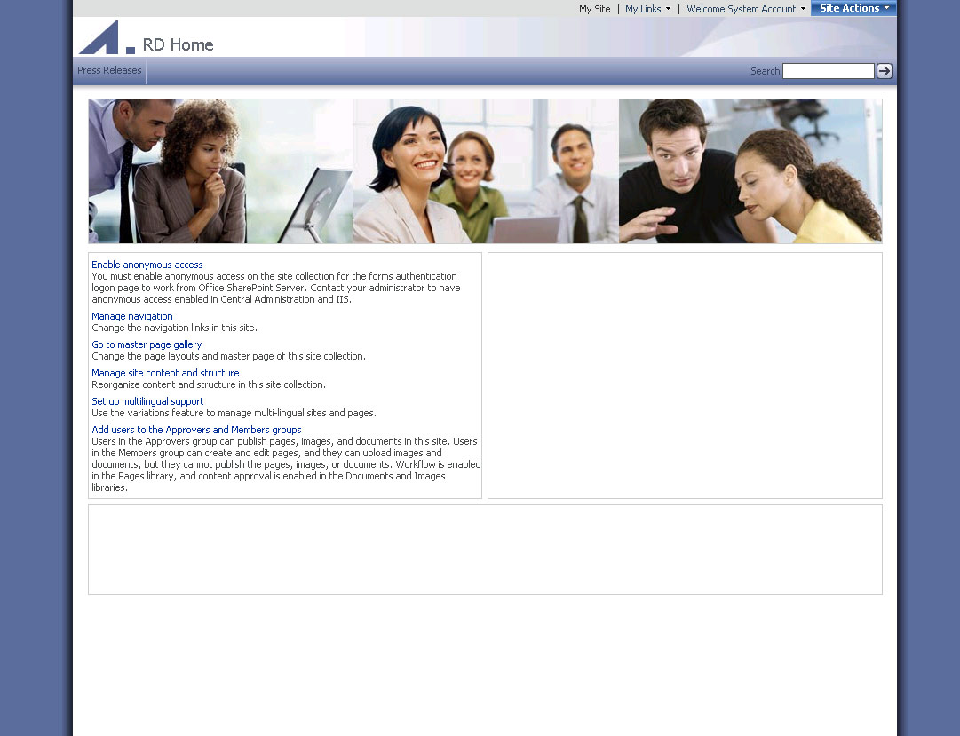
OOTB Master Pages

Slide 9
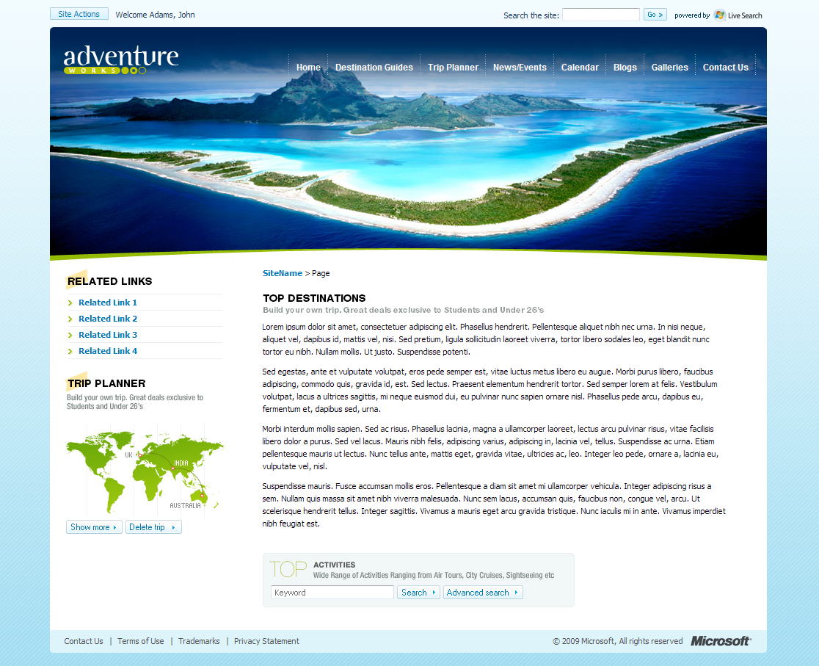

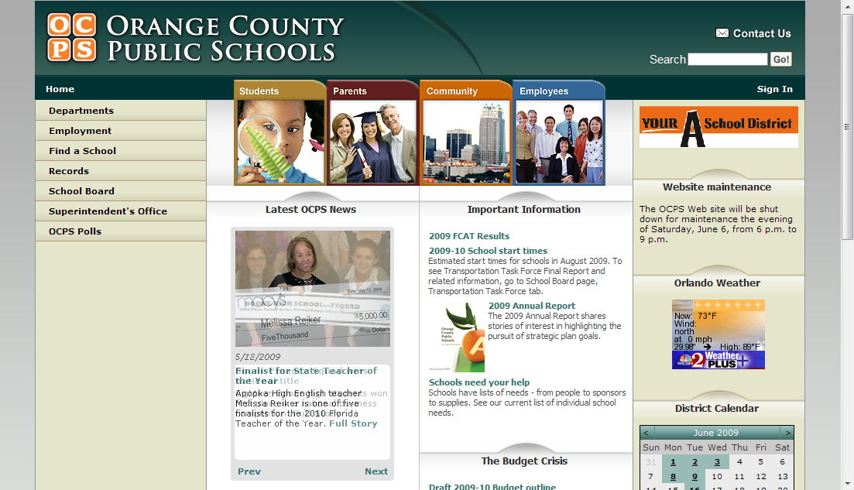
Custom Master Pages
Adventure Works MSDN Article: http://bit.ly/RealWorldBranding

Slide 10
Master Pages in WSS
Application pages use application.master
Farm-wide master page
Cannot be customized on per-site basis
Site Pages use default. master by default
default.master is a page template
default.master instance created in Master Page Gallery
default.master can be customized on per-site basis
default.master can be replaced with different template

Slide 11
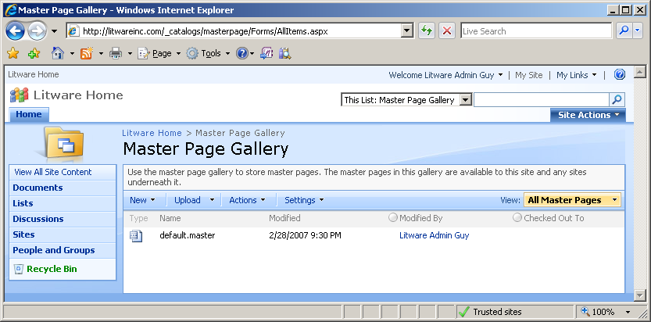
The Master Page Gallery
Each site has a Master Page Gallery
Instance of default.master automatically provisioned
default.master can be customized on per-site basis

Slide 12
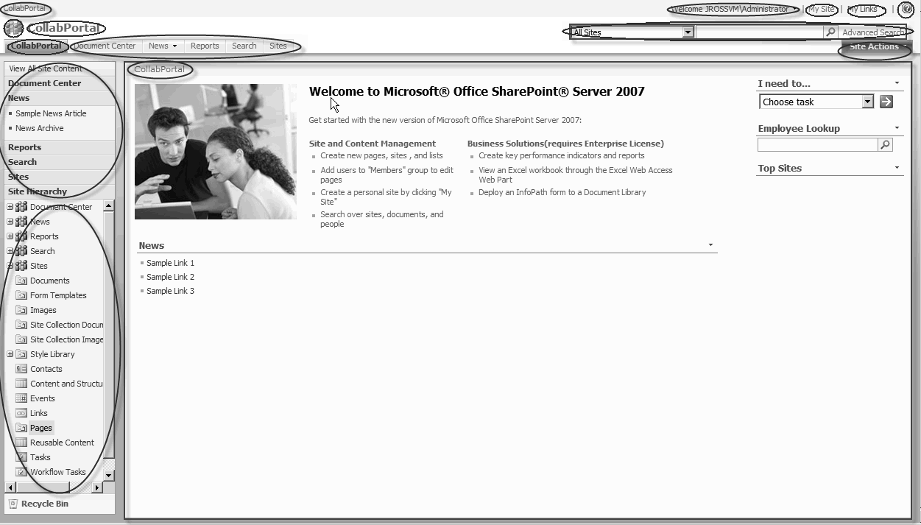
SharePoint Functional Elements
When you are making your own master page you can decide what elements to include
Notes:
Site Breadcrumbs
Title area image
Site Title
Global Navigation
Welcome Menu
My Site
My Links
Help Icon
Search Areas
Site Actions
Left Navigation
Tree View
Recycle Bin
Page Breadcrumbs
Main Content Placeholder

Slide 13
Default.master Demo
Review default.master looking at the functional elements

Slide 14
Delegate Controls
Delegate Controls live in default.master and allow for substitution based on custom Feature code
<SharePoint:DelegateControl runat="server" ControlId="SmallSearchInputBox"/>

Slide 15
Custom Master Pages
Creating a Master Page
One option is to use default.master as a starting point
Make changes to suit your tastes
Apply custom WSS Master Pages with SharePoint Designer
Right-click on Master Page and choose:
Set as Default (or Custom Master) Page

Slide 16
Content Placeholders
All Content Placeholders:
Content placeholder | Description
PlaceHolderBodyAreaClass | Additional body styles in the page header
PlaceHolderBodyLeftBorder | Border element for the main page body
PlaceHolderBodyRightMargin | Right margin of the main page body
PlaceHolderCalendarNavigator | Shows a date-picker for navigating in a calendar when a calendar is visible on the page
PlaceHolderFormDigest | The "form digest" security control
PlaceHolderGlobalNavigation | The global navigation breadcrumb
PlaceHolderHorizontalNav | Top navigation menu for the page
PlaceHolderLeftActions | Bottom of the left navigation area
PlaceHolderLeftNavBar | Left navigation area
PlaceHolderLeftNavBarBorder | Border element on the left navigation bar
PlaceHolderLeftNavBarDataSource | Data source for the left navigation menu
PlaceHolderLeftNavBarTop | Top of the left navigation area
PlaceHolderMain | Main content of the page
Notes:
http://sharepoint.microsoft.com/blogs/GetThePoint/Lists/Photos/Forms/AllItems.aspx?RootFolder=%2Fblogs%2FGetThePoint%2FLists%2FPhotos%2FContentControls

Slide 17
Content Placeholders
Content placeholder | Description
PlaceHolderMiniConsole | A place to show page-level commands, for example, WIKI commands such as Edit Page, History, and Incoming Links
PlaceHolderNavSpacer | The width of the left navigation area
PlaceHolderPageDescription | Description of the page contents
PlaceHolderPageImage | Page icon in the upper-left area of the page
PlaceHolderSearchArea | Search box area
PlaceHolderSiteName | Site name
PlaceHolderTitleAreaClass | Additional styles in the page header
PlaceHolderTitleAreaSeparator | Shows shadows for the title area
PlaceHolderTitleBreadcrumb | Main content breadcrumb area
PlaceHolderPageTitleInTitleArea | Page title shown immediately below the breadcrumbs
PlaceHolderTitleLeftBorder | Left border of the title area
PlaceHolderTitleRightMargin | Right margin of the title area
PlaceHolderTopNavBar | Top navigation area
Notes:
http://sharepoint.microsoft.com/blogs/GetThePoint/Lists/Photos/Forms/AllItems.aspx?RootFolder=%2Fblogs%2FGetThePoint%2FLists%2FPhotos%2FContentControls

Slide 18
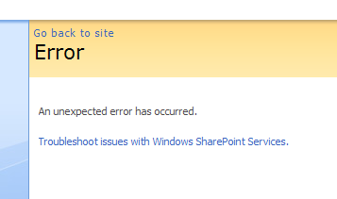
Creating Pages using default.master
If you delete a required Content Placeholder the master page will error
See full error message:
http://vspug.com/michael/2007/06/28/sharepoint-under-the-hood-see-real-error-description-and-callstack-stack-trace/
Notes:
http://sharepoint.microsoft.com/blogs/GetThePoint/Lists/Photos/Forms/AllItems.aspx?RootFolder=%2Fblogs%2FGetThePoint%2FLists%2FPhotos%2FContentControls

Slide 19
Creating Pages using default.master
To hide Content Placeholders that aren’t in use a hidden Panel:
<asp:Panel visible="false" runat="server">
<asp:ContentPlaceHolder ID="PlaceHolderNavSpacer" runat="server"/>
</asp:Panel>
Notes:
http://sharepoint.microsoft.com/blogs/GetThePoint/Lists/Photos/Forms/AllItems.aspx?RootFolder=%2Fblogs%2FGetThePoint%2FLists%2FPhotos%2FContentControls

Slide 20
Content Pages in WSS
Just like pages in ASP.NET they have <asp:Content> tags that override Content Placeholders in the Master Page
<asp:Content ContentPlaceHolderId="PlaceHolderMain" runat="server">

Slide 21
Minimal WSS Master Page Demo
Learn how to…
Begin with minimal WSS master page
Use SharePoint controls
Use / Hide Content PlaceHolders

Slide 22
Summary
Understanding default.master
SharePoint Controls
Content Placeholders

