Slide 1
Designing a Brand for Publishing Portals

Slide 2
Agenda
Understanding the MOSS Publishing features
Overview of Page Layouts and the Pages library
Designing page layouts using content types and field controls
Uploading CSS files and images to the Style Library

Slide 3
MOSS WCM Features
Branding
Define the look, feel, and navigation of the site
Decentralized Authoring
Allow users to easily create and contribute content
Workflow/Scheduling
Supervisors approve content before it is posted.
Data Integrity
Enforce validation of content structure for publishing
Ensure content published/removed in timely manner
Notes:
Instructor Notes
Most important message here is:
Setting up an environment where the responsibility for the creation and maintenance of the content is delegated to non-IT/dev persons. For this we need a very flexible and rich infrastructure that strictly guides the content managers in their tasks.

Slide 4
Benefits of MOSS for Web Sites
Better web publishing experience with more robust Rich Text Editing
Ability to templatize the design with both master pages and page layouts
Better control over out of the box (OOTB) navigation
Empowers your content authors to manage their own web pages and frees up your IT staff to work on custom functionality

Slide 5
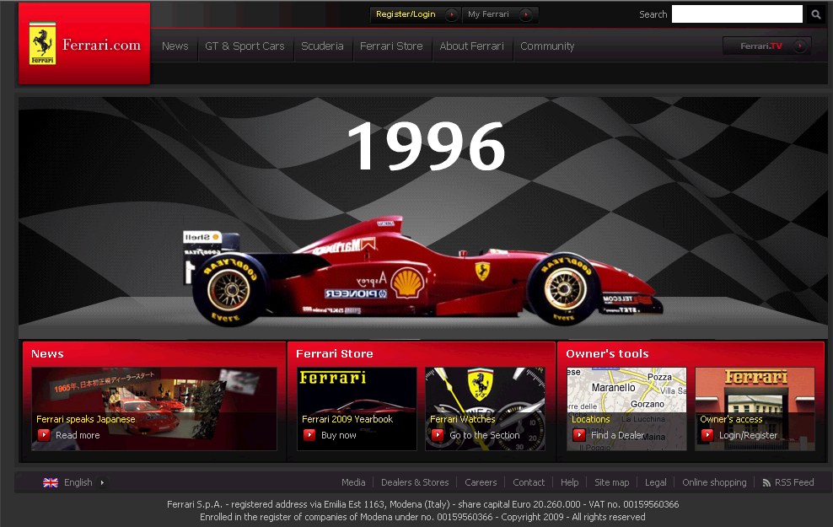
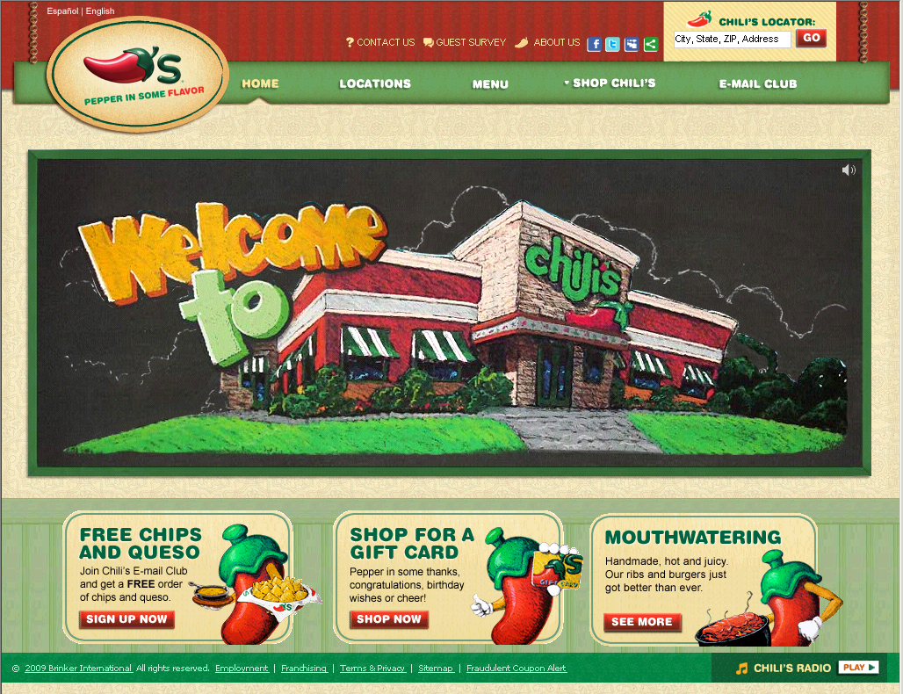
How far can SharePoint Go?
List of Many Public SharePoint Sites: http://www.wssdemo.com/Pages/websites.aspx

Slide 6
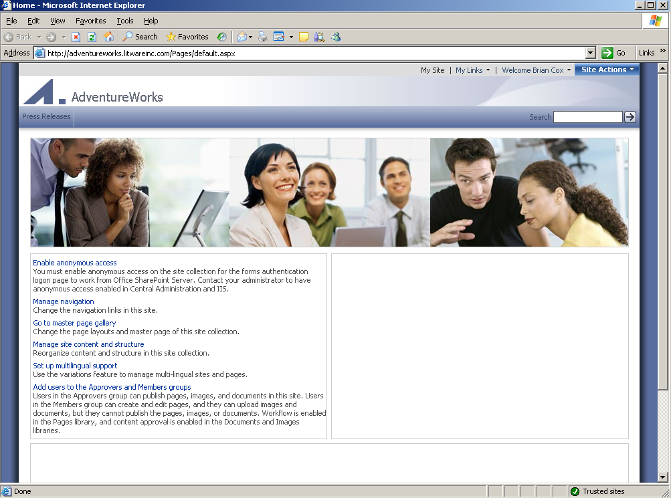
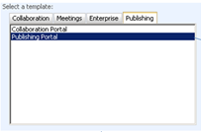
Creating A Publishing Portal
Creating with Central Administration
Create a site collection based on Publishing Portal
Notes:
Instructor Notes
Creating an Internet presence site is as easy as creating a normal team site. There is no separate procedure. Except that at the end, you choose for the proper site definition. Recap site definitions again here and move to the folder where the site definition is stored. Go through the files and point out the different features that have to do with WCM.

Slide 7
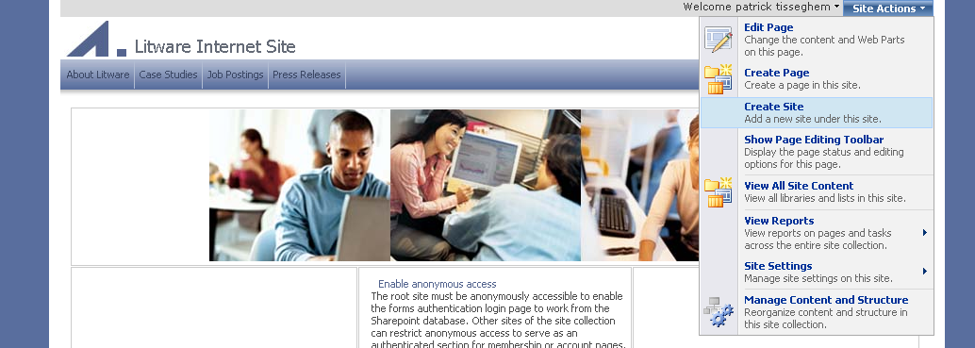
Site Hierarchy
In the past a lot of confusion
Windows SharePoint Services 2003 → sites
SharePoint Portal Server 2003 → areas
Content Management Server 2002 → channels
In SharePoint 2007 everything is a site
Notes:
Instructor Notes
Ask students if they know what a channel is. Point out that this concept no longer exists in MOSS and we are talking now about sites. So, creating the navigation infrastructure for your visitors is creating new sub-sites under your top level site.
But do know that if you went for an Internet Presence site, you are limited to the Publishing site as a possible candidate for a subsite.

Slide 8
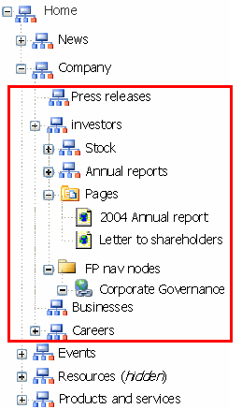
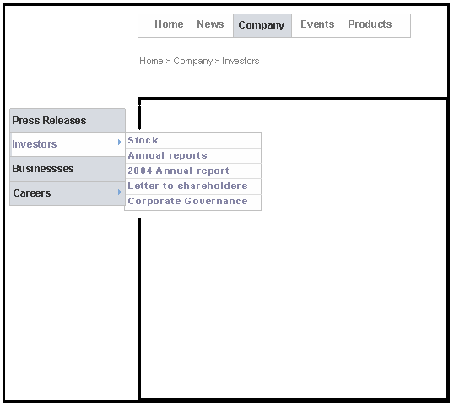

Navigation
Dynamic navigation based on site hierarchy
Includes webs, pages and authored links
Navigation links trimmed based on security, workflow state and publishing schedule
Notes:
Instructor Notes
If you have created a hierarchy of sites and sub-sites, OOB navigation controls will display that hierarchy. These can be replaced with your own navigation controls if needed. Don’t forget to point out that the navigation links are trimmed.

Slide 9
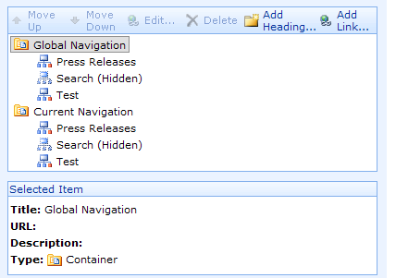
Manual Navigation Settings
Navigation can be changed manually as well

Slide 10
Navigation Settings
Custom Master Pages can control the top and side navigation fly-outs
StaticDisplayLevels – The number of levels of sub navigation to show by default
MaximumDynamicDisplayLevels – The number of levels of sub-navigation to show as fly-outs
Orientation – Can be horizontal for top navigation or vertical for side navigation
http://blogs.msdn.com/ecm/archive/2007/02/10/moss-navigation-deep-dive-part-1.aspx

Slide 11
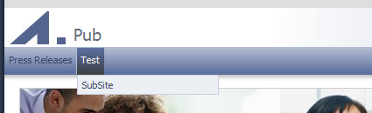
Navigation Settings
Controlled by the Master Page
<SharePoint:AspMenu
ID="GlobalNav"
Runat="server"
DataSourceID="SiteMapDataSource1”
Orientation="Horizontal"
StaticDisplayLevels="1" MaximumDynamicDisplayLevels="1“
...

Slide 12
Navigation Demo

Slide 13
Page = Master Page + Page Layout
Master page defines the outer shell of the design
Each publishing page is associated with a page layout
They now live in the Pages library
Think of it as a template for page content
Only available in MOSS Publishing
Possible scenario
1-3 Master pages
10-25 Page Layouts
10s of 1000s of Content Pages

Slide 14
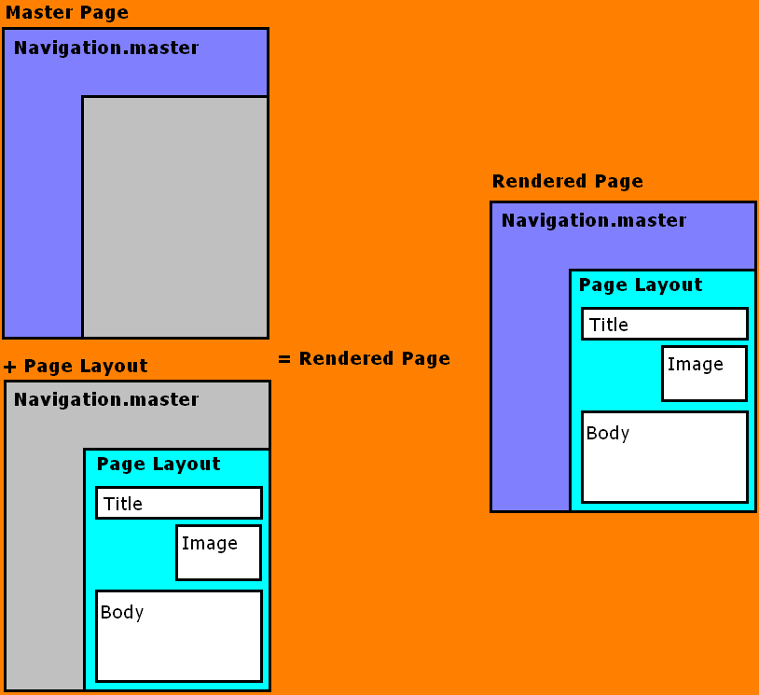
Page = Master Page + Page Layout

Slide 15
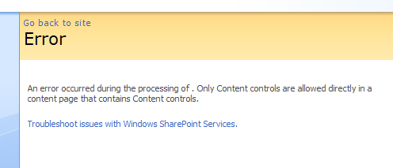
Page Layouts
Overrides the Content Placeholders that are defined in the master page
Content must go inside of Content Placeholders

Slide 16
Demo: Looking at existing Page Layout

Slide 17
Page Layouts
They are always based on one content type
Content types are made up of site columns
Site columns become field controls in the page layout
They allow editable content areas
SharePoint keeps a history of all field control content

Slide 18
Page Layouts
Web Parts
Provide many different ways of displaying content
Content stored in web parts is NOT versioned
Field controls
Editable content items
Content is saved to the content database.
Content can be versioned

Slide 19

Anatomy of a MOSS page

Slide 20
Anatomy of a MOSS page
Master Page
Page Layout
Field Control
Web Part Zone
Web Part Zones
Field Control

Slide 21
Page Layouts and Web Parts
Page layouts can define Web Part Zones
WPZ’s allow content authors to add editable Web Parts to the pages
Web parts have a wide range of options for adding content to the page
The Content Editor Web Part allows content authors to add robust JavaScript and CSS to a page
With great power comes great responsibility
Web Parts do not store content history

Slide 22
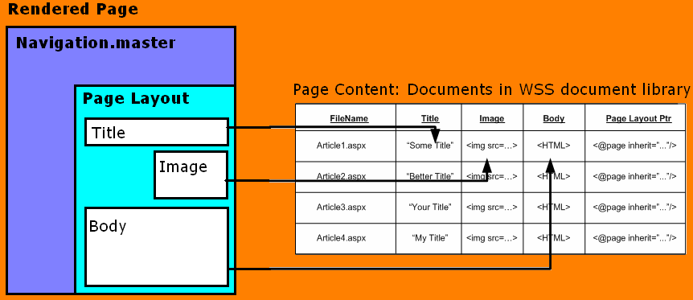

Page Layouts / Content Types
Inherited from WSS:
Versioning,
Check-in/Check-out
Content types
Access control
Workflow
Page execution:
Page URL requested
Page layout executed in content of page
Content server controls bind to page fields
Rendered page returned
Notes:
Instructor Notes
Looking back at our Master Page gallery here, you see all of the currently available page layout files. All of these files are stored in a normal WSS document library. Versioning and check in /check out are enabled. You can organize the files into folders and also apply per-item security if needed for your Web site. Custom workflows can be associated with the document library and possible instantiated and started manually or automatically.
As you notice in the gallery, page layouts are actually the underlying templates of a WSS content type. Content types are a new concept in WSS 2007 and were discussed in Ted Patisson his webcast a couple of weeks ago. Please visit the http://www.betaoneservices.com to review that cast if you want to learn the details. Briefly, content types allow us to create a the site collection level a type of content we want to store in a list or library. Associated with it, you can have specific columns and specific behavior (such as workflow). It is possible to associated one or more content types to a document library.
You see that for example the articleleft and articleright page layouts are associated with the article page content type. If we click on the content type we end up in the definition page for it. You notice the different columns that are defined for the content type. Some of them are required columns, others are custom ones. These columns correspond to fields that can be made available on the page. A field is physically represented as a control on the page. This controls is able to represent itself in edit mode (when the content manager is editing the page) and in view mode (typically what a visitor of our site will see). Field controls are the 2007 version of the place holders we had in CMS 2002.
So when you open the page layout file in SharePoint Designer, you will see these field controls. If we click on one, we can review the properties. The toolbox in SharePoint Designer displays the different fields defined for the content type associated with the page layout.
When you now create a page as a content manager, first thing you do is the selection of the page layout you want to work with. An instance of the page is created and displayed in authoring mode. It means that all of the field controls that are available on the page and that are representing the value of the columns of the content type are editable.
Let us ignore the workflow for now and click the publish action. It will make the page available to all visitors to our site. But where is the page stored? The page is stored in the Pages document library – a very important one since it stores all of the dynamic pages that make up our site. Let us navigate to it via the Site Content and Structure page. Notice how all of the text we have added to the page is actually stored as values for the columns.
When we request the page, SharePoint uses the content server controls to represented these values in the browser.

Slide 23
Demo: Looking at Content Types

Slide 24
Creating a Custom Page Layout
Create new content type (or use an OOTB one)
Add new site columns if needed
Create new page layout file in SPD
Populate the file with field controls and Web Part Zones
Add any HTML for arranging the items
Check-in and approve
Use the SharePoint web interface to create a new page based off of the page layout

Slide 25
Page Layout Demo

Slide 26
Publishing Cycle
Workflow based on Windows Workflow Foundation
Light-weight approval workflow is active OOB
Based on approval
Minor versions need to be approved to become major versions
Visitors only see the major (published) versions
Workflow can be replaced by custom workflow
OOB delivered with MOSS 2007
Designed using SharePoint Designer 2007
Created using Visual Studio.NET 2005
Notes:
Instructor Notes
OOB you have an approval workflow associated with the pages. But point out that students have learned how to create their own workflows so it is possible to replace the OOB workflow with a custom one.

Slide 27
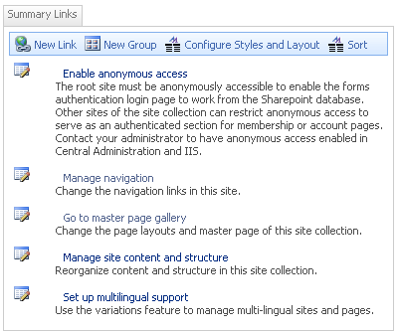

WCM Web Parts
Summary Links Web Part
Custom annotated, stylized links
Table of Contents Web Part
Displays navigation information of your site
Content Query Web Part
Displays a dynamic view of the content in your site
Notes:
Instructor Notes
Explain these Web Parts. Stress that they are tools that (non-it/developer) content managers can use to populate the pages.

Slide 28
Branding with a Minimal Pub Master Page
Minimal Master Page includes all of the key SharePoint items for Internet sites
The Lab includes one:
Student_Oct_02\Labs\Lab05_PublishingSite\Resources\Minimal Publishing Masterpage
Another one available from my MSDN Article:
http://blog.drisgill.com/2009/08/my-msdn-article-is-live-real-world.html

Slide 29
Demo: Looking at Minimal Master Page

Slide 30
Using the Minimal Master Page
Mockup the page design in HTML
Copy the minimal master page
Add the HTML structure to the minimal master
Move all of the SharePoint functionality into the HTML structure
Add the CSS and Images to the Style Library
Publish and approve the files and apply to SharePoint site
Tweak CSS for SharePoint

Slide 31
Demo: Working with Minimal MP

Slide 32
Summary
Understanding the MOSS Publishing features
Overview of Page Layouts and the Pages library
Designing page layouts using content types and field controls
Uploading CSS files and images to the Style Library

