Slide 1
Migrating a Professional Branding Design into SharePoint

Slide 2
Agenda
Planning for Branding
Wireframes
Creating a Design Mockup in Adobe Photoshop or Expressions Design
Moving design assets into SharePoint

Slide 3
Why Plan for Branding
Creating custom themes and master pages can be time consuming
By taking some time upfront to plan, designers and developers can spend less time changing complex master pages, themes, and CSS

Slide 4
Planning for Branding
Gather Design Requirements
Create Simple Wireframes
Create Realistic Design Comps
Create working HTML and CSS version of the design
Once these steps are done you are ready to create the brand in SharePoint

Slide 5
Gathering Design Requirements
Involve Key Stakeholders in the business
The more people involved the more complex and time consuming the process can be
Define the Success Criteria for the project
How do we measure the success
Define the audience to the site
What is the user base trying to do on the site
What are their Demographics

Slide 6
Design Considerations
Differences between Intranet and Internet
Internet:
Internet sites are usually focused on publishing information
Few content authors / many consumers
Usually highly customized UI
Intranet:
Intranet sites are usually focused on collaboration
Many content authors and consumers
Usually a more simple UI with consistent branding
Planning for “self service”
When creating a design for SharePoint, you must consider that areas of the design will be completely out of your control once the site goes live
Have policy in place for making sure corporate standards are met
Plan for change, once you empower your users to edit content you will quickly learn their needs

Slide 7
Design Considerations
Functionality
Will your design require all of the OOTB features?
Search? Breadcrumbs? Top navigation? Left Navigation? Tree View? My Sites? My Links? Help? Login?
Ease of Use
Clean / Simple UI (white space)
Keep the design consistent – Do the users feel like the entire site is one cohesive unit?
Make sure common functions are easily found – Multiple forms of navigation are ok
Best Practices
Choose a maximum height and width in accordance with end user capabilities
Image sizes
W3C Compliance

Slide 8
Browser Market Share
Source: http://marketshare.hitslink.com
Notes:
Intranet can be controlled. Internet sites are a free for all.

Slide 9
Browser Resolutions
Source: http://marketshare.hitslink.com

Slide 10
SharePoint Requirements
Will the site be WSS or MOSS Publishing based?
Will Themes or Master Pages be used?
Information Architecture
Taxonomy
Rollup strategy

Slide 11
Design Considerations
Taxonomy
Create a hierarchical flow chart of how your site will flow
Will each department get its own SharePoint site? Or will they just get pages?
With a sound taxonomy you can start to think about navigation needs
Navigation
Do you need top and side navigation? Do you need multiple levels of navigation?
Will the navigation be constant across all pages or will it change per section
Will navigation be managed manually using the MOSS web UI

Slide 12
Estimating Branding
Branding should be estimated after requirements are
gathered and before any other work happens
Master page vs. theme
Skill level of designers
Deployment considerations
How much time is available
Complexity of the design
Number of elements to be styled
Flexibility of the stakeholders
Give enough time to test
Setting expectations is key!

Slide 13
Creating Wireframes
Wireframes are block diagrams that visually describe the structure and functionality of a web site
Usually created Microsoft Visio
SharePoint Visio Templates:
http://www.guuui.com/issues/02_07.php
http://www.siolon.com/blog/sharepoint-wireframes/
Include targeted content and SharePoint functionality

Slide 14
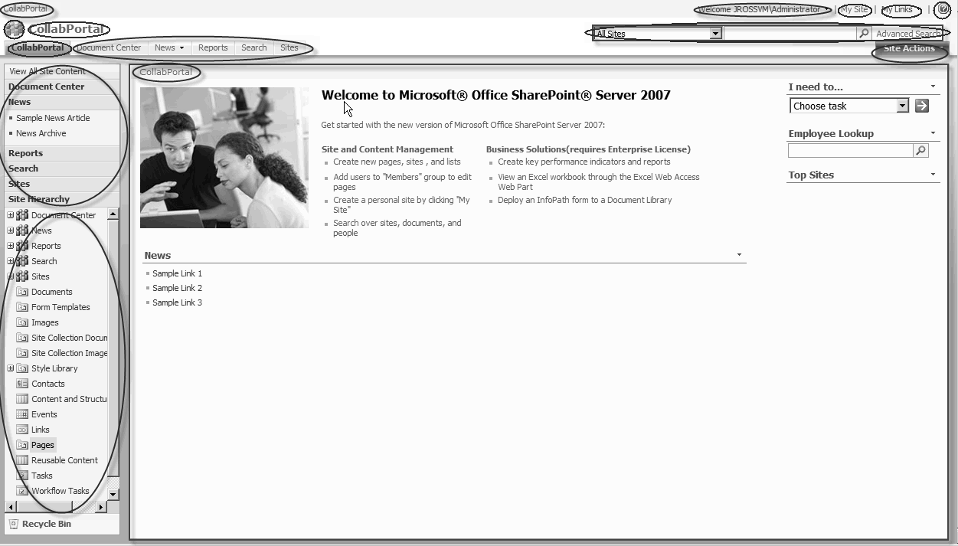
Creating Wireframes
What SharePoint functionality will or won’t be featured?
Notes:
Site Breadcrumbs
Title area image
Site Title
Global Navigation
Welcome Menu
My Site
My Links
Help Icon
Search Areas
Site Actions
Left Navigation
Tree View
Recycle Bin
Page Breadcrumbs
Main Content Placeholder

Slide 15
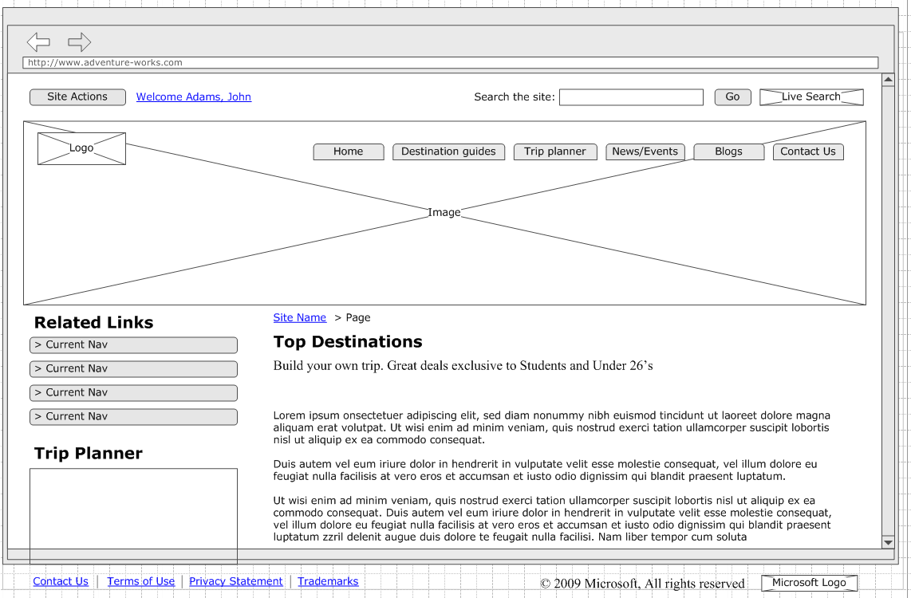
Visio Wireframe

Slide 16
Create Realistic Design Comps
Comp is short for Comprehensive Layout
Unlike Wireframes, design comps are meant to closely mimic the colors and look of an actual web site design.
Comps should be created in a modern design tool like Adobe Photoshop or Microsoft Expression Design
Comps should include anything that will appear on the page:
Photos, logos, colors, fonts, form elements, and screenshots of SharePoint functionality

Slide 17
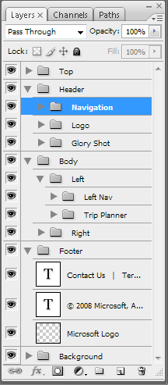
Create Realistic Design Comps
Modern design tools like Photoshop and Expression Design allow for reusable layered / exportable design elements
Be careful to make the design realistic
Be mindful of text anti-aliasing (don’t set expectations higher than the browser can reflect)
Be sure to accurately reflect what is possible in SharePoint
Notes:
You Suck at Photoshop www.mydamnchannel.com/Big_Fat_Brain/You_Suck_at_Photoshop/YouSuckatPhotoshop1_398.aspx
Recommended Book: Adobe Photoshop CS3 Classroom in a Book

Slide 18
Photoshop Basics
Working with PSD’s
Photoshop’s native format
Supports layers and editable text
Working with Layers and Groups
Create as many layers as needed to make sure each element is editable by itself
Group common layers for easy maintenance
Use layer effects to make color and gradient changes, as well as for other effects like bevels and drop shadows

Slide 19
Photoshop Basics
Working with text
Be careful choosing body or link fonts that are unavailable on user machines
Be careful with anti-aliasing, sometimes text will look better or worse in Photoshop than it will on the web
Large text should probably be converted to images before exporting to SharePoint
Working with colors
The eyedropper is good for getting hexadecimal values of colors to transfer to CSS
Use the Hue and Saturation menu to change hues of images
Image > Adjustments > Hue and Saturation

Slide 20
Slicing and dicing Photoshop graphics
Creating repeating backgrounds
Often you will want to just save a small area of an image so that it can be repeated horizontally or vertically
Saving for the web
File > Save for Web and Devices
Using GIF, JPG, and PNG formats
Compression, choose the smallest size without compromising the look
Creating transparent images
Transparent PNG’s not fully supported in all browsers

Slide 21
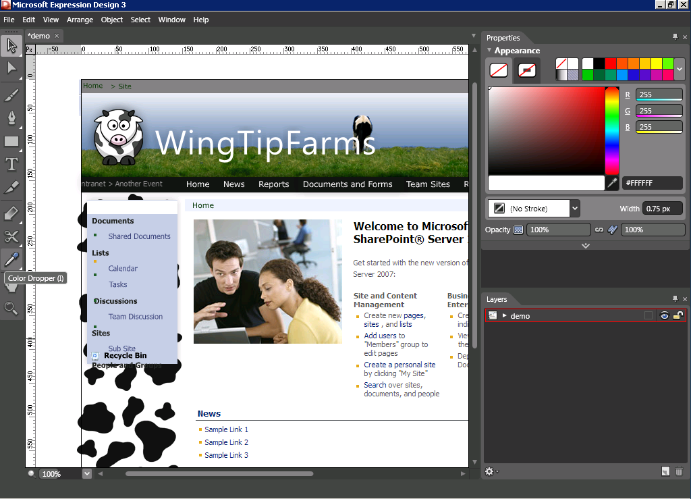
Expression Design
http://www.microsoft.com/expression/

Slide 22
Complex Designs
Sometimes it’s a good idea to create a complex design in HTML first before working with SharePoint
Most of the HTML and CSS work can be reused in SharePoint branding

Slide 23
Moving design assets into SharePoint
Where should everything live?
_layouts folder in the 12 folder
/style library/images
/images
Uploading assets with the SharePoint web UI
Site Actions > View All Site Content
Style Library
Upload
Uploading assets with SharePoint Designer
Navigate to /style library/images
Simply drag images from your computer into the Folder pane

Slide 24
Additional Information
Links
http://www.smashingmagazine.com/tag/photoshop/
Adobe Photoshop Basics
Learn Expression Design
Recommended Books
Adobe Photoshop CS4 Classroom in a Book
Microsoft® Expression® Design Step by Step (Microsoft Press)

Slide 25
Summary
Planning for Branding
Wireframes
Creating a Design Mockup in Adobe Photoshop or Expressions Design
Moving design assets into SharePoint

