Slide 1
Real World Photoshop Migration
Designing Artwork and Images for SharePoint

Slide 2
Agenda
Design considerations
Creating a wire frame
Photoshop basics
Slicing and dicing Photoshop graphics
Moving design assets into SharePoint

Slide 3
Design Considerations
OOTB SharePoint Site
Default.master
Blueband.maste
How far can you go with SharePoint design
http://www.ocps.net
http://www.kroger.com
http://www.cps.edu
http://biz.viacom.com/tvlandpress
http://www.westrac.com.au
List of Many MOSS Sites: http://www.wssdemo.com/Pages/websites.aspx

Slide 4
Design Considerations
Differences between Intranet and Internet
Internet:
Internet sites are usually focused on publishing information
Few content authors / many consumers
Usually highly customized UI
Intranet:
Intranet sites are usually focused on collaboration
Many content authors and consumers
Usually a more simple UI with consistent branding
Planning for “self service”
When creating a design for SharePoint, you must consider that areas of the design will be completely out of your control once the site goes live
Have policy in place for making sure corporate standards are met
Plan for change, once you empower your users to edit content you will quickly learn their needs

Slide 5
Design Considerations
Taxonomy
Create a hierarchical flow chart of how your site will flow
Will each department get its own SharePoint site? Or will they just get pages?
With a sound taxonomy you can start to think about navigation needs
Navigation
Do you need top and side navigation? Do you need multiple levels of navigation?
Will the navigation be constant across all pages or will it change per section
Will navigation be managed manually using the MOSS web UI
Site Actions > Site Settings > Modify Navigation
Some of the navigation features can be controlled from the MOSS web UI others need to be controlled in the master page
http://blogs.msdn.com/ecm/archive/2007/02/10/moss-navigation-deep-dive-part-1.aspx

Slide 6
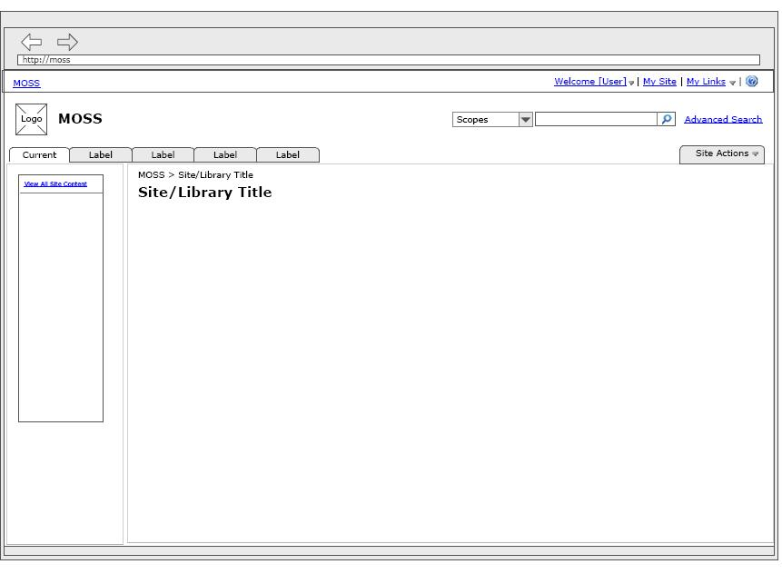
Creating a Wire Frame
Wire frames can be created using any tool you would like
They help you visualize where design elements will be located before the creative process begins
http://www.siolon.com/blog/sharepoint-wireframes/

Slide 7
Design Considerations
Functionality
Will your design require all of the OOTB features?
Search? Breadcrumbs? Top navigation? Left Navigation? Tree View? My Sites? My Links? Help? Login?
Ease of Use
Clean / Simple UI (white space)
Keep the design consistent – Do the users feel like the entire site is one cohesive unit?
Make sure common functions are easily found – Multiple forms of navigation are ok
Best Practices
Choose a maximum height and width in accordance with end user capabilities
TheCounter.com lists 1024 × 768 and 1280 × 1024 as the most common resolutions
Image sizes
W3C Compliance

Slide 8
Photoshop Basics
Overview of the Photoshop UI
Demo

Slide 9
Photoshop Basics
Working with PSD’s
Photoshop’s native format
Supports layers and editable text
Working with Layers and Groups
Create as many layers as needed to make sure each element is editable by itself
Group common layers for easy maintenance
Use layer effects to make color and gradient changes, as well as for other effects like bevels and drop shadows

Slide 10
Photoshop Basics
Working with text
Be careful choosing body or link fonts that are unavailable on user machines
Be careful with anti-aliasing, sometimes text will look better or worse in Photoshop than it will on the web
Large text should probably be converted to images before exporting to SharePoint
Small text will usually not be converted to images, instead you are simply mockup up how dynamic text will look in SharePoint
Working with colors
The eyedropper is good for getting hexadecimal values of colors to transfer to CSS
Use the Hue and Saturation menu to change hues of images
Image > Adjustments > Hue and Saturation

Slide 11
Slicing and dicing Photoshop graphics
Creating repeating backgrounds
Often you will want to just save a small area of an image so that it can be repeated horizontally or vertically
Saving for the web
File > Save for Web and Devices
Using GIF, JPG, and PNG formats
Compression, choose the smallest size without compromising the look
Creating transparent images
Transparent PNG’s not fully supported in all browsers

Slide 12
Moving design assets into SharePoint
Where should everything live?
_layouts folder in the 12 folder
/style library/images
/images
Uploading assets with the SharePoint web UI
Site Actions > Manage Content and Structure
Navigate to /style library/images
New > Item
Uploading assets with SharePoint Designer
Navigate to /style library/images
Simply drag images from your computer into the Folder pane

Slide 13
Additional Information
Links
You Suck at Photoshop www.mydamnchannel.com/Big_Fat_Brain/You_Suck_at_Photoshop/YouSuckatPhotoshop1_398.aspx
Recommended Books
Adobe Photoshop CS4 Classroom in a Book

