Slide 1
SharePoint Development and Solution Package Deployment
Achieving Reusability and Ease of Deployment

Slide 2
Agenda
SharePoint Customization versus Development
Developing Features
Solution Packages Deploy
Creating a Branding Solution

Slide 3
Customization Versus Development
Site Customizations
Changes to one particular site
Done using the browser or the SharePoint Designer
Changes recorded in content database
Easy to do but hard to reuse
WSS Development
Creation of reusable templates/components
Templates/components installed on Web server
Development based on Visual Studio projects
Project source files checked into source code control
Projects can be moved through staging to production

Slide 4
What is a Feature?
A building block for creating SharePoint solutions
A unit of design, implementation and deployment
Features can contain elements
e.g. menu items, links, list types and list instances
Many other element types possible
Features can contain event handlers
You can add any code which used WSS object model

Slide 5
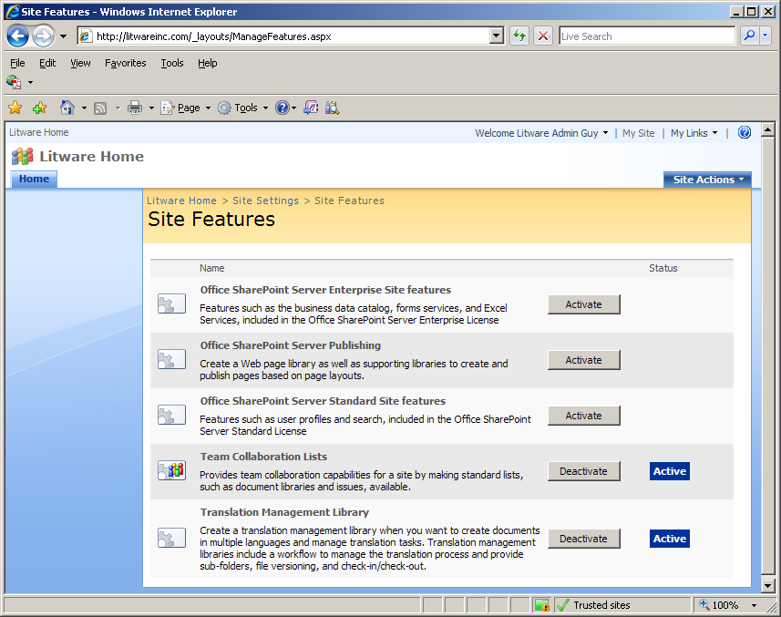
User’s View of Features
Features support concept of activation/deactivation
This is the site-level feature management page in a WSS farm where MOSS has been installed.
Much of the functionality of MOSS is enabled and disable by activating and deactivating features that have been developed by the MOSS team.

Slide 6
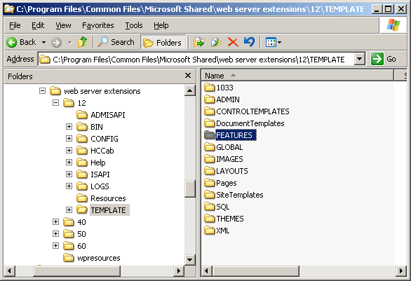
The WSS System Directories
Developers must learn WSS system directories
\12\TEMPLATE
\12\TEMPLATE\FEATURES ← This is the one we care about in this lecture
\12\TEMPLATE\IMAGES
\12\TEMPLATE\LAYOUTS

Slide 7
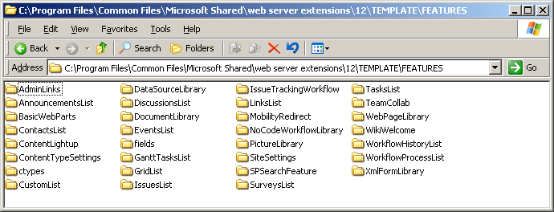
The Features Directory
Functionality in WSS based on Features
Features are installed at farm level
Feature activation makes functionality available
WSS supports for different feature activation scopes
(1) Site (2) Site Collection (3) Web Application (4) Farm
Your custom features will each need a directory created here

Slide 8
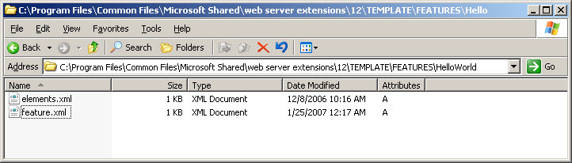
Developer’s View of a Feature
Each feature requires its own directory
Directory must contain feature.xml file
Directory often contains other files definition elements

Slide 9
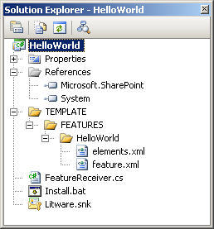
Creating the 'Hello World' Feature
Create a new Visual Studio Class Library project
Create XML files which define feature
Add a FeatureActivated event handler

Slide 10
The feature.xml file
Feature.xml file serves as feature manifest
Features defined in declarative fashion using CAML
CAML = Collaborative Application Markup Language
<Feature
Id="B2CB42E2-4F0A-4380-AABA-1EF9CD526F20"
Title="A Sample Feature: Hello World"
Description=“Hi mom, class is fun. I am doing great"
Scope="Web"
Hidden="FALSE"
ImageUrl="TPG\WhitePithHelmet.gif"
xmlns="http://schemas.microsoft.com/sharepoint/">
<ElementManifests>
<ElementManifest Location="elements.xml" />
</ElementManifests>
</Feature>

Slide 11
Elements.xml
Feature includes elements defined using CAML
This element defines a Site Actions menu item
There are many other types of elements
<Elements xmlns="http://schemas.microsoft.com/sharepoint/">
<CustomAction
Id="SiteActionsToolbar"
GroupId="SiteActions"
Location="Microsoft.SharePoint.StandardMenu"
Sequence="100"
Title="Hello World"
Description="A custom menu item added using a feature"
ImageUrl="_layouts/images/crtsite.gif" >
<UrlAction Url="http://msdn.microsoft.com"/>
</CustomAction>
</Elements>

Slide 12
Install.bat
Visual Studio supports post-build events
Can be used to run batch file to deploy components
Used on development machines
Should not be used on staging/production machines
@SET TEMPLATEDIR="c:\program files\common files\microsoft shared\web server extensions\12\Template"
@SET STSADM="c:\program files\common files\microsoft shared\web server extensions\12\bin\stsadm"
@SET GACUTIL="c:\Program Files\Microsoft Visual Studio 8\SDK\v2.0\Bin\gacutil.exe"
Echo Installing HelloWorld.dll in GAC
%GACUTIL% -if bin\debug\HelloWorld.dll
Echo Copying files to TEMPLATE directory
xcopy /e /y TEMPLATE\* %TEMPLATEDIR%
Echo Installing feature
%STSADM% -o installfeature -filename HelloWorld\feature.xml -force
Echo Restart all IIS worker processes
IISRESET
Echo Restart just the IIS worker process for a particular Application Pool
REM cscript c:\windows\system32\iisapp.vbs /a "SharePointDefaultAppPool" /r

Slide 13
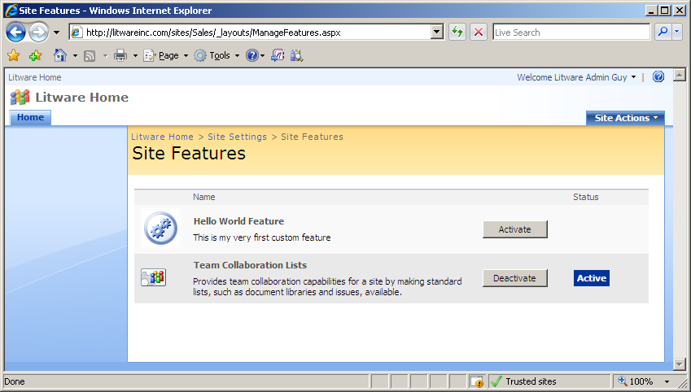
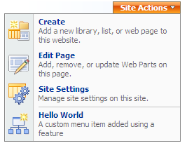
Feature Activation
Steps to testing Feature
Copy Feature files to FEATURES directory
Install feature with WSS
Activate Feature within a specific site

Slide 14
Deployment using Solution Packages
Evolution of Web Part Packages from WSS 2.0
Solution Package is a CAB file with .wsp extension
Solution Package contains a manifest
Solution Package contains files required on Web server
What can be deployed via a Solution Package
Feature definitions
Application Pages
Assembly DLLs
And much more…

Slide 15
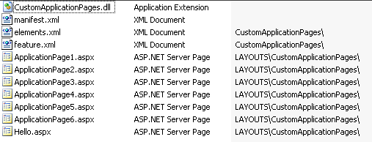
Deployment using Solution Packages
WSS Deployment done with Solution Packages
Solution Package is CAB file with .wsp extension
Created using DDF file and MAKECAB.EXE
Deployed using STSADM.EXE or WSS Central Admin
CustomApplicationPages.wsp

Slide 16
Solution Package Manifest
Solution Manifest read by WSS installer
<Solution SolutionId="9EFFE92B-781D-4c99-BBCC-432D248B899D"
xmlns="http://schemas.microsoft.com/sharepoint/">
<FeatureManifests>
<FeatureManifest Location="CustomApplicationPages\feature.xml" />
</FeatureManifests>
<TemplateFiles>
<TemplateFile Location="LAYOUTS\CustomApplicationPages\Hello.aspx"/>
<TemplateFile Location="LAYOUTS\CustomApplicationPages\ApplicationPage1.aspx"/>
<TemplateFile Location="LAYOUTS\CustomApplicationPages\ApplicationPage2.aspx"/>
<TemplateFile Location="LAYOUTS\CustomApplicationPages\ApplicationPage3.aspx"/>
<TemplateFile Location="LAYOUTS\CustomApplicationPages\ApplicationPage4.aspx"/>
<TemplateFile Location="LAYOUTS\CustomApplicationPages\ApplicationPage5.aspx"/>
<TemplateFile Location="LAYOUTS\CustomApplicationPages\ApplicationPage6.aspx"/>
</TemplateFiles>
<Assemblies>
<Assembly Location="CustomApplicationPages.dll"
DeploymentTarget="GlobalAssemblyCache" />
</Assemblies>
</Solution>

Slide 17
Solution Package: install vs. deploy
Solution Package Installation
WSP file copied into configuration database
Done using addsolution operation of STSADM.EXE
Solution Package Deployment
WSP files copied to each FE Web Server and deployed
Done using deploysolution operation of STSADM.EXE
REM – a batch file named DeploySolutionPackage.cmd from CustomApplicationPage project
Echo Generating Solution Package CustomApplicationPages.wsp
if EXIST CustomApplicationPages.wsp del CustomApplicationPages.wsp
cd ..
makecab /f Solution\cab.ddf
cd package
Echo Installing CustomApplicationPages.wsp in WSS Solution Package Store
%STSADM% -o addsolution -filename CustomApplicationPages.wsp
%STSADM% -o execadmsvcjobs
Echo Deploying Solution Package CustomApplicationPages.wsp
%STSADM% -o deploysolution -name CustomApplicationPages.wsp -immediate -allowGacDeployment
%STSADM% -o execadmsvcjobs
Notes:
Instructor Notes
One very significant enhancement to the V3 deployment story is that WSS knows about the Web servers in the farms and will push a solution out to each of these Web server. Back in WSS V2, it was necessary to install a Web part package or copy site definition files to each Web server seperately.
To deploy a solution, you starting by running an STSADM.EXE operation or by calling custom code that adds the solution CAB file into the configuration database. In a separate step, you then run another STSADM.EXE operation or by call custom code that initiates a deployment operation. This starts a timer job that copies the CAB file to each of the front end Web servers and installs the elements within the solution.

Slide 18
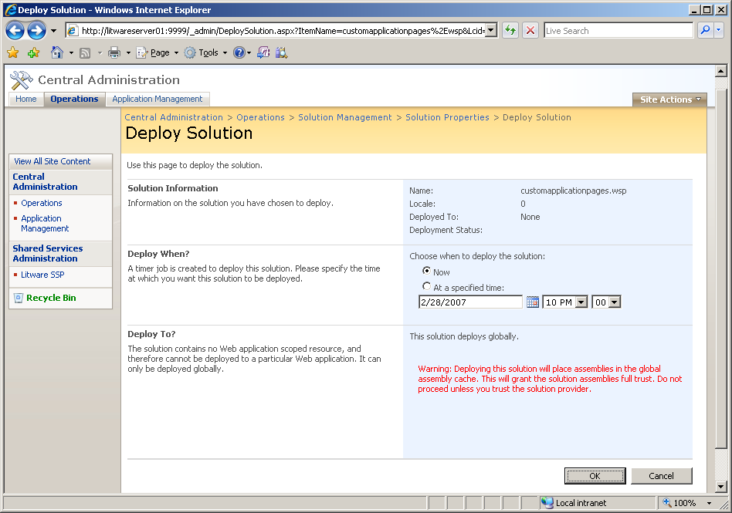
Deploying Solution Packages

Slide 19
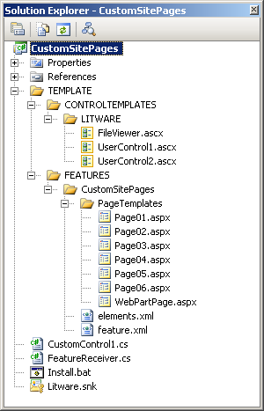
Demo: CustomSitePages
Important Concepts
Page template vs. page instance
Page customization
SafeMode processing

Slide 20
'Hello World' Page Template
Page Template can be added to feature
MasterPageFile points to ~masterurl/default.master
progid adds support for SharePoint Designer
<%@ Page MasterPageFile="~masterurl/default.master"
meta:progid="SharePoint.WebPartPage.Document" %>
<asp:Content runat="server" ContentPlaceHolderID="PlaceHolderMain">
<h3>Hello World</h3>
A simple page template used to create site pages
</asp:Content>

Slide 21
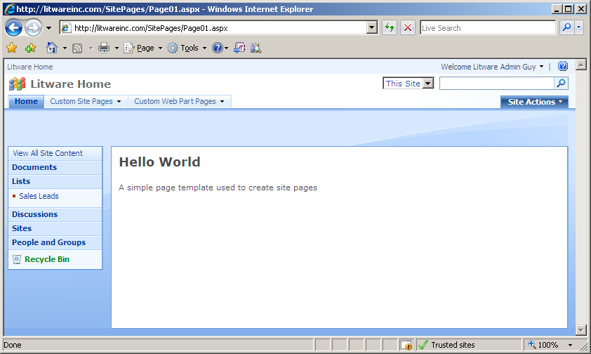
Provisioning a Page Instance
Module element used to provision page instance
File element per page instance
Supports page ghosting
<Elements xmlns="http://schemas.microsoft.com/sharepoint/">
<Module Path="PageTemplates" Url="SitePages" >
<File Url="Page01.aspx" Type="Ghostable" />
</Module>
</Elements>

Slide 22
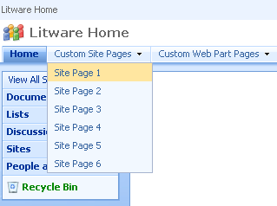
Adding Navigation Support for Pages
Navigation nodes can be added
Can be added during feature activation
Can be added to top-link bar
Can be added to QuickLaunch
Nodes created as SPNavigationNode
public class FeatureReceiver : SPFeatureReceiver {
public override void FeatureActivated(SPFeatureReceiverProperties properties) {
// get a hold off current site in context of feature activation
SPWeb site = (SPWeb)properties.Feature.Parent;
SPNavigationNodeCollection topNav = site.Navigation.TopNavigationBar;
// create dropdown menu for custom site pages
SPNavigationNode DropDownMenu1 =
new SPNavigationNode("Custom Site Pages", "", false);
topNav[0].Children.AddAsLast(DropDownMenu1);
DropDownMenu1.Children.AddAsLast(
new SPNavigationNode("Site Page 1", "SitePages/Page01.aspx"));
}
}

Slide 23
Custom Master Page Templates
Creating a Master Page Template
Use default.master as a starting point
Make changes to suit your tastes
Master Page templates like site page template
Support ghosting and unghosting
Provisioned using a File element within a Module
<Elements xmlns="http://schemas.microsoft.com/sharepoint/">
<Module Name="MasterPages" List="116" Url="_catalogs/masterpage">
<File Url="Litware.master" Type="GhostableInLibrary" />
</Module>
</Elements>

Slide 24
Master Page Elements
<%@Master language="C#"%>
<%@ Register Tagprefix="SharePoint"
Namespace="Microsoft.SharePoint.WebControls"
Assembly="Microsoft.SharePoint, …" %>
<HTML id="HTML1" runat="server">
<HEAD id="HEAD1" runat="server">
<!-- SharePoint Utility Controls -->
<SharePoint:CssLink ID="CssLink1" runat="server"/>
<SharePoint:Theme ID="Theme1" runat="server"/>
<!-- Named Placeholders -->
<Title ID=onetidTitle>
<asp:ContentPlaceHolder id=PlaceHolderPageTitle runat="server"/>
</Title>
<asp:ContentPlaceHolder id="PlaceHolderAdditionalPageHead" runat="server"/>
<!-- Named Delegate Control -->
<SharePoint:DelegateControl
ID="DelegateControl1" runat="server"
ControlId="AdditionalPageHead" AllowMultipleControls="true"/>
</HEAD>

Slide 25
Updating the MasterUrl Property
Update MasterUrl to redirect site pages
Child site can reference Master Page in top-level site
protected void cmdApplyCustomBrand_Click(object sender, EventArgs e) {
SPWeb site = SPContext.Current.Site.RootWeb
string MasterUrlPath = site.ServerRelativeUrl;
if (!MasterUrlPath.EndsWith(@"/"))
MasterUrlPath += @"/";
MasterUrlPath += @"_catalogs/masterpage/Litware.master";
ApplyCustomBrand(MasterUrlPath, site);
}
protected void ApplyCustomBrand(string MasterUrlPath, SPWeb site) {
site.MasterUrl = MasterUrlPath;
site.Update();
// use recusion to update all child sites in site collection
foreach (SPWeb child in site.Webs) {
ApplyCustomBrand(MasterUrlPath, child);
}
}

Slide 26
Agenda
SharePoint Customization versus Development
Developing Features
Solution Packages Deploy
Creating a Branding Solution

