Slide 1
Storing Data in Lists and Utilizing Web Parts
Module 2

Slide 2
Agenda
Creating Custom Lists to Store and Collect Data
Determining the Metadata to collect
Using Views to present the data
The Web Parts-Lists Relationship

Slide 3
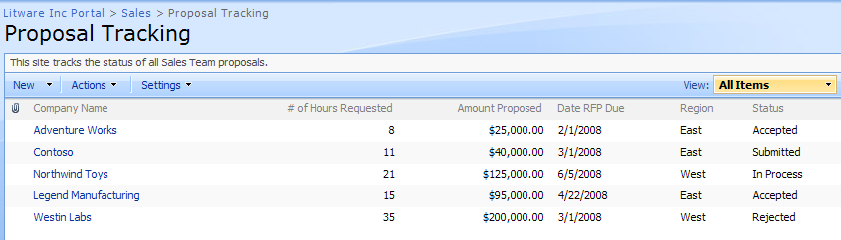
Everything is a list
List are used to store information
Think of them as a database table
They are very easy to customize
Experience is always the same
Notes:
A list is a very easy method for the used to store and create items. There are probably many things you do/use everyday that would be useful if they were stored in a list that you could sort and filter. Think of task lists, contacts lists, lists of customers, potential sales calls, all of these items could be created and stored in SharePoint. This may be a lot of the things you are currently storing in Excel, but in Excel you need to email around the workbook to share it with us, with SharePoint you point to the URL and everyone is viewing the same current data.

Slide 4
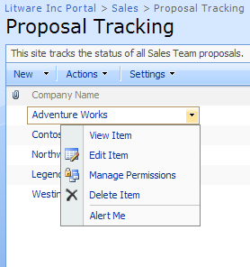
Change List Item Settings on the Drop Down
Notes:
The drop down on a item is also referred to as the ECB (Edit Control Block). You may see it referred to as both when you are doing research. This menu allows you to access options for a particular item, such as edit and manage permissions. You will see in future modules you may also see commands here for workflows, this command allows you to see workflows running on an item and start a new workflow. If we have turned on versioning, you would also see a command for version history which allows you to see previous versions. When you are looking for a command for a single item, check the drop down menu first.

Slide 5
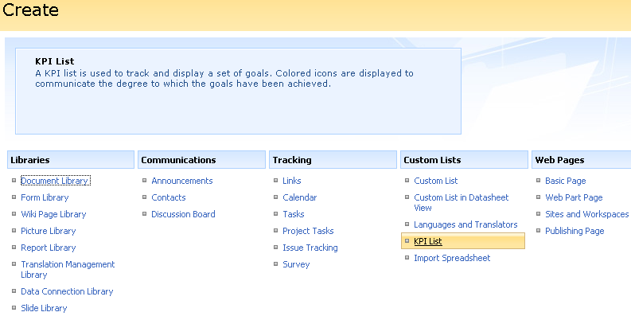
Types of list
Varies by site template and version of SharePoint
Notes:
The lists you see in the screenshot above are from a site using the team site template with the Enterprise version. All of the lists you see here are templates to get you started. They have already configured the columns you would likely need for that type of list, however after you create the list you will be able to customize the columns. For Example, you may decide you would like to maintain a list of vendors your organization uses. To do this, you would use the Contacts list template, once the template is create you may decide to add a column for what they supply your organization with. If none of the templates fit what you are trying to create, then use the custom list template and build your own columns.

Slide 6
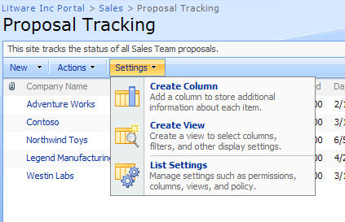
Metadata and Columns
Metadata is data about data
It allows you to capture information about an item or document. The information will make it easier to search, sort, filter, and group.
Want more metadata?
Add a column
Notes:
Metadata is data about the items or documents you are created. An example of metadata for a document might be who created it, when it was created, and what version it is. If you are familiar with using Microsoft Office Word, you might recognize this as the properties. In SharePoint this metadata is represented using columns on a list.

Slide 7
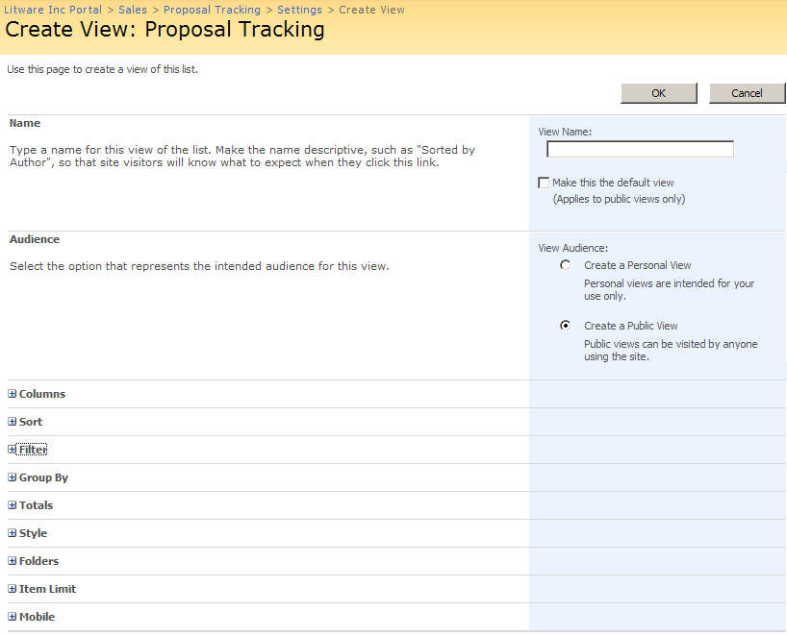
Using views to present the data
Notes:
Creating views on your SharePoint lists allows you to present the data in the most meaningful way based on what the user is attempting to accomplish basis. For example, if you are a homebuilder and you have one list of all of the vendors for the entire company, it may be more efficient if you create a view of the vendor list that is sorted by what the vendor supplied rather then an alphabetical list of the vendors. Or a task list dedicated to the launch of a new store, may hold 300 task items to be completed. It would be more useful for your users to created a view of the task list that filtered the list to only show their task items.
The final thing to know about views, is there is a 2000 item limit per view. The performance of your list is a inverse relationship, as the number of items per view increases, the performance of your list decreases. This article describes this relationship further as well as some other limitations to be aware of when planning your SharePoint Architecture.
http://technet2.microsoft.com/Office/en-us/library/6a13cd9f-4b44-40d6-85aa-c70a8e5c34fe1033.mspx?mfr=true

Slide 8
Metadata vs. Folders
A fun debate
Folders
Traditional way of organizing content
Very easy for users
Metadata
New hip way to organize
Requires users to input data
Allows better search relevance
More flexible for creating views
SharePoint lists support both
Notes:
This is a decision for you to make as an entire company. If you choose to go with the metadata method it will likely be a paradigm shift for your users, however you will likely be very happy with the change. Using Metadata allows you to be very flexible and fluid with your data. The presentation of the data can change as quickly as the users need.

Slide 9
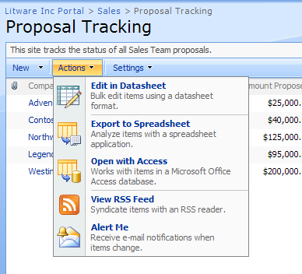
Actions Menu
Notes:
The action menu on a list or library presents you with different commands for editing the list as a whole. You may use the edit in datasheet command to edit the columns on the entire list at once rather than using the edit properties command on the item. Or use the “export to spreadsheet” or the “open with access commands” to take the data offline and manipulate it with all of the familiar options which Excel and Access present you with. The actions menu will also present the “Connect to Outlook” command when a list or library is available to be taken offline.

Slide 10
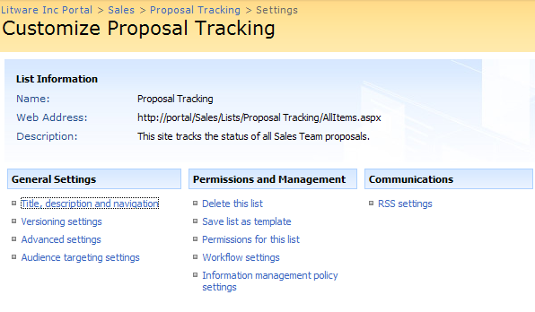
List Settings Menu
Notes:
The list settings menu presents you with all of the settings available for the entire list. Throughout this class you will become familiar with most of the options listed on this page. It would benefit you to take time during each lab, to check out the settings available. In addition to the settings you see here, the options to edit or create new columns and views are also found on this page.

Slide 11
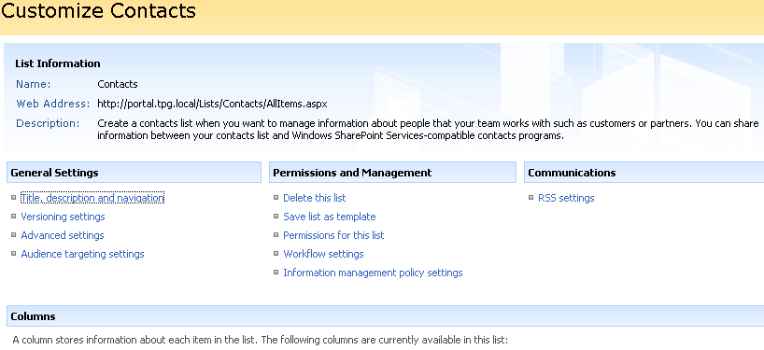
Demo!
Manipulate out of the box list
Folders & Metadata
Create a view
Create a custom list

Slide 12
Web Parts
The basis of building the user experience
Control that can be added to a page
2 “types” of Web Parts
List view Web Parts
Functional Web Parts
Notes:
Web Parts are the method with which the data held in the lists and libraries is presented to the user. In the first lab, when you viewed the sales team site, the list of announcements and events are both web parts. Web parts are controls that allow you to modify the appearance, content, and behavior of the pages.

Slide 13
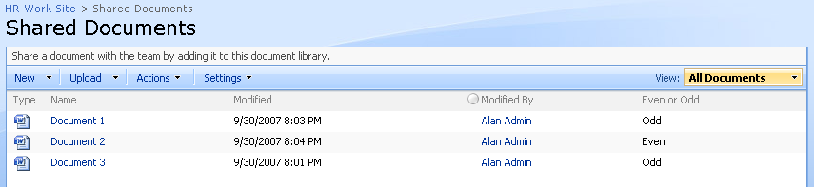
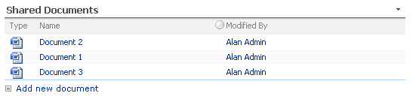
List View Web Parts
List view WPs display SharePoint Lists
Every time you create a new list you get a new Web part
List
Web Part
Notes:
List View web parts are web parts that display SharePoint lists and libraries. Some may wonder, why would you present a web part on a page if you have the data already stored in a list? Using a web part allows you to show a tailored view to users. You may have a document library that holds all of the documents for new product, but using web parts you may create a entire page that shows ordering instructions, expected delivery dates, and only the marketing related documents from the document library to the sales team. For the accounting team, they are going to want to see a completely different set of documents and items related to profit, and number of hours spent developing this particular product.

Slide 14
Functional Web Parts
Does Work
Examples
Display data from a database, RSS feed, or user input
Transform the look of the page
Perform a search
Lots of 3rd party and free web parts available
Different SharePoint SKUs = different WPs
Notes:
Functional web parts perform different actions. They may in the case of the core results web part do a search, or content editor web part transform a page using html. The web parts available vary with the version of SharePoint. To see a great list of what is included with WSS v3 vs MOSS 2007 see here http://www.wssdemo.com/Pages/webparts.aspx. It is important to note that there are also differences between the Standard and Enterprise versions of MOSS. For instance, the filter web parts only come with Enterprise.

Slide 15
Demo!
List Web Parts
Functional Web Parts

