Slide 1
Document Management
Module 3

Slide 2
Agenda
Storing Documents and files in SharePoint
Versioning and Content Approval
Configuring Required Check Out
Office Client Integration
Utilizing the Slide Library

Slide 3
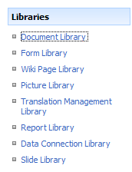
The Document Library
A special list template for storing documents
Notes:
The document library is just another list template for storing documents, all of the features you learned about in the previous module will still apply. The document library does give us the ability to create a document management solution in SharePoint. The following module will discuss versioning, content approval, and integration with Office 2007.

Slide 4
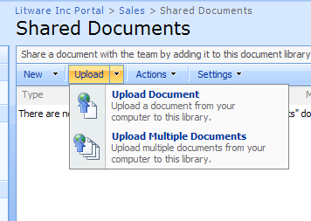
Adding Documents to the Library
Documents can be created or uploaded
Notes:
Users have the ability to create new documents from the template you have specified in the document library settings or uploading an already created document. The documents do not need to all be the same format. A single document library could hold Word, Excel, PowerPoint and even Acrobat files. All of the documents added to a document library will have the same settings applied to it. The same metadata columns, workflow options, and versioning settings will all be configured at the document library level. In Module 4, we will creating pieces of content with its own unique settings tied to it. These are called content types.

Slide 5
Keeping History with Versioning
Create both major (published) and minor (draft) versions
Allows for record keepings and reverting back to previous versions
Versioning is turned off by default
When turning it on, set quotas
Determine who has the ability to see minor versions
Notes:
An important aspect of document management is versioning. It is important to be able to see previous versions of a document for records management purposes or when changes are made that we are unhappy with. Versioning allows us to be able to revert back to a previous version. When turning on versioning on a document library it is important to remember to always set a limit to the number of major (published) versions and minor (draft) versions kept per item. Each version is a full copy of the document, and your server space could fill up quickly if you did not set these limitations.

Slide 6
Content Approval
Ensure content is correct and appropriate with content approval
It is a built in workflow
Options are located in Versioning Settings
Members in the Approvers group will have the availability to approve files
Notes:
If the portal you are setting up is going to be visible to partners or customers, content approval will be a very important aspect. Content approval allows an item/document to be added to a list, but not be visible to the users until it is approved by a member of the Approvers group. With a partner site, you may be sharing information with them about your products as the products are being released. It is important these documents be checked for accuracy and for appropriate information before they are visible to the partners. You would not want a situation where someone has used the wrong acronym to confuse your partners, or a situation where confidential information has been shared with the wrong individuals.

Slide 7
Turning on Required Checkout
Users will be required to check out a document before they can edit.
Other users can still view the file in read only mode
Owner/Administrator of the library can take control of checked out documents
Notes:
If you happen to think required check out is not necessary, think of this scenario: You are a member of the marketing team asked to write up the marketing plan for next year. You have been editing the marketing plan for about two hours making changes here and there to a rough timeline created by the team, you go to save the document back to the library and you get a pop up notification. The document has been edited since you took it offline, would you like to keep their changes or keep yours? There is no merge option. Yes, you could open up this second copy and sift through the changes, but it would have saved you at least 30 minutes of time to have required documents be checked out before editing.

Slide 8
Demo
Creating and configuring a document library

Slide 9
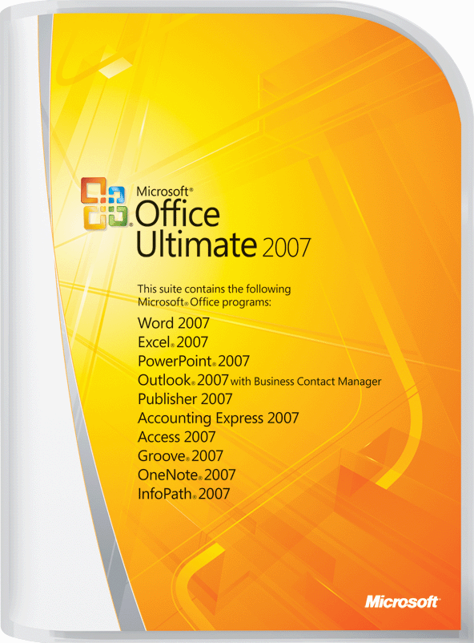
Integration between SharePoint and Office 2007
Notes:
The following features being discussed on the next few slides pertain to the Office 2007 Suite. To see a list of features available if you are using a previous version of office, please read:
Microsoft SharePoint Products and Technologies Document: Microsoft Office Programs and SharePoint Products and Technologies Integration – Fair, Good, Better, Best
http://www.microsoft.com/downloads/details.aspx?FamilyID=E0D05A69-F67B-4D37-961E-2DB3C4065CB9&displaylang=en

Slide 10
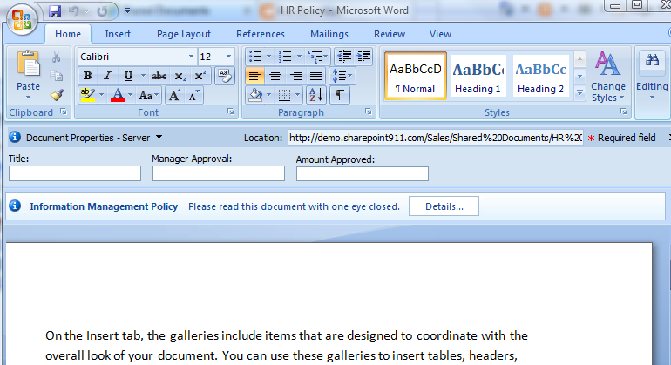
Document Information Panel
Notes:
The Document Information Panel (DIP) allows you to interact with the columns in the document library, which the document came from. It allows you to edit or view the metadata associated with this document. A benefit of interacting with the metadata through the DIP is it allows you to edit the document and the columns at one time. In previous versions, after saving the document you would need to open the edit properties menu to change information in the columns. When you open a document from a document library, and the DIP is not visible, open the office button, select prepare, and then select properties.

Slide 11
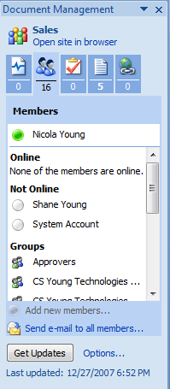
Document Management Information Panel
Notes:
The Document Management Information Panel allows you to interact with the site. There are links for other documents in the library and task items. A members area to see who is online and send a group email, and a link to the site.

Slide 12
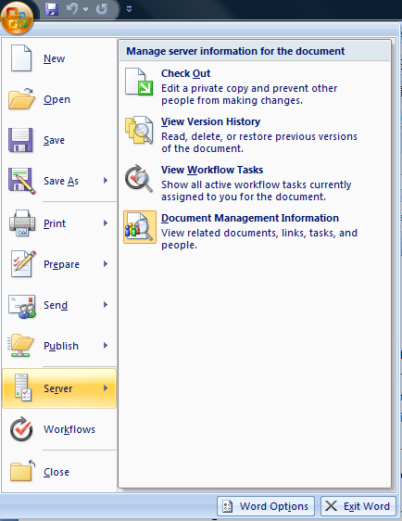
Office Button
Notes:
The Office Button replaces the file menu in previous versions of Office. You will see it in Word, Excel, and PowerPoint. In addition to the standard file menu options, you will now see a menu for server and workflow.
The server menu allows you to communicate back with the server. Through this option after saving a document you can check in a document from within the application, no need to go back to the document library. You can also see an option to open the Document Management Information Panel if it is not already visible.
The workflow allows you to view workflows already running on the document, start a new workflow, or complete the task if the workflow running on this document is assigned to you.

Slide 13
Outlook 2007 Integrations
Allows users to take content offline
Outlook is always open, why not interact with it here
Connect:
Calendars
Task lists
Document Libraries
Discussion Boards
Contact lists
Notes:
One of the most powerful changes from 2003, is the Outlook Offline Integration. You now have the availability to connect your lists to Outlook interact with them offline and then when you are back online the content will be synchronized. Document Libraries can also be viewed offline but the content will only be synchronized through the application, i.e. Word, Excel, or PowerPoint. If you are going to be editing a document offline, it is a best practice to check out the document beforehand. In addition to taking the content offline, with the amount of email people are sending and receiving everyday, it is likely your users are already spending a majority of their day in Outlook. Connecting the lists and libraries will allow them to utilize the benefits of SharePoint in an environment they are already familiar and comfortable with.

Slide 14
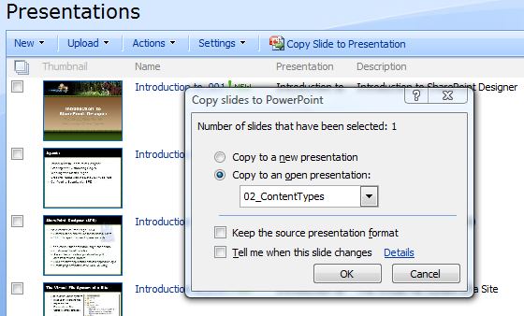
Slide Library
Notes:
The slide library is a useful library for creating dynamic presentations. As you can see from the screenshot above, once a PowerPoint presentation is uploaded the slides are parsed and available to be selected individually. This allows your users to tailor their presentation to the audience. It also ensure that the most up to date changes will be used. If your organization has sales members traveling the country giving presentations, they will have the ability to create tailored presentations while the marketing team ensures the messages on the slides are always current.

Slide 15
Demo!
Office Integration and Slide Libraries

