Slide 1
Advanced List Management
Module 4

Slide 2
Agenda
Receiving Notifications with Alerts
Easier Management of Changes with Site Columns
Content Types
Displaying Data using the Content Query Web Part
Managing processes with Workflow

Slide 3
What are alerts?
Allow for notification of changes to lists or libraries.
Email will be sent to user depending on the preference of the alert
Owners of the site can assign alerts to users, members can only sign themselves up for alerts
Notes:
Over time, there will hopefully be many document libraries and lists on your sites. It would be quite tedious for a person to go out everyday and check to make sure no changes where made to the documents or list items. To help with this management issue we have alerts. New to 2007, an owner of a site can assign alerts to users. Frequently managers would like to ensure their team members are notified of changes to a list, until now they would need to rely on the users going to the list and signing themselves up.

Slide 4
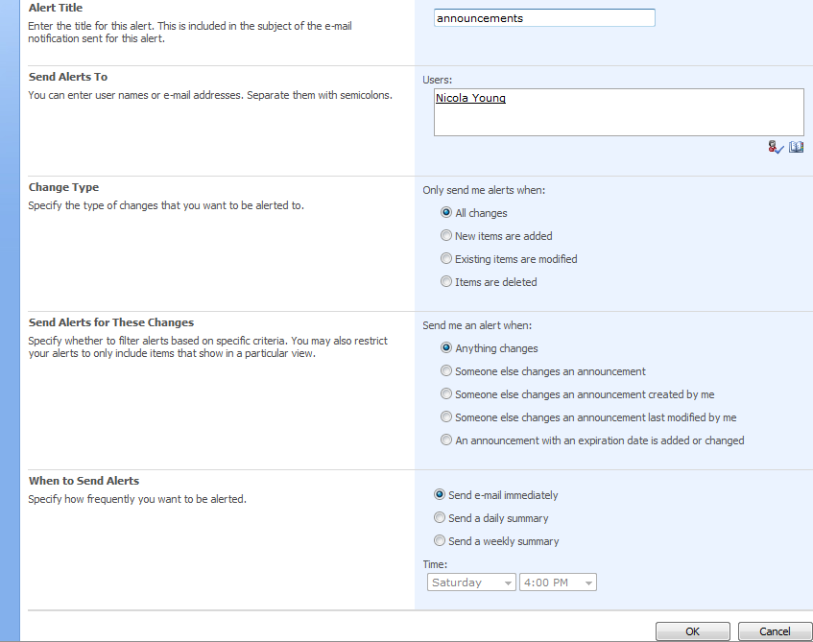
Setting up Alerts
Notes:
When setting up alerts, you have the ability to determine what type of changes you would like to be alerted for and then you can filter the type of alert based on certain criteria. For example, if you were a member of the IT staff and in charge of writing help documentation. You may want to know when an existing help document you created is modified by someone else. An option that is not shown here is the availability to filter these changes to a particular view. In the previous lab you created a proposal library, as an East region sales representative you may want to only subscribe to changes to the East view of the proposal library. Finally, you have the ability to set when you will receive the changes. It may be necessary if there are ten changes a day to receive the changes in one email daily rather than ten different emails.

Slide 5
Site Columns
Site column is a reusable column definition
Site columns can be reused across multiple lists
Site columns can be scoped to a site in the Site Column Gallery
Site columns are visible within site collection to all child sites
Updates to a site column can optionally be pushed out to lists, document libraries and content types to where it has been used.
Notes:
As it is stated above a site column is a reusable column definition. This means instead of recreating a column ten times to use is in ten different lists, you can create it once and update it once. Metadata columns provide a very powerful means of capturing information about items, but if every time there is a change to the column you need to go to each and every list that is using it across several sites. It is going to become a management nightmare. Take for instance a growing store chain, a useful metadata column may be a list of all of the stores. If you are adding a new store each month, can you imagine going to ten different sites with three or four lists per site and adding the new store.

Slide 6
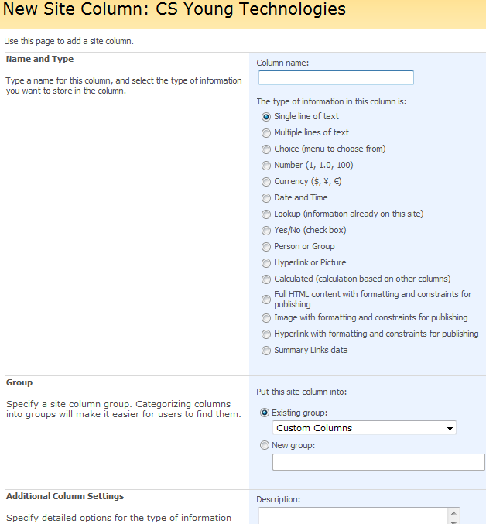
Configuring Site Columns
Notes:
As you can see from the screen shot, when you create a new site column you have many of the same choices you have available to you when you create a column on a single document library. In addition, you have four new types that are only available as site columns.

Slide 7
Demo
Creating and Updating Site Columns

Slide 8
Content Types
Reusable collection of settings that are applied to a piece of content.
Examples of Content Types
Proposals for software projects
Requires client assignment
Requires review by legal department
Customer presentation
Requires client assignment
Requires review by art department
Notes:
Our demo company Litware Inc, creates new software products. They have several products each product has a proposal that is given to potential customers that is specific to that client. Information such as how much the licensing is per user, information about the client, desired purchase date, etc. Since content types inherit, by using a general Litware Proposal Content Type, we need to make a changes to the proposal, such as changing the information we collect about a client, we can change it once it is on the Litware Proposal content type and then set all of the children product proposal content types to inherit the change. Like content types, creating an easier way to manage the robust amount of content our company produces.
Office Zealot has a couple of nice diagrams to help further explain content types:
http://www.officezealot.com/downloads/moss/ContentTypesandColumnsBeta2Conceptual.pdf
http://www.officezealot.com/downloads/moss/ContentTypesBeta2Conceptual.pdf

Slide 9
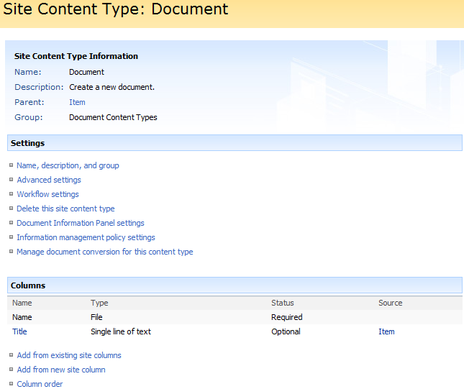
Content Types: The Settings
Notes:
As it was stated before a content type is a series of reusable collections of settings applied to a piece of content. Many of the settings you see above are similar to the settings found in a list or library. You can define a workflow, the metadata collected about an item, and in the case of a document you can even upload a template for it to use.
For example, you may create an expense report content type. You would configure a workflow that sends the item to accounting to be approved. It is important to know the ending date of the expense report, so you would add that as a piece of metadata and finally you would configure it to use the excel expense report template (your users are used to using.)
As a final note, it is important to see that content types can only use site columns. If you create a new column on a content type, it will create a new site column. Probably the most important part of this is knowing what site columns already existing and duplicating the names.

Slide 10
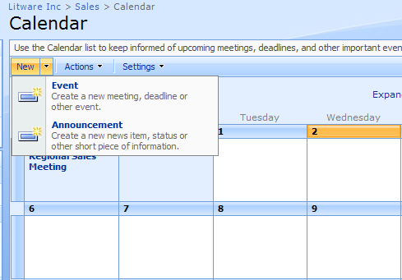
Allowing for Multiple Content Types
Notes:
Once the content type is created, on the advanced settings of the list you can allow for the management of content types. This will allow you to use more than one content type in a list. Why is this important? Going back to our earlier proposals, even though there are several different proposals collecting different pieces of information, it still may make sense for document management purposes to store all of the proposals in one library. You may want to create a view and see all of the East Proposals no matter what product the proposal is for. If the proposals were stored in separate libraries this would not be as easy to accomplish.

Slide 11
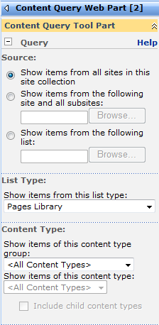
Content Query Web Part
Used to display a dynamic view of content
Notes:
The Content Query Web Part (CQWP) is a web part that allows you to aggregate content from within a single site collection. In the example used in the previous slide about the proposals, if you were storing them in separate libraries the CQWP allows you to aggregate them and show them on a page. You can even set it to filter the proposals to East.

Slide 12
Demo
Creating a Content Type and Using the Content Query Web Part

Slide 13
What Can Workflow do for your company?
Business Process Management
Create Structure
Reliability
Records Management
Notes:
At Litware Inc, before there were workflows, when there was a change to a piece of product documentation a user would print the change take it to their managers office place it in a bin, wait for the change to be signed off on, and returned to their desk. Once the change was approved go back in and post the change for the rest of the company to see. Sound familiar? With the built-in workflow in MOSS, you can create an approval workflow that automatically starts when an item is changed, and once the approver marks it approved the document will be automatically published.

Slide 14
Out-of-the-Box Workflows
 | Description
Approval | Routes the content for approval. You can setup this workflow as serial or parallel plus preset the approvers.
Collect Feedback | Routes the content for feedback. When the workflow completes all the feedback is sent to the originator of the workflow.
Collect Signatures | Rather than just sending content for approval, this workflow requires digital signatures on the content. This workflow requires the Office 2007 client and can only be initiated from a client application.
Disposition Approval | This workflow works with the records management capabilities of SharePoint. It allows you to manage document expiration and retention.
Group Approval (available in some languages) | To support hierarchical approvals, this workflow presents a hierarchical control to select the approvers and stamping rather than signatures for approval.
Translation Management | This workflow is used with the Web content management features of SharePoint to support a translation workflow for content to multiple languages.
Three-state (Included in Windows SharePoint Services; works with Issue Tracking list or any list with a Choice column with 3 values) | This workflow ships with Windows SharePoint Services and is a simple issue tracking workflow that shows status of active and resolved issues.
Notes:
The table above lists all of the built in workflows available in MOSS. If you do not see these workflows available on your site, look at the features for the site and site collection and ensure all of the workflow features are activated. The last workflow, “the three-state workflow “can be activated in WSS only implementations.

Slide 15
Taking the next step
SharePoint Designer Workflows
Easy to use Wizard
Create more dynamic workflows
Not easy to reuse
Visual Studio Workflows
Very customizable
Can reuse
Ability to attach to Content Types
Notes:
If the built-in workflows do not accomplish what you would like, a power user could create you a more complex workflow using SharePoint Designer or a developer could create you an even more complex workflow using Visual Studio.

Slide 16
Demo!
Creating a Workflow

