Slide 1
Creating and Securing SharePoint Sites
Module 5

Slide 2
Agenda
Sites & Site Collections
Templates
Site Security

Slide 3
SharePoint Containment
Farm
Web Front End, APP, SQL
Web Applications
Databases
Site Collections
Sites
Lists
Items
Content, Config, SSP, Search
Central Admin, SSP Admin, Content
Servers
Internet, Intranet Portal, Wikis, Blogs, Team, Doc, Mtg
Wikis, Blogs, Team, Doc, Mtg
Doc Lib, Pages, Events, Discussions, Surveys, etc…
Files, calendar items, contacts, customers, images, custom
Notes:
These slide gives you a nice overview of the hierarchy of SharePoint.

Slide 4
What is a site?
A collection of lists, libraries and pages
Notes:
A site is a container. It contains a collection of list and libraries and all of their content. A site can have unique security and security groups applied to it as well.

Slide 5
What is a site collection?
Simply, a collection of sites.
Notes:
A site collection is a group of sites. These sites can share information, security settings, and navigation across their boundaries. These sites are also all stored in the same database.

Slide 6
Site Collections
Why are they important?
Separation of security
Level of ownership
Administration
Can have quotas
Sharing between sites confined to
Notes:
Use the question above to help you determine if the site you are creating needs to be a site or its own site collection.

Slide 7
Assign a template
Sites are just containers
Needs to have a template applied
Different SKUs = Different OOTB Templates
Notes:
When you create a site collection, that is a container that you can create sites in. The first site you create is the root site. This is the parent site to all of the sub-sites in the site collection. This site needs to have a site template assigned to it.

Slide 8
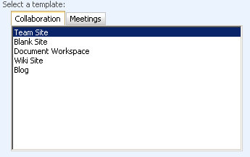
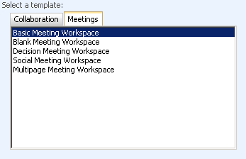
WSS Templates
Notes:
These are the templates that come with Windows SharePoint Services. You have two main tabs. The Collaboration templates and the Meetings templates.
The Collaboration templates are primarily used for sites that are dynamic. Team sites are probably the most popular. They come with a an easy to use interface and with some common list and libraries pre-created. The Blank Site is the same as a team site but it comes without the pre-created lists. Document Workspaces are the same as team sites also except, they have some defaults geared around working on specific document. The Wiki Sites are used to quickly capture information on the page. Blog sites are used to let someone publish information in an informal method. Wikis and Blogs are covered in detail in Module 8.
All of the Meeting Workspaces are exactly the same. Each of the templates just has its own unique default content.

Slide 9
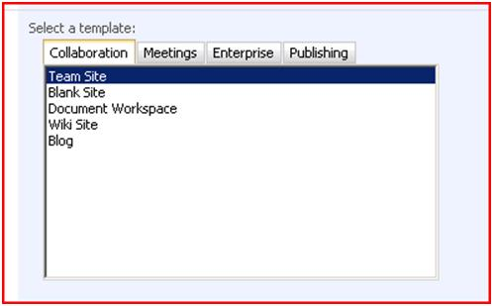
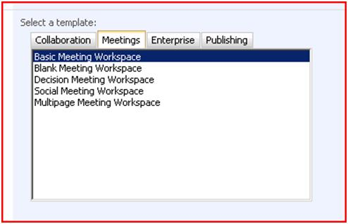
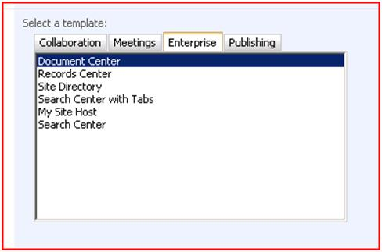
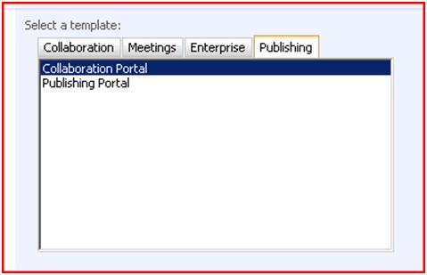
MOSS Standard Templates
Notes:
MOSS Standard adds two new sections the Enterprise templates and the Publishing templates.
Document Center is a team site preconfigured to manage large amounts of documents. The Records Center allows the management and routing of records. The Site Directory helps you categorize and discovery sites as they are created. The Search Center templates are used to create sites to help your users search, you will learn more about them in module 9. My Site Host is a special template only to be used by administrators.
The Collaboration Portal and Publishing Portal are templates with the publishing functionality enabled by default. The Publishing Portal also has approval workflows preconfigured for all pages. You will learn more about these 2 tabs in the next few slides.

Slide 10
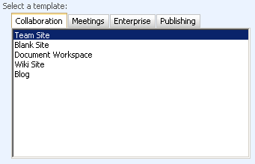
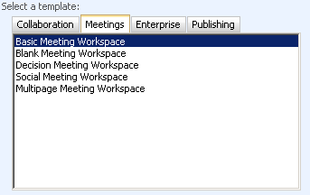
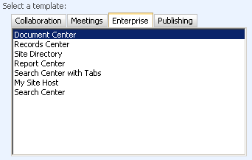
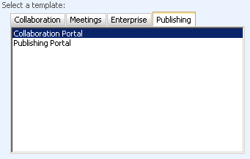
MOSS Enterprise Templates
Notes:
The only unique site template that MOSS Enterprise add is the Report Center. This template is preconfigured with KPIs and Dashboards that you will learn about extensively in module 12.

Slide 11
Getting Started
Intranet/Portal = Collaboration Portal
Internet Site = Publishing Portal
Project/Department Work Site = Team Site
Not required just the usual choices
Notes:
Above are suggested starting spots depending on the purpose of the site you are creating. All 3 templates are covered in the following slides.

Slide 12
The Collaboration Portal
Great for those intranets
Many readers/few contributors
Publishing features: great for static slow to change sites
Search center is ready to go
Built-in Web Parts focused on targeting and ease of use
Notes:
The collaboration portal is the basis of any good intranet. This template will help you get started in organizing information. Because of the enabled publishing features it is great for sites that are static or slow to change. With the publishing process it is possible to edit the page without effecting the current users. Not until you say publish will anyone see the changes you have made. And if the next day you don’t like your changes you can always revert back to an earlier version. The pages in this template are maintained in a document library called Pages. So all of the changes you can make to a document library you can make to this library. Pretty cool.

Slide 13
Publishing Portal
Starting place for building pages
Publishing features put you in control of content
Has approval workflow setup on pages
Add your custom master page and ready to go
Notes:
The Publishing Portal is a template used to start more of a public web site. It has very little pre-created content and the only significant change compared to the collaboration portal is the fact that the approval workflow is enabled on the pages library by default. So not only do check out the page and make your edits but you also have to submit it for approval and get it approved before users will see your updates. Critical when you are updating the companies public face.

Slide 14
Team Site
Start collaborating now
Edit the page; see the results
Ready for lots of contributors
Notes:
Team sites are quick and dirty. No check in or check out process. You edit this page, it will show up in real time. Which is really ideal for work sites where people don’t want a process, they want it done. Most environments team sites are where all the work gets done. Because of the lack of a process they are very easy for power users to learn and maintain.

Slide 15
Reusing Sites
Save site as template
Available from Site Settings
Works for all sites except publishing sites
Can choose to include content or not
Default template limit 10 MB
Change via command line
Change to max of 500 MB
Does not save security settings
Notes:
The pre-packaged templates from Microsoft are great, but probably not exactly what you need. Sometimes what you want to do is take the out of the box team site, make some changes to be your project site, and then reuse that site over and over again. No problem. Very easy to save any site as a template (except publishing sites) and then reuse them over and over again. You can even choose whether you want just the structure or the structure and the content. So do you want the project documents library you created or do you want the library with the 3 documents already saved in the template. The choice is yours.

Slide 16
Getting users logged in
Most environments use accounts from Active Directory
Same account you log into your computer or email with
Adding external users?
Possible to use forms based authentication against an LDAP store.
This can include simple repository like a SQL database
Now these users do not require AD accounts
Notes:
How do your users gain access to the site? In most environments you would use your active directory account. That same username and password you use to log into your computer can be configured to grant you access to SharePoint. This is the most common scenario.
In some cases you may want to add vendors or customers to SharePoint. In this case it is possible to use and LDAP store or a SQL database to maintain there login information. This is some geeky stuff so we will leave it to the admins, just help for us to know it is an option.

Slide 17
Site Security
Can be broad or granular
Inheriting permissions makes admin life easy
Granted by applying permission levels to groups
Can use AD groups directly
Can use SharePoint Groups
AD groups can be assigned to SP groups
Can assign permissions directly to an AD user
BAD! Management nightmare
Notes:
By default SharePoint inherits security from the top all the way to the bottom. What we can do is create SharePoint groups, assign permissions to those groups, and then add our users to those groups. Now our users have access to SharePoint.
With security we can be very broad, setting permissions to the whole site at once or we can be very granular and set permissions on a specific item in a list or library. SharePoint supports both of those and everything in between. Be careful though, very granular permissions seem nice, but they can be a nightmare to maintain.

Slide 18
SharePoint Groups
3 main groups to consider
Owners – Full Site Control
Member – Add/Edit/Delete in existing list
Visitors – Read access only
Custom Groups can be created
All Groups are available throughout the entire site collection
Notes:
When you create a site SharePoint will automatically create some default groups for you. Most of the time these are good enough. You can then assign your users to these groups as needed giving them access. If need be though, you can create your own groups.

Slide 19
Permission Levels
9 available OOTB (MOSS) 5 (WSS)
Set default list permissions
Set site and personalization permissions (not available otherwise)
Don’t modify instead create your own
Notes:
Once you have your SharePoint groups you will assign permission levels to these groups. Permission levels allow you to set the default access for the group on the site.
If you look at the standard permission levels and they don’t exactly meet your needs you will be tempted to change them. It is better to create you own permission levels and set them with the permissions you require. Then assign your custom permission level to the group. You never know when Microsoft might modify the out of the box permission level resetting your changes.

Slide 20
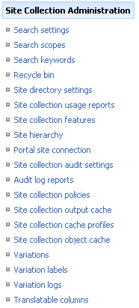
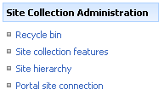
Site Collection Administrators
Separate group for full control in entire collection
Site Collection Owners automatically added
Special administrative menu
Team Site Collection
Collab Portal Collection
Notes:
Site Collection Administrators are a special group that have complete power over all sites in the site collection. Allowing them to do whatever the want on any site. They also get the special options you see above. Allowing them to make some administrative changes not available to your typical site owner (who has full control of a specific site). This is a very powerful group that should be used with caution.

Slide 21
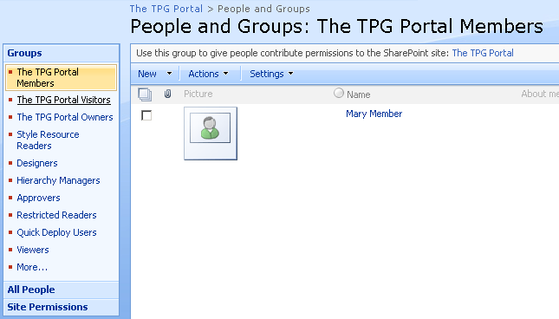
Demo!
Security walk through time

