Slide 1
Creating a Consistent Navigation
Module 6

Slide 2
Agenda
Creating a Consistent Navigation
Using the Audience Targeting feature
Displaying the hierarchy throughout the Table of Contents Web Part
Utilizing the Site Directory

Slide 3
Navigation
The key to finding things on the site
Very flexible
Targeting
Security trimming
Open in new window
Fly-outs
Navigation Elements
Global Navigation
Current Navigation
Global Breadcrumb
Current Site Breadcrumb
Notes:
Good strong navigation is key to any good web solution. You can have all the great content you want but if there isn’t a way for users to get to the data, then it doesn’t do your users any good.
SharePoint goes above and beyond the call of duty when it comes to navigation. It is very flexible in the way it can be configured. While it can be completely self maintaining, it can just as easily be completely custom.

Slide 4
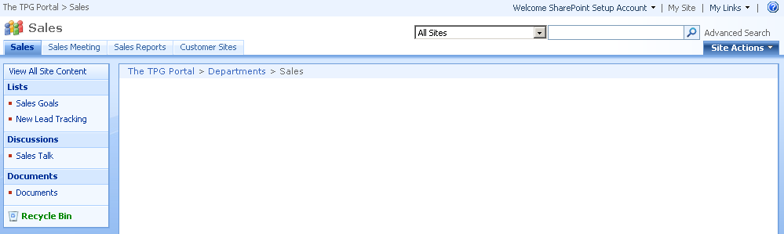
Picture worth 1000 words?
1-Global Bread Crumb
2-Global Navigation
4-Current Breadcrumb
3-Current Navigation
Notes:
Since the picture is worth a 1000 words no need for them to be written down here. (Of course we will cover all of these pieces individually over the next few slides.)

Slide 5
Global Navigation
Also called Horizontal Nav or Top Link Bar
Should make this as consistent as possible
Inherits from parent site by default
Modify
Site Actions > Site Settings > Modify Navigation
Notes:
Global nav is where you provide the structure for the site. The items appearing across the top of the page are generally consistent through out the site or at least for each section of the site. Giving your users a common feel as they move through your site. By default when you create a sub site it will inherit the parents the navigation. With just a simple click though, you can create a custom nav for a site. Then you can completely control the links allowing SharePoint to automatically maintain them with sub-sites, and pages or use the interface to manually insert headings and/or links. The choice is yours.
A quick design note. If at all possible you do not want to have more than 7 links in the top nav. Any more than that and usability starts to suffer.

Slide 6
Current Navigation
Called Quick Launch bar and Left hand Nav
Important since product varies name
Provide links that are relevant to current site
Customizable same as Global
Can be disabled through site admin
Notes:
Current Navigation is the navigation links usually located on the left hand side of the page. They are just as flexible as global nav. Usually though instead of inheriting from the parent this links should be unique to the site you are on. They will help the user navigate through the current site. In contrast global nav is going to help users move from site to site.

Slide 7
Breadcrumbs
Self maintaining
Global is updated when you break global nav
Current just shows your path on the site
Notes:
The two breadcrumbs are completely self maintaining so not a lot for you to do here. The global breadcrumb is incremented every time you break global nav through the site collection. The current breadcrumb tells you where you are within the site you are currently on.

Slide 8
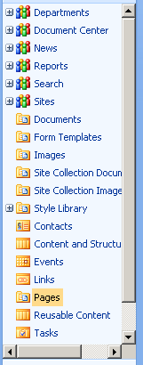
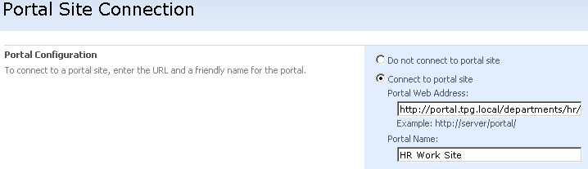
Other nav
Tree view
Looks cool
No settings
Portal site connection (up to portal)
Key for connecting separate Site Collections
Site Collection Administrator setting
Notes:
The tree view provides you with a hierarchal view of your site. So you can expand through the sections, and find what you are looking for. The only down side to the tree view is it is either on or off. There is no way to customize its behavior which is makes it a no go for most users. If you do turn it on it appears below the quick launch (current nav).
Portal site connection just allows you to create a root link on the global breadcrumb. This can actually be a link to anywhere and does not have to point to SharePoint.

Slide 9
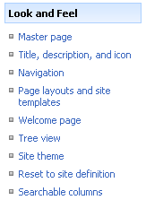
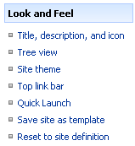
No Publishing Feature – Nav Changes
Instead of Site Settings > Navigation use
Site Settings > Top link bar
Site Settings > Quick Launch
Notes:
A very confusing point for many students! If you create a site collection using a template other than collaboration portal or publishing portal then you do not have the Publishing Site Collection feature enabled by default. In this case you get new navigations options that are not as powerful.

Slide 10
Demo!
Walk through navigation

Slide 11
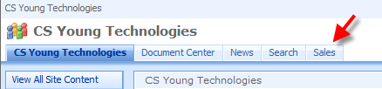

Audience Targeting
Allows for the creation of a personalized experience
The Sales Manager sees:
While the Accounting Manager sees:
Notes:
Another powerful feature in SharePoint is the ability to use Audience Targeting to create a personalized user experience. So as the example above shows when the Sales Manager logs in he sees links pertinent to him, where as when the accounting manager logs in she will see link for her. This is quite useful when attempting to create a personalized experience for you users.

Slide 12
What Can be Targeted?
Navigational Links on the Top Link Bar and Quick Launch Bar
Web Parts
Using the Content Query Web Part, you can target:
List items
Documents
Notes:
There are 3 main things you target.
Navigation – Allowing you to provide custom nav links to users.
Web Parts – This will allow you to choose which Web Parts a user sees when they come to a page. Maybe you want to display a KPI to executives on the home page but you want to display the part-time policy update to the part time employees.
Actual content – Using the Content Query Web Part (CQWP) and the audience targeting feature of list you actually show audiences only targeted list items instead of all list items. And the CQWP can scan the entire site collection or just a specific list, giving you complete control.

Slide 13
Who can be targeted?
SharePoint Groups
Active Directory Security Groups
Active Directory Distribution Groups
Global Audiences
Created in Central Administration
Based on user profile information from active directory
Notes:
When it comes to targeting you can choose between SharePoint Groups, Active Directory Security, Distribution groups, or you can compile your own Global Audiences.
Global Audiences are maintained through the Shared Services Provider (SSP). Here you can build and compile an audience either based off of profile attributes, reporting structure, or group memberships. Giving you the power to make very configurable audiences. So maybe you want to make one called Executives. This group might be made up of everyone who reports to the CEO or anyone who has VP in their title.

Slide 14
Demo
Audience Targeting

Slide 15
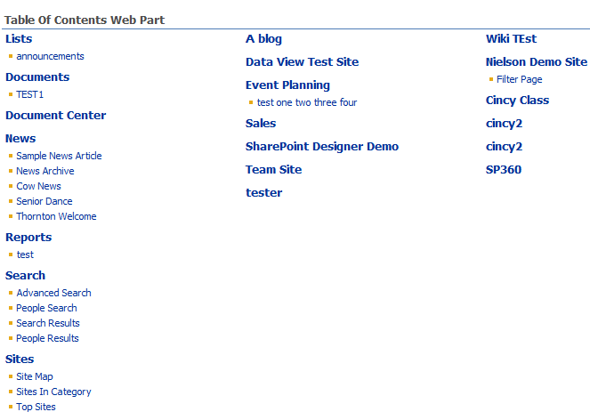
Table of Contents Web Part
Used to show items below a site
Notes:
The table of Contents Web Part is a configurable web part that can show information from a location down. Be careful using this web part. If you have it displaying too much information it can affect server performance.

Slide 16
Demo
Table of Contents Web Part

Slide 17
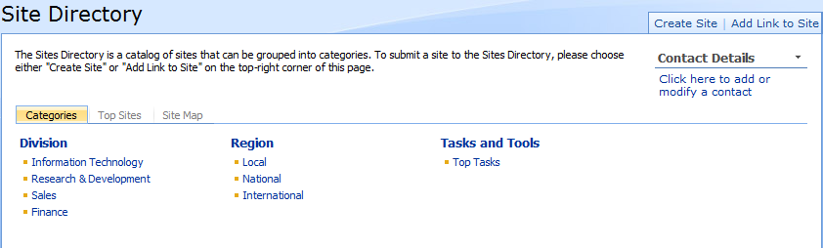
Site Directory
Notes:
The site directory is a special site template. It is setup to help you create and categorize sites. Once you have done this it has a convenient user interface to help people find sites based on their metadata. By default when you create a site anywhere in the site collection it will prompt you if you would like to provide metadata for the site and list it in the site directory.

Slide 18
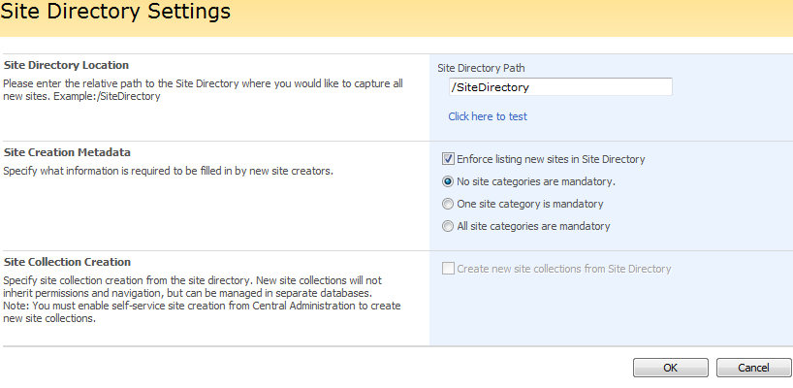
Site Directory Cont.
Defining the Site Directory
Site Directory can be required
Site Collection Setting
Notes:
As a site collection administrator you can go to site collection administration and specify that listing in the site directory is required if you choose.

Slide 19
Tabs of the Site Directory
Categories
Top Sites
Site Map
Notes:
The categories tab will allow you to drill down the sites based on their metadata.
The top sites tab will show only sites that were specified as a top site when they were added to the directory.
The site map is a tab with a table of contents web part on it. By default it is showing you 2 levels deep.
You can add additional tabs by creating a page using the Site Directory Home page layout. Then at the top of the face you will be given the option of adding a new tab or editing the current tabs.

Slide 20
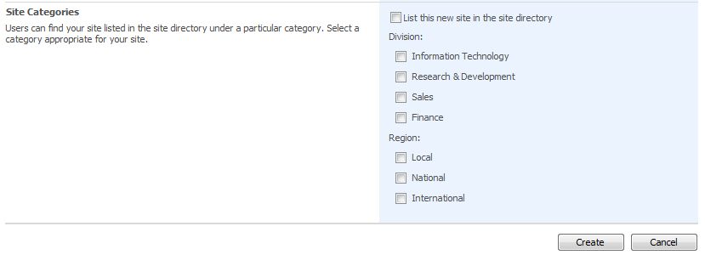
Adding a Site to the Site Directory
Site Creation Page
Can Manually Add
Add a Link
Add a list item to the Sites List
Notes:
You are automatically prompted to add any new site you create to the site directory. But sometimes you forget to do it when you create the site or you want to add sites that aren’t part of SharePoint. This can be accomplished by clicking the link to Add Link to Site from the top right hand corner of the site directory.

Slide 21
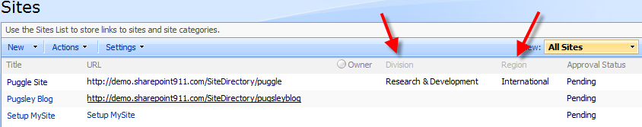
Customizing the Site Directory
Categories are columns on the Sites list
To customize, add new columns or customize existing Division and Region columns
Notes:
In reality the site directory is just a list called sites. So you can add columns and change their settings just like you can for any other list. You could also add workflows or alerts. It really is just another list.

Slide 22
Demo
Creating and Customizing the Site Directory

