Slide 1
Web 2.0
Module 8

Slide 2
Agenda
What is Web 2.0?
Blog Site Template
Wiki Site Template
Incorporating RSS

Slide 3
What is Web 2.0?
A concept of empowering the users to be the authors and creators of content on the web
Getting ideas out there and written down
Interaction
Examples:
Blogs
Wikis
Forums
Notes:
As the evolution of the internet continues, it is becoming a trend to have sites that are populated by the users and visitors of the site.
Web 2.0 Resources for SharePoint:
MSDN Forums
http://forums.microsoft.com/MSDN/default.aspx?ForumGroupID=328&SiteID=1
SharePoint Team Blog
http://blogs.msdn.com/sharepoint/
SharePointPedia
http://sharepoint.microsoft.com/pedia/Pages/Home.aspx

Slide 4
Blogging
A way to allow users to share their thoughts, best practices, and experiences around their area of expertise
Typically, one person or a team of people are the authors
Everyone else comments on the particular idea or thought
Great for:
Managers
CEO’s
Geographically spread out teams
Notes:
Blogs are perfect for getting out ideas that in the past would have been forgotten or not bothered with because a formal document would have been necessary. In your portal, if you have a team that is geographically spread out the manager might use it to ensure everyone is getting the same consistent message. It may also be a great idea for the CEO or President to blog to make sure his or her voice is heard. In many large organization most of the people have never met the CEO, a blog would be a great way to make sure his vision for the company is heard.

Slide 5
Blog Site Template
Specially configured template for blogging, includes:
Categories List
Posts List
Comments List
Since the Posts and Comments are separate lists:
security can be configured separately
Alerts can be placed on each
Content Approval or Workflows can be configured
Notes:
The Blog Site template contains lists and libraries specially designed for creating blogs. The posts and comments are separate lists, which will allow the author of the blog to only sign up for alerts on the posts, or will allow users to sign up to be alerted when a new post is created. In addition, if your organization is concerned with inappropriate content of confidential information being posted, then content approval can be turned on and neither posts nor comments will be seen by visitors until they have been approved.

Slide 6
Demo
Creating a Blog Site

Slide 7
Wiki
A Wiki allows for a method of collecting data and thoughts that are usually invented in email, in phone conversations, or on a white board
Ideas for use:
Knowledge base
Project Management Documentation
Brainstorming
Notes:
You have all heard the story of the million dollar company that was started by a couple of people jotting down a business plan on a napkin at a restaurant, or have probably taken part in a conversation around a water cooler about a particular product your company sells and ideas to improve it, or even further what about all of the meetings you attend and the conversations that happen at them where is the information recorded? A wiki is a quick method of recording this information. All of the random ideas people come with and forget now have a place to live. Or is you are service industry you can use the wiki to record interaction and decisions made by your clients.

Slide 8
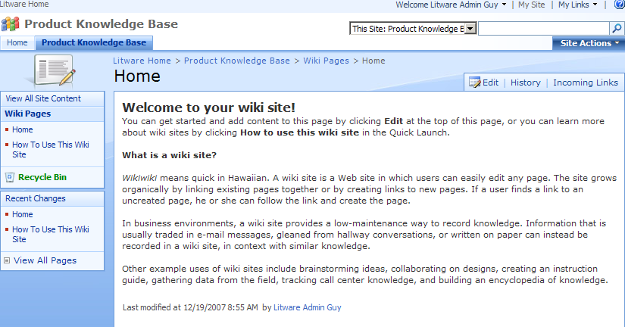
Wiki Site Template
Notes:
The wiki site template is a special site template configured for wikis. One of the best parts about this template is the recent changes section on the left hand navigation. If this site starts to be several pages, then it can be quite cumbersome sifting through all of the pages and determining what has changed.

Slide 9
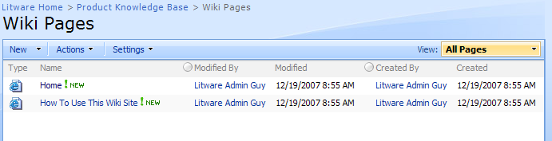
Wiki Pages Library
Included in Wiki Site, but it can also be added to any site
Notes:
The wiki library is a list configured to hold wiki pages. While it is included on the wiki site, it can be added to any site to create a knowledge base. Instead of creating an entire site, you may want to just add a wiki library to the sales site to hold the four or five pages that describe the products your company offers.

Slide 10
Demo
Creating a Wiki Site

Slide 11
RSS
RSS-Really Simple Syndication
Feeds of frequently updated content on the web, can either be a summary or full text
The feeds need to be aggregated using a feed reader
SharePoint has the RSS Viewer Web Part built in
Look for the RSS Feed icon on websites to determine if they have a feed
Notes:
RSS is a technology that allows websites to send updates to their subscribers. Think of this situation, in your industry there may be ten different websites that publish relevant information several times a week. You may check the websites several times a day for updates, which is a waste of time. If the website uses RSS you can subscribe to the feed and use a feed reader to aggregate the feeds, then you simply need to check the feed reader for updates feeds. Most feed readers look similar to Outlook in that there is a folder with the name of the feed, and if there are new feeds there will be a number next to the folder indicating the number of new feeds.

Slide 12
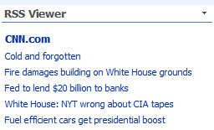
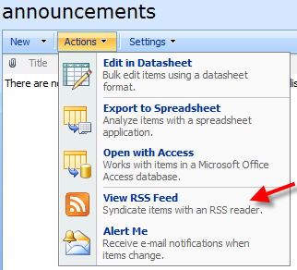
RSS and SharePoint
Showing relevant RSS feeds on the homepage is a great way to keep the content fresh
SharePoint Lists can be converted into feeds
Notes:
RSS can help keep the content of your portal changing. If you can locate a couple relevant RSS feeds and place them on your homepage, it will keep your users visiting the homepage and thus noticing when important announcements are placed there. In addition your SharePoint Lists and libraries can be converted into RSS feeds for consumption by your users feed readers. This is an alternative option to receiving email alerts.

Slide 13
Demo
Adding an RSS feed

