Slide 1
Configuring and Customizing Search
Module 9

Slide 2
Agenda
The WSS vs MOSS Search Experience
Using Scopes to narrow the search
Utilizing Key Words and Best Bets to help users find the appropriate content
Tailor the Search Center with Search Web Parts

Slide 3
MOSS Search is Awesome!
WSS Search is cool too!
Same technology behind both
WSS Search only works within the site collection
MOSS can crawl for just about anything
Biggest difference?
WSS Search just runs
MOSS Search has many of configuration options
Remember MOSS Search and SSP
Notes:
WSS Search
One of the key investments for this release is that WSS (v3) will be using the same search technology as in MOSS as opposed to WSS(v2) that used SQL full text search.
The WSS search functionality is a subset of MOSS search functionality
This adds ease of transition when you want to move from a WSS installation to a MOSS installation.
Only local content gets indexed and search is available at the individual site scope.
MOSS Search
MOSS search has more enhanced functionality than WSS – richer search results UI and customization control, crawls of local and external content supported and management of search configuration.
One important thing to note is the topological concepts are same across WSS and MOSS with certain differences based on the usage patterns of the portals/sites

Slide 4
Feature Breakdown – Content Sources
WSS – Just your SharePoint Site Collection
MOSS Standard– All of your SharePoint Sites at once and add things like
Exchange Public Folders
Other Web Sites
File Shares
Other SharePoint Sites
MOSS Enterprise – The BDC baby!
Notes:
One of the major differences between MOSS and WSS is the ability to configure the content sources. With WSS, you are restricted to just the site collection. This can be confusing for your users, since they are not likely to realize when they are switching through links they are switching from one site collection to another. With MOSS, you can configure many different sources for your users creating an enterprise search experience. And if you co with MOSS Enterprise, your users will learn to just go to SharePoint and search for what they are looking for rather than digging through databases and applications to find what they are looking for.

Slide 5
Feature Breakdown – Scopes
WSS not really – MOSS for sure.
What is a scope?
Notes:
Scopes are the way you can search a specific portion of your index. So instead of searching all of your index you could search just the HR site or just the Accounting Exchange Public Folder. This allows your users to find exactly what they are looking for. If a user knows a particular policy is located on the HR site, but does not want to sift through all 300 policies they can use the HR search scope to look for it. You may also use search scopes to exclude content. For example, you may want to exclude your archive folder from being searched.

Slide 6
All Sites Scope *
SharePoint Sites, Exchange PF, File Shares, Web Sites, Etc
HR Scope
http://portal.tpg.local/hr
\\server\HR
Exchange PF HR
People Scope *
All people
F: Drive Scope \\server\share
* Automatically Created Scopes
Notes:
SharePoint automatically creates for you a All Sites Scope, a People scope, and a This Site scope. The All Sites scope allows your users to search all SharePoint sites at once as well as file shares, exchange public folders, and web sites. The People scope allows your users to search only for people, this scope is created through the profile import. Finally the This Site scope allows a user to only search the site they are on.

Slide 7
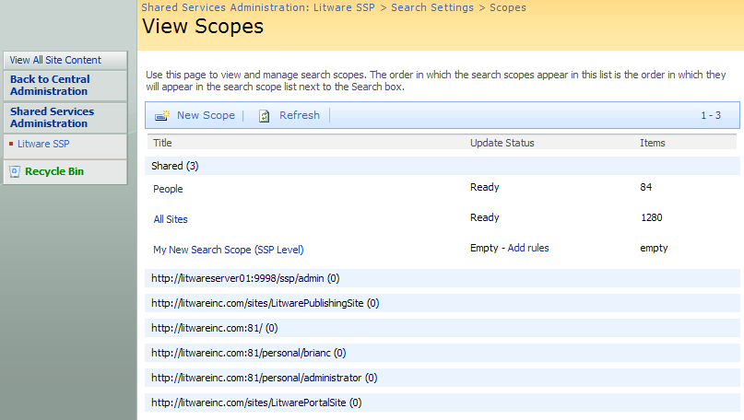
Search Scopes
Created at one of two different levels
Can be created within content of an SSP
Can be created within context of a site collection
Notes:
The ability to create search scopes at both the SSP level and the site collection level is a very powerful option. If a scope makes sense to be used across all site collections, it is easiest for it to be created an maintained once. However, a site collection owner can determine and implement on their own the pertinent search scopes.

Slide 8
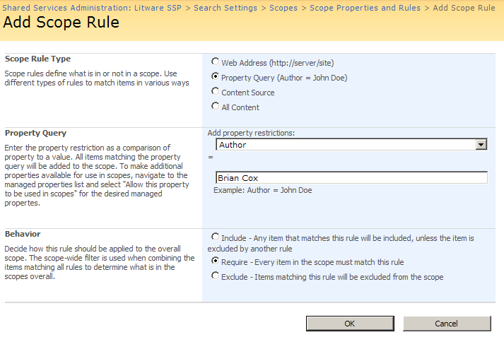
Adding Rules to a Search Scope
Each search scope has one or more rules
Rules define criteria to include/exclude content
Notes:
Scopes are configured using rules. These rules define what is being searched and how this scope will be utilized. For example, there may be a time when a site is determined not to have relevant information. As the site collection administrator, you could create a scope with a rule excluding that site from the search results.

Slide 9
Other MOSS only features
Detailed easy to use logs
Control over relevance
Crawl Rules
Easy to grow out farm and off load roles
Management of properties and advanced search
Keywords and best bets
Search center and 11 search web parts
Detailed search reporting
Notes:
As it has been said before MOSS gives you more power and control. Many of the items listed above are for the SharePoint administrators, but three of them: Keywords and Best Bets, the Search center and 11 search web parts, and the detailed search reporting are important for you to understand and will be discussed further in the following slides.

Slide 10
Keyword/Best bets
Highly under utilized
Keyword is what your user is searching for
Can assign a definition to display
Best bet is what you think they want
Links to any web url
Administered by site collection admin
Notes:
For example, a commonly searched for item on many organizations’ portals may be the holiday schedule. When a user goes to search for holiday schedule, first of all there many terms a user may search for: paid holidays, paid time off, vacation days, scheduling, etc. Many of these terms many not return the correct result at all, or for a couple of the terms, the desired result may be far down on the list of return results. By creating a keyword and best bet, you can include synonyms, provide a short definition of the term, Holiday Schedule, and provide a link to the holiday schedule. This does two things, speeds up the users productivity by not wasting time searching, and improves their confidence in SharePoint.

Slide 11
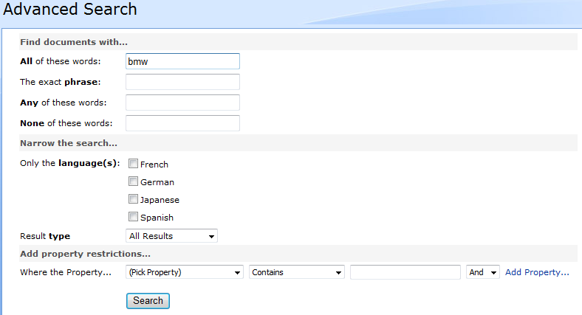
Advanced Search
Built with configurable Web Parts
Notes:
The advanced search pages allows your users to customize what they are searching for. Using Result Type, the user can identify what type of document they are searching for: documents, word document, excel documents, presentations. The properties located beneath that can be customized to be the different columns you have create throughout your portal. This customization is made in the SSP.

Slide 12
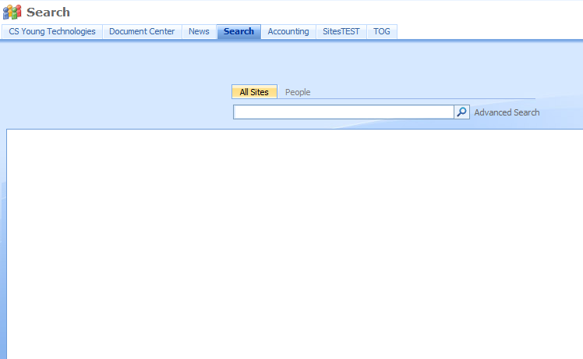
Search Center and Search Pages
Notes:
The search center allows you to customize the search experience. Tabs can be added for different scopes and pages can be created for each tab. This will allow you to determine how the search results will be presented.
Need to customize more?
Use XSLT and CSS to transform search results
Write code against Object Model or Web Services
Look to 3rd party
http://www.codeplex.com/FacetedSearch
Free Community Tool
http://www.ontolica.com/
Free Wild Card search/Pay full product
http://www.coveo.com
Replaces SharePoint Search Engine
http://www.ba-insight.net
Hit Highlighting, preview

Slide 13
Search Web Parts
9 OOTB web parts including
Search Box
Core Results
High Confidence
Statistics
Pagination
Action Links
Matching Keywords and Best Bets
Search Summary (Did you mean?)
Advanced Search
Notes:
These web parts allow you to create customized search pages for your users. You can also use them to create a static search page. It is typical to get a request to see the last ten modified documents, search will allow you to do this. These web parts can even be added to other sites they do not only need to be used on the search pages. You might add the Core Results web part to the homepage to display the last ten modified documents.

Slide 14
Search Features
Duplicate Collapsing
Hit Highlighting
Did You Mean?
Notes:
Duplicate Collapsing-If there are duplicate results, only one will be shown.
Hit Highlighting-Highlights the term searched for in the search results.
Did you mean?-Provides with a best guess, when a word has been potentially misspelled. For example, when I searched for PbZip it may give a “did you mean of PubZip?”.

Slide 15
Possible customizations
Customize Thesaurus
Located at drive:\Program Files\Microsoft Office Servers\12.0\Data\Config
Replacement or Expansion sets
Eg. Replace “Weirdo” with “Eccentric”
Substitution weighs and stemming is supported
Noise Words
Notes:
The thesaurus file provides the synonyms for the search results. In Litware Inc, we may add to the thesaurus, HR as a synonym for Human Resources. The Noise words file is located in the same location as the thesaurus file. This file allows us to place in words we do not want search results returned. We might add “Litware” to the noise word file because almost every document we create is going to have “Litware” in it somewhere.

Slide 16
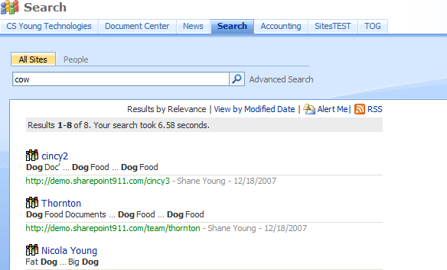
RSS Feeds and Alerts on Search Results
Notes:
In the same way users can sign up for alerts and subscribe to an RSS feed on a list, they can also do this same thing on search results. The way this works, is if a user has signed up for the alerts or the RSS feed, when the portal indexes if a new item meets the search criteria the user will be notified by the method they have selected. For instance, as the lead product manager for the Litware Sales Saver, I may want to be notified any time someone uploads an item referring to the Sales Saver product.

Slide 17
Search Reporting
Available from the SSP
Two types of reports
Search queries
Search results
Great feature for understanding your environment
Notes:
After the portal has been in production for awhile, the search reports will help you to constantly improve the user experience. You might notice users are constantly searching for “sales figures” and not returning any results or not clicking on any of the results that are presented. You could talk to the sales team and find out what someone might be trying to find when they are searching for “sales figures” and create a keyword and best bet.

Slide 18
Demo!
Everything search

