Slide 1
Managing Meetings with Meeting Workspaces
Module 10

Slide 2
Agenda
Meeting Workspace Template
Creating Meeting Workspaces
Reoccurring Meetings
Series Items
Meeting Workspace Pages

Slide 3
Meeting Workspace Templates
Allows for the planning, organization, and documentation of meetings
Available in both WSS and MOSS
Templates available:
Basic Meeting Workspace
Blank Meeting Workspace
Decision Meeting Workspace
Social Meeting Workspace
Multipage Meeting Workspace
Notes:
The meeting site template is a template for the organization and documentation of meetings. Within the meeting templates group there are four different meeting workspace templates to choose from. Like each the other templates we have talked about these are merely templates and can be customized to suite the needs of your individual meetings.

Slide 4
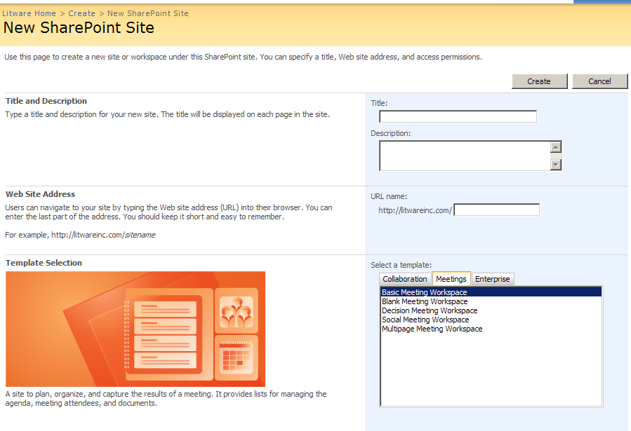
Site Creation Page
Notes:
There are three different methods for creating meeting workspaces. The first method using the site creation page allows you to create a meeting workspace in the same manner you have created the other sites.

Slide 5
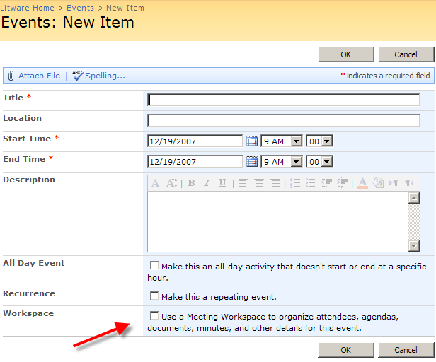
Calendar Creation
When creating new calendar item, the option to create a meeting workspace is available
Notes:
Creating the meeting workspace through the creation of new calendar item serves two purposes: it adds a link to the meeting workspace from the item and if the date of the meeting changes it updates the meeting workspace. It makes sense to have a link to the meeting from the event item on the calendar. If not the user is going to see the sales meeting coming up on the calendar and then need to go and find the meeting workspace.

Slide 6
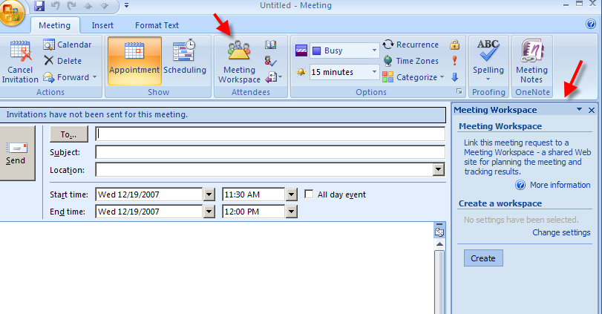
Outlook Creation
In Outlook, when a meeting request is sent the user has to option to create a meeting workspace
Notes:
The final way to create a meeting workspace is through Outlook when you are sending a meeting request. This creation method allows you to send out a notification through outlook, receive the notification of attendance from the users. It also will update the attendee list with whether or not they will be attending and set the security to be only the users invited to the meeting.

Slide 7
Demo
Creating a Meeting Workspace

Slide 8
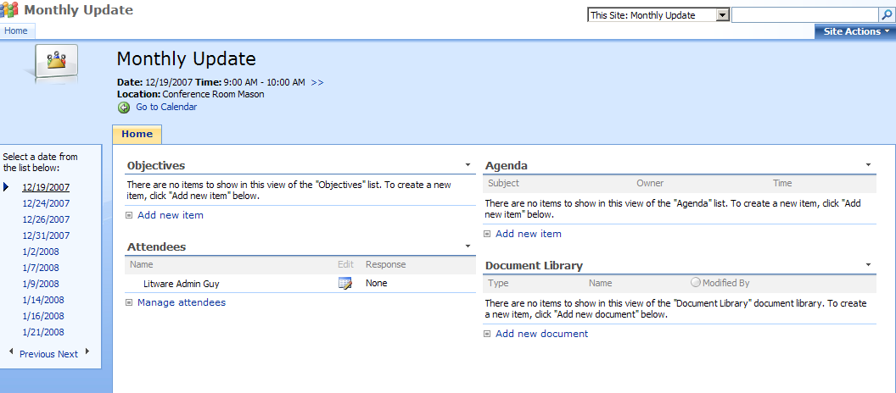
Managing Reoccurring Meetings
Notes:
It doesn’t make sense if a meeting is reoccurring to create a site for each meeting. Using the reoccurring meeting template you can set a schedule and the site will create different views for each date. This will allow you to easily switch view previous and future meetings. The document libraries and lists will have a command on the action menu to view items from all meetings. There may be a situation when you would want to see all of the agenda items for a particular meeting, this would allow you to do that without needing to flip through each one individually.

Slide 9
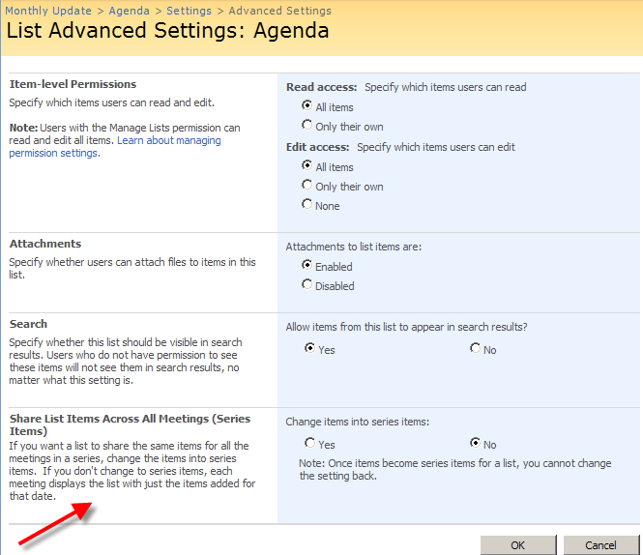
Series Items
Notes:
When creating a reoccurring meeting, there may be several lists or libraries that you want to be shared across all meetings. This may be especially true if this is a set of ten meetings to decide upon a budget for next year. The budget needs to appear at every meeting and having ten different copies would not be good idea. Keep in mind once you make a list or library a series list you can not switch it back.

Slide 10
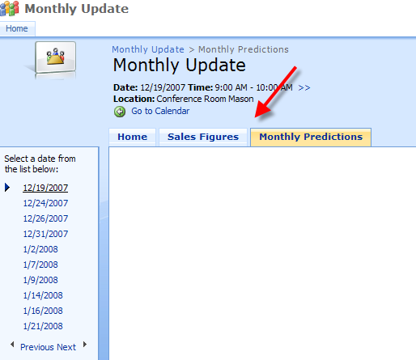
Meeting Workspace Pages
Notes:
As in the screenshot above, at Litware Inc., we have a monthly sales meeting for all sales representatives. At this sales meeting, the sales representatives need to submit their monthly predictions. Using pages we can view on a page the sales numbers for the region and for the individual sales representatives. The pages are configured to be shown for all meetings, whereas the lists for sales figures and monthly predictions change each month.

Slide 11
Demo
Creating a Reoccurring Meeting

