Slide 1
Enterprise Features
Module 11

Slide 2
Agenda
Excel Services Architecture
Creating Electronic Forms with InfoPath 2007 and Forms Services
Using the BDC

Slide 3
Why Do We Need Excel Services?
Common customer requirements/complains
Distributing spreadsheets to users creates many copies
Excel doesn’t play well with the BI dashboard and reporting world
It’s difficult to protect proprietary information in spreadsheets
Incorporating Excel logic into applications is difficult
Excel was designed as a desktop application (read: Excel really stinks as a server-side application)
Notes:
If your company is like most, Excel has became a critical business application. Some of the common usage:
Tracking performance data and then creating rich charts and graphs
Customer information.
Pulling data from other sources (SQL Database, Oracle, People Soft, AS400) and then reporting on it.
Simple list of data that you want to be able to perform basic calculations and sorting on. Then being able to share the information.
Computing sales figures and bonuses.
The challenge is these spreadsheets are then created and stored all over the company. Some in email, some on file shares, and most can be found just on someone’s desktop. Not a very good idea for critical business information. Worse yet, when you need to share this information with lots of people what do you do? Email them all a copy? Then when you update it next month???
To try and bring this madness that is Excel under control and allow it to flourish as the business application it wants to be.
Then Excel Services were born.
Excel Services is part of the Microsoft Office SharePoint Server 2007 Enterprise edition and is made up of three main components.
Excel Calculation Services (ECS) is the "engine" of Excel Services that loads the workbook, calculates in full fidelity with Microsoft Office Excel 2007, refreshes external data, and maintains sessions.
Excel Web Access (EWA) is a Web Part that displays and enables interaction with the Microsoft Office Excel workbook in a browser by using Dynamic Hierarchical Tag Markup Language (DHTML) and JavaScript without the need for downloading ActiveX controls on your client computer, and can be connected to other Web Parts on dashboards and other Web Part Pages.
Excel Web Services (EWS) is a Web service hosted in Microsoft Office SharePoint Services that provides several methods that a developer can use as an application programming interface (API) to build custom applications based on the Excel workbook.
Because Excel Services is a component of Microsoft Office SharePoint Server 2007, you can also take advantage of many SharePoint technology features such as, controlling, securing, and managing access to spreadsheets, server-based performance, and ability to scale well when users are added.
For more information please check out - http://office.microsoft.com/en-us/sharepointserver/HA101054761033.aspx?pid=CH101768471033

Slide 4
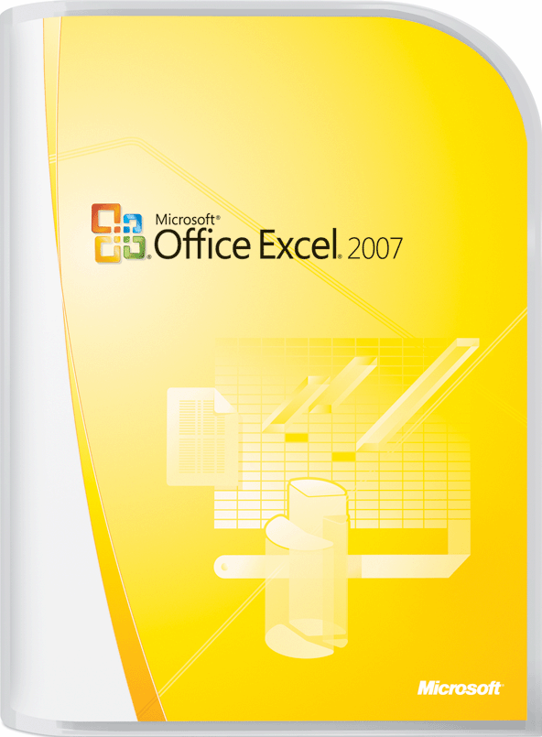
Excel 2007
Notes:
A cornerstone of the new Excel Services feature is its integration with Microsoft Excel 2007.
Excel is still that great little spreadsheet program you have been using for years. It just been drastically improved by extending existing features and introducing some new features. Some examples:
Increases storage – 1 million rows and 16 thousand columns
Table creation and manipulation is now simple and intuitive
Fast formatting options for professional look workbooks
Conditional formatting and data manipulation
Full support for SQL Server 2005 analysis services
The Excel 2007 Product guide is available for download here - http://office.microsoft.com/en-us/excel/HA101680001033.aspx

Slide 5
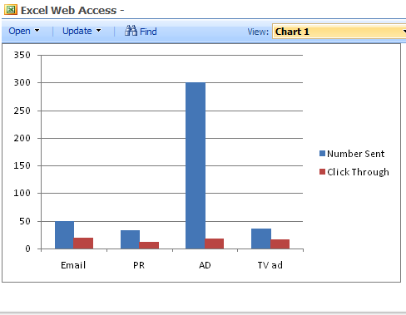
Excel Web Access Web Part
Web Part to view Excel workbooks on a page
Entire Workbook
Specified range of cells
Named Items
Notes:
The Excel Web Access web part is very simple to drag on to the page. Then you can connect it to a hosted Excel workbook. When you make the connection you can choose to display the entire Workbook, a range of cells, or a specific named range. You can even allow your users to interact with only the data you specify.

Slide 6
Key Performance Indicators
Goals
KPIs can be an important instrument in the organization, let’s make it easier to create them
Use the environment we already know – the portal and team sites
Support KPI types from simple to enterprise class
Types
Manually entered
SharePoint list
Excel workbook
SQL Server Analysis Services
Technologies
KPI web part & list
Customizable KPI profile page
Dashboard template focused on KPIs
Notes:
Key Performance indicators are instrument in organizations to visualize how well we are doing in various domains (sales, customer satisfaction, …). Think of the red light, yellow light, green light.
SharePoint has 4 types of KPI’s out of the box.
Manually entered – you put in the data and you decide what leveles get what color lights.
SharePoint List – hook your kpi up to a SharePoint list and tell it what columns to pull from. Then as the list is updated the KPI is automatically updated.
Excel Workbook – Here you can use a hosted Excel Workbook to drive your KPI.
SQL Server Analysis Services – Have some fancy OLAP cubes calculating your business performance data? Then SharePoint will let you get your business data from there.

Slide 7
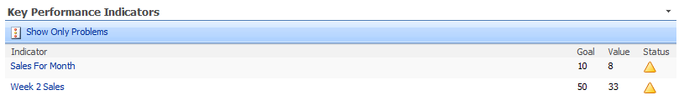
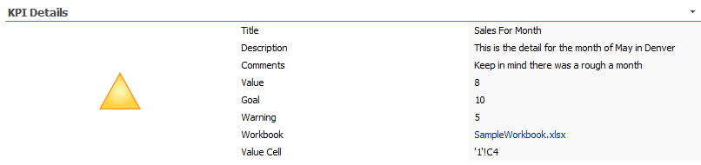
KPI Web Parts
Notes:
Out of the box you have 2 KPI web parts available.
The Key Performance Indictors Web Part shows a list of status indicators. Status indicators display important measures for your organization, and show how your organization is performing with respect to your goals.
The KPI Details Web Part displays the details of a single status indicator. Status indicators display an important measure for an organization and may be obtained from other data sources including SharePoint lists, Excel workbooks, and SQL Server 2005 Analysis Services KPI’s.

Slide 8
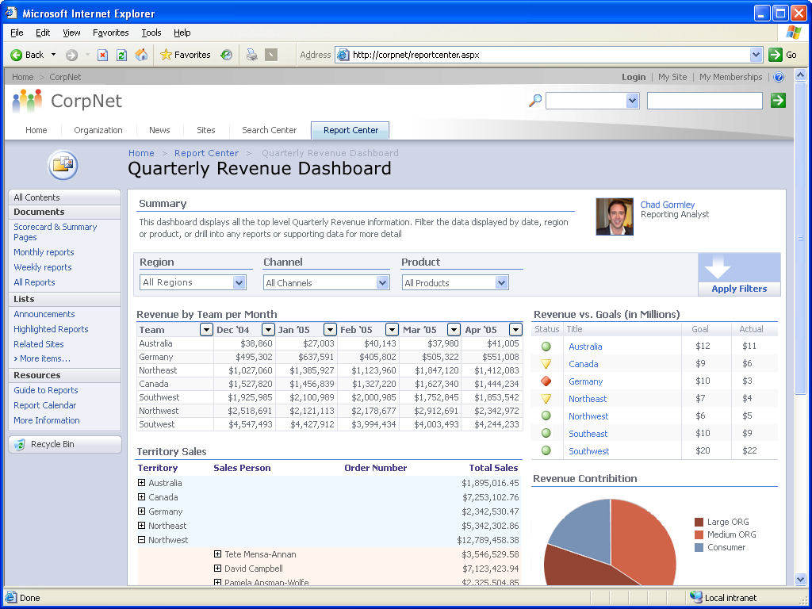
Dashboards
Dashboards are SharePoint pages
Dashboard pages are in the same document library as spreadsheets and reports
Types
Generic dashboard
KPI focused
Notes:
Dashboards are highly visual pages that allow someone to quickly evaluate the current information. Example might be a sales dashboard. Showing you all of the sales reports in a graphical form. With links to allow you to drill into the details if you wanted.
From a SharePoint perspective they are really just a page template to help you get started. You can create them from the new button on the report library.

Slide 9
Demo!
Using Excel Services

Slide 10
InfoPath, what is it?
InfoPath allows users a WYSIWYG way to create electronic forms.
All of the forms that are currently created in Word and Excel and then emailed around or printed out.
Think: expense reports, vacation request, scheduling forms.
Once they are created using InfoPath, users can fill them out and the data can be submitted to a database or a SharePoint list
Notes:
InfoPath 2007 is a Word like tool that allows you to quickly and efficiently create electronic forms that users can fill out. The data by default is written to an XML file but with a little work you can have the information written to a SharePoint list, a database, or a web service.
For more information on InfoPath 2007 check out http://office.microsoft.com/en-us/infopath/default.aspx

Slide 11
Previous Challenges
Companies like InfoPath 2003, but…
They want better support for offline scenarios
They want to have a greater reach (browser-based clients)
They want a better code-behind the model
InfoPath 2007 introduces several improvements
Improved offline support through wizard
Forms Services extended into InfoPath forms to browse
IT People Responsible for the Deployment
Code-behind using Visual Studio Tools Applications
Notes:
InfoPath 2003 was the first version. Users really liked its easy to use interface where you could make very powerful forms. But it did have some downsides. The biggest? In order for a user to fill out an InfoPath form you created they had to have a copy of InfoPath also. While this might be doable internally (expensive) this was impossible for forms that were sent outside the company (customer, vendors, partners).

Slide 12
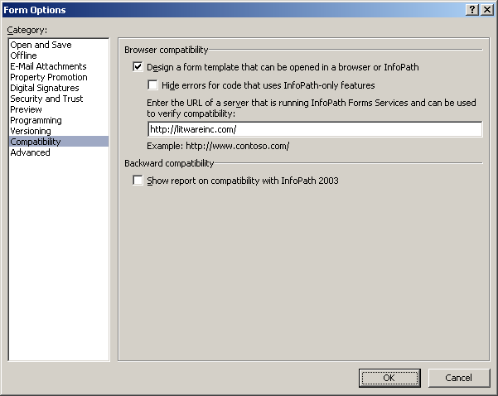
Browser-based Forms
Forms Services provides HTML rendering
Forms must be designed using InfoPath 2007
Forms must be designed to be browser compatible
Notes:
With the use of Forms Server 2007 (included with MOSS Enterprise or available as a stand alone product) you can publish your InfoPath 2007 form so users can fill out the form through a simple browser interface. No more need for them to have the InfoPath client. This opens up a world of possibility because now you can use InfoPath to create the form, then publish it to your SharePoint site and allow people to fill out right in their browser.

Slide 13
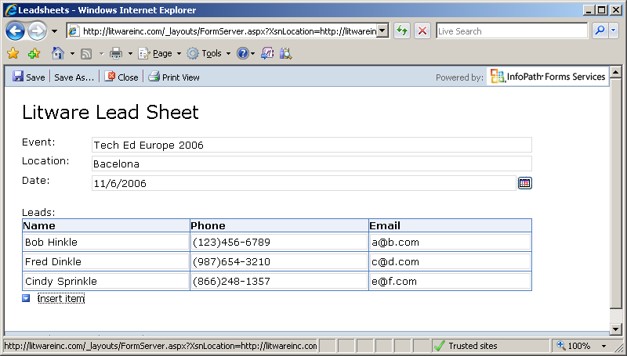
Browser-based Rendering
Browser-based rendering for wide reach
The users can fill out the form in the browser
Tested with IE, FireFox, Netscape & hand-held devices
Notes:
The forms are compatible with a range of browsers. To help you better plan for functionality check out the links below.
Plan MOSS Browser support http://technet2.microsoft.com/Office/en-us/library/ff6c5b8c-59bd-4079-8f0b-de4f8b4e0a861033.mspx?mfr=tru
Web Browser Compatibility in InfoPath Forms Services http://office.microsoft.com/en-us/infopath/HA102040851033.aspx?pid=CH100211501033
InfoPath 2007 features that are unavailable in Forms Services http://office.microsoft.com/en-us/infopath/HA102105871033.aspx

Slide 14
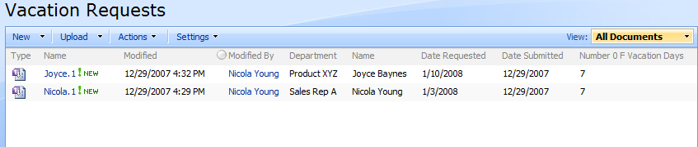
Form Library
Notes:
Form libraries are really just document libraries with a different name. You can publish your form to the library and then store the responses in the library. While you store all of the information they enter you can also publish certain fields as columns in the library. That way you can view, sort, filter or otherwise interact with that information without opening the actual form.

Slide 15
InfoPath and Workflow
Once the form is submitted to a form library a workflow can be ran on it.
Both OOTB workflows and custom (SharePoint Designer and Visual Studio) workflows can be created
Notes:
Pretty typically once a user fills out an electronic form something needs to be done with the information. Maybe the form was an expense report. Using a workflow you could have the completed form automatically forwarded to their manager for approval. Workflows allow you to automate these repetitive type tasks and have the routing become a process handled by SharePoint instead of the user.

Slide 16
Demo!
Using Form Server

Slide 17
What is so great about the Business Data Catalog?
Bring into SharePoint, important data, from back end server applications
Put together a one stop shop for your users
No need to recreate data that is already being stored somewhere else
Notes:
Business Data Catalog (BDC) is a new business integration feature in Microsoft Office SharePoint Server 2007. It is a shared service and it enables Office SharePoint Server 2007 to surface business data from back-end server applications without any coding. Business Data Catalog bridges the gap between the portal site and your business applications and enables you to bring in key data from various business applications to Office SharePoint Server 2007 lists, Web Parts, search, user profiles, and custom applications.
Business Data Catalog provides built-in support for displaying data from databases and Web services. That is, you can use Business Data Catalog to display data from your SAP, Siebel, or other line-of-business (LOB) application via Web services or databases.
For more information on the BDC check out http://office.microsoft.com/en-us/sharepointserver/HA102443601033.aspx?pid=CH100948691033

Slide 18
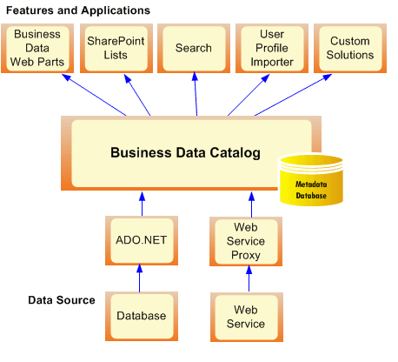
BDC Architecture
Notes:
At a high level how the BDC works.
You have your business data in its existing application.
You administrator creates an application file that allows SharePoint to connect to the business data.
The business data is then imported in the BDC.
Now the data can be searched, displayed, used as columns in list, and other custom functions throughout SharePoint.

Slide 19
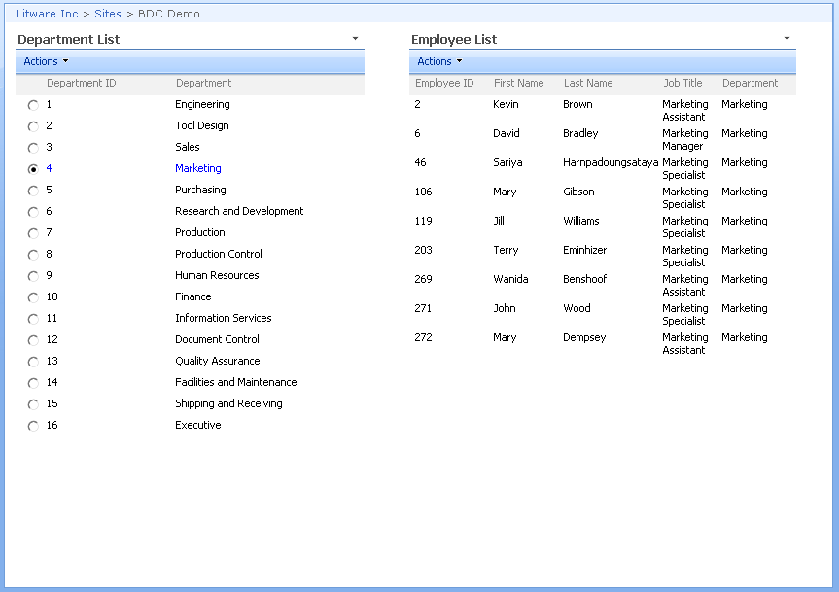
Connecting Web Parts with Associations
Notes:
The BDC has several specific Web Parts
Business Data Actions – Displays a list of actions from the BDC
Business Data Item – Displays one item from a data source in the BDC
Business Data Item Builder – Creates a Business Data Item from parameters in the query string and provides it to other web parts. This web part is only on Business Data profile pages.
Business Data List – Displays a list of items from a data source in the BDC
Business Data Related List – Displays a list of items related to one or more parent items from a data source in the BDC.

Slide 20
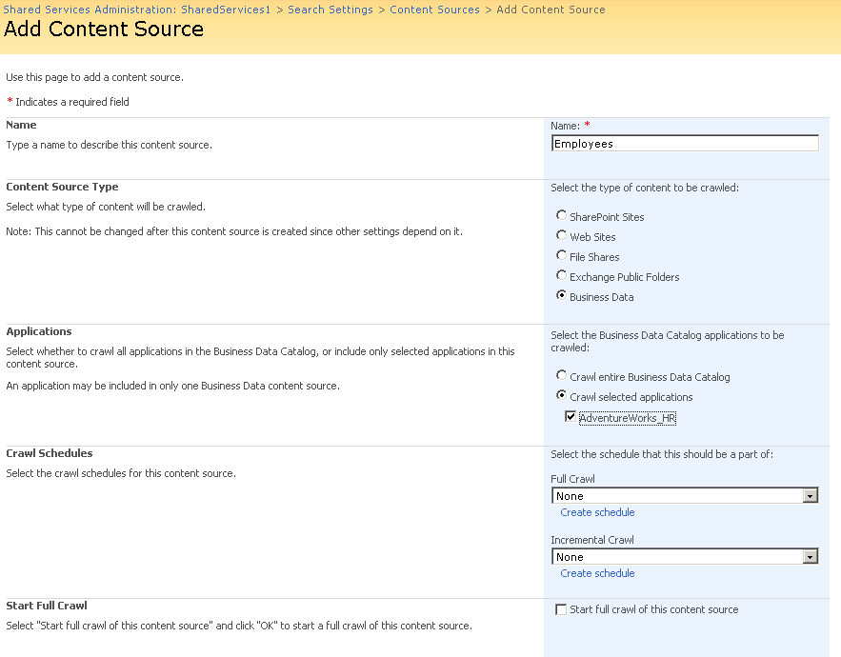
Searching through BDC Applications
Notes:
By adding the BDC as a content source in search you make it fully searchable.

Slide 21
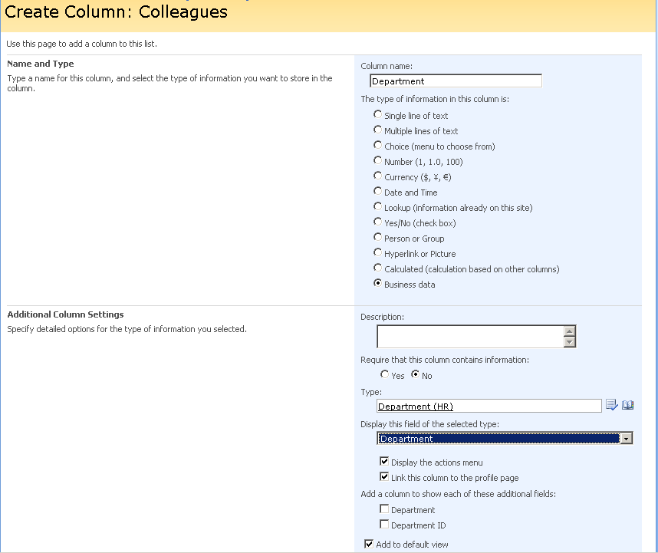
Adding BDC Columns to WSS Lists
Notes:
By adding a BDC column to a list you can now more fully integrate your information. Example is you have a document library for storing customer orders. You could setup the BDC to import you customer data from your CRM application. Then when you upload the order to the document library you can choose the customer number. Now anywhere you display that document library you can click the customer number metadata field and interact with your business data. No need to have to go to your CRM to look up the customers info. SharePoint already has it.

Slide 22
Demo!
Using the BDC

