Slide 1
Publishing Features
Module 12

Slide 2
Agenda
Publishing Site Template
Pages and Page Layouts
Branding with Master Pages
Restructuring with Manage Content and Structure

Slide 3
Publishing
Use the publishing sites to ensure accuracy of information
Requires changes to be published before users see them
Good for making design changes
Notes:
Different than team sites, publishing sites allow user to make a change and the change remains unseen by the visitors to the site until the changes are published. This is very important in environments where you need to control the message to the public.

Slide 4
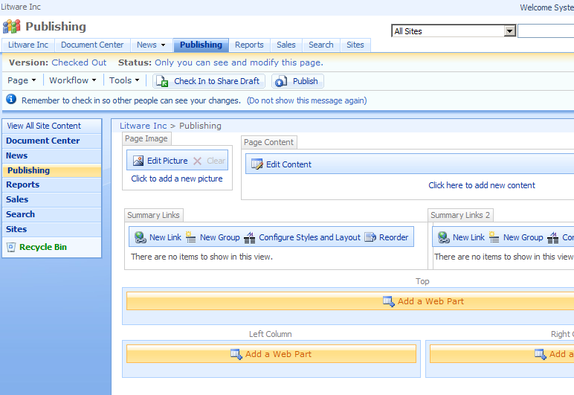
Publishing Site
Notes:
As you can see for the picture here, the publishing site template adds the concept of pages and the page editing tool bar. With publishing sites, pages are an integral part of the structure they are even able to be included automatically in the navigation. The page editing tool bar allows the users access to special commands such as the properties of the page, or the version history of the page. It also creates a seamless process for submitting a page for approval and publishing a page.

Slide 5
Publishing Site with Workflow
Uses the publishing site template but has workflow turned on
Light-weight approval workflow is active OOB
Based on approval
Minor versions need to be approved to become major versions
Visitors only see the major (published) versions
Workflow can be replaced by custom workflow
Notes:
The second publishing site template, publishing sites with workflow, is the same template as the publishing template except workflow is turned on all of the libraries for the site including the pages library, document library, and images library. This ensures all of the content on the site is approved before it is seen by visitors. Even thought the workflow is turned on, it can still be customized or changed.

Slide 6
Publishing Features
Site Collection
Site
Notes:
The publishing features are what control whether or not a site will be able to use publishing pages and page layouts as well as many other features. The site collection feature, Office SharePoint Server Publishing Infrastructure, must be activated in order to turn on the site feature, Office SharePoint Server Publishing. These features are not limited to publishing sites, they may be activated on any site.

Slide 7
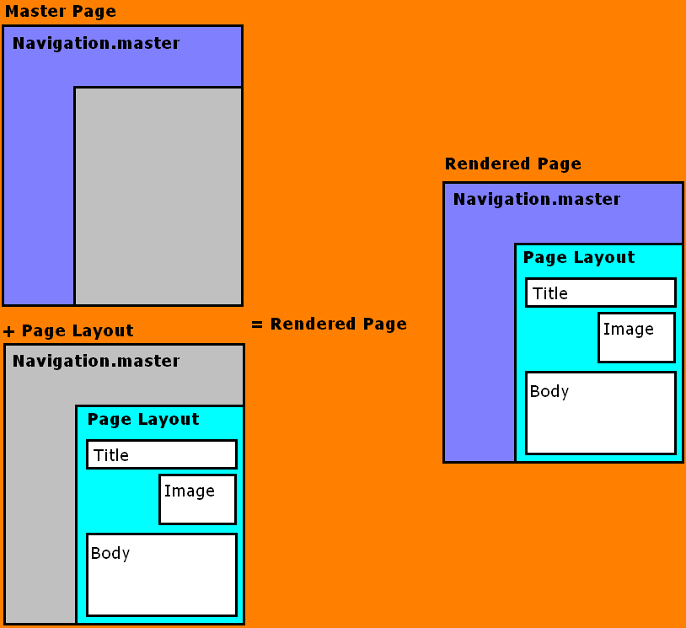
Page = Master Page + Page Layout
Master page defines banner and navigation
Page layout ASPX defines how page content is rendered
Possible scenario
1-3 Master pages
10-25 Page Layouts
10s of 1000s of Content Pages
Notes:
The pages on a site are composed out of two parts: a master page and a content page that is based on a specific page layout. The masterpage defines the look and feel of the banner and navigation while the page layout determines how the page will be rendered. Together, the page based on the page layout and the master page render the full page you see in the browser.

Slide 8
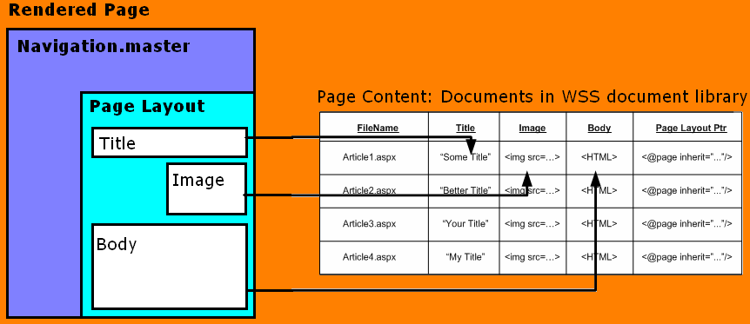

Page Layouts
Inherited from WSS:
Versioning,
Check-in/Check-out
Content types
Access control
Workflow
Page execution:
Page URL requested
Page layout executed in content of page
Content server controls bind to page fields
Rendered page returned
Notes:
Page layouts are based on content types. In your organization you make choose to make a newsletter content type. In SharePoint designer, you could customize this page layout and determine where the title of the newsletter should appear on the page, should there be a two spots on the left and right for images from the newsletter, where should the body of the newsletter be placed. A typical portal is going to contain several page layouts for your users to change from. Since these page layouts are all content types, if you decide you would like to add a spot for a third image for all newsletters, you can make the change to the page layouts and all the pages using the newsletter page layout will inherit the change.

Slide 9
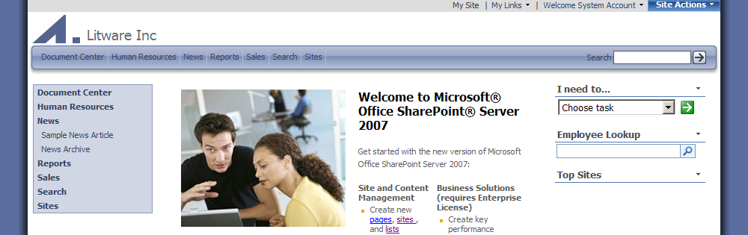
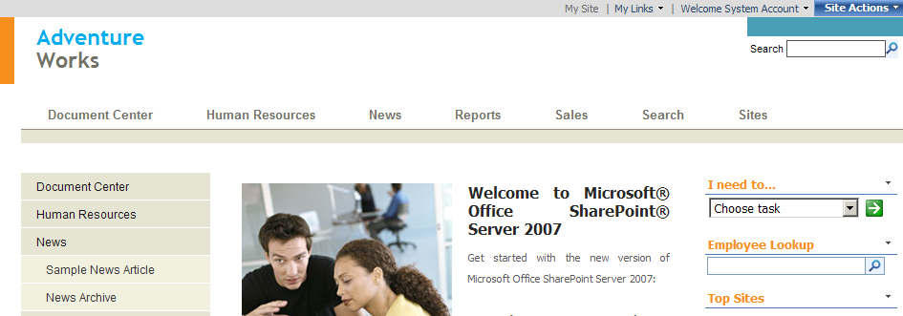
Master Pages
Notes:
The master page combines with the CSS file to define the general look and feel and host also the navigation controls. With MOSS you have several Master Pages out of the box, you can see two of them rendered above. As you can tell, the master page is defining the not only how and where the navigational controls appear but the colors the site is using as well. With the help of a designer, your company will be able to apply your company look and feel to your portal.

Slide 10
Site Master
Site Master
Set at the site level
Affects web part pages
System Master
Set at the site level
Affects list view pages
Application Master
Set at the farm level
Affects files in /_layouts
Stored on file system, should not modify
Notes:
If you decide to change the master page there are three different master pages making up the look and feel of your site. Two of them, Site Master and System Master, can be changed at site level. However the final, Application Master, can only be changed once per farm, this means all of your portals if you have a intranet and extranet on the same farm will have the same Application Master file. The application master file affects your site settings pages for example.
Knowledge Base article on modifying Application Master http://support.microsoft.com/kb/944105/en-us

Slide 11
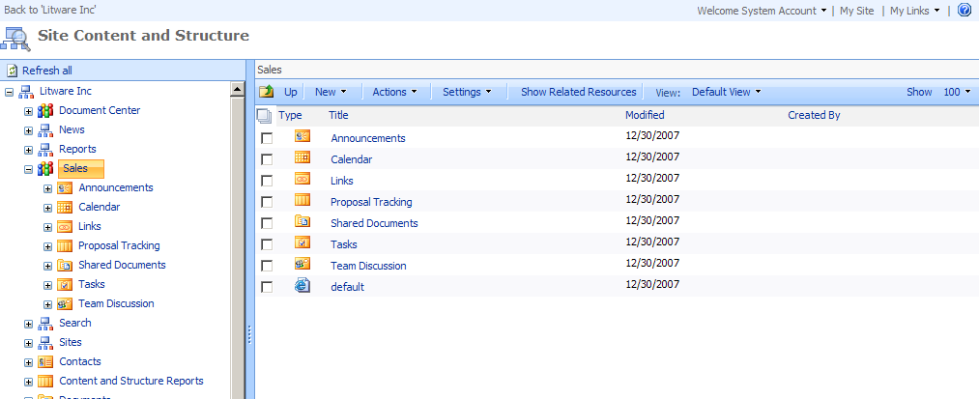
Manage Content and Structure
Notes:
The Site Content and Structure page is a powerful page for viewing the content of the lists and libraries in your site collection, viewing the subsites, and rearranging the hierarchy. This page is accessed through the link to Manage Content and Structure which is located on the Site Actions menu of publishing sites, and under the Site Adminstration heading on the Site Settings page for all other site templates. As you go through this final lab, please take a few moments to look through all of the commands that are available to you here.

Slide 12
Demo!
Building a Publishing Site

