Slide 1
Introduction to SharePoint Workflows
Developing SharePoint Workflow Templates with Visual Studio
Notes:
Demo setup:
- make sure OrderWorkflow demo can run
- make sure Shared Documents of Demos site has an Approval workflow attached to it (should be default)

Slide 2
Agenda
What is a Reactive Program?
Why is workflow beneficial
Introduction to Windows Workflow Foundation
Introduction to Workflow in SharePoint

Slide 3
Reactive Programming
Processes requiring human interaction
Process defined centrally
Asynchronously interact with other systems
Users
Web Services
Other external services

Slide 4
Scenario – Online Order Pipeline
Place Order
Enter Payment Info
Enter Shipping Info
Confirm Order
Notes:
Focus on stages and possible state/page transitions

Slide 5
Where does the code live?
Each transition’s code exists in step
Decentralized process
Place Order
Enter Payment Info
Enter Shipping Info
Confirm Order
Process Code
Process Code
Process Code
Process Code
Shared State

Slide 6
A Centralized Model
Centralize code in central controller
Decouples interface from process
Place Order
Enter Payment Info
Enter Shipping Info
Confirm Order
Centralized Code
Shared State

Slide 7
Common Process Functionality
Centralized process leads to common behaviors
Track the state of the process
Move between “states”
Communicate with the outside world

Slide 8
A Process Management Framework
Decoupling allows generic process framework
Stores state as .NET objects
Defines process as an interconnected set of steps
Define a well known interface for communication
Place Order
Enter Payment Info
Enter Shipping Info
Confirm Order
Process Framework
Place Order
Enter Payment Info
Enter Shipping Info
Confirm Order
Notes:
Scalability improved by allowing serialization one machine and de-serialization on another machine.
Allows resources to be freed when waiting for asynchronous interaction.

Slide 9
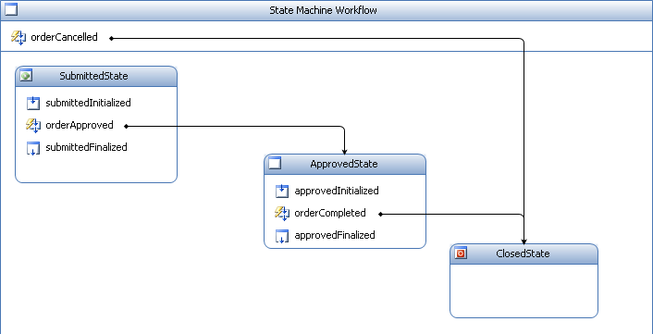
Windows Workflow Foundation
Provides processing framework
Shipped with .NET 3.0
Design environment in VS2005, VS2008

Slide 10
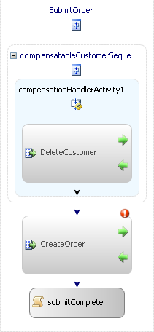
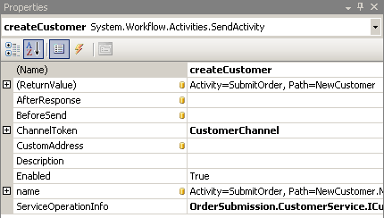
What is WinWF?
Workflows are made up of Activities
Processes = Workflows
Steps = Activities

Slide 11
Demo: Simple Order Processing

Slide 12
Hosting the WinWF Runtime
Can be hosted in any application
Windows Forms
ASP.NET
SharePoint
Host/Framework interaction via services
ExternalDataExchange
Persistence
Threading
Etc...

Slide 13
SharePoint Integration
SharePoint is another WinWF Host
SharePoint provides it’s own services
Can execute any WinWF workflow
Ships with several built in workflows
Three State
Approval – MOSS only
Translation – MOSS only

Slide 14
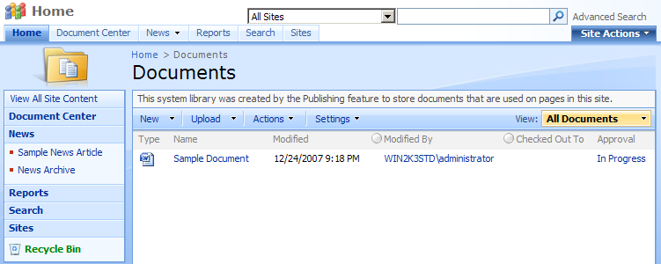
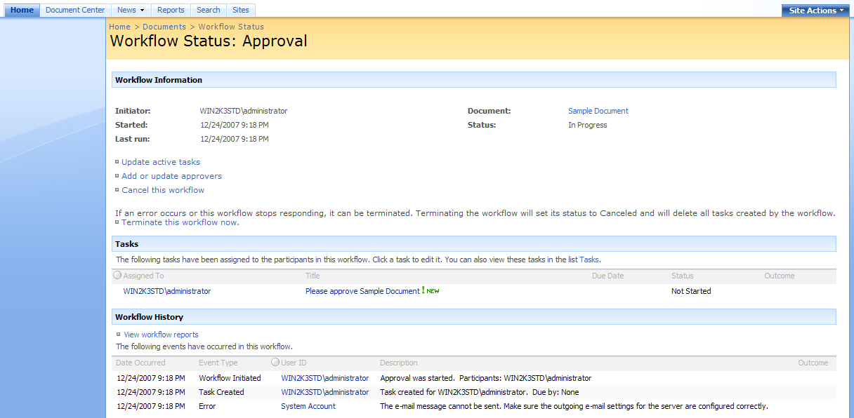
Human Interaction in SharePoint
Human interaction defined via Tasks
Assigned to users
Workflow “pauses” while waiting for task completion
Think of SharePoint as UI for WinWF

Slide 15
Demo: SharePoint Approval Workflow

Slide 16
Student Questionnaire
What’s Your Name?
What Company are you with?
How have you evolved as a Developer?
Do you have experience with…
The .NET Framework and Visual Studio
WSS 2.0 and SPS 2003
WSS 3.0 and MOSS
WinWF or BizTalk

Slide 17
Day 1
Introduction to SharePoint Workflows
Windows Workflow Foundation Primer
Understanding the Windows Workflow Foundation Runtime

Slide 18
Day 2
Windows Workflow Foundation Integration with SharePoint 2007
Programming with SharePoint Workflow API
Developing SharePoint Workflow Templates with Visual Studio 2008

Slide 19
Day 3
Creating and Waiting on SharePoint Tasks
Creating Workflow Association Forms
Creating Workflow Instantiation and Modification Forms

Slide 20
Day 4
Integrating InfoPath Forms into a SharePoint Workflow
Developing Custom Activities for a SharePoint Workflow
Extending SharePoint Designer with Custom Activities

Slide 21
Summary
What is a Reactive Program?
Why is workflow beneficial
Introduction to Windows Workflow Foundation
Introduction to Workflow in SharePoint

