Slide 1
Windows Workflow Foundation Primer
Developing SharePoint Workflow Templates with Visual Studio

Slide 2
Agenda
What is a workflow?
Running Workflows
Activities
Built In Activities

Slide 3
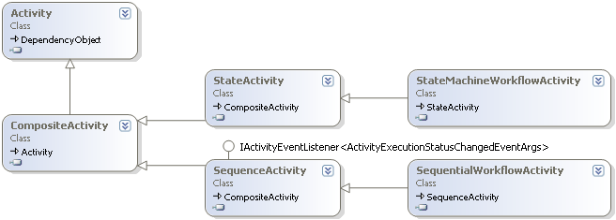
What is a Workflow?
Collection of activities
Activities are just classes
Activity
Some activities can contain other activities
CompositeActivity
Workflows are also activities

Slide 4
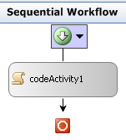
How are workflows defined? (Code)
private void InitializeComponent()
{
this.CanModifyActivities = true;
this.codeActivity1 = new System.Workflow.Activities.CodeActivity();
//
// codeActivity1
//
this.codeActivity1.Name = "codeActivity1";
this.codeActivity1.ExecuteCode += new System.EventHandler(ExecuteCode);
//
// HelloWorld
//
this.Activities.Add(this.codeActivity1);
this.Name = "HelloWorld";
this.CanModifyActivities = false;
}

Slide 5
How are workflow’s defined? (XOML)
<SequentialWorkflowActivity xmlns:x=“…" xmlns=“…“
x:Class="HelloWorldWorkflow.Workflow"
x:Name="Workflow" >
<CodeActivity x:Name="codeActivity1"
ExecuteCode="codeActivity1_ExecuteCode" />
</SequentialWorkflowActivity>
Notes:
This needs to be fixed. It should focus on how a workflow is created and it’s inheritence hierarchy. Hint that xoml is another option ffor dynamically loading workflows

Slide 6
Xoml
Xml format used to control object creation
Allows dynamic loading of workflows
<SequentialWorkflowActivity xmlns:x=“…" xmlns=“…“ x:Name="Workflow"
x:Class="HelloWorldWorkflow.Workflow“>
<CodeActivity x:Name="codeActivity1“
ExecuteCode="codeActivity1_ExecuteCode" />
</SequentialWorkflowActivity>
private void InitializeComponent()
{
this.CanModifyActivities = true;
this.codeActivity1 = new System.Workflow.Activities.CodeActivity();
this.codeActivity1.Name = "codeActivity1";
this.codeActivity1.ExecuteCode += new System.EventHandler(ExecuteCode);
this.Activities.Add(this.codeActivity1);
this.Name = "HelloWorld";
this.CanModifyActivities = false;
}
Notes:
Focus on the nature of Xoml as an object creation language. Show how objects are created and embedded inside other objects with special properties.

Slide 7
Code Behind
Implemented using partial classes
Xoml and Code workflow classes are marked as partial
public sealed partial class HelloWorld : SequentialWorkflowActivity
{
public HelloWorld() { InitializeComponent(); }
}
partial class HelloWorld
{
private CodeActivity codeActivity1;
private void InitializeComponent()
{
this.CanModifyActivities = true;
this.codeActivity1 = new CodeActivity();
this.codeActivity1.Name = "codeActivity1";
this.Activities.Add(this.codeActivity1);
this.Name = "HelloWorld";
this.CanModifyActivities = false;
}
}

Slide 8
Running a Workflow
Several classes are involved
WorkflowRuntime hosts the execution environment
WorkflowInstance represents the executing process
Scheduler provides the environment with a thread
Workflow Runtime
Scheduler
Workflow Instance
Thread Pool

Slide 9
Running a Workflow
using (WorkflowRuntime workflowRuntime = new WorkflowRuntime())
{
AutoResetEvent waitHandle = new AutoResetEvent(false);
workflowRuntime.WorkflowCompleted +=
delegate(object sender, WorkflowCompletedEventArgs e) {
waitHandle.Set();
};
workflowRuntime.WorkflowTerminated +=
delegate(object sender, WorkflowTerminatedEventArgs e)
{
Console.WriteLine(e.Exception.Message);
waitHandle.Set();
};
WorkflowInstance instance =
workflowRuntime.CreateWorkflow(typeof(Workflow));
instance.Start();
waitHandle.WaitOne();
}
Notes:
Start with the focus on creation of the workflow instance, then move into how the scheduler starts on another thread and the hosting thread must block. Once that’s done, talk about the runtime events that tell us when the workflow is no longer running.

Slide 10
Demo: Hello World Workflow
Find this demo at
Demos\HelloWorldWorkflow

Slide 11
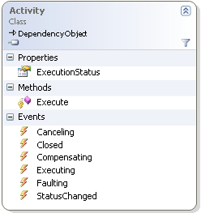
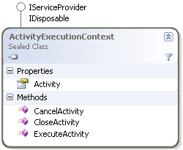
Activities
All activities live in an Activity Execution Context
Activity Execution Context (AEC) tracks activity state
Optimizes creation and destruction of activity tree
Quick to serialize and de-serialize
Notes:
http://msdn.microsoft.com/msdnmag/issues/07/06/Foundations/default.aspx

Slide 12
Activity Lifecycle
Activities exist in a specific state
Activities are completed when in the closed state
Faulting
Engine Transitions
Fault Transitions
Activity Transitions
Canceling
Initialized
Executing
Closed
Compensating
Notes:
Transition into this slide with a “How does this all work?” question
http://download.microsoft.com/download/1/9/5/195c1f00-bc52-44d8-9950-a00b4a7bc751/Track04__14.Practical_Windows_Workflow_Foundation.pdf

Slide 13
Activity Execution
Work queues used to detach activity from thread
Activity starts async method
Execute method returns executing
When async operation complete, item placed in queue
When the item is de-queued, the activity is resumed
Notes:
I need a good image here that shows how activity execution really works.
Focus on activities being async… We’ll come back to this later on day 4

Slide 14
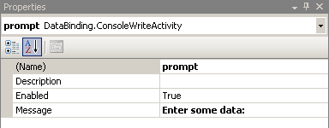
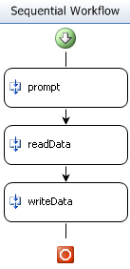
Designing with Activities
Activities are configured via Properties
Can be assigned via code
Data flows from activity to activity
Mechanism needed to declaratively connect properties
private void readData_AfterRead(
object sender, EventArgs e)
{
writeData.Message = readData.Result;
}
Notes:
Build a simple demo with two custom activities ConsoleWriteLineActivity, ConsoleReadLineActivity. Add two properties and use code behind to assign them.

Slide 15


Binding Activity Properties
Declarative activity relationships are better
Minimizes amount of repetitive code
Requires centralized storage of bind-able properties
Binding
Binding
.NET Property

Slide 16
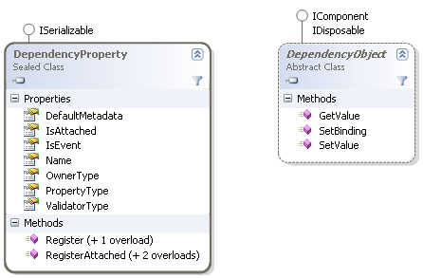
Dependency Properties/Objects
Designed to allow runtime object extensions
Similar to dynamic languages
composite activities may use to attach data to children
ConditionedGroupActivity

Slide 17
Using DependencyProperties
Requires two parts
Object that derives from DependencyObject
Static DependencyProperty object
Often accompanied by helper .NET properties
DependencyObject’s Get/SetValue used for access
public static readonly DependencyProperty ResultProperty =
DependencyProperty.Register("Result",
typeof(string), typeof(ConsoleReadActivity));
public string Result
{
get { return (string)GetValue(ResultProperty); }
set { SetValue(ResultProperty, value); }
}

Slide 18
Using Data Binding
Done using an ActivityBind object
Defines the source object and property
Defines target property (must be DependencyProperty)
Can be defined via Code or Xoml
ActivityBind activitybind1 = new ActivityBind();
activitybind1.Name = "readData";
activitybind1.Path = "Result";
this.writeData.SetBinding(
DataBinding.ConsoleWriteActivity.MessageProperty,
activitybind1);
<SequentialWorkflowActivity xmlns:ns0=“…" xmlns:x=“…" xmlns=“…“
x:Name="Workflow1" >
<ns0:ConsoleWriteActivity x:Name="consoleWriteActivity1"
Message="{ActivityBind Workflow,Path=Prompt}" />
</SequentialWorkflowActivity>
Notes:
The source object/property does not need to be a dependency property.

Slide 19
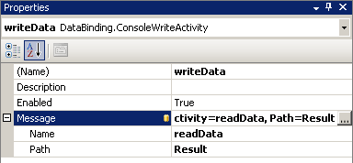
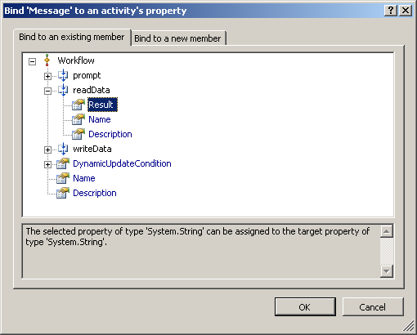
Using Data Binding
Or use the VS 2008 user interface
Property window links to binding dialog
Notes:
Convert the custom activities to use dependency properties and replace code behind with declarative binding

Slide 20
Demo: DependencyProperty

Slide 21
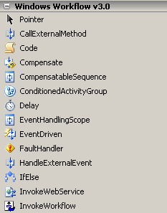
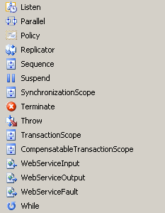
Built-in Workflow Activities
Located in System.Workflows.Activities Assembly
Used as a starting point for custom activities

Slide 22
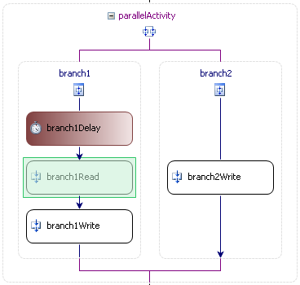
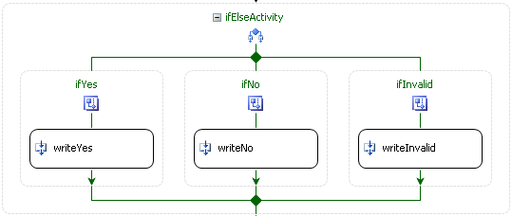
Branching Activities
Controls the flow of activity execution
Two determine when activities run
Sequential and Parallel
One determines which activities run
If/Else
Notes:
Show the branching demo at this point. Start with a simple two branch for yes and no. Use a code condition for branch yes and declarative for no. Then add the third else branch to catch all the invalid types.

Slide 23
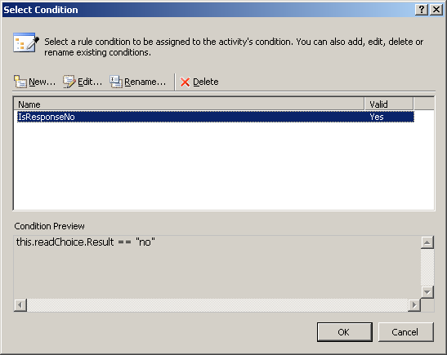
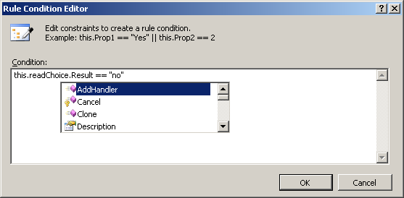
Declarative Conditions
Allow declarative conditions to be declared
Defined using C# like syntax, stored as xml rules
Embedded into assembly as a resource
Attached to activities properties via named conditions
<RuleDefinitions xmlns="http://schemas.microsoft.com/...">
<RuleDefinitions.Conditions>
<RuleExpressionCondition Name="IsResponseNo">
<RuleExpressionCondition.Expression>
<ns0:CodeBinaryOperatorExpression Operator="ValueEquality“ xmlns:ns0=“…">
<ns0:CodeBinaryOperatorExpression.Left>
<ns0:CodePropertyReferenceExpression PropertyName="Result">
<ns0:CodePropertyReferenceExpression.TargetObject>
<ns0:CodeFieldReferenceExpression FieldName="readChoice">
<ns0:CodeFieldReferenceExpression.TargetObject>
<ns0:CodeThisReferenceExpression />
</ns0:CodeFieldReferenceExpression.TargetObject>
</ns0:CodeFieldReferenceExpression>
</ns0:CodePropertyReferenceExpression.TargetObject>
</ns0:CodePropertyReferenceExpression>
</ns0:CodeBinaryOperatorExpression.Left>
<ns0:CodeBinaryOperatorExpression.Right>
<ns0:CodePrimitiveExpression>
<ns0:CodePrimitiveExpression.Value>
<ns1:String xmlns:ns1=“…">no</ns1:String>
</ns0:CodePrimitiveExpression.Value>
</ns0:CodePrimitiveExpression>
</ns0:CodeBinaryOperatorExpression.Right>
</ns0:CodeBinaryOperatorExpression>
</RuleExpressionCondition.Expression>
</RuleExpressionCondition>
</RuleDefinitions.Conditions>
</RuleDefinitions>

Slide 24
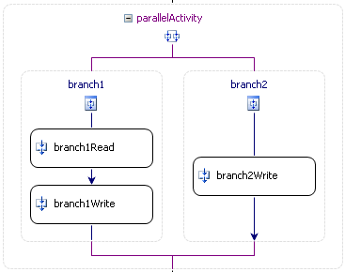
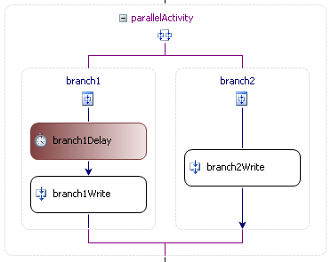
Parallel Activity
Allows two independent execution paths
Does not provide multi-threaded
Does provide better utilization of single thread
1
1
2
3
2
3
4
Notes:
This slide is an opportunity to introduce the concept of an execution path waiting for external interaction. When the first execution path blocks due to the delay, the second can now execute on the same thread. This leads to a great reference back to the executor discussion in the activity lifecycle.

Slide 25
Looping Activities
Looping done using for or for-each constructs
While loop provides for functionality
Based on exit condition
Replicator provides for-each functionality
Based on list data and optional exit condition

Slide 26
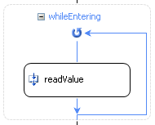
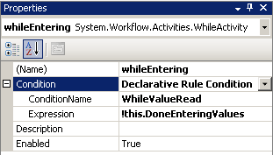
While Activity
Continues executing until a condition is false
Condition can be declarative or code
Can only contain a single child activity
Use a sequence activity if you need multiple
private void ReadValueComplete(object sender, EventArgs e)
{
string result = (sender as ConsoleReadActivity).Result;
this.DoneEnteringValues = string.IsNullOrEmpty(result);
if (!this.DoneEnteringValues)
Values.Add(result);
}
Notes:
Note how often a child activity will change a value the condition is based on to break the loop

Slide 27
Replicator Activity
Creates on instance of contained activity per item
Can only contain a single child activity
Instances can be run in sequence or parallel
No way to bind current element to activity
Must be done in code

Slide 28
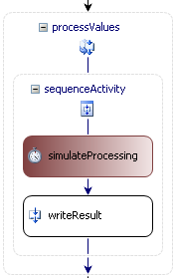
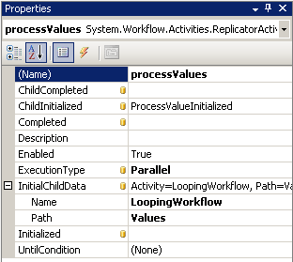
Replicator Activity
private void ProcessValueInitialized(
object sender, ReplicatorChildEventArgs e)
{
ConsoleWriteActivity writeResult =
e.Activity.GetActivityByName("writeResult")
as ConsoleWriteActivity;
writeResult.Message =
string.Format(" {0}", e.InstanceData);
}

Slide 29
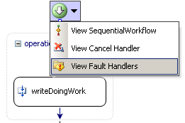

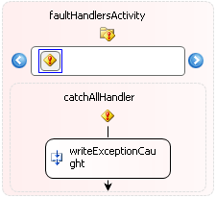
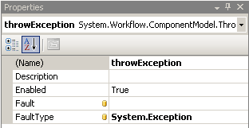
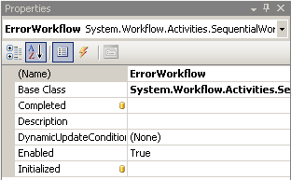
Error Handling
Exception handling in workflow similary to .NET
Exceptions thrown with ThrowFault activity
Exceptions caught with FaultHandler activity

Slide 30
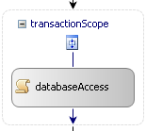
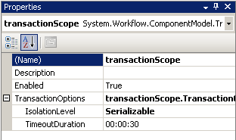
Transactions
Wraps activities into a distributed transaction
Workflow can’t sleep while in a transaction
No Delay, Web Service calls, etc…
Transactions implemented by external plug-in services
Default implementations use TransactionScope

Slide 31
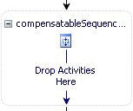

Compensation
Can’t hold transactions and wait for user input
Humans are slow; would lead to resource contention
Better way is to manually ‘undo’ on failure
Ex. Undo create customer with delete customer
Done using CompensatableScope and Compensate activities

Slide 32
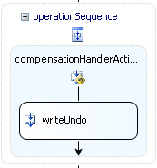
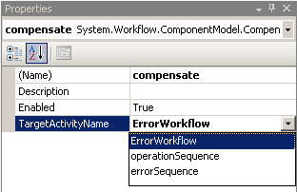
Using Compensation
CompensatableSequence activities hold actions
Has Compensation Handler holding ‘undo’ activities
Compensate activity initiates ‘undo’ activities
Runs Compensation Handler for target and children
Handler executed if sequence completed successfully
Notes:
Bring up that if the target doesn’t have to be a compensatable scope

Slide 33
Other Activities
Code Activity
Allows execution of custom code
Delay Activity
Forces the workflow to sleep for a specified time
CompensatableTransactionScope Activity
Provides compensation and transactions together
Web Service Activities
Allow invocation of web services inside the workflow
Suspend and Terminate Activities
Allow suspension and termination inside the workflow

Slide 34
Summary
What is a workflow?
Running Workflows
Activities
Built In Activities

