Slide 1
Understanding the Windows Workflow Foundation Runtime
Developing SharePoint Workflow Templates with Visual Studio

Slide 2
Agenda
Workflow Runtime
WorkflowRuntimeServices
ExternalDataExchangeService
StateMachine Workflow
WorkflowPersistenceService

Slide 3
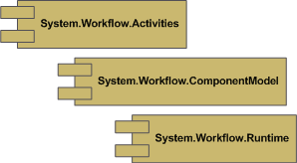
Workflow Runtime
Part of .NET 3.0
System.Workflow.Activities
System.Workflow.ComponentModel
System.Workflow.Runtime

Slide 4
Workflow Runtime Services
Allows host to choose and extend the runtime
Services derive from WorkflowRuntimeService
Key WorkflowRuntimeServices
WorkflowPersistence Service
ExternalDataExchangeService

Slide 5
ExternalDataExchangeService
Allows direct communication to host
Hosts one or more “services” inside it
WorkflowRuntime
ExternalDataExchange Service
MyService1
MyService2

Slide 6
ExternalDataExchange Interfaces
Hosted services derive from special interfaces
Interfaces have the ExternalDataExchange attribute
Interfaces contain methods and events
[ExternalDataExchange]
public interface ITimerService
{
event EventHandler<TimerEventArgs> Complete;
void StartTimer(string timerId, int delay);
}

Slide 7
ExternalDataExchange “Services”
Implements the ExternalDataExchange interface
Registered with ExternalDataExchangeService
Optionally derives from WorkflowRuntimeService
public class TimerService : ITimerService
{
public event EventHandler<TimerEventArgs> Complete;
public void StartTimer(string timerId, int delay)
{
Guid instanceId = WorkflowEnvironment.WorkflowInstanceId;
/* Implementation omitted for clarity */
}
}

Slide 8
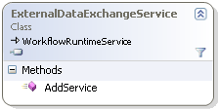
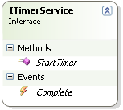
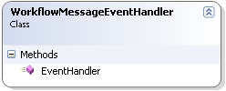
How does it work?
ExternalDataExchangeService registers “service”
Registers “service” with workflow runtime
Handles all events in “service” interfaces

Slide 9
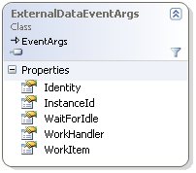
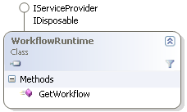
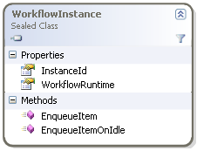

How does it work?
Interface event routed back to WorkflowInstance
Event is raised with ExternalDataExchangeEventArgs
WorkflowInstance located using event args InstanceId
Internal handler converts event to IMethodMessage
Message sent using WorkflowInstance.EnqueueItem
Notes:
Note: If the event is raised with a sender other than null, the message will not be delivered. This is an annoying detail that will drive you crazy if you’re not aware of it

Slide 10
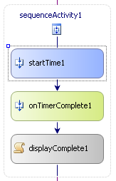
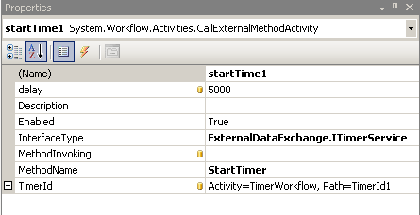
CallExternalMethodActivity
Calls external method by defining
The interface to use – InterfaceType
The method to call – MethodName
Any properties defined by the method

Slide 11
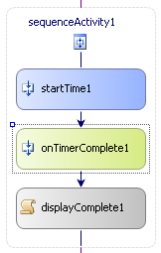
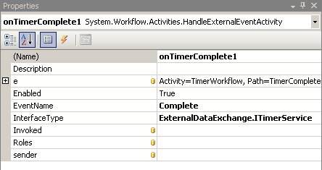
HandleExternalEventActivity
Waits for an external event by defining:
The interface to use - InterfaceType
The event to wait for - EventName
Any parameters provided with the event
Notes:
Focus on the key word Waits

Slide 12
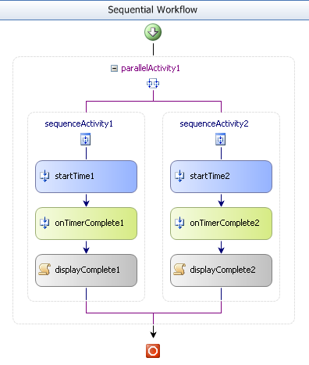
Demo: ExternalDataExchange

Slide 13
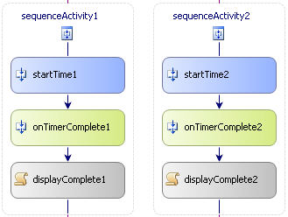
Correlation
What if the workflow receives multiple events
Which waiting activity receives the event?
Some way is needed to relate an event to an activity
Timer Id: 1
Timer Id: 2
Timer Id: 1
Timer Id: 2
Correlation Token
Correlation Token
Timer Id: 1
Timer Id: 2
Notes:
The primary goal of this slide is to introduce the concept of tagging an outgoing message and correlating it with an incoming message. An example to use would be a busload of people going to a show and checking their coats. Even though they all have a bus ticket to associate them with their bus (workflow) they will each need their own coat check ticket to identify their coat (activity instance).

Slide 14
Correlation Attributes
Attributes applied to ExternalDataExchange interface
Define the parameter used for correlation
Defines how a method initializes the correlation
Defines how an event relates to another method
[ExternalDataExchange]
[CorrelationParameter(“timerId")]
public interface ICorrelatedTimerService
{
[CorrelationAlias(“timerId", "e.TimerId")]
event EventHandler<TimerEventArgs> Complete;
[CorrelationInitializer]
void StartTimer(string timerId, int delay);
}
Notes:
[CorrelationParameter(‘’)]
[CorrelationInitializer]
[CorrelationAlias(“”, “”)]

Slide 15
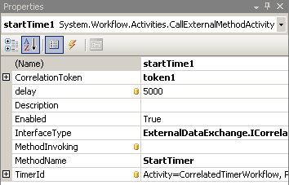
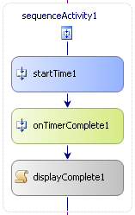
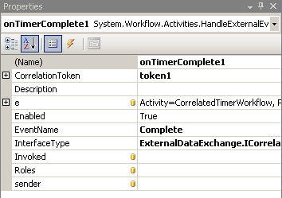
Using CorrelatedTokens
Correlated activities need a way to connect
CorrelationInitializers create or assign tokens
Token used on event activities to define relationship

Slide 16
Demo: Correlation

Slide 17
Are Sequential Workflows best?
Human processes often:
Stop while waiting for user interaction
Start again on receipt of external events
Skip steps when appropriate
Go back to previous steps
Failings of sequential workflow
Difficult to skip steps
Difficult to go back to previous steps
Notes:
Sequential workflows are conceptually simple but don’t model how humans work. Humans need to be forced into structure sometimes, but they also need to be allowed to skip back a few steps and perform some actions at any time. The concept of canceling or backing up aren’t simple to implement in the sequential model.

Slide 18
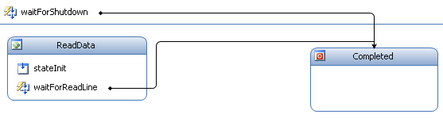
State Machine Workflow
Break processes into discrete states
Define events that initiate state changes
Execute activities on state enter and exit
Execute activities on transitions

Slide 19
Sequential vs. State Machine
Sequential more common for
Orchestration processes
Simple human interaction
State machines more common for
Complex human interaction
UI Flow
Sequential is just a special case state machine
Single state workflow with initiation activities

Slide 20
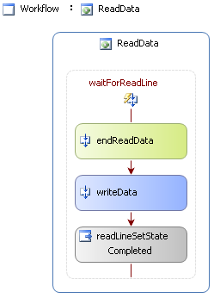
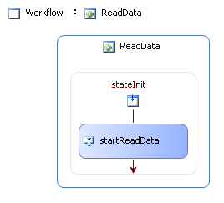
Example State Machine Workflow

Slide 21
Demo: State Machine Demo

Slide 22
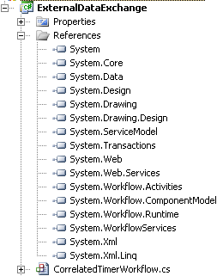
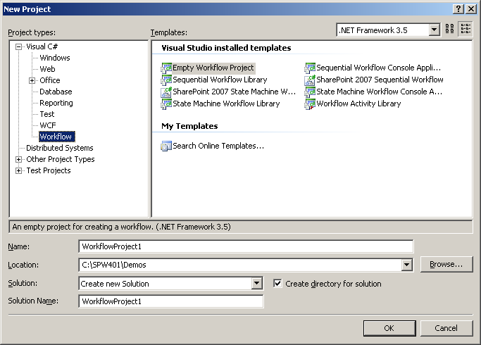
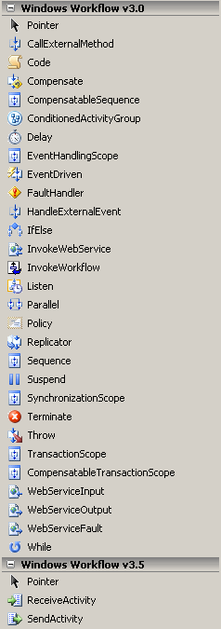
Building State Machine Workflows
New State Machine workflow project
Adds a reference to the workflow assemblies
Adds workflow activities to the toolbox

Slide 23
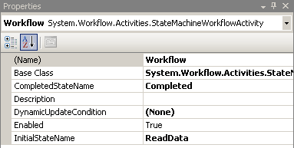
Defining the States
Workflow composed of multiple State activities
State activities are available in the toolbox
The workflow starts in a specific start state
When the workflow enters the end state, it completes

Slide 24

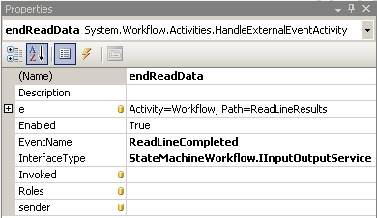
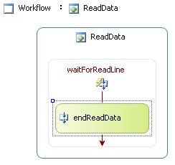
Responding to External Events
External stimuli causes activities to execute
Indicated using EventDriven activities in a state
EventDriven activities are mini sequential workflows
Must begin with HandleExternalEvent activity

Slide 25
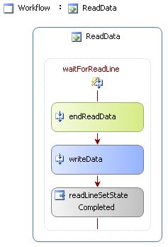
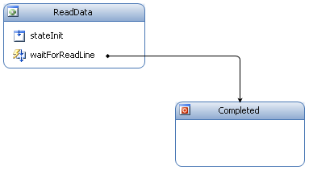
Changing States
EventDriven activities don’t change current state
SetState activity is used to change the state
Often placed in EventDriven activities
The state diagram will add arrows indicating transitions

Slide 26
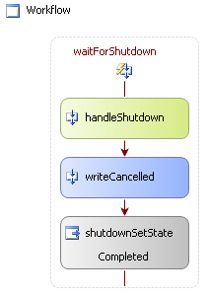
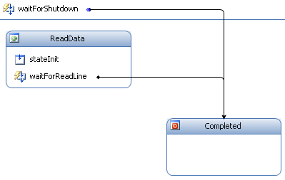
Responding to Global Events
Events are ignored if not currently listening
What if we want to listen for an event across all states?
EventDriven activities can be workflow scoped
Event will be handled regardless of current state

Slide 27
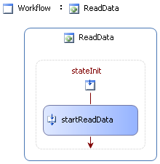

State Initialization and Finalization
State Init and Finalization tasks are tied to state
Both init and finalize are mini sequential workflows
Initialization execute on state entry
Finalization execute on state exit
Finalization will always execute on state changes
Notes:
So far all actions have occurred on state transitions. What about actions that occur on entry and exit to the state?

Slide 28
Resource Utilization
State Machine workflows often are waiting
Waste of memory
Lack of scalability
Memory needs to be reclaimed while waiting

Slide 29
Workflow Serialization
Workflows and Activities are .NET objects
Marked as Serializable
Can be serialized using IFormatter
Idle workflows can be serialized and unloaded
Workflows are idle when waiting for external event
Serialized workflow needs a location to be stored

Slide 30
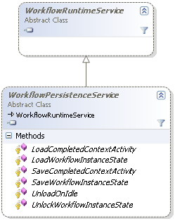
Persistence Service
WinWF provides WorkflowPersistenceService
Derives from WorkflowRuntimeService
Provides methods to load and save workflow instances

Slide 31
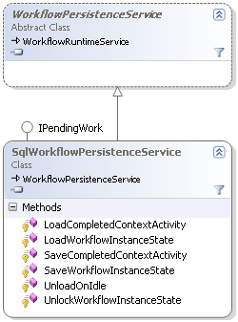
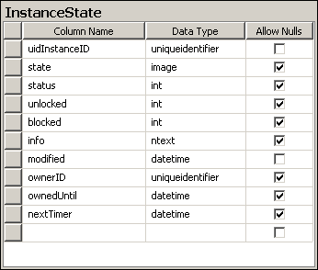
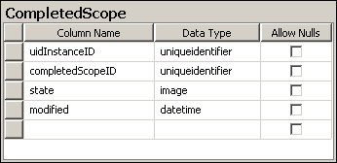
SqlWorkflowPersistenceService

Slide 32
When does a workflow persist?
Persistence Point
Persistence Point
Notes:
Get into discussion on transactions here

Slide 33
Summary
Workflow Runtime
WorkflowRuntimeServices
ExternalDataExchangeService
StateMachine Workflow
WorkflowPersistenceService

