Slide 1
Windows Workflow Foundation Integration with SharePoint 2007
Developing SharePoint Workflow Templates with Visual Studio

Slide 2
Agenda
WSS as a Workflow UI
Association Workflow to Lists and Content Types
Executing Workflow in WSS
WSS/WinWF Communication
Integration with Office 2007

Slide 3
Workflow UI
Human workflow requires process and UI
WinWF provides process, but no UI
WinWF provides external communication mechanism
Traditionally it’s the developers job to provide UI
Pre Processing
Start Human Interaction
Wait for Human Response
Post Processing
User
Interface

Slide 4
Workflow UI Patterns
UI in human workflow centers around tasks
Process defines tasks and waits for result
Humans complete tasks and provide result
Process continues to execute
Pre Processing
Start Human Interaction
Wait for Human Response
Post Processing
Task
User
Interface
Task

Slide 5
WSS as Workflow UI
Tasks are very similar to list items
In fact WSS 3.0 has a list type called tasks
Could the tasks list be our Workflow UI?
Can the tasks list hold multiple types of tasks with custom UIs?
What useful functionality do lists have in WSS
Custom display and edit forms
Potential for multiple content types with custom forms
Filtering to allow display of a single type of task

Slide 6
Using Workflow in WSS
There are three primary interaction points
Workflow Association
Workflow Initiation
Task Completion
Association
Initiation
Task Completion
A workflow may have multiple tasks

Slide 7
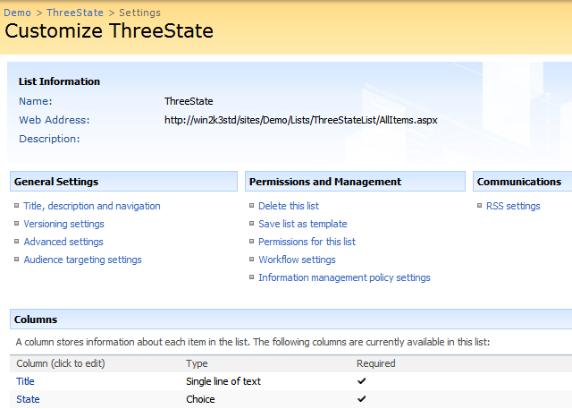
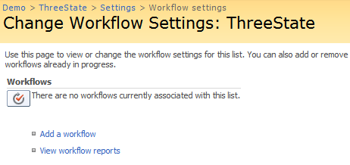
WSS Workflow Association
Workflows must be associated with containers
Can be associated with lists or content types
Association ties a type of workflow to a set of items
Requires entry of workflow type specific data

Slide 8
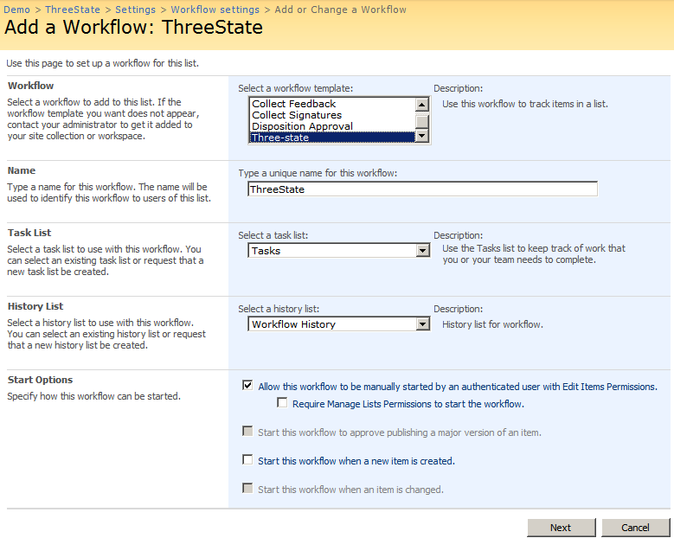
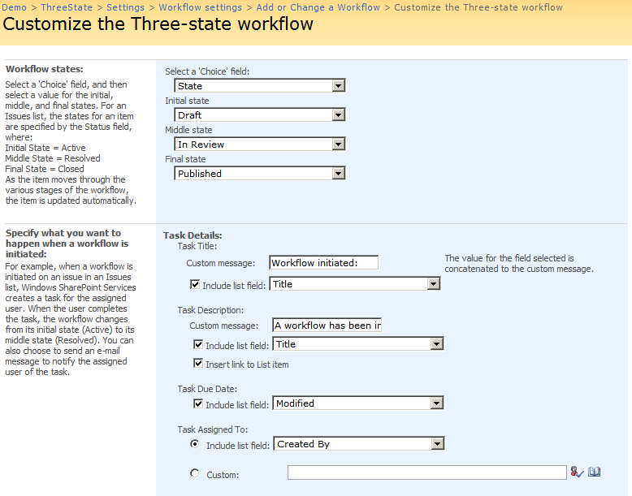
WSS Workflow Association

Slide 9
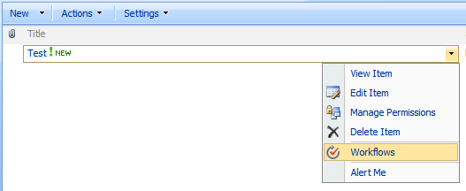
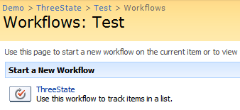
WSS Workflow Initiation
Initiation occurs at the list item level
Workflow types associated with its container allowed
Ex. WF Types associated with content type or list
Initiation can be automatic (when item created edited)
Initiation can be manual (anyone or only editors)

Slide 10
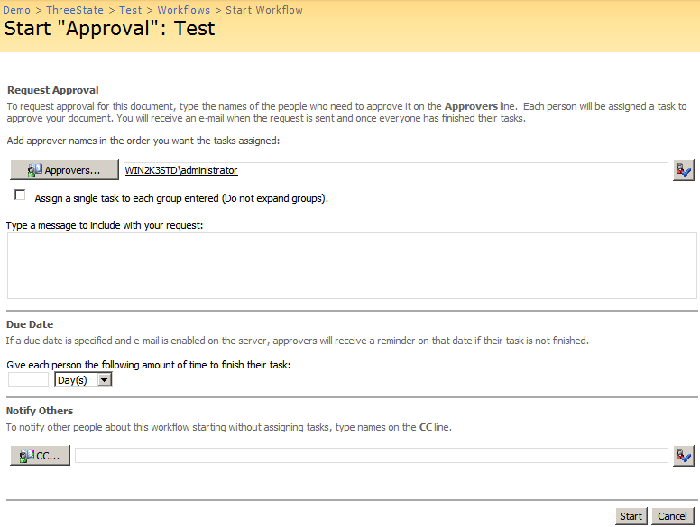
WSS Workflow Initiation UI
When a workflow instance is initiated
User has a chance to override instance settings
Done using UI specified by workflow type

Slide 11
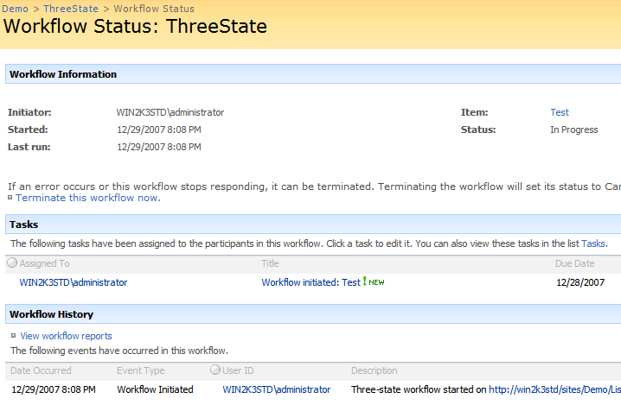

WSS Workflow Status
Once workflow is running, status accessed via list
List column added showing WF instance current state
Links to a special status page showing
Tasks related to workflow instance
History information logged by workflow instance
Notes:
We’ll talk about history in more detail later

Slide 12
WSS Workflow Modification
What if a workflow needs to be changed?
The list of approvers changes
The approval process becomes more urgent?

Slide 13
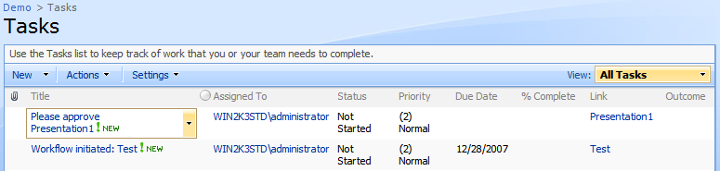
Using WSS Tasks
Tasks are the key WF/UI interaction point
Process defines tasks that the user can complete
Tasks are stored in a standard list with custom forms
The status UI displays a filtered view of the tasks

Slide 14
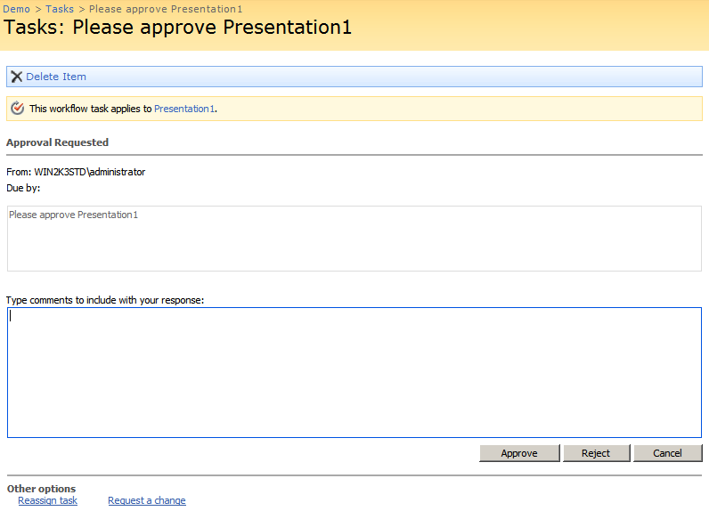
Completing WSS Tasks
Content types allow multiple forms per list
Each workflow can have its own task content type
Each content type has it’s own custom forms
Custom forms have 1 to 1 relationship with aspx pages

Slide 15
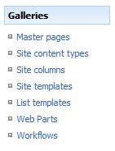
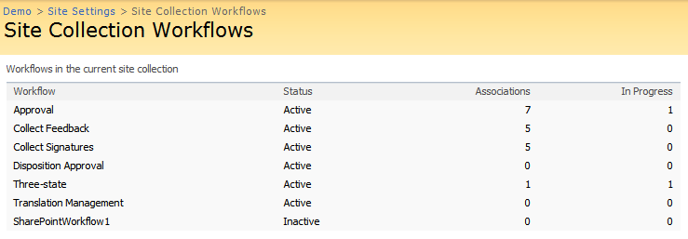
Viewing Current Workflow Tasks
Report page displays workflow types
Located in site settings at site collection level
Displays list of all workflow types
Displays number of associations and instances

Slide 16
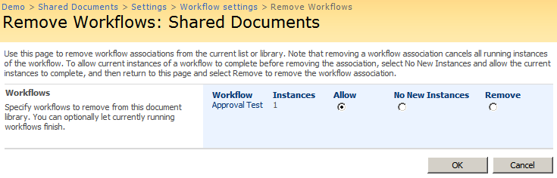
Un-associating a Workflow Type
Removal of a workflow type done in three steps
Remove the ability to start new instances
Wait until all instances are complete
Remove the workflow association
It is possible to terminate current instances

Slide 17
WSS Workflow Security
Workflow runs under worker process identity
Instances may have more permissions than initiator
Initiator may also be an event, not a user
Security is necessary on the workflow initiation
Tight controls on who can start a workflow
User Account
System Account
Workflow Initiator
Workflow Runtime
Security
Checkpoint

Slide 18
How does this all work?
WSS integrates with WinWF two ways
WSS hosts the WorkflowRuntime class
WSS provides custom services for the runtime
SPWinOePersistenceService
SPWinOETaskService
SPWinOEWSSService

Slide 19
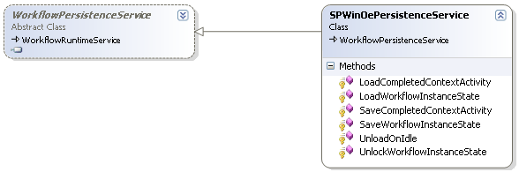
Dehydration of workflow instances
Workflow persisted while waiting on tasks
Running workflow is serialized into content database
Persistence service chosen in code
Can’t be overridden in config file

Slide 20
Rehydration of workflow instances
Workflow deserialized when tasks change
Tasks are just list items
SPItemEventReceiver fires the onUpdated event
Workflow event receivers deserialize and start workflow
1. Load Persisted Workflow
Workflow Runtime
Task Item Changed Event
2. Resume Workflow
Notes:
Discuss which thread/machine the new workflow runs on. Follow back through stimiulus of changing task

Slide 21
How are events delivered?
Done using ExternalDataExchange
WSS Defines a set of ExternalDataExchange interfaces
Implements the interfaces in special service
WSS provides a set of activities to use interfaces

Slide 22
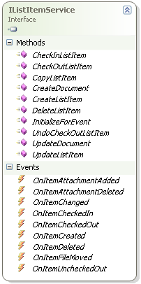
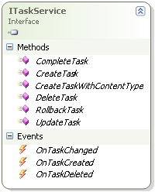
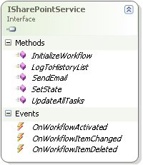
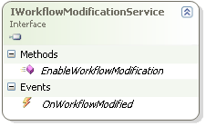
ExternalDataExchange Interfaces

Slide 23

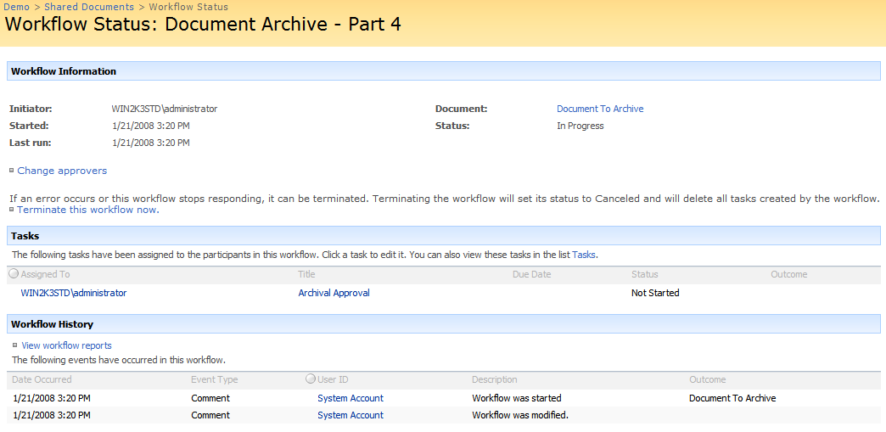
Task Creation Scenario
Workflow instance uses CreateTask activity
Workflow calls method in ITaskService interface
Task is created in the Tasks list
Activity initializes a correlation token
1. Calls External Method
3. Initializes Token
2. Creates Task
Token

Slide 24
Task Completion Scenario
WSS Event handler sends event to workflow
Event is converted into an ITaskService event
Message is correlated to a previous CreateTask call
Event is routed back to the correct activity and workflow
Token
1. Registers For Event
2. Task Changed
3. Receives Event

Slide 25
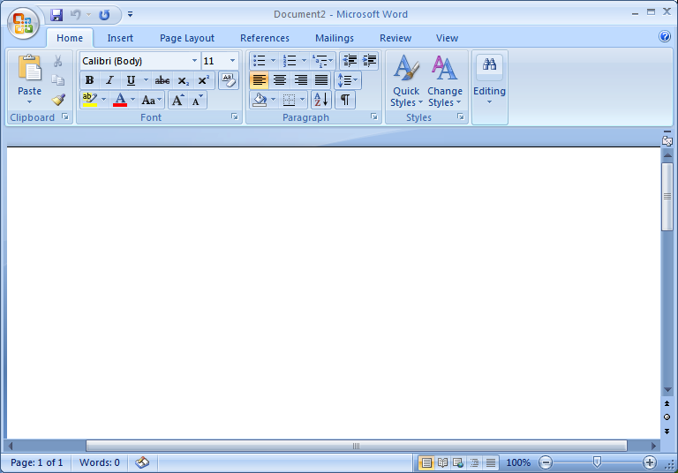
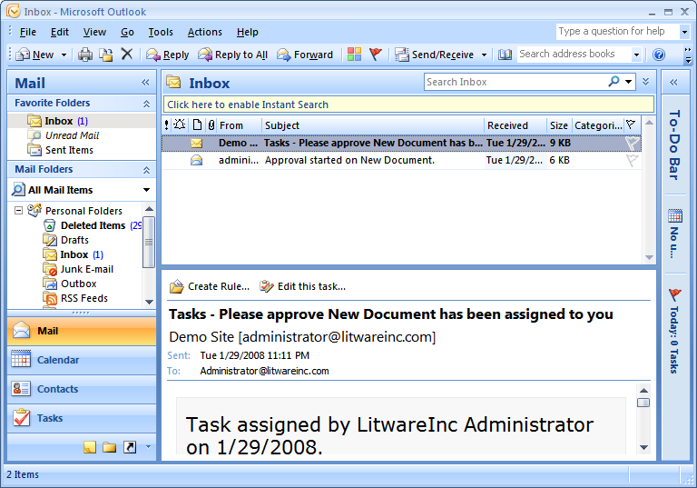
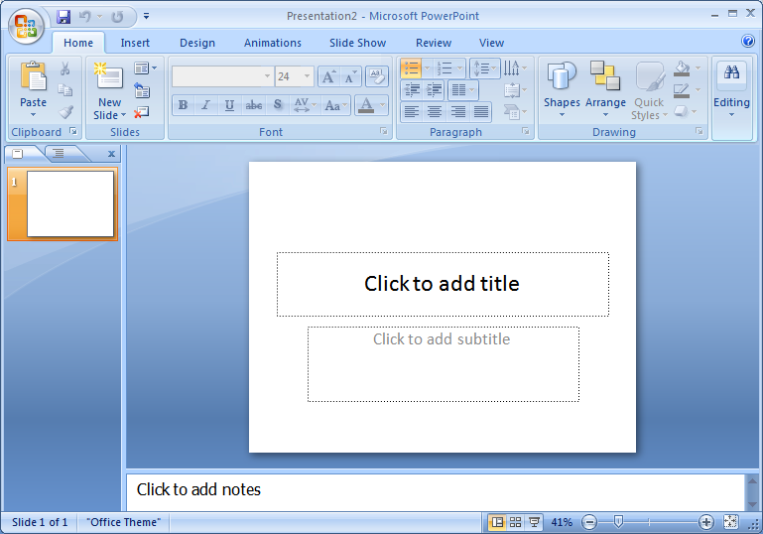
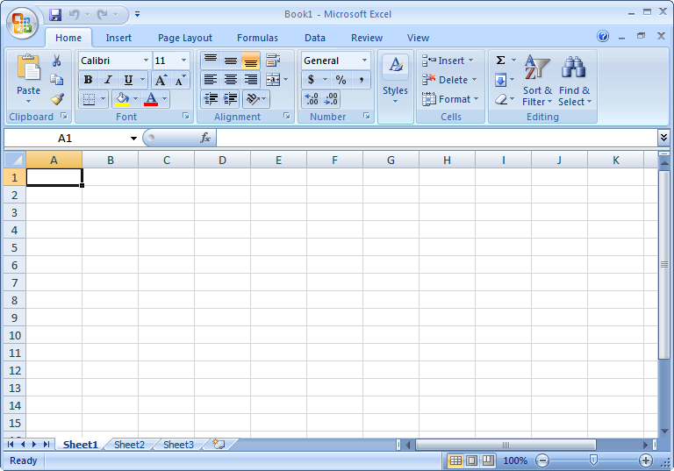
Office 2007 Integration
Office Applications that support workflow
Word 2007
Excel 2007
PowerPoint 2007
Outlook 2007

Slide 26
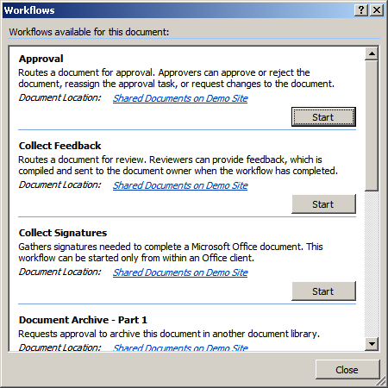
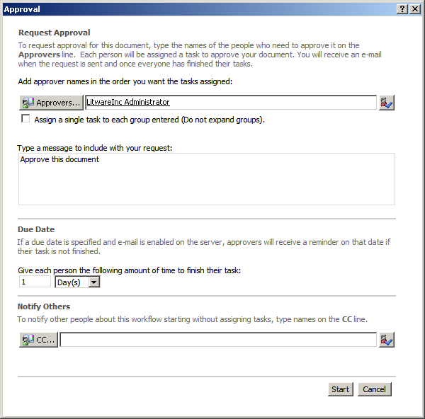
Starting Workflow via Office 2007
Office applications allow workflow to be started
Can only start workflows previous associated
Office hosts initiation page in embedded browser

Slide 27
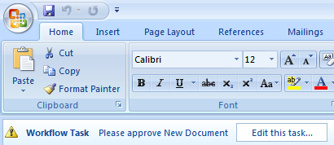
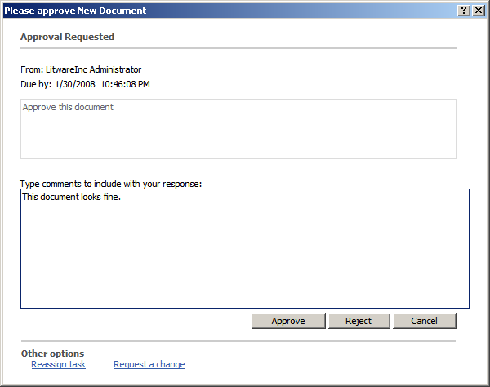
Acting on Tasks via Office 2007
Office can find any tasks for open item
Display notification for the user
Can host task edit form in embedded host

Slide 28
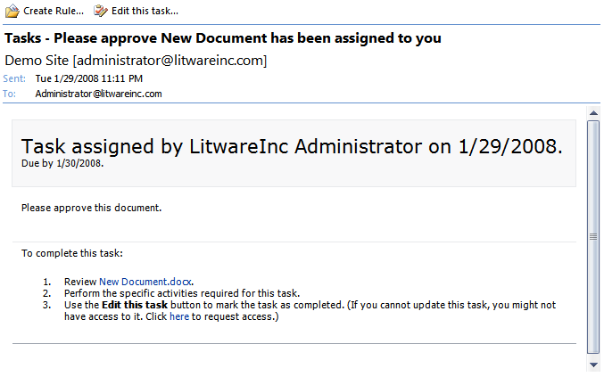
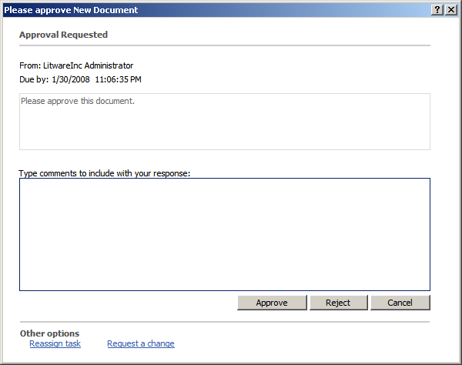
Receiving Tasks via Outlook 2007
Workflow status received via Email
Tasks sent as an email to all recipients
Hosts task edit form in embedded host

Slide 29
Summary
WSS as a Workflow UI
Association Workflow to Lists and Content Types
Executing Workflow in WSS
WSS/WinWF Communication
Integration with Office 2007

