Slide 1
Programming with SharePoint Workflow API
Developing SharePoint Workflow Templates with Visual Studio

Slide 2
Agenda
Overview of Workflow API
Associating workflow templates
Initiating workflows
Accessing running instances using the API

Slide 3
Why do we need Worflow APIs?
SharePoint allows custom workflows and forms
This means developers must create custom UIs
Custom UIs require access to workflow concepts
APIs used by SharePoint UIs are available to developers
Notes:
I’m not sure I like this slide. It’s an attempt to intro into why we have a slide full of details and not much conceptual content. Might be better to do a story of association, initiation, and management.

Slide 4
Managing Workflow via Code
SharePoint’s workflow UIs all use standard API
Necessary to allow third party extensions to workflows
Used in custom management forms and web parts
Used in custom workflow forms
These APIs allow:
Manual workflow template association
Manual workflow initiation
Manual workflow status
Manual workflow modification

Slide 5
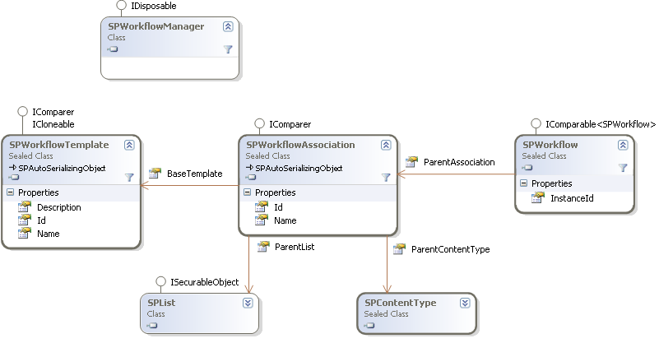
Workflow API Objects
Notes:
A

Slide 6
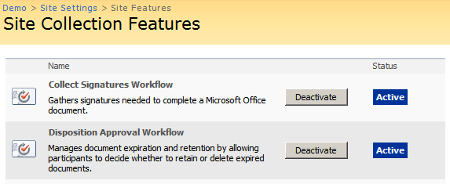
Workflow Templates
Define a type of workflow with no relationships
Installed via features and associated with site collection
Used as the template when associating workflows
Can be attached to lists or content types

Slide 7
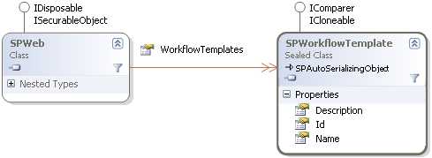
Workflow Templates
Can be referenced from the SPSite object
Can be listed using SPWeb.WorkflowTemplates
Can be filtered using SPWorkflowManager
No ability to add or remove

Slide 8
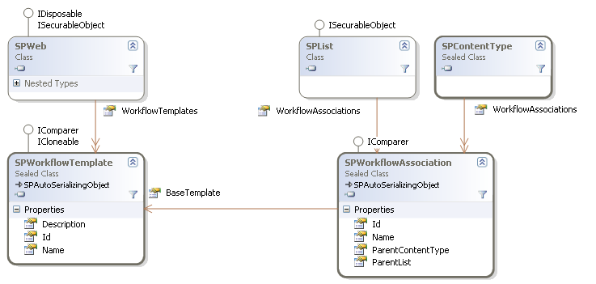
Associating Workflow Templates
Workflows can’t be started until associated
Association ties SPWorkflowTemplate to container
Association connects SPList or SPContentType
Holds association specific data

Slide 9
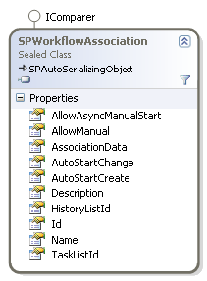
SPWorkflowAssociation
Association defined by SPWorkflowAssociation
Defines workflow association name
Defines startup conditions
Auto/Manual Startup
Defines association data
Defines the tasks and history lists
Notes:
Don’t go into details on tasks and history lists and association data

Slide 10
Association Data
Associated Workflows need parameters
Differentiates one association to another
Ex. Who is the default approver for this process?
Set using a custom string called association data
Often formatted as XML
SPWorkflowAssociation.AssociationData stores string

Slide 11
Association Data Example
<my:myFields xml:lang="en-us" xmlns:xsi=“…" xmlns:my=“…">
<my:Reviewers>
<my:Person>
<my:DisplayName></my:DisplayName>
<my:AccountId></my:AccountId>
<my:AccountType></my:AccountType>
</my:Person>
</my:Reviewers>
<my:CC></my:CC>
<my:DueDate xsi:nil="true"></my:DueDate>
<my:Description></my:Description>
<my:Title></my:Title>
<my:DefaultTaskType>1</my:DefaultTaskType>
<my:CreateTasksInSerial>true</my:CreateTasksInSerial>
<my:AllowDelegation>true</my:AllowDelegation>
<my:AllowChangeRequests>true</my:AllowChangeRequests>
<my:StopOnAnyReject xsi:nil="true"></my:StopOnAnyReject>
<my:WantedTasks xsi:nil="true"></my:WantedTasks>
<my:SetMetadataOnSuccess>false</my:SetMetadataOnSuccess>
<my:MetadataSuccessField></my:MetadataSuccessField>
<my:MetadataSuccessValue></my:MetadataSuccessValue>
<my:ApproveWhenComplete>false</my:ApproveWhenComplete>
<my:TimePerTaskVal xsi:nil="true"></my:TimePerTaskVal>
<my:TimePerTaskType xsi:nil="true"></my:TimePerTaskType>
<my:Voting>false</my:Voting>
<my:MetadataTriggerField></my:MetadataTriggerField>
<my:MetadataTriggerValue></my:MetadataTriggerValue>
<my:InitLock>false</my:InitLock>
<my:MetadataStop>false</my:MetadataStop>
<my:ItemChangeStop>false</my:ItemChangeStop>
<my:GroupTasks>false</my:GroupTasks>
</my:myFields>

Slide 12
Tasks and History lists
Running workflow needs to store information
Tasks to define user interaction
History to log key events
All stored in special SharePoint lists

Slide 13
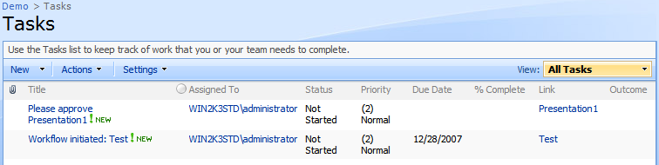
Task Lists
List defined using the Tasks list template
List type of SPListTemplateType.Tasks
List template Id of 107
// create the list
Guid listId = m_web.Lists.Add(
name, string.Empty, SPListTemplateType.Tasks);
// commit the changes
m_web.Update();

Slide 14
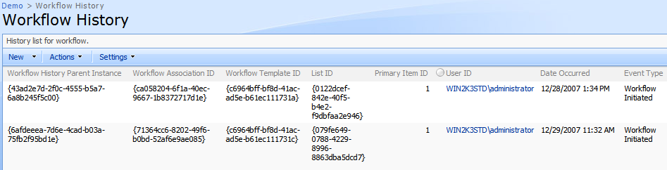
History Lists
List defined using the WorkflowHistory template
List type of SPListTemplateType.WorkflowHistory
List template Id of 140
// create the list
Guid listId = m_web.Lists.Add(
name, string.Empty, SPListTemplateType. WorkflowHistory);
// commit the changes
m_web.Update();

Slide 15
Creating Workflow Associations
Done using SPList.AddWorkflowAssociation
Verify tasks and history lists are available
Find the workflow template to use
Create a new SPWorkflowAssociation
Optionally assign new association data
// create the association
SPWorkflowAssociation result =
SPWorkflowAssociation.CreateListAssociation(template, txtName.Text,
taskList, historyList);
result.AssociationData = associationData;
// add the association to the list
list.AddWorkflowAssociation(result);
list.Update();
Notes:
Mention not to forget list.Update();

Slide 16
Demo: Associating Workflows

Slide 17
Starting workflow instances
All running workflows are tied to a list item
Workflows available tied to item’s list or content type
Start using SPWorkflowManager.StartWorkflow
Requires list item, association, and init data
SPListItem listItem = ...;
SPWorkflowAssociation association =
list.WorkflowAssociations.
GetAssociationByName("Approval",
CultureInfo.CurrentCulture);
SPWorkflow workflow =
site.WorkflowManager.StartWorkflow(
listItem, association, initiationData);
Notes:
Now that we have a workflow associated with a list or content type, let’s start a workflow instance

Slide 18
Initiation Data
Workflow instances require parameters as well
Just like association data in concept
Custom string passed directly to the workflow
Often formatted XML

Slide 19
Initiation Data Example
<my:myFields xml:lang="en-us" xmlns:xsi=“…" xmlns:my=“…">
<my:Reviewers>
<my:Person>
<my:DisplayName>WIN2K3STD\administrator</my:DisplayName>
<my:AccountId>WIN2K3STD\administrator</my:AccountId>
<my:AccountType>User</my:AccountType>
</my:Person>
</my:Reviewers>
<my:CC></my:CC>
<my:DueDate xsi:nil="true"></my:DueDate>
<my:Description></my:Description>
<my:Title></my:Title>
<my:DefaultTaskType>1</my:DefaultTaskType>
<my:CreateTasksInSerial>true</my:CreateTasksInSerial>
<my:AllowDelegation>true</my:AllowDelegation>
<my:AllowChangeRequests>true</my:AllowChangeRequests>
<my:StopOnAnyReject xsi:nil="true"></my:StopOnAnyReject>
<my:WantedTasks xsi:nil="true"></my:WantedTasks>
<my:SetMetadataOnSuccess>false</my:SetMetadataOnSuccess>
<my:MetadataSuccessField></my:MetadataSuccessField>
<my:MetadataSuccessValue></my:MetadataSuccessValue>
<my:ApproveWhenComplete>false</my:ApproveWhenComplete>
<my:TimePerTaskVal xsi:nil="true"></my:TimePerTaskVal>
<my:TimePerTaskType xsi:nil="true"></my:TimePerTaskType>
<my:Voting>false</my:Voting>
<my:MetadataTriggerField></my:MetadataTriggerField>
<my:MetadataTriggerValue></my:MetadataTriggerValue>
<my:InitLock>false</my:InitLock>
<my:MetadataStop>false</my:MetadataStop>
<my:ItemChangeStop>false</my:ItemChangeStop>
<my:GroupTasks>false</my:GroupTasks>
</my:myFields>

Slide 20
Demo: Initiating Workflows

Slide 21
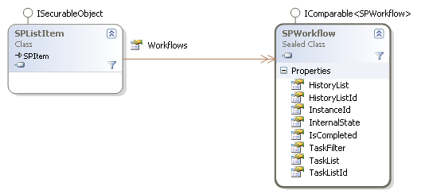
SPWorkflow Object
Running workflows represented by SPWorkflow
Can be found in SPListItem.Workflows list
Can also be found using SPWorkflowManager
Provides access to state, tasks, and other details

Slide 22
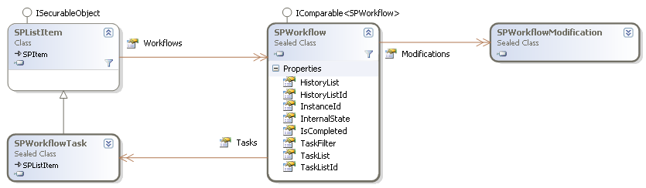
Workflow Status
Once the workflow is running, status is available
SPWorkflow object allows status access
Can provide basic workflow stats
Can provide a list of tasks and history events
Can provide access to available modifications

Slide 23
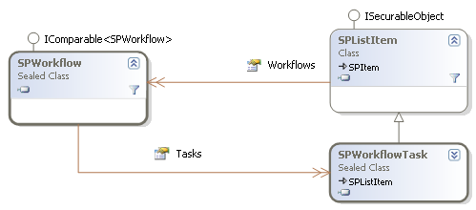
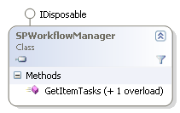
Current Tasks
Tasks related to the workflow are provided
Accessible using tasks list and filter
List of tasks available via
SPWorkflow.Tasks
SPWorkflowManager.GetItemTasks

Slide 24
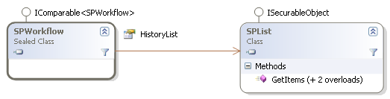
Current History
History related to the workflow is provided
No simple property that filters the history list
Accessible using history list and query
<Where>
<Eq>
<FieldRef Name="WorkflowInstance“ />
<Value Type="Text">
{00000000-0000-0000-0000-000000000000}
</Value>
</Eq>
</Where>

Slide 25
Current History Query
Get history for workflow using SPList.GetItems
SPQuery query = new SPQuery();
query.Query =
"<Where>" +
"<Eq>" +
"<FieldRef Name=\"WorkflowInstance\" />" +
"<Value Type=\"Text\">" +
workflow.InstanceId.ToString() +
"</Value> " +
"</Eq>" +
"</Where>";
SPListItemCollection history =
workflow.HistoryList.GetItems(query);

Slide 26
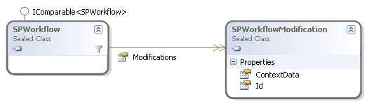
Workflow Modifications
Available modifications are stored in SPWorkflow
Accessed via SPWorkflow.Modifications
Stored in SPWorkflowModification class
Only contains ID and ContextData

Slide 27
Displaying Available Modifications
SPWorkflowModification only contains an Id
Id represents a predefined modification point
Metadata describing modification stored in template
Accessed using specially formatted property names
Name – Modification_ModID_Name
SPWorkflow workflow = …;
SPWorkflowTemplate template =
workflow.ParentAssociation.BaseTemplate;
SPWorkflowModification modification;
foreach (modification in workflow.Modifications)
Console.WriteLine(
template[
"Modification_" + modification.Id.ToString() + "_Name"]);

Slide 28
SPWorkflowModification ContextData
Once a modification is made changes are stored
SPWorkflowModification.ContextData stores changes
Up to the form implementer to store changes
Up to the workflow implementer to use changes

Slide 29
Demo: Workflow Status

Slide 30
Updating Workflow Associations
Done using UpdateWorkflowAssociation method
Available in SPList and SPContentType
SPWorkflowAssociation association = …;
// update the association
association.ParentList.
UpdateWorkflowAssociation(association);

Slide 31
Removing Workflow Association
Done using RemoveWorkflowAssociation method
Available in SPList and SPContentType
SPWorkflowAssociation association = …;
// remove the association
association.ParentList.RemoveWorkflowAssociation(association);
association.ParentList.Update();

Slide 32
Summary
Overview of Workflow API
Associating workflow templates
Initiating workflows
Accessing running instances using the API

