Slide 1
Developing SharePoint Workflow Templates with Visual Studio 2008
Developing SharePoint Workflow Templates with Visual Studio

Slide 2
Agenda
Create a simple workflow in VS 2008
Installing workflow using features
Pass startup parameters to workflows
Build state machine workflows in WSS
Handle item change events in workflow

Slide 3
WSS Workflow Templates
Made up of several parts
Workflow assembly
Feature definition
Workflow forms
Workflow Template
Custom
Forms
Workflow Assembly
Feature
XML
Notes:
This lecture will focus on

Slide 4
What makes up a workflow assembly?
Workflow assembly contains all used by workflow
Workflow classes
Feature activation handlers
Code behind for forms
Any other supporting code
Workflow assembly must be deployed in GAC

Slide 5
Packaging Workflow Templates
Feature definition packages assembly and forms
Feature scoped at Site level
Workflow element ties a name to workflow class
Also Defines any form overrides
<Workflow
Name="Hello World Workflow"
Description="My Hello World Workflow"
Id="59dd0352-c8be-4e08-9e0e-3c6a91fa18ec"
CodeBesideClass="WssHelloWorldWorkflow.HelloWorld"
CodeBesideAssembly="WssHelloWorldWorkflow, ...">
<Categories />
<MetaData />
</Workflow>

Slide 6
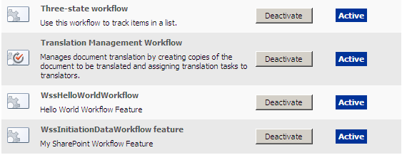
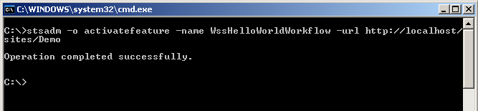
Installing Workflow Template
Feature activation adds workflow templates
Activated via UI or stsadm
Represented as SPWorkflowTemplate
Related to SPWebs within the site feature activated in

Slide 7
Demo: WSS Hello World Workflow
Build and install simple workflow that writes to event log
Done using custom workflow project, no VS integration
Notes:
Create workflow project
Create feature.xml and workflow.xml file
Create simple workflow
Add assembly to gac
Copy feature to features folder
Install and activate the feature
Associate the feature

Slide 8
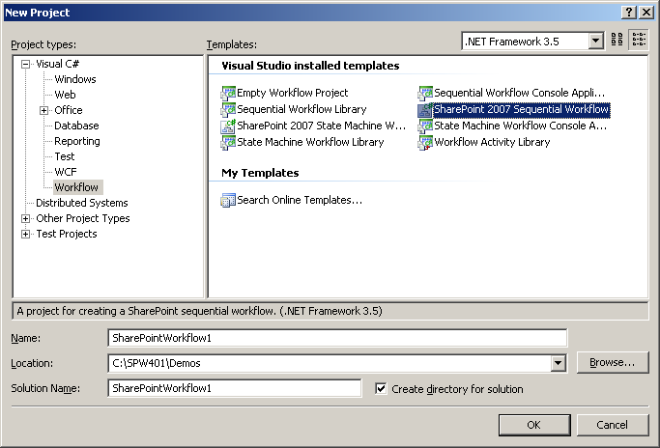
Visual Studio 2008 WSS Workflow
Visual Studio 2008 adds WSS Workflow Project
Provides feature related files
Provides facilities to automatically deploy workflows
Automatically associates workflow to a list

Slide 9
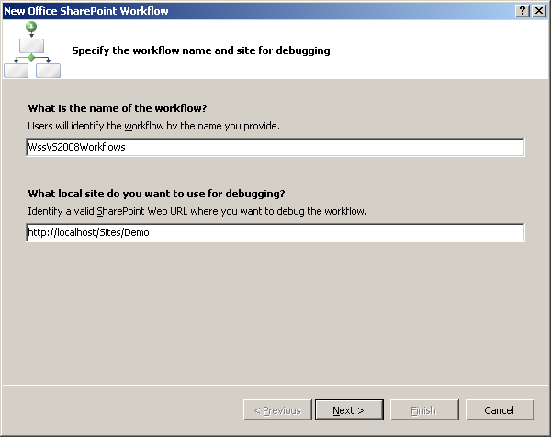
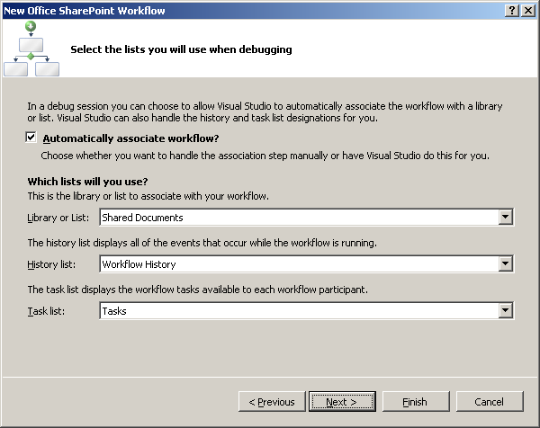
Creating VS2008 Workflow Project
Requires key information about workflow
Workflow name and site path required
Allows automatic association to an existing list
Requires list name, task list, history list

Slide 10
VS2008 Workflow Project
Completed project is WSS Specific
Contains Feature.xml and Workflow.xml
Contains user properties in Project.csproj.user
Used to deploy and associate the workflow
<Project xmlns="http://schemas.microsoft.com/developer/msbuild/2003">
<ProjectExtensions>
<VisualStudio>
<FlavorProperties GUID="{…}" xmlns="">
<DisplayName>WSSHelloWorldWorkflow</DisplayName>
<SiteURL>http://…/Docs</SiteURL>
<ListURL>http://…/Docs/Documents/Forms/AllItems.aspx</ListURL>
<TargetList Id="{…}">Documents</TargetList>
<HistoryList Id="{…}">Workflow History</HistoryList>
<TaskList Id="{…}">Tasks</TaskList>
...
</FlavorProperties>
</VisualStudio>
</ProjectExtensions>
</Project>
Notes:
Focus on the fact that the parameters for WSS deployment are user specific.

Slide 11
Demo: VS2008 Workflow Project
Do the hello world again with project type

Slide 12
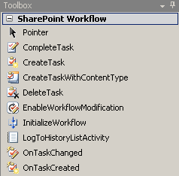
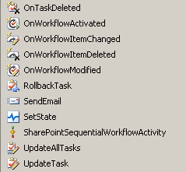
SharePoint Workflow Activities
Integration with SharePoint done via activities
Communicate with host via ExternalDataExchange
Focused around workflow, task, and workflow item

Slide 13

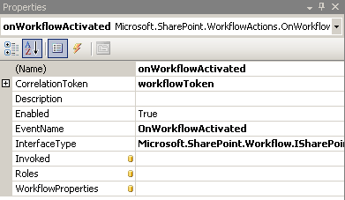
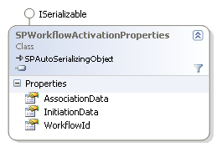
OnWorkflowActiviated Activity
All SharePoint workflows start with this activity
Derived from HandleExternalEventActivity
Used to receive SPWorkflowActivationProperties

Slide 14

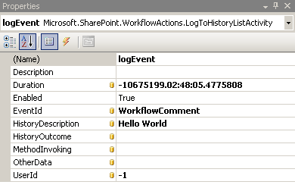
LogToHistoryList Activity
Used to log status information to the host
Implemented like CallExternalMethod
Used to log an entry to the workflow’s history list
Notes:
All parameters just map to fields in the Workflow History list.

Slide 15


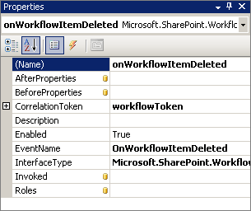
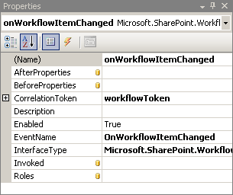
Other Workflow Item Events
Workflow can also wait for the item to change
OnWorkflowItemChanged received on item change
OnWorkflowItemDeleted received on item delete
Both contain a Hashtable of before and after properties

Slide 16
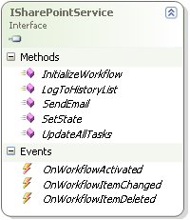
How Workflow Communication Works
Communication done using ISharePointService
Implemented by SPWinOEWSSService
Provides events needed for workflow and item activities
Also provides methods for other communication
Notes:
Focus on the LogToHistoryList method and transition into next slide

Slide 17
Passing Data to Workflow Instances
Done using AssociationData and InitiationData
AssociationData assigned at workflow association
InitiationData assigned at workflow start
Both strings, often passed as xml
<my:myFields xmlns:xsi="http://www.w3.org/2001/XMLSchema-instance"
xmlns:my="http://schemas.microsoft.com/office/infopath/2003/myXSD">
<my:Reviewers>
<my:Person>
<my:DisplayName>WIN2K3STD\administrator</my:DisplayName>
<my:AccountId>WIN2K3STD\administrator</my:AccountId>
<my:AccountType>User</my:AccountType>
</my:Person>
</my:Reviewers>
<my:CC></my:CC>
<my:DueDate xsi:nil="true"></my:DueDate>
...
</my:myFields>

Slide 18
Building InitiationData
Often formatted using serialized classes
Define classes storing initiation data
Use XmlSerializer to convert classes to XML
[Serializable]
public class StartupData
{
public string Message { get; set; }
public static string Serialize(StartupData value)
{
XmlSerializer serializer =
new XmlSerializer(typeof(StartupData));
using (StringWriter writer = new StringWriter())
{
serializer.Serialize(writer, value);
return writer.ToString();
}
}
}

Slide 19
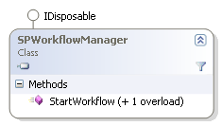
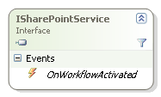
Sending InitiationData
Sent using SPWorkflowManager.StartWorkflow
String representing serialized initiation data sent
Starts workflow instance and sends data via event
Init Data
Init Data

Slide 20
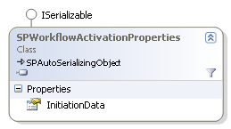
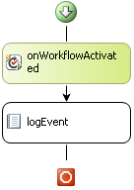
Receiving InitiationData
Received via OnWorkflowActivated activity
First activity in workflow is OnWorkflowActivated
Receives event from the host containing initiation data
Init Data

Slide 21
Deserializing InitiationData
InitiationData received as string and deserialized
String data deserialized via XmlSerializer
Converts string xml into classes
[Serializable]
public class StartupData
{
public string Message { get; set; }
public static StartupData Deserialize(string value)
{
XmlSerializer serializer =
new XmlSerializer(typeof(StartupData));
using (StringReader reader = new StringReader(value))
return serializer.Deserialize(reader) as StartupData;
}
}

Slide 22
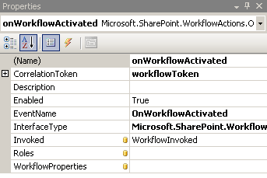
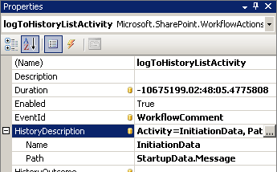
Verifying InitiationData
Write initiation parameters to the event log
Receive and deserialize initiation data
Write data to the event log
private void WorkflowInvoked(object sender, ExternalDataEventArgs e) {
try {
this.StartupData = StartupData.Deserialize(
onWorkflowActivated.WorkflowProperties.InitiationData);
}
catch {
StartupData = new StartupData();
this.StartupData.Message = "No startup data provided.";
}
}

Slide 23
Demo: Using InitiationData

Slide 24

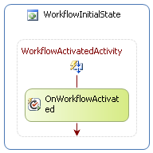
Creating WSS State Machines
State Machines can be used in WSS
Same requirements as SequentialWorkflows exists
Workflows start with OnWorkflowActivated activity
Usually done with an EventDriven activity in start state

Slide 25
Demo: WSS State Machine
Do demo that shows startup parameters and item changing

Slide 26
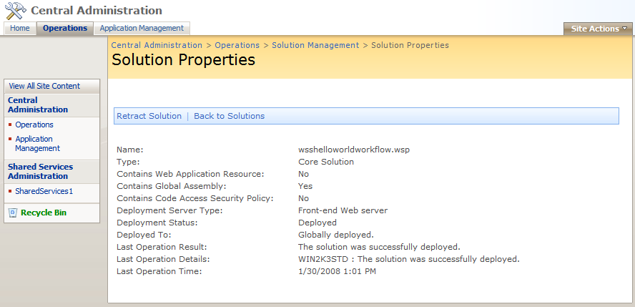
Deploying Workflows
Features don’t handle entire deployment
Need a way to copy files, register files in GAC
Solution packages are the solution
Installed using stsadm

Slide 27
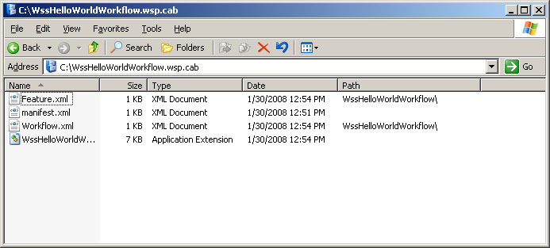
Solution Package structure
Solution packages are single .wsp files
Just renamed .cab files
Cab files contain all needed files and a manifest file
Manifest file contains instructions to install package

Slide 28
Workflow Solution Package
Manifest contains references to all files
Installs DLL in the GAC
Copies .aspx files to Layouts folder
Copies features into Features folder
Installs features

Slide 29
Workflow Solution Manifest
<?xml version="1.0" encoding="utf-8" ?>
<Solution SolutionId="189c9a36-a1a1-4f76-a36c-fbba6cb99fdb"
xmlns="http://schemas.microsoft.com/sharepoint/">
<FeatureManifests>
<FeatureManifest Location="WssHelloWorldWorkflow\Feature.xml" />
</FeatureManifests>
<Assemblies>
<Assembly Location="WssHelloWorldWorkflow.dll“
DeploymentTarget="GlobalAssemblyCache"/>
</Assemblies>
</Solution>

Slide 30
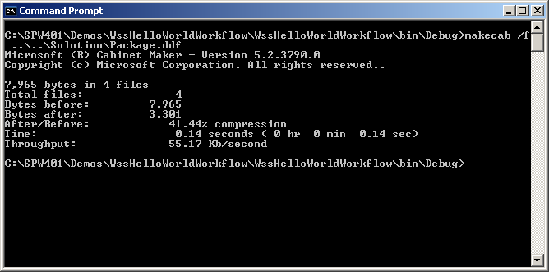
Creating the solution Package
Packaged into cab using makecab.exe
Requires DDF file
DDF file contains list of files to package
Each file contains a source and destination path

Slide 31
Workflow Solution DDF
.OPTION EXPLICIT ; Generate errors
.Set CabinetNameTemplate=WssHelloWorldWorkflow.wsp
.set DiskDirectoryTemplate=CDROM ; All cabinets go in a single directory
.Set CompressionType=MSZIP;** All files are compressed in cabinet files
.Set UniqueFiles="ON"
.Set Cabinet=on
.Set DiskDirectory1=Package
..\..\Solution\Manifest.xml manifest.xml
..\..\Template\Features\WssHelloWorldWorkflow\Feature.xml WssHelloWorldWorkflow\Feature.xml
..\..\Template\Features\WssHelloWorldWorkflow\Workflow.xml WssHelloWorldWorkflow\Workflow.xml
WssHelloWorldWorkflow.dll WssHelloWorldWorkflow.dll

Slide 32
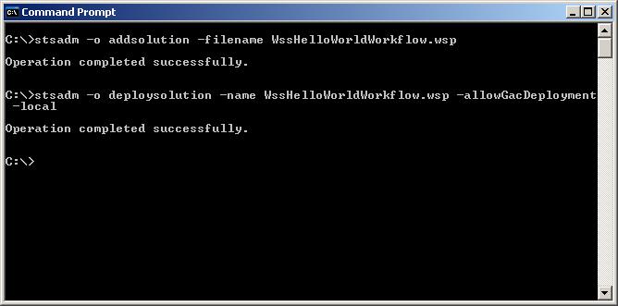
Installing the solution package
Installation is made up of two steps
stsadm –o addsolution –filename Package.wsp
stsadm –o deploysolution –name Package.wsp
Use –allowgacdeployment to authorize GAC install
Use –local or –immediate to deploy now

Slide 33
Integrating Solution into Build
Often integrated into post build steps
Post build runs makecab.exe
Deploy configuration runs stsadm to install and deploy
Some open source packages under development
WSPBuilder - http://www.codeplex.com/wspbuilder
Generates solution based on files in folders
WSP Proj - http://www.codeplex.com/wspprojecttemplate
Project template that generates manifest and ddf
Stsdev - http://www.codeplex.com/stsdev
Generates simple VS Project files

Slide 34
Summary
Create a simple workflow in VS 2008
Installing workflow using features
Pass startup parameters to workflows
Build state machine workflows in WSS
Handle item change events in workflow

