Slide 1
Creating and Waiting on SharePoint Tasks
Developing SharePoint Workflow Templates with Visual Studio

Slide 2
Agenda
Discuss workflow/task interaction
Create a simple workflow using tasks
Add a custom form a task

Slide 3
Task Responsibilities
Tasks are SharePoint’s way of user interaction
WSS responsible for managing tasks
Workflow responsible for passing data to tasks
Workflow responsible for reacting to task changes
Workflow
SharePoint
CreateTask Activity
Create List Item
OnTaskChanged Event
List Item Updated
Processing
CompleteTask Activity
Remove List Item

Slide 4
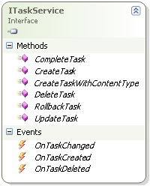



Workflow/WSS Task Interaction
WF\WSS interaction done via activities
CreateTask and CompleteTask used to manage tasks
OnTaskChanged used to wait for task changes
All methods use ITaskService interface

Slide 5
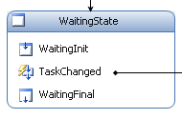
Common Task Scenario
Waiting State
State init creates a task
Waits for task changed event
Transitions out of state if task was completed
State finalization completes or deletes a task

Slide 6
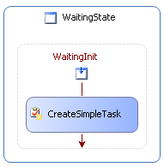
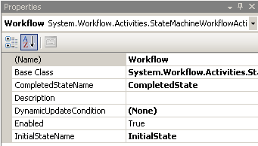
Creating the Task
Done using CreateTask activity
Requires correlation token
Requires task ID
Requires task specific properties

Slide 7

CreateTask Correlation Token
Correlation token defines activity relationships
Token initialized in CreateTask activity
Used later to wait or act on the task created
Often scoped at the state
Can’t be used outside the state
Allows state to be re-enterable
Notes:
If the correlation token is scoped to the state, it is recreated each time the state is entered. This means that the correlation token can’t be used outside the event, but it does allow the state to be reentered. If the correlation token is scoped at the workflow, if the state is reentered the correlation token is initialized again causing an error.

Slide 8

CreateTask TaskId
TaskId required for task related activities
Stored as a Guid
Used to initialize the correlation token
Often stored as a workflow property
Initialized prior to CreateTask execution
CreateTask activity bound to the property
public Guid TaskId { get; set; }
this.TaskId = Guid.NewGuid();

Slide 9
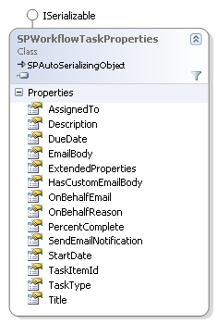
CreateTask TaskProperties
Defines the details of an activity
Stored as SPWorkflowTaskProperties
Contains title, description, assigned to, etc…
Allows addition of extra data using ExtendedPropertes
Only needed while activity executes
Notes:
Lead into the concept of having to create workflow properties to store data that will be serialized even though it’s only needed for a limited time. Transition into a better way of creating the options.

Slide 10
Assigning TaskProperties Explicitly
Storing task properties in workflow wasteful
Why not create them only when needed?
Can’t we just assign the properties in constructor?
Not always. Sometimes the activities are copied.
Solution; handle MethodInvoking event and use sender
private void CreateSimpleTask_Invoking(object sender, EventArgs e) {
TaskId = Guid.NewGuid();
CreateTask activity = sender as CreateTask;
activity.TaskProperties = new SPWorkflowTaskProperties();
activity.TaskProperties.AssignedTo = "Administrator";
activity.TaskProperties.Title = "Simple Task";
activity.TaskProperties.Description = "Complete this simple task.";
}
Notes:
Focus of this slide is to show that using myCreateTask.TaskProperties won’t work since it may not be the same actual object as the one being used. The better solution is to cast the sender property of the CreateTask’s MethodInvoking event and set its TaskProperties value. This allows the TaskProperties object to be transitory and only exist while it is needed.

Slide 11
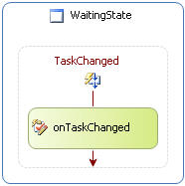
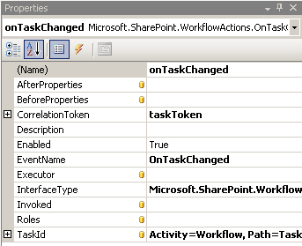
Waiting for task changes
Done using OnTaskChanged event activity
Waits for ITaskService.OnTaskChanged event
Initialized using correlation token
Doesn’t flag task as complete, that’s up to the workflow

Slide 12
Accessing Task Properties
Properties available in OnTaskChanged activity
BeforeProperties contain properties before changes
AfterProperties contain properties after changes
Both exposed as SPWorkflowTaskProperties
Can be bound or accessed directly using Invoked event
private void TaskChanged_Invoked(object sender,
ExternalDataEventArgs e)
{
SPTaskServiceEventArgs args = e as SPTaskServiceEventArgs;
string state = args.afterProperties.ExtendedProperties["..."];
/* Code operating on task state */
}

Slide 13
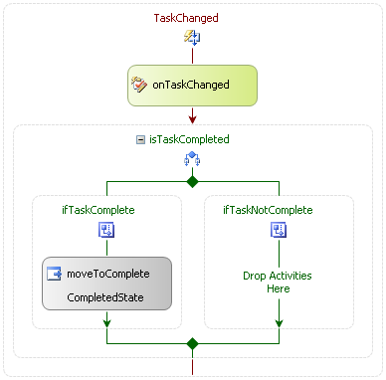
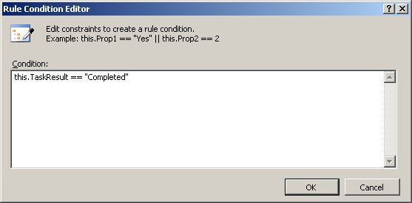
Using Task Properties
Decisions made by workflow based on properties
“Status” property often used to determine next steps
Notes:
The purpose of this slide is to indicate that there’s no automatic connection between task properties and actions. It’s up to the workflow developer to examine the output properties of the task and use activities to react to them.

Slide 14
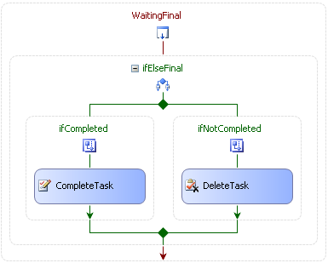
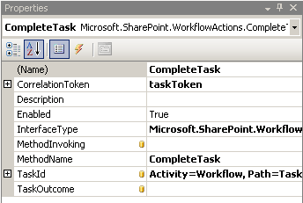

Completing/Deleting Tasks
Done using CompleteTask or DeleteTask activity
Both require CorrelationToken and TaskId
Often used in state finalization activity
Notes:
How would we leave the stat if the task wasn’t completed? What if another state transition is introduced such as the document changed transition? This could cause the state to transition back into the waiting state and essentially reset the process. In this case the finalizer for the state would be called again and then the initializer. This would delete the task and then recreate it.

Slide 15
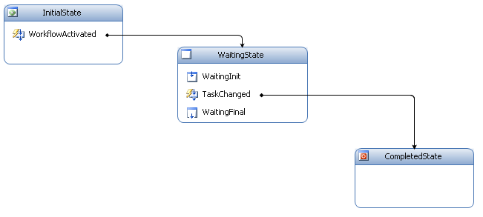
Demo: Using Tasks in State Machine
Build a simple state machine that creates tasks
Wait until the task is completed

Slide 16
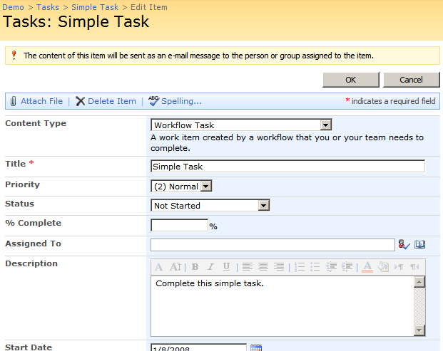
Custom Task Forms
Default task forms aren’t enough
Very generic, no task specific information
No way to use custom extended properties
Notes:
Discuss how to solve the problem. All tasks are just list items in the Tasks list. We can change the display and edit for the list but the changes will apply to all tasks. We need some way to differentiate between types of tasks in the same lists. Leads into the next slide.

Slide 17
Content Type Forms
Content types used to differentiate task types
Each task created has a specific content type
Custom task content types have custom forms
Content type forms defined in feature
http://schemas.microsoft.com/sharepoint/v3/contenttype/forms/url
<ContentType ID="0x0108010021EAE10FFD704A418A504B340DEA68BE" Name=“…"
Group=“…" Description=“…" Version="0" Hidden="False">
<FieldRefs />
<XmlDocuments>
<XmlDocument NamespaceURI ="http://...">
<FormUrls xmlns="http://...">
<Edit>_layouts/WssDemo/CustomFormsTaskForm.aspx</Edit>
<Display>_layouts/WssDemo/CustomFormsTaskForm.aspx</Display>
</FormUrls>
</XmlDocument>
</XmlDocuments>
</ContentType>

Slide 18
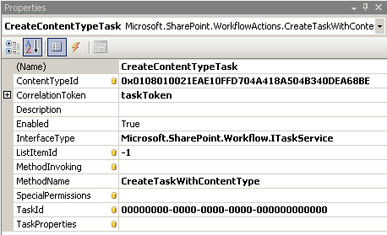

Using Task Content Types
Two ways of defining task content type
Default content type id defined in workflow feature
Content type set in CreateTaskWithContentType
Done with ContentTypeId property
<Workflow ...
TaskListContentTypeId="0x0108010021EAE10FFD704A418A504B340DEA68BE">
...
</Workflow>

Slide 19
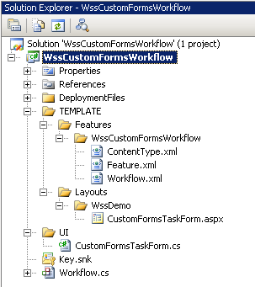
Building Custom Task Forms
Task forms are aspx pages
Visual Studio doesn’t support forms directly
Markup and Code-Behind connected manually
Page Markup
Page Code-Behind
Notes:
Discuss how no design environment exists so we need to break the page into two parts that we’ll tie together later. Transition into

Slide 20
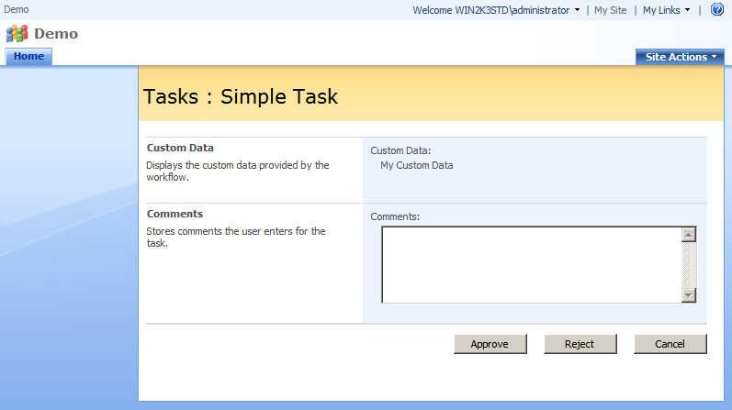
Page Visual Design
WSS Provides support for common look and feel
Application.master used to provide standard “chrome”
Special UserControls used to provide layout
Content Control
Content Control
InputFormSection Control
InputFormSection Control
ButtonSection Control

Slide 21
Master Page and Code Behind
ASPX Page directive defines page properties
Defines master page
Defines code behind class
Assembly directive references workflow assembly
<%@ Assembly Name="WssCustomFormsWorkflow, ..." %>
<%@ Page Language="C#" MasterPageFile="~/_layouts/application.master“
Inherits="WssCustomFormsWorkflow.UI.CustomFormsTaskForm" %>

Slide 22
WSS Layout User Controls
Controls used by WSS to define look and feel
Provides simple standard structure
Rendered HTML decorated with standard CSS classes
Registered on each page using Register directive
<%@ Register TagPrefix="wssuc" TagName="InputFormSection"
Src="/_controltemplates/InputFormSection.ascx" %>
<%@ Register TagPrefix="wssuc" TagName="InputFormControl"
Src="/_controltemplates/InputFormControl.ascx" %>
<%@ Register TagPrefix="wssuc" TagName="ButtonSection"
Src="/_controltemplates/ButtonSection.ascx" %>

Slide 23

WSS Layout User Controls
<wssuc:InputFormSection Title="Custom Data" Description=“...” runat="server">
<template_inputformcontrols>
<wssuc:InputFormControl LabelText="Custom Data:" runat="server">
<Template_Control>
<asp:Label ID="lblCustomData" runat="server" />
</Template_Control>
</wssuc:InputFormControl>
</template_inputformcontrols>
</wssuc:InputFormSection>

Slide 24
WSS Layout User Controls
<wssuc:ButtonSection runat="server" ShowStandardCancelButton="false">
<template_buttons>
<asp:PlaceHolder runat="server">
<asp:Button ID="btnApprove" Text="Approve“ UseSubmitBehavior="false"
class="ms-ButtonHeightWidth" OnClick="Approve_Click"
runat="server" />
&nbsp;
<asp:Button ID="btnReject" Text="Reject" UseSubmitBehavior="false"
class="ms-ButtonHeightWidth" OnClick="Reject_Click"
runat="server" />
&nbsp;
<asp:Button ID="btnCancel" Text="Cancel" UseSubmitBehavior="false"
class="ms-ButtonHeightWidth" OnClick="Cancel_Click"
runat="server" />
</asp:PlaceHolder>
</template_buttons>
</wssuc:ButtonSection>

Slide 25
Form Code-Behind
Task forms are provided a set of URL parameters
Parameters determine the list and id of the task item
List and task item used to find the workflow
Lookup often done in OnLoad event
protected override void OnLoad(EventArgs e)
{
_taskList = Web.Lists[new Guid(Request.Params["List"])];
_taskItem = _taskList.GetItemById(int.Parse(Request.Params["ID"]));
_workflow = new SPWorkflow(Web,
new Guid(_taskItem["WorkflowInstanceID"] as string));
_task = _workflow.Tasks[0];
_list = Web.Lists[_workflow.ListId];
...
}

Slide 26
Populating the Form
The Task SPListItem used to populate data
SPListItem fields can be accessed direction
Extended properties accessed with SPWorkflowTask
protected override void OnLoad(EventArgs e)
{
...
if (!IsPostBack)
{
Hashtable extendedProperties =
SPWorkflowTask.GetExtendedPropertiesAsHashtable(_taskItem);
lblCustomData.Text =
extendedProperties["CustomData"] as string;
}
...
}

Slide 27
Closing the Form
User can close form in multiple ways
All ways of closing the form are task specific
Ex. Approve, Reject, Delegate, Cancel
Code-behind sends properties back to the workflow
Page is closed by redirecting to another page
protected void Cancel_Click(object sender, EventArgs e)
{
SPUtility.Redirect(_list.DefaultViewUrl,
SPRedirectFlags.Default, this.Context);
}

Slide 28
Sending Properties to Workflow
Response sent to workflow using ExtendedProps
SPWorkflowTask.AlterTask accepts a Hashtable of data
Data contains one or more properties used by workflow
protected void Approve_Click(object sender, EventArgs e)
{
// build properties to send to workflow
Hashtable data = new Hashtable();
data.Add("Result", "Approved");
data.Add("Comments", txtComments.Text);
// update the task and redirect to list's default view
SPWorkflowTask.AlterTask(_taskItem, data, true);
SPUtility.Redirect(_list.DefaultViewUrl,
SPRedirectFlags.Default, this.Context);
}

Slide 29
Using Task Results in Workflow
Task extended properties accessible in workflow
Accessible via afterProperties
Contains a hashtable named ExtendedProperites
ExtendedProperties also contains task item columns
Accessible by list item field IDs
private void TaskChanged_Invoked(object sender, ExternalDataEventArgs e)
{
SPTaskServiceEventArgs args = e as SPTaskServiceEventArgs;
// access a named extended property
TaskResult =
args.afterProperties.ExtendedProperties["Result"] as string;
// access a list item field by id
Guid commentsId = new Guid("{52578FC3-1F01-4f4d-B016-94CCBCF428CF}");
TaskComments =
args.afterProperties.ExtendedProperties[commentsId] as string;
}

Slide 30
Demo: Adding a custom Task form
Design a custom form
Register with content type

Slide 31
Summary
Discuss workflow/task interaction
Create a simple workflow using tasks
Add a custom form a task

