Slide 1
Creating Workflow Association Forms
Developing SharePoint Workflow Templates with Visual Studio

Slide 2
Agenda
Custom Workflow Forms in SharePoint
Workflow Form Data Flow
Building & Registering Custom Association Forms
Creating/Updating Workflow Associations

Slide 3
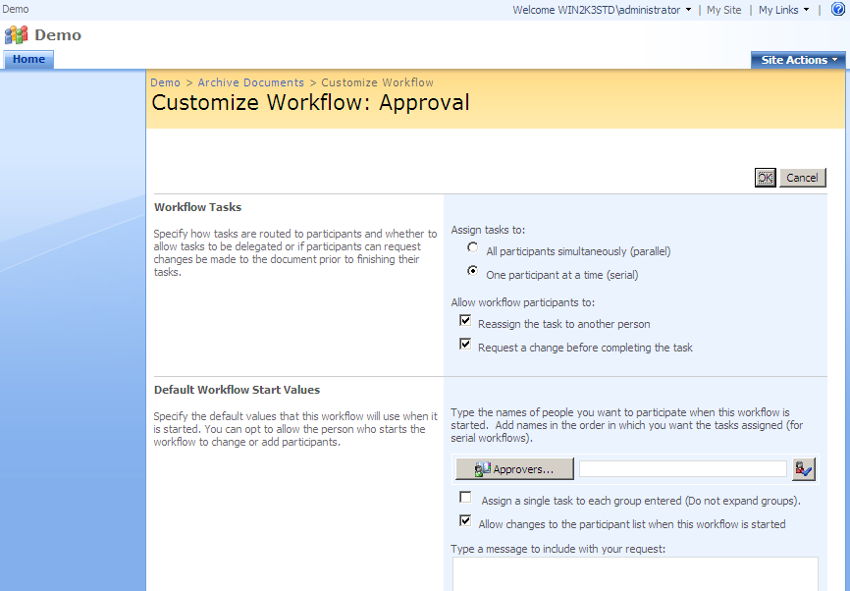
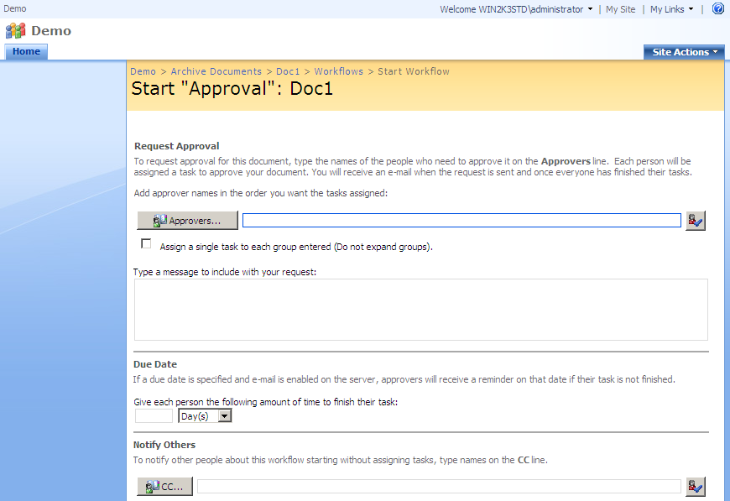
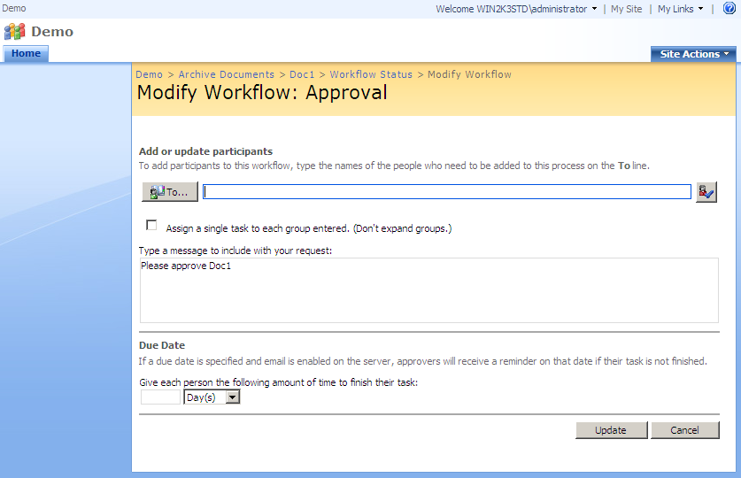
Workflow Forms
WSS Workflows reference three types of forms
Association forms for attachment to list/content type
Instantiation forms for starting workflow on a list item
Modification forms for changing settings while running
All types of forms are optional
Notes:
Note, tasks are not included here since task forms are more directly related to the content types that host them.

Slide 4
Association Forms
Displayed when associating a workflow template
Displayed after default association page
Specific to each workflow template
Often used to setup “default” parameters
Responsible for creating the SPWorkflowAssociation

Slide 5
Instantiation Forms
Displayed whenever a workflow instance started
Displayed immediately when workflow started
Specific to each workflow template
Often initialized using the association form’s data
Responsible for starting the workflow using

Slide 6
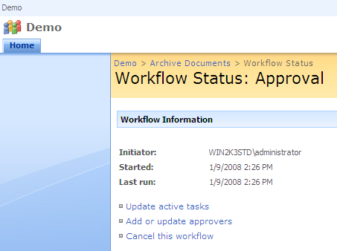
Modification Forms
Accessible from the workflow status page
Modification points registered by workflow
Links to forms displayed on status page

Slide 7


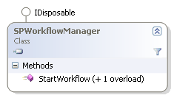
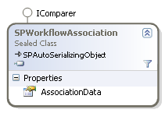
Form Data Flow
Data flows from Assoc form to Instantiation form
Assoc form data stored in SPWorkflowAssociation
Init data passed from form to SPWorkflowManager
Data passed via parameter in StartWorkflow method
Form data often formatted as XML using XmlSerializer
Assoc Form
Init Form

Slide 8
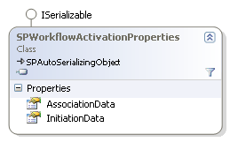
Using Form Data in Workflow
Workflow accesses Assoc and Initiation Data
Provided to workflow in OnWorkflowActivated activity
Up to the workflow developer to use data appropriately
private void onWorkflowActivated_Invoked(
object sender, ExternalDataEventArgs e)
{
SPActivationEventArgs args = e as
SPActivationEventArgs;
AssociationData assocData = AssociationData.Deserialize(
args.properties.AssociationData);
this.CustomData = assocData.DefaultCustomData;
}

Slide 9
Registering Custom Forms
Registration of custom forms done in feature
Workflow element provides form URL attributes
Form URL is used to load a custom .aspx page
If no URL is registered, no form is displayed
<Workflow
Name="Wss Custom Forms Workflow"
Description=“…
Id="3768e1f1-560e-4b95-8d60-dcbb53c37a56"
CodeBesideClass="WssCustomFormsWorkflow.Workflow"
CodeBesideAssembly="WssCustomFormsWorkflow, ..."
TaskListContentTypeId="0x0108010021EAE10FFD704A418A504B340DEA68BE"
AssociationUrl ="_layouts/WssDemo/CustomFormsAssocForm.aspx"
InstantiationUrl="_layouts/WssDemo/CustomFormsInitForm.aspx"
ModificationUrl="_layouts/WssDemo/CustomFormsModForm.aspx">
...
</Workflow>

Slide 10
Building Custom Association Form
Steps for building association forms:
Design aspx page
Create code-behind class
Initialize the UI elements
Load any existing association data
Create or Update the Workflow Association
Register the new custom form

Slide 11
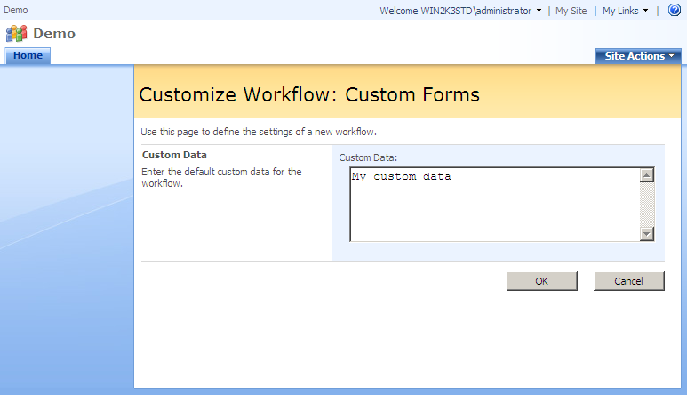
Designing Association Form ASPX
Uses the same layout concepts as task form
Uses same master page
Uses same WSS layout UserControls
Content Control
Content Control
InputFormSection Control
ButtonSection Control

Slide 12
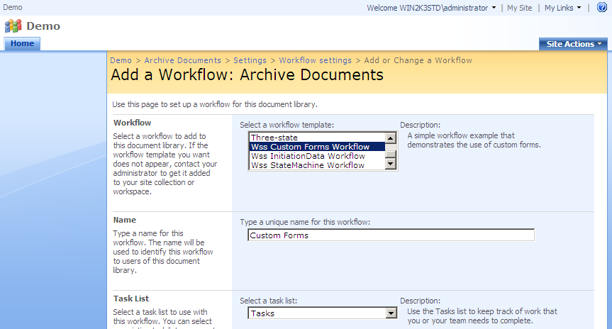
Association Forms are unique?
Association form is accessed via post back
Previous page posts to the association form
Passes key workflow information via post form
Requires some special handling by form developer
HTTP
POST

Slide 13
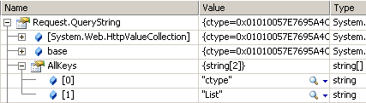
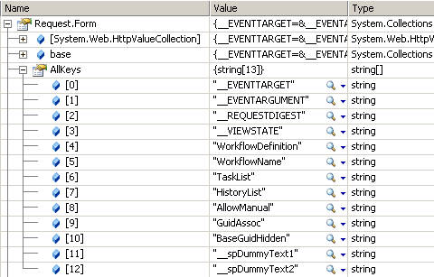
Association Form Post and URL data
Data contained in URL and Post form defines
Is this a new association or an existing association?
Is this association attached to a list or a content type?
What are the names of the tasks and history lists?
What permissions and startup handlers are used?

Slide 14
Why a POST?
Why use a HTTP POST? Why not a GET?
First step of association shouldn’t create association
All data collected on first steps must be sent
Get doesn’t allow data transmission beyond URL
Post allows more data to be transmitted easily

Slide 15
How is handling a POST different?
ASP.NET uses a postback to perform processing
Data on the page’s form posted back to current page
If not careful, the initial post’s data is lost
Solution; put the data from initial post into page’s form
<input type="hidden" name="WorkflowDefinition"
value=<%= Request.Form["WorkflowDefinition"]; %>>
<input type="hidden" name="WorkflowName"
value=<%= Request.Form["WorkflowName"]; %>>
<input type="hidden" name="AddToStatusMenu"
value=<%= Request.Form["AddToStatusMenu"]; %>>
<input type="hidden" name="AllowManual" value=<%= Request.Form["AllowManual"]; %>>
<input type="hidden" name="RoleSelect" value=<%= Request.Form["RoleSelect"]; %>>
<input type="hidden" name="AutoStartCreate"
value=<%= Request.Form["AutoStartCreate"]; %>>
<input type="hidden" name="AutoStartChange"
value=<%= Request.Form["AutoStartChange"]; %>>
<input type="hidden" name="GuidAssoc" value=<%= Request.Form["GuidAssoc"]; %>>
Notes:
After this slide, recommend that the rest of the content be covered while demoing a custom form. Due to the complexity of the code I recommend you walk through the demo as opposed to writing it from scratch.

Slide 16
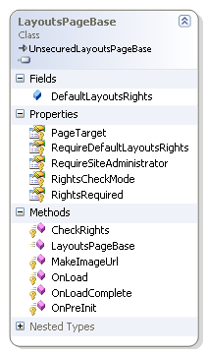
Creating Code-Behind Class
Code behind class derives from LayoutPageBase
Provides base functionality of pages in layouts folder
public class CustomFormsAssocForm :
LayoutsPageBase
{ }

Slide 17
Processing Page Parameters
Page parameters come from URL and form
Immediate focus finding association’s parent
Can be list, content type, or both
Determined with List and ctype URL parameters
protected override void OnLoad(EventArgs e) {
// read the form level parameters
string listId = this.Request.Params["List"];
string ctypeId = this.Request.Params["ctype"];
// determine the type of association
if (!string.IsNullOrEmpty(listId) && !string.IsNullOrEmpty(ctypeId))
this._associationType = AssociationType.ListContentType;
else if (!string.IsNullOrEmpty(listId) && string.IsNullOrEmpty(ctypeId))
this._associationType = AssociationType.List;
else if (string.IsNullOrEmpty(listId) && !string.IsNullOrEmpty(ctypeId))
this._associationType = AssociationType.ContentType;
...
}
Notes:
An association with a list and content type parent defined as a list specific content type

Slide 18
Create or Update Association
GuidAssoc param determines create or update
If form contains GuidAssoc, association exists
GuidAssoc used to lookup the association object
// read the form level parameters
string guidAssocId = Request.Params["GuidAssoc"];
// validate the workflow association id
Guid? workflowAssociationId = new Guid?();
if (!string.IsNullOrEmpty(guidAssocId))
workflowAssociationId = new Guid(guidAssocId);

Slide 19
Lookup existing Association
Location of association based on parent
case AssociationType.ContentType:
_contentType = Web.AvailableContentTypes[new SPContentTypeId(ctypeId)];
_workflowAssociation =
_contentType.WorkflowAssociations[workflowAssociationId.Value];
break;
case AssociationType.List:
_list = Web.Lists[new Guid(listId)];
_workflowAssociation =
_list.WorkflowAssociations[workflowAssociationId.Value];
break;
case AssociationType.ListContentType:
_list = Web.Lists[new Guid(listId)];
_contentType = _list.ContentTypes[new SPContentTypeId(ctypeId)];
_workflowAssociation =
_contentType.WorkflowAssociations[workflowAssociationId.Value];
break;

Slide 20
Storing Form parameters for later
URL and Form parameters used to load data
Form parameters won’t be available in postback
Form parameters written back into hidden fields
protected override void OnPreRender(EventArgs e) {
// register parameters in the hidden field
ClientScript.RegisterHiddenField("WorkflowName", Request.Params["WorkflowName"]);
ClientScript.RegisterHiddenField("WorkflowDefinition",
Request.Params["WorkflowDefinition"]);
ClientScript.RegisterHiddenField("AddToStatusMenu",
Request.Params["AddToStatusMenu"]);
ClientScript.RegisterHiddenField("AllowManual", Request.Params["AllowManual"]);
ClientScript.RegisterHiddenField("RoleSelect", Request.Params["RoleSelect"]);
ClientScript.RegisterHiddenField("GuidAssoc", Request.Params["GuidAssoc"]);
ClientScript.RegisterHiddenField("SetDefault", Request.Params["SetDefault"]);
ClientScript.RegisterHiddenField("HistoryList", Request.Params["HistoryList"]);
ClientScript.RegisterHiddenField("TaskList", Request.Params["TaskList"]);
ClientScript.RegisterHiddenField("UpdateLists", Request.Params["UpdateLists"]);
ClientScript.RegisterHiddenField("AutoStartCreate",
Request.Params["AutoStartCreate"]);
ClientScript.RegisterHiddenField("AutoStartChange",
Request.Params["AutoStartChange"]);
...
Notes:
By writing the form parameters back into the form being rendered, future postbacks will contain the same form parameters

Slide 21
Displaying existing Association
If association exists the UI needs to be populated
UI population usually done in OnLoad if !IsPostBack
Initial assoc form load is a postback
Solution is to initialize in OnPreRender
protected override void OnPreRender(EventArgs e)
{
// bind the association data (if any)
if (_workflowAssociation != null)
{
// deserialize the association data
AssociationData assocData = AssociationData.Deserialize(
_workflowAssociation.AssociationData);
// bind the controls to the association data
txtCustomData.Text = assocData.DefaultCustomData;
}
Notes:
Now that we’ve taken care of parsing the input parameters and found the association, we can populate the UI based on these parameters.
Discuss the problem with initializing in onload. !IsPostBack will always be false. If load is done in OnLoad, any changes from postback will be lost. Solution is to initialize in PreRender.

Slide 22
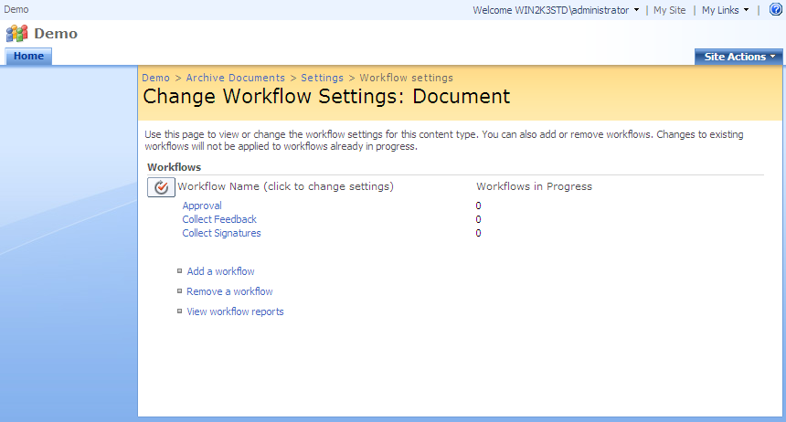
Handling Button Events
The user can click OK or Cancel to submit form
OK causes the SPWorkflowAssociation object creation
Cancel causes no object creation
Both end up redirecting back to workflow settings page

Slide 23
Handling OK Button Click Events
Create and update actions require assoc data
First step of handler is to serialize assoc data to string
Often done using a custom class and XmlSerializer
AssociationData associationData = new AssociationData();
associationData.DefaultCustomData = txtCustomData.Text;
string serializedData = associationData.Serialize();
public class AssociationData
{
public string DefaultCustomData { get; set; }
public string Serialize()
{
XmlSerializer serializer = new XmlSerializer(typeof(AssociationData));
using (StringWriter writer = new StringWriter())
{
serializer.Serialize(writer, this);
return writer.ToString();
}
}

Slide 24
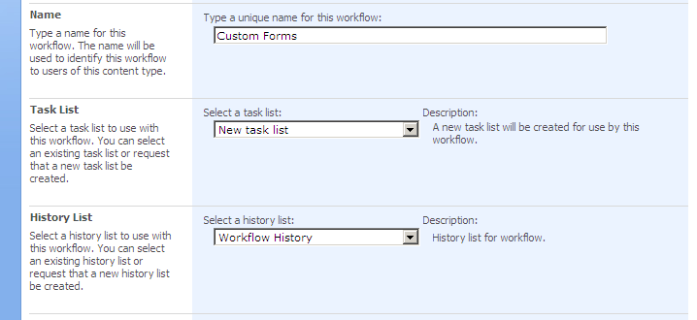
Finding/Creating Supporting Lists
Workflow associations depend on special lists
Lists store tasks and history for workflow instances
Previous page allows choice of existing or new lists
Association form responsible for finding or creating lists

Slide 25
Finding/Creating Supporting Lists
List name or ID encoded in Form parameters
If name starts with ‘z’, it’s the name of a new list
Otherwise the name is the list name or ID
If parent is list, it’s a name or ID
SPList LookupOrCreateList(string paramList, SPListTemplateType listType) {
if (paramList.StartsWith("z")) {
Guid newListId =
Web.Lists.Add(paramList.Substring(1), "Workflow Tasks",
listType);
return Web.Lists[newListId];
}
else {
return Web.Lists[new Guid(paramList)];
}
}

Slide 26
Creating or Updating Association?
Create or update based on lookup in OnLoad
If a workflow association was found, it’s an update
protected void Submit_Click(object sender, EventArgs e) {
...
// create or find the lists
SPList taskList = LookupOrCreateList(Request.Params["TaskList"],
SPListTemplateType.Tasks);
SPList historyList = LookupOrCreateList(Request.Params["HistoryList"],
SPListTemplateType.WorkflowHistory);
// create or update the workflow association
if (_workflowAssociation != null)
UpdateWorkflowAssociation(taskList, historyList,
associationData.Serialize());
else
CreateWorkflowAssociation(taskList, historyList,
associationData.Serialize());

Slide 27
Updating Existing Association
Existing SPWorkflowAssociation values updated
Values from HTTP Form and URL updated first
AssociationData from custom form updated next
// assign base workflow association information
_workflowAssociation.Name = Request.Params["WorkflowName"];
_workflowAssociation.AutoStartCreate =
(Request.Params["AutoStartCreate"] == "ON");
_workflowAssociation.AutoStartChange =
(Request.Params["AutoStartChange"] == "ON");
_workflowAssociation.AllowManual = (Request.Params["AllowManual"] == "ON");
_workflowAssociation.AssociationData = associationData;
// assign the chosen task list to the association
if (_workflowAssociation.TaskListId != taskList.ID)
_workflowAssociation.SetTaskList(taskList);
// assign the chosen history list to the association
if (_workflowAssociation.HistoryListId != historyList.ID)
_workflowAssociation.SetHistoryList(historyList);

Slide 28
Commiting Association Updates
Once changes made, they must be committed
Done with parent’s UpdateWorkflowAssociation method
switch (_associationType)
{
case AssociationType.ContentType:
// commit the changes to the existing workflow association
_contentType.UpdateWorkflowAssociation(_workflowAssociation);
break;
case AssociationType.List:
// commit the changes to the existing workflow association
_list.UpdateWorkflowAssociation(_workflowAssociation);
break;
case AssociationType.ListContentType:
// commit the changes to the existing workflow association
_contentType.UpdateWorkflowAssociation(_workflowAssociation);
break;
}

Slide 29
Creating New Associations
Done with SPWorkflowAssociation static methods
One method for each type of parent
All take similar parameters
case AssociationType.ContentType:
_workflowAssociation =
SPWorkflowAssociation.CreateSiteContentTypeAssociation(
workflowTemplate, workflowName,
taskList.Title, historyList.Title);
break;
case AssociationType.List:
_workflowAssociation = SPWorkflowAssociation.CreateListAssociation(
workflowTemplate, workflowName, taskList, historyList);
break;
case AssociationType.ListContentType:
_workflowAssociation =
SPWorkflowAssociation.CreateListContentTypeAssociation(
workflowTemplate, workflowName, taskList, historyList);
break;

Slide 30
Adding the new Association to Parent
Once new association is populated, it’s added
Each parent type has AddWorkflowAssociation method
case AssociationType.ContentType:
PopulateWorkflowAssociation(taskList, historyList, assocData);
_contentType.AddWorkflowAssociation(_workflowAssociation);
break;
case AssociationType.List:
PopulateWorkflowAssociation(taskList, historyList, assocData);
_list.AddWorkflowAssociation(_workflowAssociation);
break;
case AssociationType.ListContentType:
PopulateWorkflowAssociation(taskList, historyList, assocData);
_contentType.AddWorkflowAssociation(_workflowAssociation);
break;

Slide 31
Redirecting to Workflow Settings
On OK or Cancel handler complete, form “closes”
Closes by redirecting to WorkflowSettings page
URL parameters differ based on association parent
string url = null;
string list = Request.Params["List"];
string ctype = Request.Params["ctype"];
switch (_associationType)
{
case AssociationType.ContentType:
url = "WrkSetng.aspx?ctype=" + paramCtype;
case AssociationType.List:
url = "WrkSetng.aspx?List=" + paramList;
case AssociationType.ListContentType:
url = "WrkSetng.aspx?List=" + paramList + "&ctype=" + paramCtype;
}
SPUtility.Redirect(url, SPRedirectFlags.RelativeToLayoutsPage, this.Context);

Slide 32
ContentTypes and WF Associations
Are content type association changes inherited?
When UpdateWorkflowAssociationsOnChildren called
Association form should call if UpdateLists is true
Should be called after Add and Update call
// check whether updates to content types cascade to their lists
_updateContentTypeLists = (Request.Params["UpdateLists"] == "TRUE");
...
// update the association and update child associations
_contentType.UpdateWorkflowAssociation(_workflowAssociation);
if (_updateContentTypeLists)
_contentType.UpdateWorkflowAssociationsOnChildren(true, true, true); ... // add the association and update child associations _contentType.AddWorkflowAssociation(_workflowAssociation); if (_updateContentTypeLists) _contentType.UpdateWorkflowAssociationsOnChildren(true, true, true);

Slide 33
Demo: Custom Association Forms

Slide 34
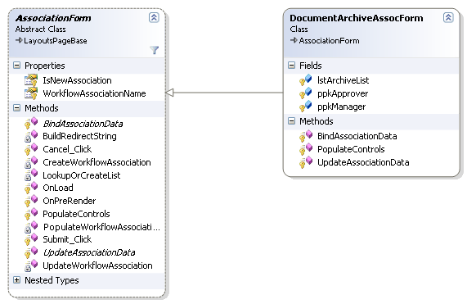
Making it Simpler
Use a standard base class
Most of the code in an association form never changes
Code that varies displays and saves form data

Slide 35
Summary
Custom Workflow Forms in SharePoint
Workflow Form Data Flow
Building & Registering Custom Association Forms
Creating/Updating Workflow Associations

