Slide 1
Creating Workflow Instantiation and Modification Forms
Developing SharePoint Workflow Templates with Visual Studio

Slide 2
Agenda
Create and Register Initiation Forms
Create Modification Forms
Register and Enable Modification Forms

Slide 3
Building Custom Initiation Forms
Steps for building initiation forms:
Design aspx page
Create code-behind class
Initialize the UI elements
Load any existing association data
Start the workflow instance
Register the new custom form

Slide 4
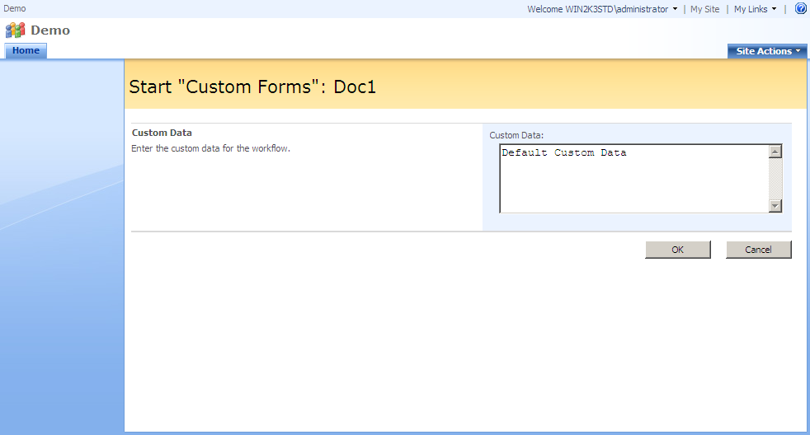
Designing Initiation Form ASPX
Uses same layout concepts as association form
Uses same master page
Uses same WSS layout UserControls
Content Control
Content Control
InputFormSection Control
ButtonSection Control

Slide 5
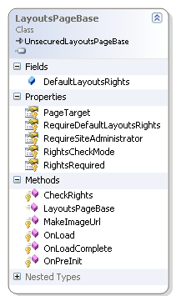
Creating Code-Behind Class
Code behind pages derive from LayoutPageBase
Provides base application page functionality
public class CustomFormsInitForm :
LayoutsPageBase
{ }

Slide 6
Processing Page Parameters
Page parameters come from URL
List and ctype define the parent of the association
ID identifies the list item the workflow instance is for
TemplateId identifies the workflow association
protected override void OnLoad(EventArgs e)
{
// read the form level parameters
string listId = Request.Params["List"];
string listItemId = Request.Params["ID"];
string ctypeId = Request.Params["ctype"];
string templateId = Request.Params["TemplateId"];
// find the list and list item
_list = Web.Lists[new Guid(listId)];
_listItem = _list.GetItemById(int.Parse(listItemId));

Slide 7
Locating the Workflow Association
Workflow association may be in two locations
Could be associated with the list
Could be associated with the content type
Easiest way to find it is check both locations
// check for the workflow association in the list
_workflowAssociation = _list.WorkflowAssociations[
new Guid(templateId)];
// if the association wasn't found, check the content type
if (_workflowAssociation == null)
{
SPContentType _contentType = _list.ContentTypes[
new SPContentTypeId(ctypeId)];
_workflowAssociation = _contentType.WorkflowAssociations[
new Guid(templateId)];
}

Slide 8
Initializing the UI
The initial page load is not caused by a postback
Much simpler than Association form
Override OnLoad event and load when !IsPostBack
protected override void OnLoad(EventArgs e)
{
...
// bind the association data (if any)
if (!IsPostBack && (_workflowAssociation != null))
{
// bind the controls to the association data
AssociationData assocData =
AssociationData.Deserialize(_workflowAssociation.AssociationData);
txtCustomData.Text = assocData.DefaultCustomData;
}

Slide 9
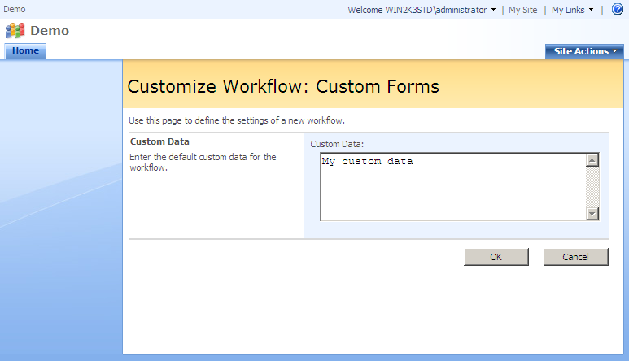
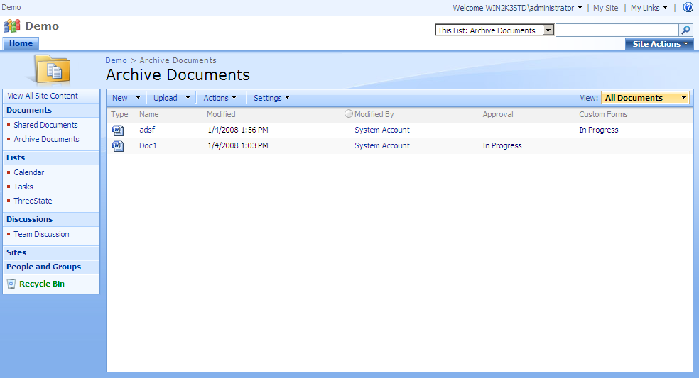
Handling Button Events
The user can click Start or Cancel to submit form
Start causes the workflow instance to start
Cancel causes no workflows to start
Both end up redirecting back to the list’s default view

Slide 10
Handling Start Button Click
Starting the workflow requires Initiation Data
Initiation data is gathered from the UI and serialized
Workflow is started using the site’s workflow manager
Requires the workflow association and list item
protected void Start_Click(object sender, EventArgs e)
{
// serialize the initiation data
InitiationData initiationData = new InitiationData();
initiationData.CustomData = txtCustomData.Text;
// start the new workflow instance
Web.Site.WorkflowManager.StartWorkflow(
_listItem, _workflowAssociation,
initiationData.Serialize());

Slide 11
Redirecting to List Default View
Start and Cancel buttons both redirect to list
Redirects to list’s default view url
protected void Cancel_Click(object sender, EventArgs e)
{
// redirect to the list default view
SPUtility.Redirect(_list.DefaultViewUrl,
SPRedirectFlags.Default, this.Context);
}

Slide 12
Registering Instantiation Forms
Registration of custom forms done in feature
Workflow element provides form URL attributes
Form URL is used to load a custom .aspx page
If no URL is registered, no form is displayed
<Workflow
Name="Wss Custom Forms Workflow"
Description=“…
Id="3768e1f1-560e-4b95-8d60-dcbb53c37a56"
CodeBesideClass="WssCustomFormsWorkflow.Workflow"
CodeBesideAssembly="WssCustomFormsWorkflow, ..."
TaskListContentTypeId="0x0108010021EAE10FFD704A418A504B340DEA68BE"
AssociationUrl ="_layouts/WssDemo/CustomFormsAssocForm.aspx"
InstantiationUrl="_layouts/WssDemo/CustomFormsInitForm.aspx"
ModificationUrl="_layouts/WssDemo/CustomFormsModForm.aspx">
...
</Workflow>

Slide 13
Demo: Custom Initiation Forms

Slide 14
Building Custom Modification Forms
Steps for building modification forms:
Design aspx page
Create code-behind class
Initialize the UI elements
Load any existing association data
Start the workflow instance
Register the new custom form
Add metadata defining link
Enable modification in workflow

Slide 15
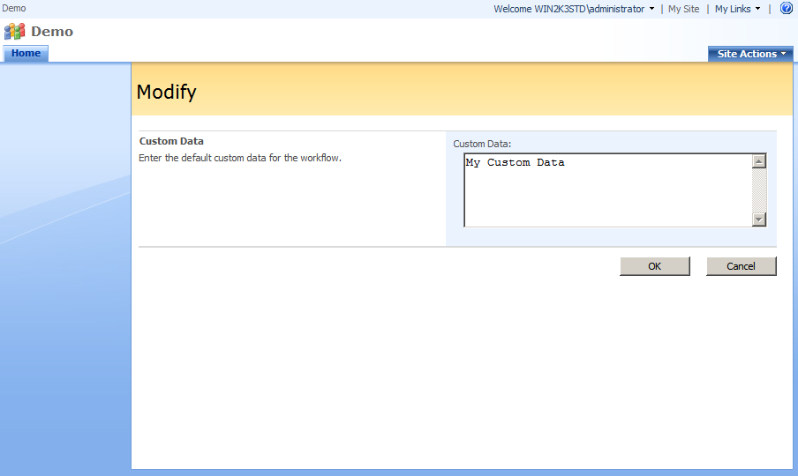
Designing Modification Form ASPX
Uses same layout concepts as association form
Uses same master page
Uses same WSS layout UserControls
Content Control
Content Control
InputFormSection Control
ButtonSection Control

Slide 16
Processing Page Parameters
Page parameters come from URL
List and ID identify the list item related to the workflow
WorkflowInstanceID identifies the workflow instance
ModificationID identifies a SPWorkflowModification
protected override void OnLoad(EventArgs e)
{
// read the form level parameters
string listId = Request.Params["List"];
string listItemId = Request.Params["ID"];
string workflowId = Request.Params["WorkflowInstanceID"];
string modificationId = Request.Params["ModificationID"];
// find the list, list item, workflow, and modification
_list = Web.Lists[new Guid(listId)];
_listItem = _list.GetItemById(Convert.ToInt32(listItemId));
_workflow = _listItem.Workflows[new Guid(workflowId)];
_modification = _workflow.Modifications[new Guid(modificationId)];

Slide 17
Initializing the UI
The initial page load is not caused by a postback
Override OnLoad event and load when !IsPostBack
Use SPWorkflowModification.ContextData to load UI
Often ContextData is XML created by XmlSerializer
protected override void OnLoad(EventArgs e)
{
...
// populate the controls
if (!IsPostBack)
{
// deserialize the association data
ModificationData modData =
ModificationData.Deserialize(_modification.ContextData);
// bind the controls to the association data
txtCustomData.Text = modData.CustomData;
}

Slide 18
Handling Button Events
The user can click OK or Cancel to submit form
OK applies modifications to workflow
Cancel causes no modifications to be made
Both end up redirecting back to the list’s default view

Slide 19
Handling OK Button Click
Changes applied using ModifyWorkflow method
Modification data gathered from UI and serialized
Workflow is modified using the site’s workflow manager
Requires SPWorkflow and SPWorkflowModification
protected void Start_Click(object sender, EventArgs e)
{
// populate the modification data using the UI
ModificationData modData = new ModificationData();
modData.CustomData = txtCustomData.Text;
// modify the workflow
Web.Site.WorkflowManager.ModifyWorkflow(
_workflow, _modification, modData.Serialize());

Slide 20
Redirecting to List Default View
Just like instantiation form, close redirects to list
Redirects to list’s default view url
protected void Cancel_Click(object sender, EventArgs e)
{
// redirect to the list default view
SPUtility.Redirect(_list.DefaultViewUrl,
SPRedirectFlags.Default, this.Context);
}

Slide 21
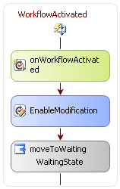
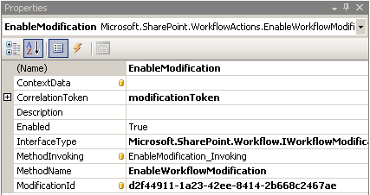
Using the Modification Form
Each type of modification identified by an ID
Used when modifications are enabled in the workflow
Specified in the EnableWorkflowModification activity
Related to a new modification correlation token
Modification ID
Notes:
Talk about how the workflow must enable modifications and how they are tied to a scope.

Slide 22
Enabling Workflow Modifications
Modification form needs data to populate form
Association or Initiation data may be out dated
Better solution is to store data in modification object
Use SPWorkflowModification.ContextData property
void EnableModification_Invoking(object sender, EventArgs e)
{
ModificationData modData = new ModificationData();
modData.CustomData = this.CustomData;
EnableWorkflowModification enableModification =
sender as EnableWorkflowModification;
enableModification.ContextData = modData.Serialize();
}

Slide 23
Registering Workflow Modifications
Registration of custom forms done in feature
Form registration isn’t only change required
The name of the modification is needed as well
Used when displaying the modification link
Name identified by Modification ID

Slide 24
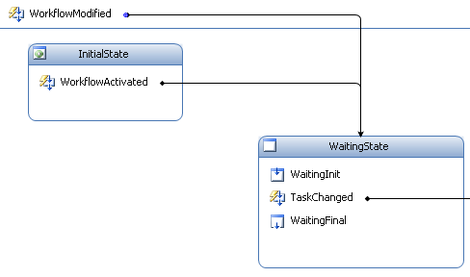
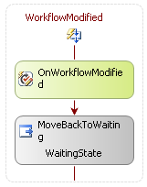
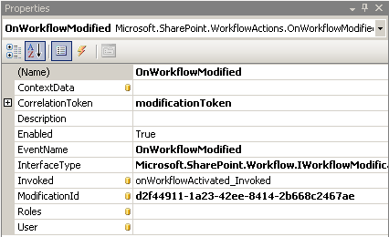
Responding to Modifications
Modifications are received via event
Received using OnWorkflowModified activity
Uses modification correlation token and modification ID
Provides the context data returned from the form
Notes:
Focus on how state machines allow events to live outside states and easily transition between the states. During demo, also point out that the transition to the state ,even though it the state is currently active causes the final and init actions to execute. This is a perfect place to cleanup.

Slide 25
Integrating Modified Data
OnWorkflowModified event returns form data
Available in the SPModificationEventArgs.data property
Can be processed in the MethodInvoked handler
private void OnWorkflowModified_Invoked(
object sender, ExternalDataEventArgs e)
{
SPModificationEventArgs args = e as SPModificationEventArgs;
ModificationData modData =
ModificationData.Deserialize(args.data);
this.CustomData = modData.CustomData;
}

Slide 26
Resetting Workflow State
Modifications often made as workflow is waiting
Tasks will most likely need to be updated
Two options
Update Task
Delete and Create Task
Notes:
Discuss the two options.

Slide 27

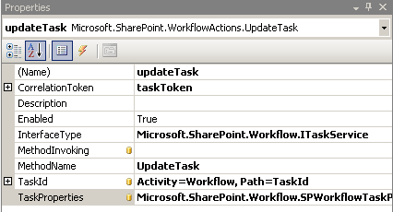
Updating Tasks
Done using the UpdateTask activities
Requires task correlation token
Can’t be done outside the token’s scope
Task updated with SPWorkflowTaskProperties object
Notes:
SPWorkflowTaskProperties is the same object used when creating the task.

Slide 28
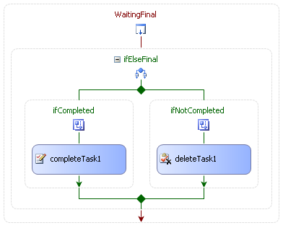
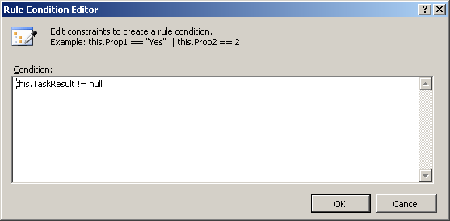
Delete and Re-create Task
Can use state initializer and finalizer
Create task in initializer
Complete or delete task in finalizer based on result
Store result when task is complete
State transition causes initializer and finalizer execution
Notes:
The goal in this scenario is to setup the state as the scope for the task. When the state is entered the task is created. When the state is left, the task is completed or deleted. The single value that determines which is the result. If for some reason we leave the state without completing the task, the task is deleted. Therefore a state transition caused by modification will cause the uncompleted outdated task to be deleted and a new current task to be created.

Slide 29
Demo: Custom Modification Forms

Slide 30
Summary
Create and Register Initiation Forms
Create Modification Forms
Register and Enable Modification Forms

