Slide 1
Integrating InfoPath Forms into SharePoint Workflow
Developing SharePoint Workflow Templates with Visual Studio

Slide 2
Agenda
Why use InfoPath?
How it works
Creating workflow forms with InfoPath
Interacting with hosting environment
Custom .NET code

Slide 3
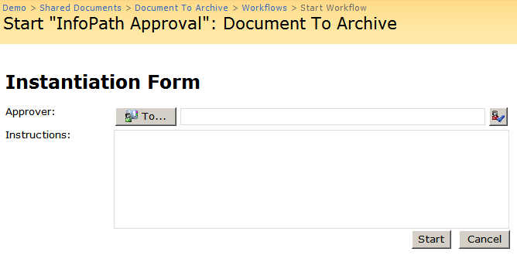
Workflow Forms have commonalities
Every workflow form type has many similarities
Essentially accept data, modify it, and pass it on
Accepting and passing on data is identical across forms
The modification of data is the unique part
Assoc Data
Init Data

Slide 4
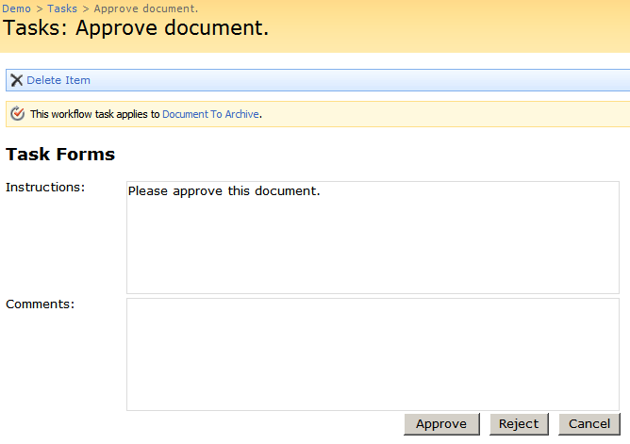
Common Forms Framework
Abstracting out the modification simplifies forms
One solution is to create a standard base class
Another solution is to define forms as metadata
Layout as well as behavior are needed
Form XSN file
CstWrkflIP.aspx
Assoc
Init Data
Notes:
Focus on the metadata part here. In the previous lab, they did the base class approach. In this lecture we’ll focus on the metadata.

Slide 5
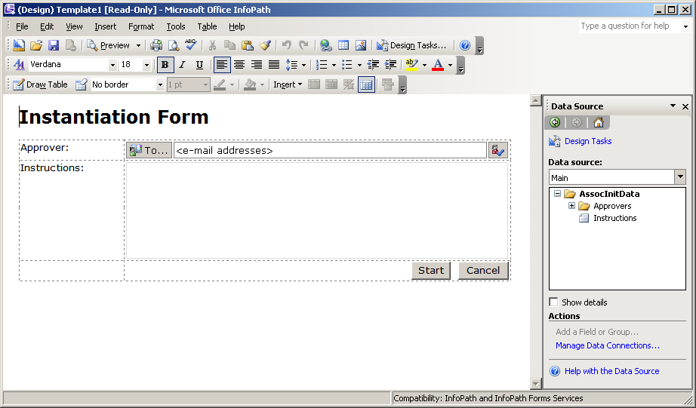
What is InfoPath?
InfoPath is a tool that stores forms as metadata
Designer stores layout and behavior in a XSN file
Viewer opens XSN file and loads/saves data as XML
Designer intended to be useable by non-developers

Slide 6
Difficulties Deploying InfoPath 2003
InfoPath 2003 is a client side only application
Requires InfoPath on the end users machine
Trust issues required complex signing process
A better way was needed to deploy InfoPath forms

Slide 7
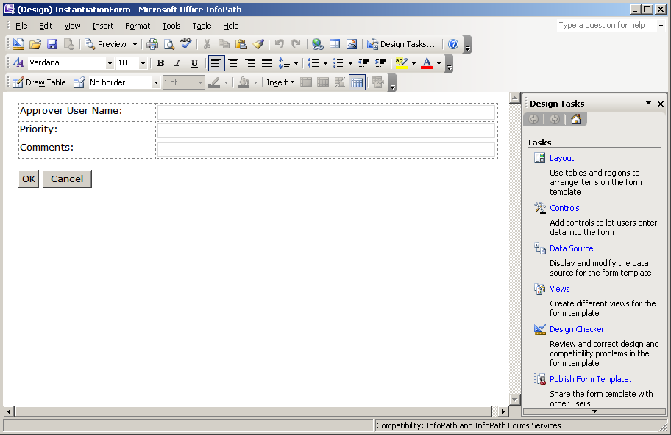
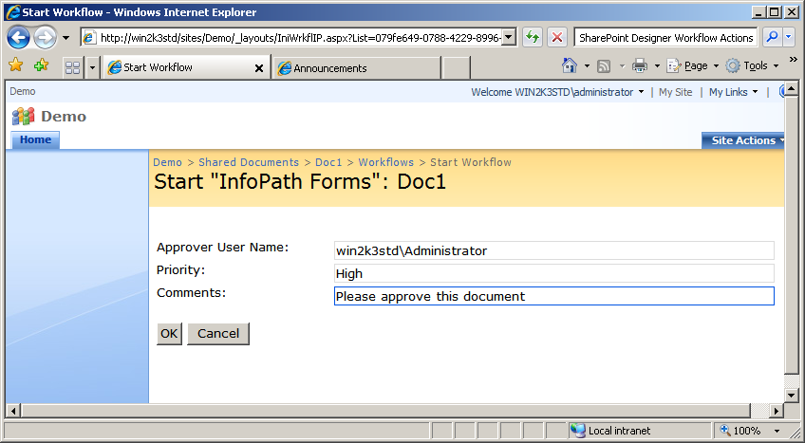
InfoPath Forms Services
SharePoint 2007 introduced Forms Services
Ships as part of MOSS
Interprets InfoPath files and displays as web page
InfoPath forms now accessible to anyone via browser

Slide 8
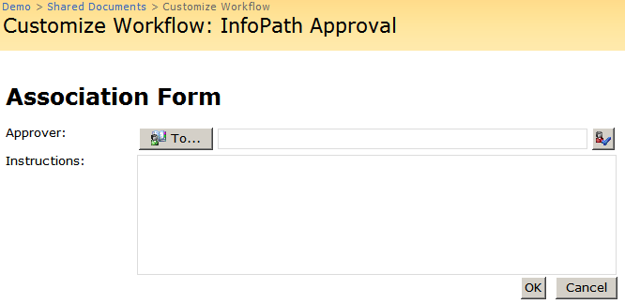
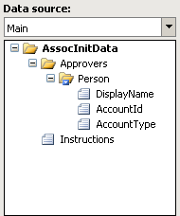
Using InfoPath Forms in Workflow
InfoPath data model imposes some restrictions
InfoPath forms have same input and output schema
Requires Association and Initiation data share schema
Rarely is this a problem
Assoc
/Init
Schema
Assoc /Init Schema
Assoc
/Init
Schema
Assoc /Init Schema

Slide 9

Forms Services and Workflow
MOSS defines standard workflow ASPX pages
One ASPX page for each type of form
Pages automatically load the correct InfoPath form
Association Form | _layouts/CstWrkflIP.aspx
Instantiation Form | _layouts/IniWrkflIP.aspx
Modification Form | _layouts/ModWrkflIP.aspx
Task Form | _layouts/WrkTaskIP.aspx

Slide 10
InfoPath Forms ASPX Pages
Page markup contains a special web control
XmlFormView control renders the InfoPath form
Control requires two pieces of information
The InfoPath form to host
The XML data used to initialize the form
<%@ Register Tagprefix="InfoPath"
Namespace="Microsoft.Office.InfoPath.Server.Controls"
Assembly="Microsoft.Office.InfoPath.Server, ..." %>
<asp:Content ContentPlaceHolderId="PlaceHolderMain" runat="server">
<InfoPath:XmlFormView id="XmlFormView" runat="server" />
...
</asp:Content>

Slide 11
InfoPath and Workflow Metadata
WSS Workflow Features can have metadata
This metadata is accessible via an API
Forms Services pages access standard metadata tags
These tags define a URN for each type of form
<Workflow Id="66dd3439-b412-423e-8e15-cc972c9eb36a“
...
AssociationUrl ="_layouts/CstWrkflIP.aspx" InstantiationUrl="_layouts/IniWrkflIP.aspx“>
<MetaData>
<Association_FormURN> urn:...:AssociationForm:urn-WssInfoPathFormsWorkflow </Association_FormURN>
<Instantiation_FormURN> urn:...:InstantiationForm:urn-WssInfoPathFormsWorkflow </Instantiation_FormURN>
</MetaData>
</Workflow>

Slide 12
Registration of InfoPath Forms
Locating forms by URN requires form registration
On feature activation event receiver registers forms
Microsoft.Office.Workflow.Feature.WorkflowFeatureReceiver
Event receiver uses path in feature properties element
<Feature Id="695fb738-da73-438d-aa10-d50669dc3457"
ReceiverAssembly="Microsoft.Office.Workflow.Feature, ..."
ReceiverClass="Microsoft.Office.Workflow.Feature.WorkflowFeatureReceiver"
xmlns="http://schemas.microsoft.com/sharepoint/">
...
<Properties>
...
<Property Key="RegisterForms" Value="Forms\*.xsn" />
</Properties>
</Feature>

Slide 13
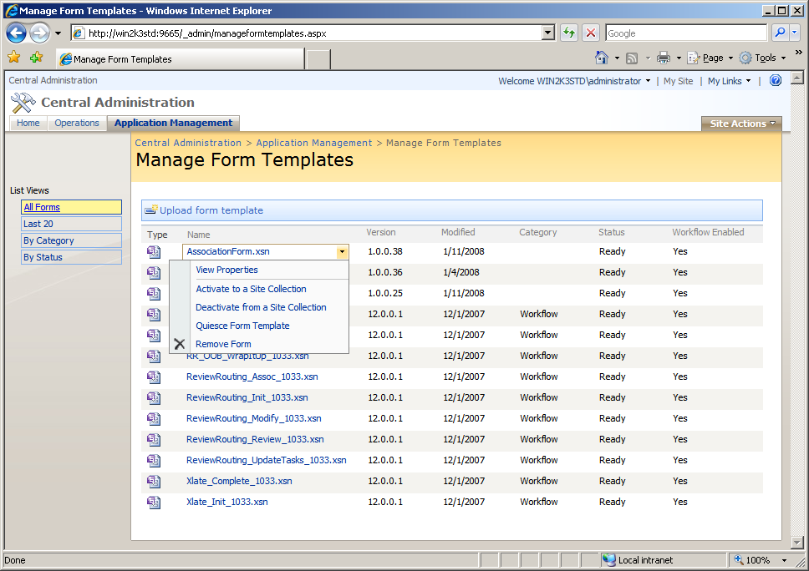
Form Registration with Central Admin
Central Admin allows form management
Accessed from Application Management tab
Allows upload and installation of custom forms

Slide 14
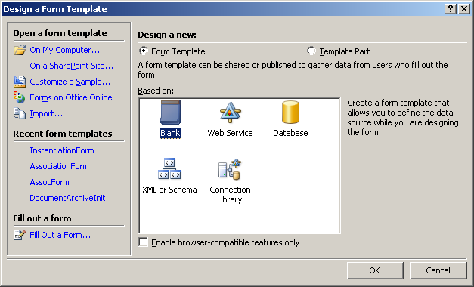
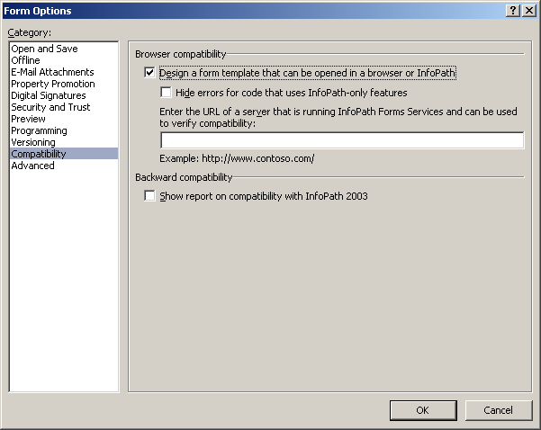
Creating custom InfoPath Forms
Create a new form by designing a blank form
Some actions are not supported in Form Services
Use Tools -> Form Options to choose web form
Raises validation error if form not supported

Slide 15
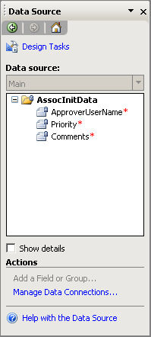
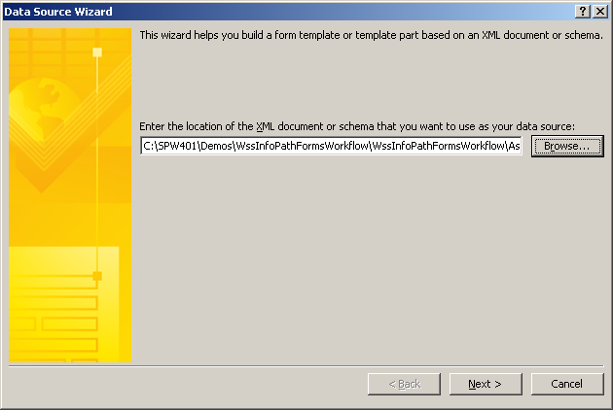
Importing Data Schema
Form schema can be imported or created
Created XML schemas use generated namespace
Complications when sharing schema between forms
Imported using Tools -> Convert Main Data Source

Slide 16
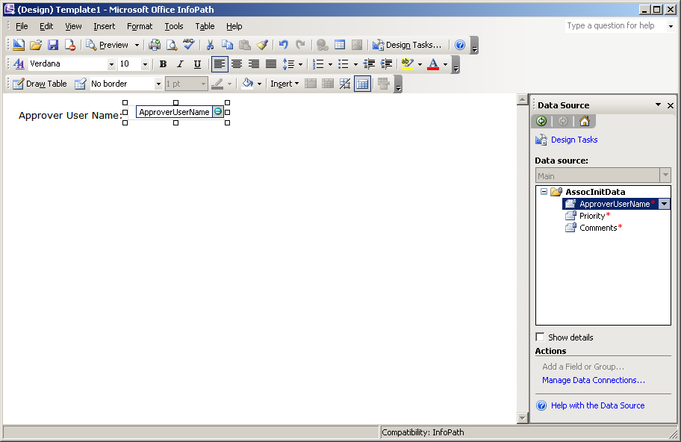
Adding Input Controls
Data has a natural relationship to controls
Controls bound to data elements
Data can be “dragged” onto design service as controls
Control type and label inferred from data

Slide 17
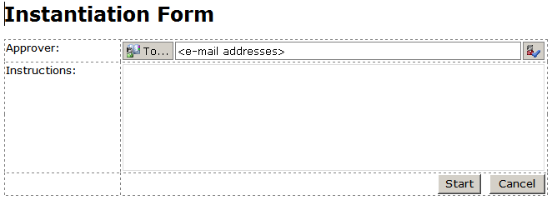
Layout Tables
InfoPath provides formatting tools to designer
Layout tables provides structure
Text can have Word like layout and font applied
Experience intended to be similar to Word

Slide 18
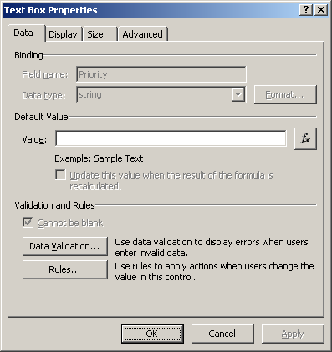
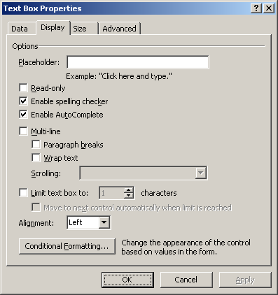
Control Properties
Each InfoPath control has specific properties
Allows restrictions such as read only
Allow sizing and formatting options
Provides custom data validation rules

Slide 19
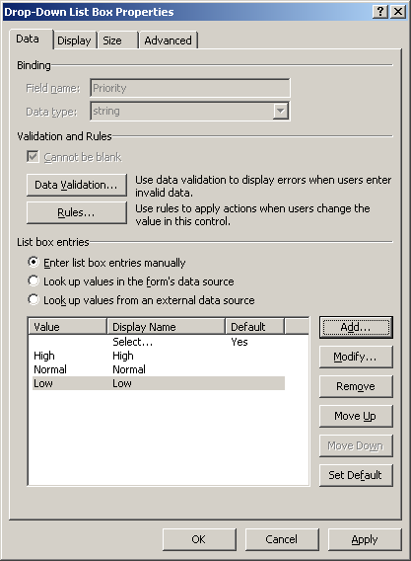
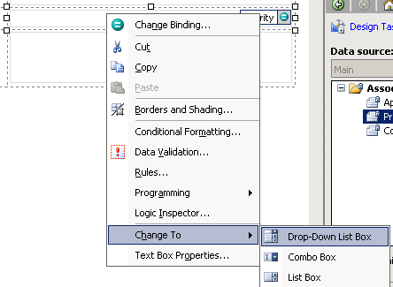
Using Drop Down Lists
Drop Down Lists allow choosing from a list
TextBox converted using Change To context menu
Selected value bound to primary data source
Options can come from multiple sources
Fixed list, external data source
Notes:
Transition into next slide talking about adding an external data source

Slide 20
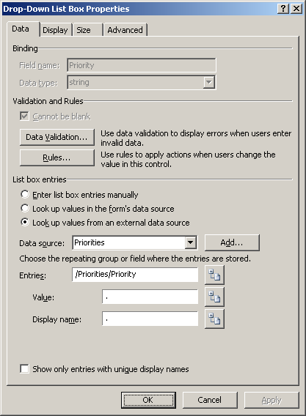
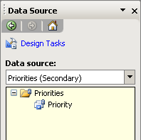
Binding to Secondary Data Sources
External data can be accessed for list population
Data can come from multiple locations
Xml, WebService, SharePoint lists, etc…

Slide 21
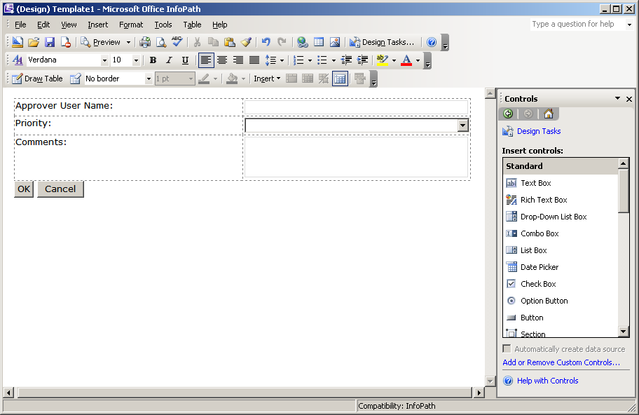
Submitting the Data
Data submission initiated by button clicks
Controls can be added without data binding
Common for controls with no display
Button controls often used to submit or close

Slide 22
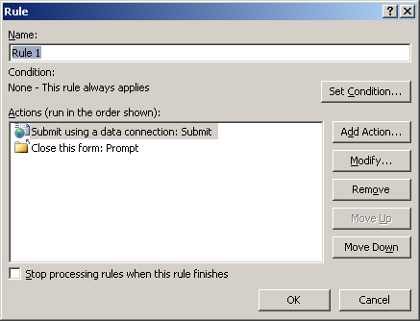
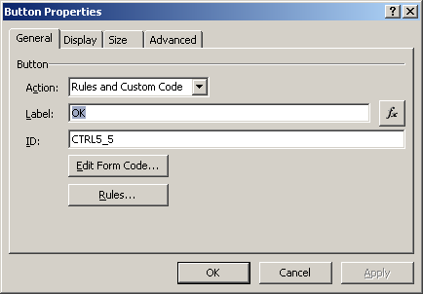
Applying Rules to Buttons
Data submission done using InfoPath rules
Rules are executed when button is clicked
Forms submitted using submit to host
Special external data source
Forms closed using Close Form action
Notes:
Note: cancel buttons rules are same without submit

Slide 23
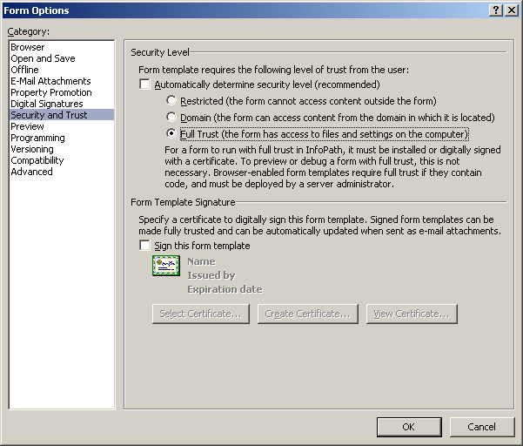
Choosing Trust Level
InfoPath forms request a level of trust
InfoPath defaults to Restricted
Causes InfoPath to fail while installing form
Most WSS applications require Domain or Full Trust

Slide 24
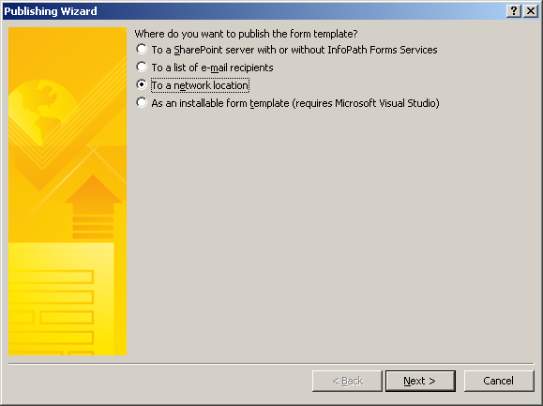
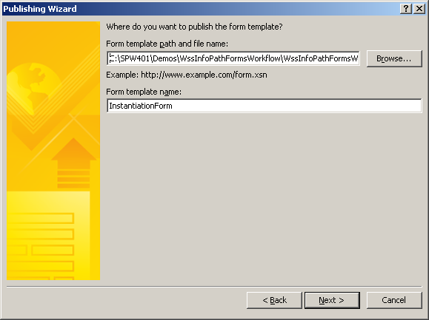
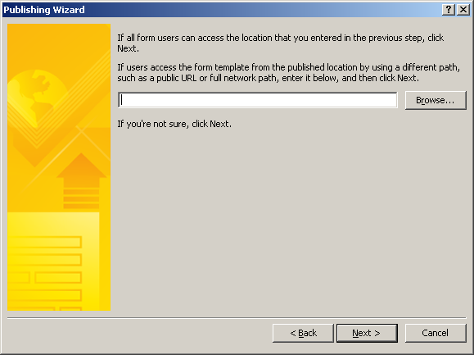
Publishing InfoPath Forms
Publishing is required to create a usable form
Signs form if a certificate is attached to the form
Attaches a publish location
Publish location must be empty for SharePoint

Slide 25
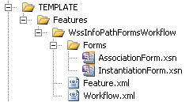
Deploying InfoPath Forms
Published forms deployed with feature
Often located in Forms sub folder
Copied to the FEATURES folder along with feature xml
Registered by the feature activation event receiver
<Feature Id="695fb738-da73-438d-aa10-d50669dc3457"
...
ReceiverAssembly="Microsoft.Office.Workflow.Feature, ...“
ReceiverClass=“Microsoft.Office.Workflow.Feature.WorkflowFeatureReceiver"
xmlns="http://schemas.microsoft.com/sharepoint/">
...
<Properties>
<Property Key="RegisterForms" Value="Forms\*.xsn" />
</Properties>
</Feature>

Slide 26
Demo: Using InfoPath Forms

Slide 27
Forms Services Host Interaction
InfoPath Forms have no connection to WSS
ASPX Forms can access WSS Object Model
InfoPath Forms are isolated from the Object Model
InfoPath does have access to Context data source
Task Forms can request task fields via ItemMetadata

Slide 28
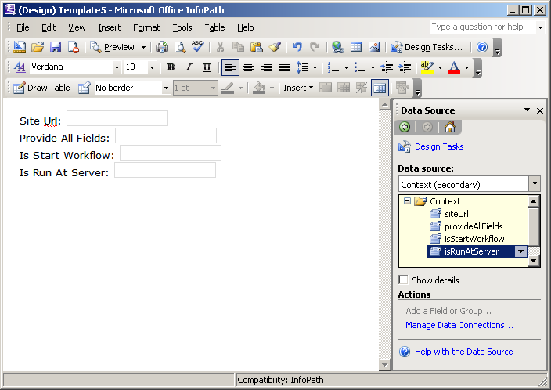
Context Data Source
Context data source based on XML file
Data automatically populated by ASPX host page
Allows InfoPath form access to critical context data
<Context
isStartWorkflow="true"
isRunAtServer="false"
provideAllFields="true"
siteUrl="" />

Slide 29
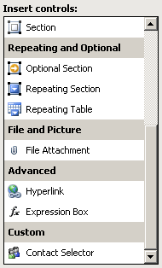

Using People Picker
External ActiveX control used to pick users
Added to the Controls list in InfoPath
Bound to a special data structure

Slide 30
Demo: Using Contact Selector

Slide 31
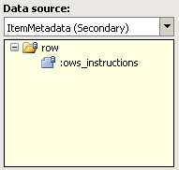
Accesing Task Extended Properties
Task properties provided via ItemMetadata
ItemMetadata.xml provided by task form designer
Defines which properties should be provided
ows_ prefix required
Accessed as secondary data source by form designer
<z:row xmlns:z="#RowsetSchema"
ows_Instructions="" />

Slide 32
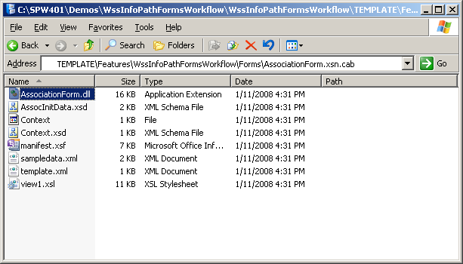
InfoPath Code Behind
InfoPath 2007 Supports .NET Code Behind
Key events can be handled using C# or VB Code
Generates an assembly that is embedded in template
Template is just a CAB file

Slide 33
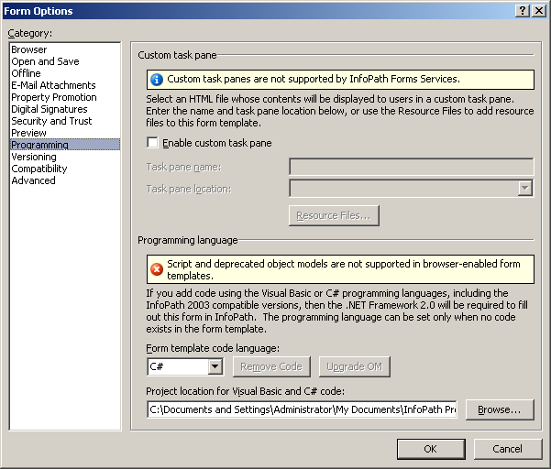
Editing Code Behind
Visual Studio Tools for Applications (VSTA) used
Deployed as part of InfoPath 2007
Allows full editing and compilation of C# and VB Code
Project created automatically when handling events
Language chosen in
Form Options

Slide 34
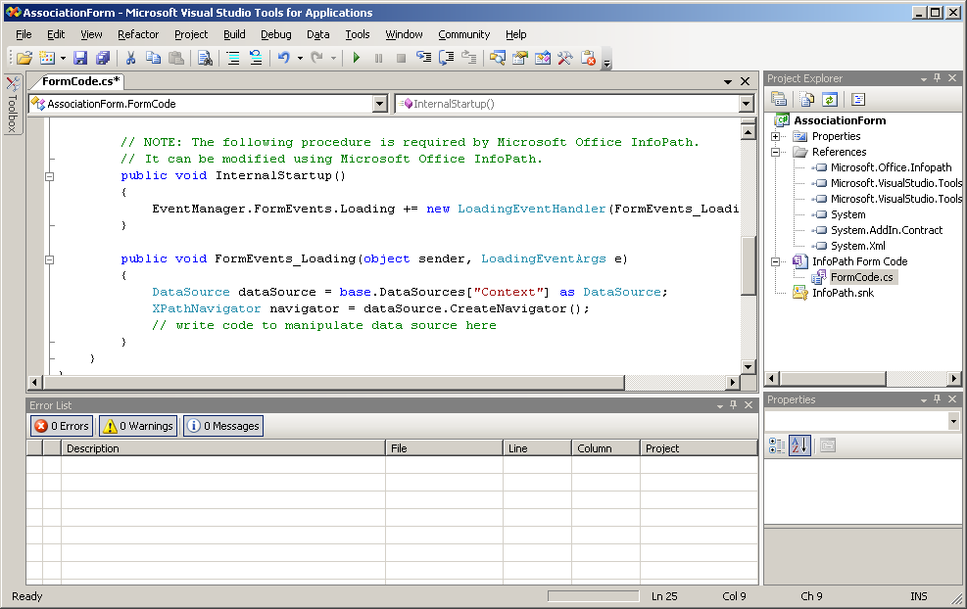
Building Simple Initialization Code
Code Behind has direct access to form data

Slide 35
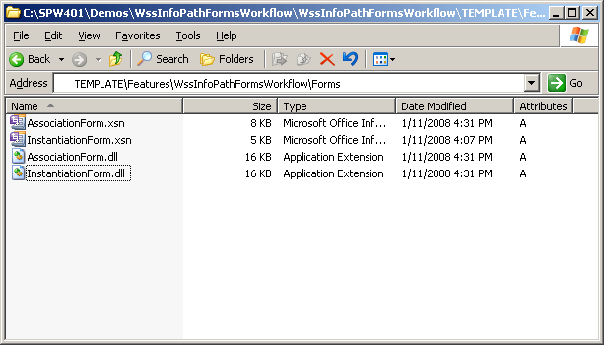
Forms Services and Code Behind
Forms Services has unique requirements
Won’t access assembly inside of the XSN
Requires assembly be placed in same folder as XSN
Currently no automated way to perform

Slide 36
Demo: InfoPath Code Behind

Slide 37
Common Code Behind Problems
Deploying code behind can be difficult
Make sure the form’s security level is correct
Make sure the assembly is outside the XSN
Don’t forget to check LOGS folder

Slide 38
Summary
Why use InfoPath?
How it works
Creating workflow forms with InfoPath
Interacting with hosting environment
Custom .NET code

