Slide 1
Developing Custom Activities
Developing SharePoint Workflow Templates with Visual Studio

Slide 2
Agenda
Create activities
Events and Dependency Properties
Custom Activity Validators
Understanding Activity Lifecycle
Creating Composite Activities
Custom Activity Designers

Slide 3
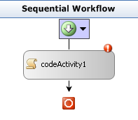
Why Custom Activities?
Activities provide functionality encapsulation
Similar in concept to methods in C# or VB
Activity developers provide libraries to workflow builder
Custom designers communicate intent
Custom validators prevent simple mistakes

Slide 4
Hello World Activity
All activities derive from Activity class
Key activity method is Execute
Execute is where the activity starts
Returning status of closed indicates the activity is done
public class HelloWorldActivity : Activity
{
protected override ActivityExecutionStatus Execute(
ActivityExecutionContext executionContext)
{
Console.WriteLine("Hello World");
return ActivityExecutionStatus.Closed;
}
}

Slide 5
Adding Parameters to Activities
Parameters allow activities to be reused
Activity properties are just .NET properties
Should wrap DependencyProperty to allow binding
public static DependencyProperty MessageProperty =
DependencyProperty.RegisterAttached("Message",
typeof(string), typeof(WriteConsoleActivity));
public string Message
{
get { return base.GetValue(MessageProperty) as string; }
set { base.SetValue(MessageProperty, value); }
}

Slide 6
Adding Events to Activities
Events provide callback capabilities
Activity events are just .NET events
Should wrap DependencyProperty to allow binding
Event implementation delegates to Activity members
public static DependencyProperty InvokingEvent =
DependencyProperty.RegisterAttached("Invoking",
typeof(EventHandler), typeof(WriteConsoleActivity));
public event EventHandler Invoking
{
add { base.AddHandler(InvokingEvent, value); }
remove { base.RemoveHandler(InvokingEvent, value); }
}

Slide 7
Raising Events in Activities
Events raised using Activity.RaiseEvent method
Raises the event registered using AddHandler
Automatically deals with any bindings
protected override ActivityExecutionStatus Execute(
ActivityExecutionContext executionContext)
{
// raise the bound event
base.RaiseEvent(InvokingEvent, this, EventArgs.Empty);
// write the value stored in the dependency property
Console.WriteLine(this.Message);
// tell the framework that this activity is done
return ActivityExecutionStatus.Closed;
}

Slide 8
Validating Activities
Activities can have an associated validator
Must derive from ActivityValidator
Validated at design time and at compile time
Validate method performs the validation
Receives activity, returns an error collection
internal class WriteConsoleActivityValidator : ActivityValidator
{
public override ValidationErrorCollection Validate(
ValidationManager manager, object obj)
{
...
// return the errors
return errors;
}
}

Slide 9
Validating Activities
Validation fails when contained by an activity type
public override ValidationErrorCollection Validate(
ValidationManager manager, object obj) {
WriteConsoleActivity activity = obj as WriteConsoleActivity;
if (activity == null)
throw new InvalidOperationException();
// check if any parent actions are a transaction scope
ValidationErrorCollection errors = new ValidationErrorCollection();
Activity parent = activity.Parent;
while (parent != null) {
if (parent is TransactionScopeActivity)
errors.Add(new ValidationError(
“Error Message", 100));
parent = parent.Parent;
}
// call the base validation method
errors.AddRange(base.Validate(manager, obj));
return errors;
}

Slide 10
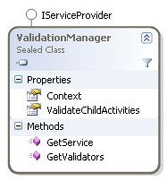
ValidationManager
Allows communication between validators
Context allows data to be passed to child validators
ValidateChildActivities determines scope of validation
GetValidators and GetService allow context access

Slide 11
Attaching the Validator
Validator attached to activity by .NET attribute
ActivityValidatorAttribute defines the validator type
Workflow designer and compiler reference attribute
[ActivityValidator(typeof(WriteConsoleActivityValidator))]
public class WriteConsoleActivity : Activity
{
... }

Slide 12
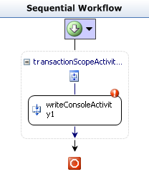
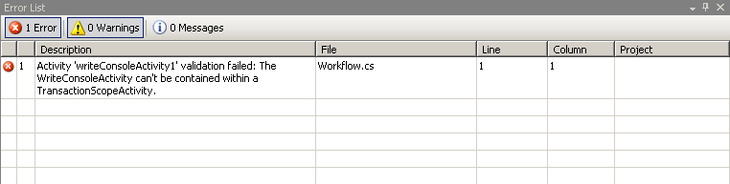
Validators In Action
Validators fire at design time and compile time
Design time validator errors are displayed in designer
Compile time validator errors displayed in error list
Multiple validator errors can be displayed at once

Slide 13
Demo: Custom Simple Activity

Slide 14
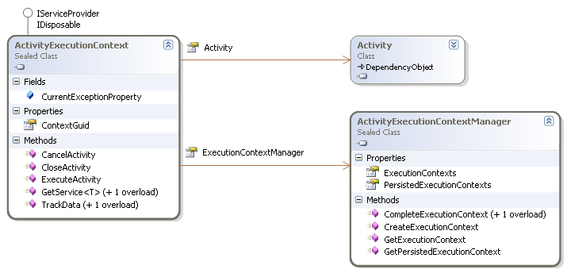
Activity Execution Context
Created automatically for each activity
Manages the activities lifecycle
Allows activities to close or cancel themselves
Can create new AECs using ExecutionContextManager
Used for looping activities; While or Replicator
Notes:
Discuss the cloning concept. The fact that new AECs are created is why we can’t access activities in loops by name and not get their state. Cloned AECs also have their own instances of activities.

Slide 15
Activity States
Activity developers must be aware of states
State transitions are often influenced by custom code
Ex. If execute completes but activity not done
Valid state transitions defined by Workflow Runtime
Faulting
Engine Transitions
Fault Transitions
Activity Transitions
Canceling
Initialized
Executing
Closed
Compensating

Slide 16
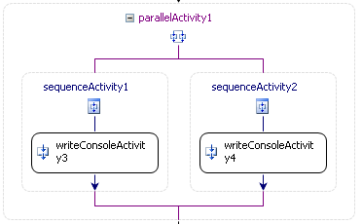
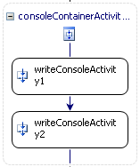
Composite Activities
Some activities contain multiple child elements
These activities execute child activities in different ways
Sequence executes on child at a time
Parallel executes all simultaneously
If/Else executes based on condition

Slide 17
Sequence Activity
Execute method isn’t always synchronous
Execute method returns the state of the activity
Activity can wait for events from the runtime
Often used to initiate activity state transition
public class ConsoleContainerActivity : SequenceActivity,
{
protected override ActivityExecutionStatus Execute(
ActivityExecutionContext executionContext)
{
...
// start the first child activity and register for closed event
base.EnabledActivities[0].RegisterForStatusChange(
Activity.ClosedEvent, this);
executionContext.ExecuteActivity(base.EnabledActivities[0]);
// tell the runtime this activity is still executing
return ActivityExecutionStatus.Executing;
}
Notes:
Focus on how the execute method returns a status of executing. This causes no transition of state.

Slide 18
IActivityEventListener Interface
Activities send events when their state changes
Event received via IActivityEventListener
Parent activities monitor state of children using events
Register for events using RegisterForStatusChange
Receive events in IActivityEventListener.OnEvent
base.EnabledActivities[0].RegisterForStatusChange(
Activity.ClosedEvent, this);
void OnEvent(object sender,
ActivityExecutionStatusChangedEventArgs e) {
...
// unregister the handler for status events
e.Activity.UnregisterForStatusChange(
Activity.ClosedEvent, this);
}

Slide 19
Handling Child Closed Event
Next activity executed when previous closed
Execute method registers for child activity closed event
When event received, next activity started
When no activities remain, sequence activity closes
public void OnEvent(object sender,
ActivityExecutionStatusChangedEventArgs e)
{
ActivityExecutionContext executionContext =
sender as ActivityExecutionContext;
...
if (activity.ExecutionStatus == ActivityExecutionStatus.Executing)
{
// if no more children exist
if (!this.TryScheduleNextChild(executionContext))
executionContext.CloseActivity();
}
}
Notes:
Focus on where the state activity transition takes place.

Slide 20
Handling Faults
Exceptions during execution lead to faulting state
Runtime transitions activity to faulting state
Executes Activity.HandleFault and enters closed state
This is where activities can clean up
Faults in HandleFault cause transition to faulting state
Fault Transitions
Activity Transitions
Faulting
Executing
Closed
Notes:
Errors in HandleFault can cause infinite fault loops

Slide 21
Activity Completion
When the activity completes it is closed
Completed by ActivityExecutionContext.CloseActivity
Activities can override OnClosed to perform cleanup
Called any time the closed state is entered
Can be called multiple times
Faulting
Activity Transitions
Canceling
Executing
Closed
Compensating
Notes:
Notice that the only way to close an activity is via code. It’s not automatic.

Slide 22
Composite Activity Validators
Derives from CompositeActivityValidators
Adds support for fault and cancel views
Often used to restrict types of activities
Ex. Don’t allow any EventDriven activities
Can check immediate children and descendents
internal class ConsoleContainerActivityValidator : CompositeActivityValidator {
public override ValidationErrorCollection Validate(
ValidationManager manager, object obj) {
...
ValidationErrorCollection errors = new ValidationErrorCollection();
foreach (Activity childActivity in activity.EnabledActivities)
if (!(childActivity is WriteConsoleActivity))
errors.Add(new ValidationError(“...", 100));
...
}
}

Slide 23
Demo: Custom Composite Activity

Slide 24
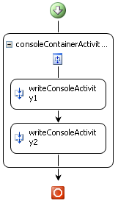
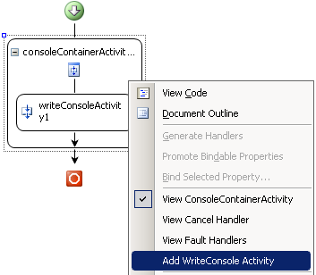
Activity Designers
Designers control Activity usage in designer
Designers can restrict an activity’s parent and children
Insert, Delete events can be controled
Designers can control the look and feel of an activity
Colors, border styles, etc…

Slide 25
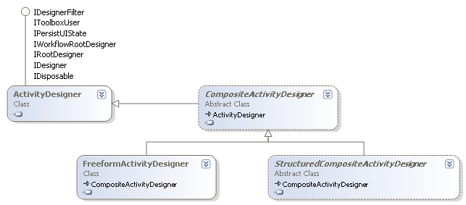
Creating Designers
Custom designers derive from ActivityDesigner
More advanced designers can derive from others
Methods are overridden to control designer behavior
Notes:
Simple activities use the ActivityDesigner base. Composite activities use either a composite designer. The freeform vs structured are the difference between activities on a sequential activities and state machines.

Slide 26
Restricting Parent Activities
Designers can restrict an activity’s parent activity
Done by override CanBeParentedTo
Decision made based on the parent designer
Often used to keep activity in specific parent activities
internal class WriteConsoleActivityDesigner : ActivityDesigner
{
public override bool CanBeParentedTo(
CompositeActivityDesigner parentActivityDesigner)
{
return (parentActivityDesigner.Activity is
ConsoleContainerActivity);
}
}

Slide 27
Restricting Child Activities
Designers can restrict an activities children
Done by overriding several methods
CanInsertActivities
CanMoveActivities
CanDeleteActivities
public class ConsoleContainerActivityDesigner :
SequentialActivityDesigner {
public override bool CanInsertActivities(
HitTestInfo insertLocation,
ReadOnlyCollection<Activity> activitiesToInsert) {
foreach (Activity activity in activitiesToInsert)
if (!(activity is WriteConsoleActivity))
return false;
return true;
}
}

Slide 28
Custom Designer Verbs
Activity designers support custom verbs
If/Else Activity has Add Branch verb
Verbs perform a variety of actions
Add new branches
Create new child activities
Etc…

Slide 29
Adding Custom Verbs
Verbs defined by the activity’s designer
Verbs represented by ActivityDesignerVerb
List of verbs provided by designer’s Verbs property
protected override ActivityDesignerVerbCollection Verbs {
get {
// create the list containing the verbs
ActivityDesignerVerbCollection verbs =
new ActivityDesignerVerbCollection(base.Verbs);
// add the new verb
verbs.Add(
new ActivityDesignerVerb(this, DesignerVerbGroup.Actions,
"Add WriteConsole Activity",
new EventHandler(AddWriteConsole_Click)));
// return the list of verbs
return verbs;
}
}

Slide 30
Handling Verb Click Events
Verbs have event handler code attached
EventHandler delegate attached to verb object
When the verb is clicked, the event handler executed
private void AddWriteConsole_Click(object sender, EventArgs e)
{
CompositeActivity activity = base.Activity as CompositeActivity;
// create the list of new activites
List<Activity> activities = new List<Activity>();
activities.Add(new WriteConsoleActivity());
// determine where to add the activities
ConnectorHitTestInfo location =
new ConnectorHitTestInfo(this,
HitTestLocations.Designer, activity.Activities.Count);
// add the activities to the designer
this.InsertActivities(location, activities.AsReadOnly());
}

Slide 31
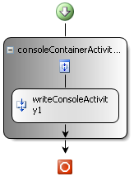
Activity Designer Themes
Defines visual display characteristics of activity
Theme class derives from ActivityDesignerTheme
Added to designer with ActivityDesignerThemeAttribute
Defines fore and back colors, activity connectors, etc…
[ActivityDesignerTheme(typeof(ConsoleContainerActivityTheme))]
public class ConsoleContainerActivityDesigner
internal class ConsoleContainerActivityTheme : CompositeDesignerTheme
{
public ConsoleContainerActivityTheme(WorkflowTheme theme)
: base(theme)
{
this.ShowDropShadow = true;
this.BackColorStart = Color.Gray;
this.BackColorEnd = Color.White;
}
}
Notes:
Don’t forget that VS needs to be reset if workflow using the activity designer is in the same process so VS can reload the assembly containing the designer theme.

Slide 32
Activity Toolbox Items
Allows definition of activity “package” in toolbox
Class derives from ActivityToolboxItem
Attached to activity using ToolboxItemAttribute
Override CreateComponentsCore to Create activities
Default implementation creates one activity
[ToolboxItem(typeof(ConsoleContainerActivityToolboxItem))]
public class ConsoleContainerActivity : SequenceActivity
public class ConsoleContainerActivityToolboxItem : ActivityToolboxItem
{
protected override IComponent[] CreateComponentsCore(
IDesignerHost host) {
ConsoleContainerActivity container =
new ConsoleContainerActivity();
container.Activities.Add(new WriteConsoleActivity());
return new IComponent[] { container };
}
}

Slide 33
Demo: Custom Designer Actions

Slide 34
Summary
Create activities
Events and Dependency Properties
Custom Activity Validators
Custom Activity Designers
Understanding Activity Lifecycle
Creating Composite Activities

