Slide 1
Extending SharePoint Designer with Custom Activities
Developing SharePoint Workflow Templates with Visual Studio

Slide 2
Agenda
SharePoint Designer vs. VS 2008
No Code Workflows
Building Workflows in SharePoint Designer
Extending SharePoint Designer with Custom Activities

Slide 3
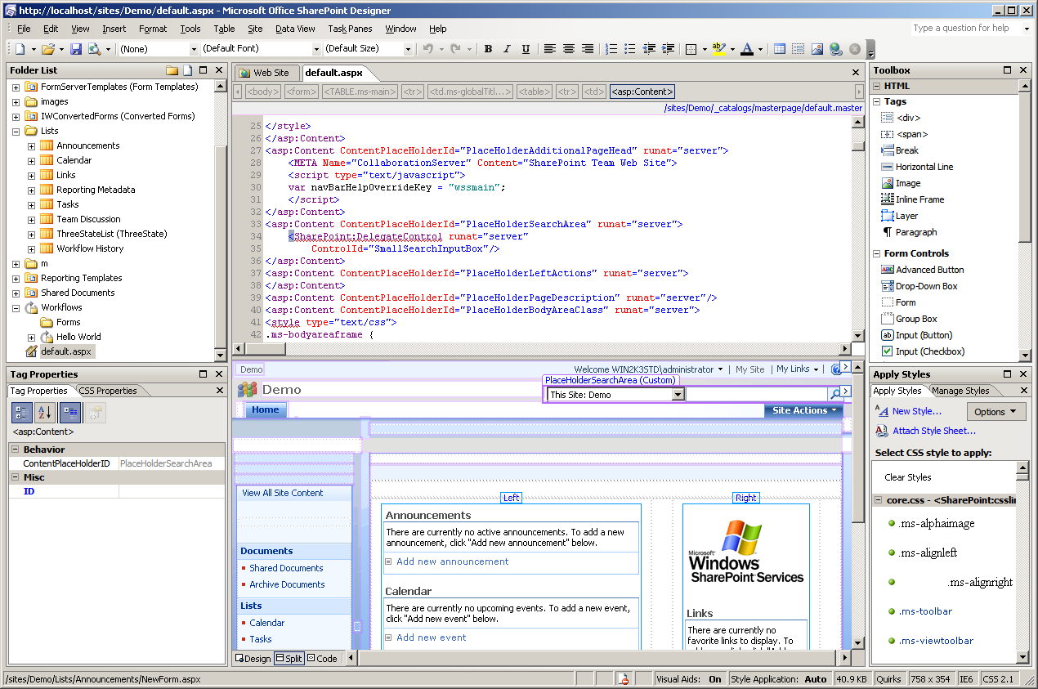
What is the SharePoint Designer?
SPD is designed for non developers
Allows WYSIWYG page management
Allows rule based workflow development

Slide 4
Which is better? VS 2008 or SPD
SPD is primarily a non-developer tool
Allows tasks to be done easily, not efficiently
Modifications to content not easily redeployed
Useful for per-site modifications
Rule of thumb
SPD for end user and non deployable solutions
VS 2008 for deployable solution packages

Slide 5
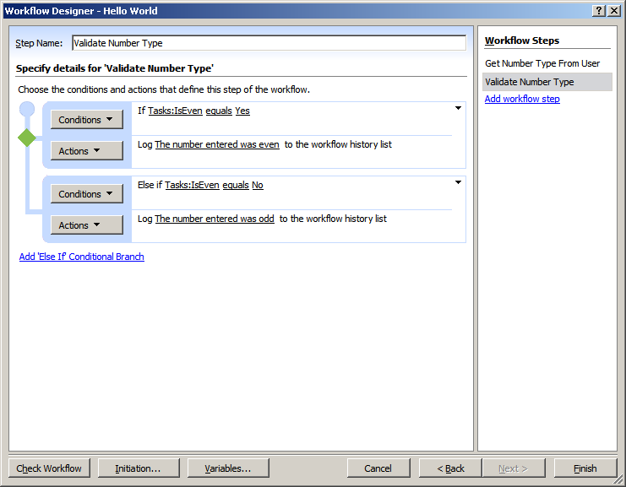
No Code Workflows
Declarative definition made up of multiple files
Wfconfig.xml referencing all needed iles
XOML file containing the workflow
ASPX files defining the workflow forms

Slide 6
Wfconfig.xml file
Defines the structure of the workflow
Defines workflow template and association
Defines the location and data layout of all forms
Always named <workflow file>>.wfconfig.xml
<WorkflowConfig>
<Template
BaseID="{8F5D9FAF-6F2A-4EF9-9A70-5E7CD49C294D}"
DocLibID="{1891A50F-275C-4180-B338-6B589BDD04F6}"
XomlHref="Workflows/Hello World/Hello World.xoml“
RulesHref="Workflows/Hello World/Hello World.xoml.rules"
... >
</Template>
<Association
ListID="{079FE649-0788-4229-8996-8863DBA5DCD7}"
TaskListID="{0B84F02E-031D-48ED-BAAC-D8A878CFADBC}"
StartManually="true”>
</Association>

Slide 7
Wfconfig.xml file
<ContentTypes>
<ContentType Name="Get Number Type" ContentTypeID="0x01080100…"
Form="/Workflows/Hello World/Get Number Type.aspx" ...>
<Fields>
<Field DisplayName="IsEven" ...>
<Default>1</Default>
</Field>
</Fields>
</ContentType>
</ContentTypes>
<Initiation URL="Workflows/Hello World/Hello World.aspx">
<Fields>
<Field Name="Value" DisplayName="Value" Type="Number" ...>
<Default>0</Default>
</Field>
</Fields>
<Parameters>
<Parameter Name="Value" Type="System.Double" />
</Parameters>
</Initiation>
</WorkflowConfig>

Slide 8
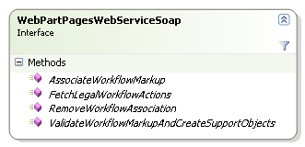
Deploying No Code Workflows
Deployment handled via web service
websvcWebPartPages exposes workflow methods
FetchLevelWorkflowActions
ValidateWorkflowMarkupAndCreateSupportObjects
AssociationWorkflowMarkup
Used by SharePoint Designer to create workflow

Slide 9
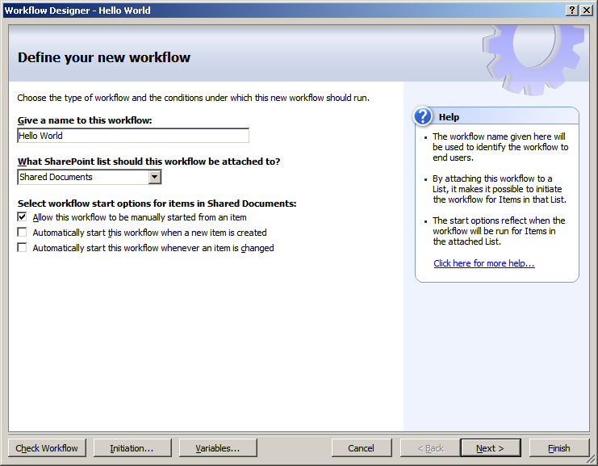
Creating SPD Workflow
Association created automatically
List and startup parameters chosen at design time
Notes:
Demo this instead of walking through slides.

Slide 10
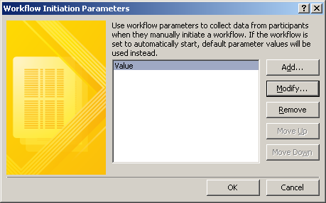
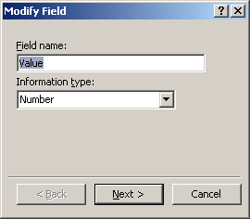
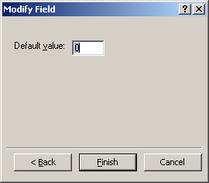
Workflow InstantiationForm Definition
Instantiation form generated automatically
Initiation form made up of a set of fields
Each field has a name and type

Slide 11
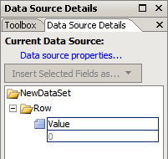
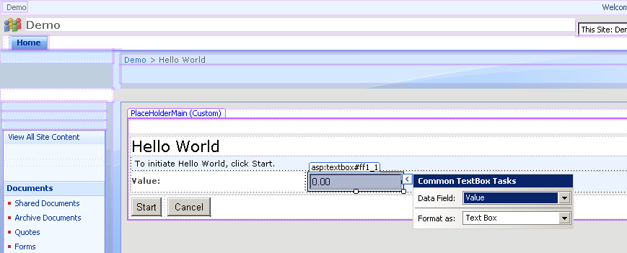
Customizing Instantiation Form
Generated form designed as an .ASPX page.
Initiation form fields available in Data Source pane
Controls displaying fields can be formatted
Page is designed just like any other .ASPX page

Slide 12
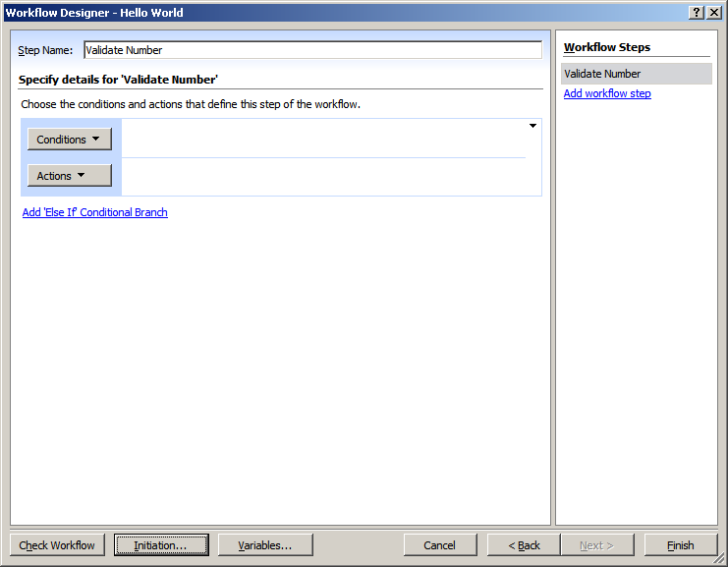
Building Workflow in SPD
SharePoint Designer provides workflow builder
Build workflow based on basic rules
Rules made up of conditions and actions
Similar to Outlook rules

Slide 13
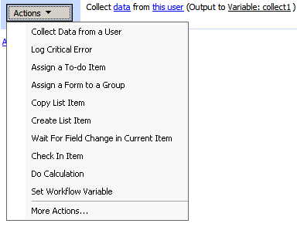
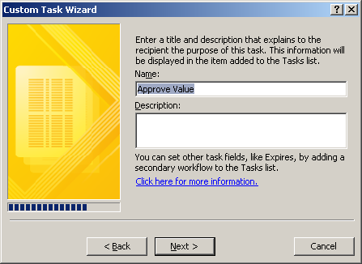
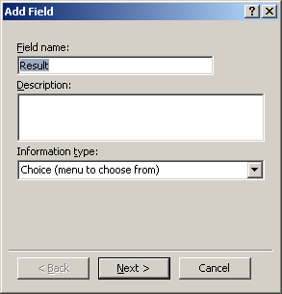
Workflow Task Form Definitions
Tasks handled automatically by designer
Single action creates task and waits for completion
Entire task process in one activity
Form is generated automatically based on fields

Slide 14
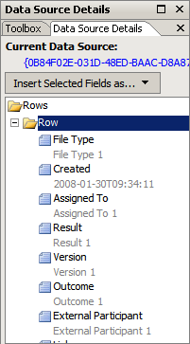
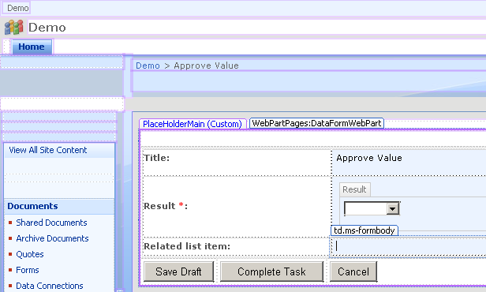
Customizing Task Form
Generated by workflow wizard as .ASPX page
Same process as editing Instantiation form
Different data source
Task form fields available in Data Source pane

Slide 15
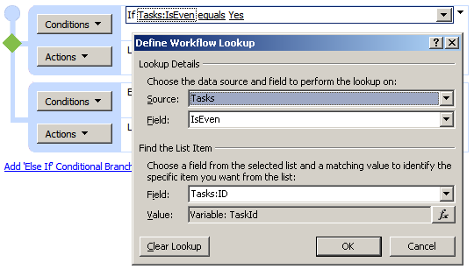
Adding Conditions
Conditions determine if related actions execute
Conditions can compare fields or constant values
Fields defined as fields from forms or current item
Other lists can be accessed using simple “queries”
Task data is stored in Tasks list

Slide 16
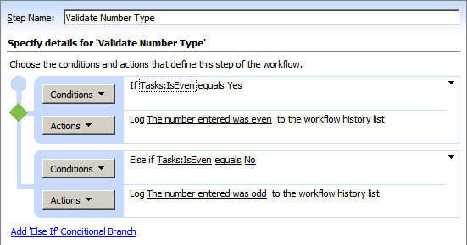
Multiple Conditions
Steps can contain multiple condition/actions
Each condition executed separately
Allows if/else structure in workflow rules

Slide 17
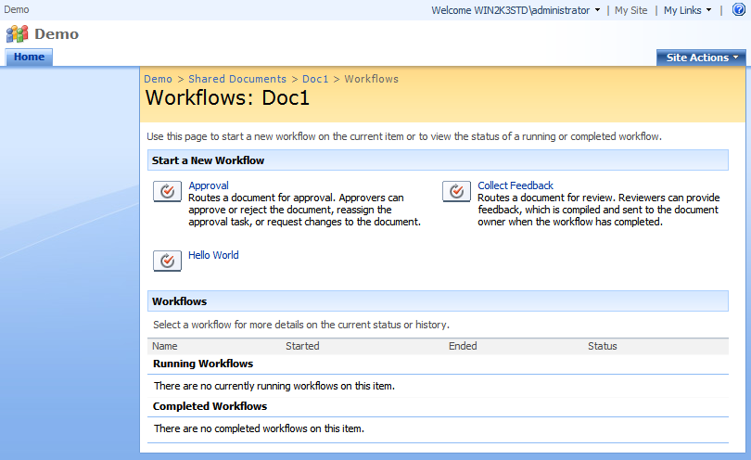
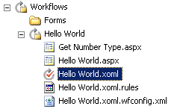
Completed Workflow
Workflow stored in SharePoint site
All files needed are generated automatically
Hard coded lists make deployment difficult
Workflow initiated same as any other workflow

Slide 18
Demo: Building Workflow with SPD

Slide 19
What are Conditions and Actions?
Conditions and Actions are shortcuts
Groups smaller actions into larger functional pieces
Allows non-developers to avoid fine grained activities
Developers build actions for non-developers to use
Developers
Non-Developers
Build Custom Actions
Build Custom Conditions
Build Workflows
Use Custom Actions
Use Custom Conditions

Slide 20
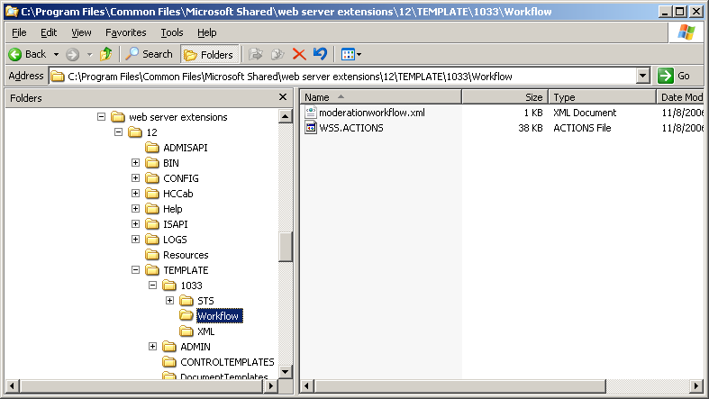
WSS.ACTIONS
Contains definitions for conditions and actions
Maps conditions to methods
Maps actions to custom activities
Parameters are mapped to user friendly options
Resides in TEMPLATE\1033\Workflow folder

Slide 21
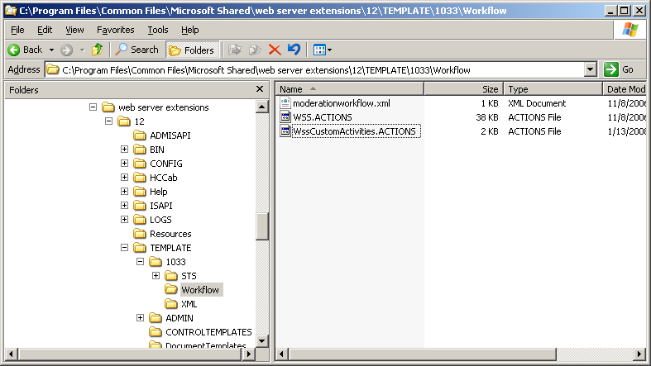
Custom Conditions and Actions
Add custom items by creating second .actions file
Must have the .actions extension
Made up of a conditions and actions section
Must exist in the TEMPLATE\1033\Workflow folder
1033 is US English, for others use appropriate ID

Slide 22
Defining Custom Conditions
Custom conditions are static methods
Method must have specific signature
Must return bool
Must accept context parameters
public class WssWorkflowConditions
{
public static bool IsEven(WorkflowContext context,
string listId, int itemId, double data)
{
return ((int)data % 2) == 0;
}

Slide 23
Custom Conditions in .ACTIONS
.ACTIONS maps methods to sentences
Sentences define placeholders for parameters
Placeholders are mapped to method parameters
<Condition Name="Is even" FunctionName="IsEven" AppliesTo="all"
ClassName="WssCustomActivities.WssWorkflowConditions"
Assembly="WssCustomActivities, ...">
<RuleDesigner Sentence="%1 is even">
<FieldBind Id="1" Field="_1_" Text="value" />
</RuleDesigner>
<Parameters>
<Parameter Name="_1_" Direction="In"
Type="System.Double, mscorlib" />
</Parameters>
</Condition>

Slide 24
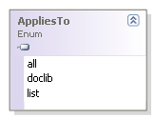
Scoping Conditions
Most conditions and activities apply globally
What if a they only work on a list item?
.ACTIONS files allow scoping to specific types
Defined in the AppliesTo attribute
Applies to conditions and activities
<Action ... AppliesTo="all" >
Notes:
Go into detail of each option

Slide 25
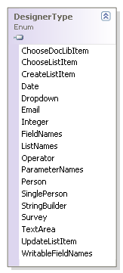
Rule Designers
Designer made up of sentence and fields
Sentence defines what the user sees
Placeholders replaced by parameters in designer
Click placeholder to select parameter
Dialog displayed depends on DesignerType
Defaults to field chooser
<RuleDesigner Sentence="Log '%1' as critical error">
<FieldBind Field=“ErrorMessage" Id="1“
DesignerType="TextArea" />
</RuleDesigner>

Slide 26
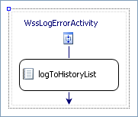
Defining Custom Actions
Custom Activities are defined as WinWF Activities
Activities are often designer based Sequential activities
Although any activity will work
Exposes parameters as dependency properties
public static DependencyProperty ErrorMessageProperty =
DependencyProperty.Register("ErrorMessage",
typeof(System.String),
typeof(WssLogErrorActivity));
public String ErrorMessage
{
get { ... }
set { ... }
}

Slide 27
Custom Activities in .ACTIONS
.ACTIONS maps Activities to sentences
Sentences define placeholders for parameters
Placeholders are mapped to method parameters
All parameters must be mapped to dependency properties
<Action Name="Log Critical Error" AppliesTo="all" Category="Core Actions"
ClassName="WssCustomActivities.WssLogErrorActivity"
Assembly="WssCustomActivities, ..." >
<RuleDesigner Sentence="Log '%1' as critical error">
<FieldBind Field="MyErrorMessage" DesignerType="TextArea" Id="1" />
</RuleDesigner>
<Parameters>
<Parameter Name="MyErrorMessage" Direction="In"
Type="System.String, mscorlib" />
</Parameters>
</Action>
Notes:
Point out categories attribute as a simple string parameter

Slide 28
Special Activity Parameters
Special parameters are available to activities
Defines the workflow context, current list or item
Special names required in the .ACTIONS file
<Parameter Name="__Context"
Type="Microsoft.SharePoint.WorkflowActions.WorkflowContext, ..."
Direction="In"/>
<Parameter Name="__ListId" Type="System.String, ..."
Direction="In" />
<Parameter Name="__ListItem" Type="System.Int32, ..."
Direction="In" />

Slide 29
Working with .ACTIONS files
SP Designers accessed data via web services
Changes to .ACTIONS requires AppPool recycle
Changes do not require SP Designer restart
Common Problems
Can’t load custom conditions and activities
Make sure Method, Class, Assembly Names correct
Can see custom items, but can’t use them
Make sure parameter names and types match

Slide 30
Demo: Building Custom Actions

Slide 31
Summary
SharePoint Designer vs. VS 2008
No Code Workflows
Building Workflows in SharePoint Designer
Extending SharePoint Designer with Custom Activities
SharePoint Designer vs. VS 2008
No Code Workflows
Building Workflows in SharePoint Designer
Extending SharePoint Designer with Custom Activities

