Slide 1
Windows SharePoint Services 3.0 Development Primer
Refresher & Object Model Primer of WSS 3.0

Slide 2
Agenda
Introduction to Windows SharePoint Services 3.0
Overview of WSS architecture
Overview of WSS collaboration capabilities
SharePoint customization vs. development
Customized / unghosted vs. uncustomized / ghosted
Templates vs. instances
Overview of SharePoint Features
Overview of WSS solution packages
Working with the Microsoft.SharePoint Namespace

Slide 3
Introduction to WSS 3.0
Windows SharePoint Services 3.0
Site provisioning engine
Core collaboration services
Application development platform
Licensing: Part of Windows Server 2003
WSS 3.0
.NET Framework v3.0
Internet Information Server v6
Windows Server 2003

Slide 4



SharePoint Logical Architecture
Web Application
Site Collection
Site Collection
Top-Level Site
Top-Level Site
Child Site
Child Site
Child Site
Child Site

Slide 5
SharePoint Logical Arch. (Part 2)
Administrator creates Web application & provisions it with WSS 3.0
Used as the HTTP entry point
Web applications contain site collections
Site collections have exactly 1 top-level site
Site collections can contain a hierarchy of sites
Site collection content is stored in a content DB

Slide 6
SharePoint Physical Architecture
SharePoint content resides in SQL Server DB’s
One central database contains farm configuration data
Different sized farms:
Small: WSS & SQL installed on same server
Medium: WSS & SQL installed on separate servers
Large: WSS installed on multiple application servers & Web Front End (WFE) servers for load balancing & all connect to a central SQL server

Slide 7
Implications Of .NET 3.0 As The Foundation
Unlike the previous version, WSS 3.0 is built on top of the .NET Framework 3.0
All capabilities provided by ASP.NET 2.0 bleed through to WSS v3
Web Part framework
Navigation provider model
Pluggable authentication via authentication providers
Master page – content page infrastructure
Can create custom HTTP handlers & modules
Caching
No ISAPI filter!!!
Windows Workflow Foundation

Slide 8
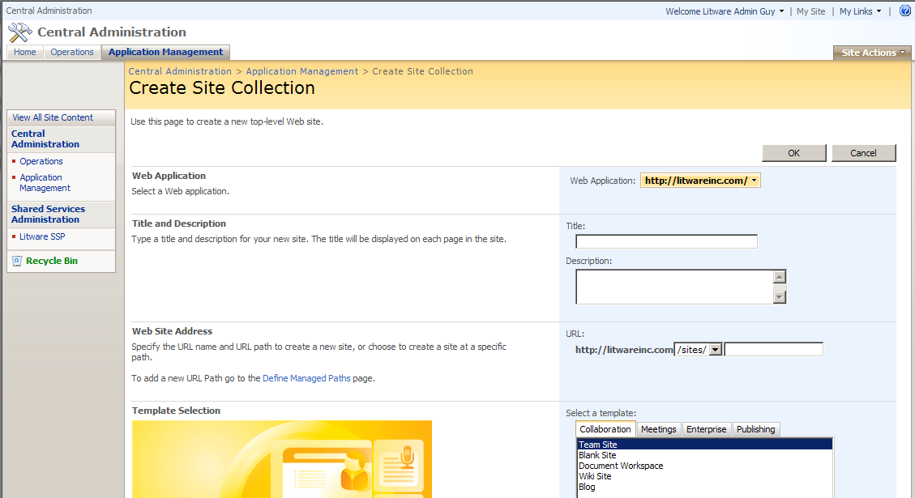

Creating a New WSS Site Collection
Site collections can be created via:
Central Administration Web site
STSADM.EXE
SharePoint API

Slide 9
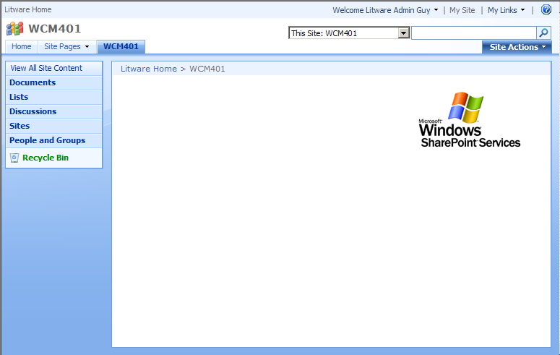
WSS 3.0 Sites
Site owners manage content & security
Can delegate creation / management of content & security permissions to other users
Top-level sites can contain child sites
Child sites can also have subsites, and so on

Slide 10
SharePoint Administration
Central Administration Web Site
Special WSS v3 Web site available to farm admins
Can do most admin functions, but not all
MOSS adds additional links for additional admin functionality
Extensible (just another SharePoint site)…
Can not be personalized
STSADM.EXE command line utility
Can do everything Central Administration Web site can do, and more
Commands can be automated / scripted via batch files
Extensible… developers can add custom commands

Slide 11
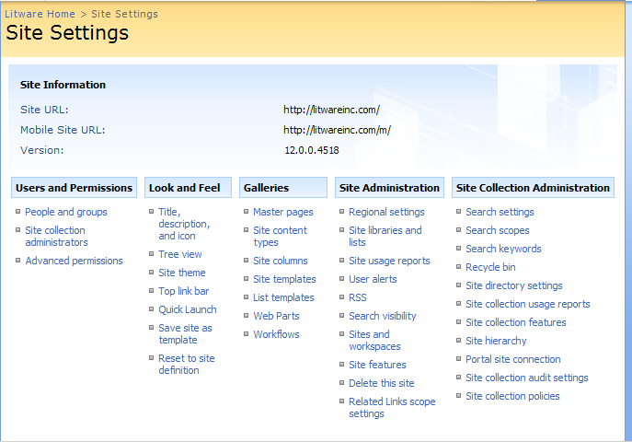
Site Administration – Site Settings
All WSS sites have a site settings page, accessible via the Site Actions menu
Contains links to admin pages (security trimmed)
Top-level site in a site collection has extra site collection administration links

Slide 12
Concept of Templates vs. Instances
Pages in a site exist in the site object model as SPFiles
All pages live within folders (SPFolder)
Concept of customized vs. uncustomized files
Uncustomized Page – Appears in site’s hierarchy, but content of page resides on the file system
Customized Page – Appears in site’s hierarchy, but content of page resides in the site’s content DB

Slide 13

Uncustomized vs. Customized Files
Browser / Web Services
SharePoint Designer
SharePoint (HTTP Application / Modules / Handlers)
Source of the file is retrieved… first
the content database is checked
SPFile
http://foo/somePage.aspx
* if file is uncustomized, underlying template is fetched
File template / definition
[ .. ]\12\TEMPLATE\FEATURES\SomeFeature\PageTemplate.aspx

Slide 14
Typical Site Development
Infrastructure assets
Create site column and content types via browser
Layout assets
Create master pages and page layouts with SharePoint Designer 2007
Modify look and feel, adding CSS and images using SharePoint Designer 2007

Slide 15
"Big Picture" Challenges
How do you make this development process repeatable? How to automate it?
What about source control?
SharePoint has version control on lists and libraries
No version control for infrastructure assets
No version control for site pages and files
What about a true software development lifecycle process?
What about change management process?

Slide 16
SharePoint Customization
Creating and editing instances of assets that live exclusively in the site’s content DB
Even if originally based off a template, source still lives in content DB
Tools used in SharePoint customization
SharePoint API
SharePoint browser interface
SharePoint Designer 2007

Slide 17
SharePoint Customization
Advantages
Plenty of resources documenting the process
WYSIWYG development with SharePoint Designer 2007
Easily make changes in multiple environments
Disadvantages
Site columns and content types are not easily moved between environments
Challenging to package and deploy
New files and changes to existing files
Multiple environments

Slide 18
Challenges In Creating Publishing Sites
Publishing sites exacerbate the challenges
All projects require sharing assets
Between developers on project team
Between environments (Dev / QA / UAT / Prod)
How to move asset change to other environments?
Manually move infrastructure and layout assets
Backup / restore (*** bad bad bad option! ***)
Content deployment
Does not promote code reuse!

Slide 19
SharePoint Development
Goals
Developers work at a lower level (file system)
Keep infrastructure / layout assets out of DB
SharePoint Feature schema allows creation of all kinds of assets
Upon activation, Feature creates uncustomized instances in the site
SharePoint solutions enable packaging of Features in one portable file

Slide 20
SP Development: Disadvantages
SharePoint Features are tedious to build
No visual designer
Lots of CAML (XML) markup
Minimal debugging support
Provisioning files requires double development
Feature deactivation leaves artifacts
Current tools do not promote this approach

Slide 21
SP Development: Advantages
Developers stay in Visual Studio
Keeps layout files uncustomized on server
Easy to package changes in order to
Share with other members on project dev team
Deploy to other environments
Fully leverage existing SCM solutions
Easier to adhere to SDL and change control

Slide 22
Tips And Tricks To SP Dev
Add CAML IntelliSense to Visual Studio
via Visual Studio XML Schema Cache
Using existing tools as IDE, then “Featurize”
Use browser for site column and content type creation
Use SharePoint Designer 2007 to create master pages and page layouts faster
Utilize SharePoint API to extract assets
STSADM.EXE Custom Commands
Automate process of building WSP’s

Slide 23
DEMO: Page Templates vs. Instances
Demo: Create a page using Office SharePoint Designer 2007
Demo: WssCreatePages
Create a page & add to site via Feature
Important Takeaways:
Customization vs. development
Concept of page template vs. page instance
Demo: WssCreatePageObjectModel
Create a customized page through the object model

Slide 24
Two Types of Pages
Content pages:
Web Part Pages
List pages (display / new / edit forms)
Can be personalized
Can use customized master pages
Application pages:
Shared with all sites on a WFE server
Live within [..]\12\TEMPLATE\LAYOUTS
Can not be personalized
All share a single master page (application.master)

Slide 25
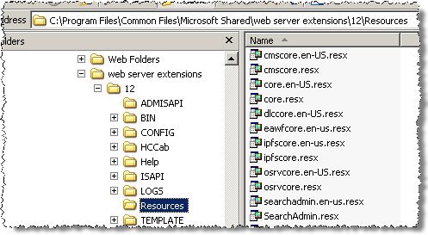

WSS Resource Files
Provide an easy way for localizing a solution
Special tokens used in XML files
Ability to target a specific token file

Slide 26
SharePoint Features
Features are the building blocks of WSS 3.0 sites
Low-level, reusable vehicle to define and deploy elements within a site
Two primary uses:
Define and create site elements
Deployment and implementation of new functionality
Can be activated on existing sites!
Added flexibility that site definitions can’t provide

Slide 27
What Can Features Do?
Deploy site columns & content types
Define & deploy list templates
Create list instances from templates
Define & deploy page templates
Create page instances from templates
Deploy Web Parts
Deploy custom workflow templates
Deploy event receivers to lists templates
Create new menu items in the various menus within SharePoint sites

Slide 28
Advantages of Features
Promote functionality & code reuse across sites
No longer have to copy the same list template definition / instances across multiple site definitions
Features can be applied to any site within a SharePoint farm
Features can be added / removed to sites via activation / deactivation
Features can activate other dependent Features

Slide 29
Advantages of Features (Part 2)
Used to deploy custom code solutions
Event receivers
Create custom permission levels
Workflows
Features can be “stapled” to site definitions, thereby adding functionality to new sites
Features are extensible!
Developers can write custom code to handle Feature events

Slide 30
Feature Installation & Scope
All Features live in one place:
[..]\12\TEMPLATE\FEATURES
Must be installed to make SharePoint aware
Installation only possible via STSADM.exe or the API
Once installed, available for activation at it’s defined scope
Feature scope options:
Farm
Web Application
Site Collection
Site

Slide 31
Feature Activation / Deactivation
Activation options
Via pages linked from each site’s “Site Settings” page
Features can be hidden
Requiring farm administrators for activation
Activation dependent upon the scope
Feature activation dependencies
Feature stapling – attaching to site definitions
Feature deactivation
Removes functionality in Feature
Data created by Feature activation is not removed upon deactivation

Slide 32
WSS Solution Packages
Deployment vehicle for custom code & files
WSS solution packages are CAB files with a WSP extension
Replaces WSS 2.0’s Web Part packages
Possible contents:
Site definitions
Feature definitions
Images & script files for site definitions, Web Parts, etc.
Assemblies (deployed to a site’s \bin or the GAC)
Custom code access security policies
InfoPath forms for Forms Services
manifest.xml file used to tell SharePoint where files go

Slide 33
Creating WSS Solution Packages
Create solutions using MakeCab.exe (included in the Microsoft Cabinet SDK – Q310618)
MakeCab.exe requires a Diamond Directive File (*.ddf) as an input parameter
Defines what files to include in the package, where they are on the source system, and where to put them in the target package (including subfolders)

Slide 34
Working with Solutions
Add solution to farm’s Solution Store:
stsadm.exe –o addsolution –filename c:\foo.wsp
Deploy solution:
stsadm.exe –o deploysolution –name foo.wsp –url http://bar -local
Upgrading solutions:
Re-adds solution to farm’s solution store and if previously deployed, redeploys
stsadm.exe –o upgradesolution –name foo.wsp -filename c:\foo.wsp –url http://bar -local
Retracting solutions:
“Undeploys” a deployed solution

Slide 35
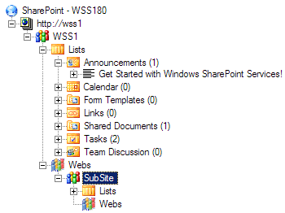
Introducing Microsoft.SharePoint.dll
SPWebApplication
SPSite
SPWeb
SPList
SPListItem
SPDocumentLibrary
SPWeb

Slide 36
DEMO: Utilizing Microsoft.SharePoint
Demo: WssObjectModel
Displays information about a specified WSS 3.0 site
Displays list of all lists within the specified WSS 3.0 site

Slide 37

Additional Commonly Used Objects
Event receivers
Most contain pre & post events
Pre events are synchronous and cancellable
Post events are asynchronous and not cancellable
Examples:
SPItemEventReceiver
SPListEventReceiver
SPWebEventReceiver
SPFeatureReceiver
SPContext (like ASP.NET 2.0’s HttpContext)

Slide 38
Development Environment Tips
Out-of-the-box SharePoint sites ship with ASP.NET 2.0 custom errors turned on
Sometimes the SharePoint error message doesn’t provide enough information

Slide 39




Development Environment Tips (Part 2)
Configure SharePoint to show the ASP.NET 2.0 “YSOD” (yellow screen of death)
Configure SharePoint to show the call stack
Where to do this?
web.config within the Web application’s Web root
web.config within the _layouts virtual directory

Slide 40
Debugging SharePoint Projects
No “F5” debugging
Need to manually attach to the Application Pool hosting the SharePoint site (w3wp.exe process)
Visual Studio: Debug -> Attach to Process…
Assemblies deployed to the GAC:
Need to deploy assembly symbol files to the GAC
Start -> RUN: %systemroot%\Assembly\GAC
Add *.PDB files to:
[AssemblyFile] \ [AssemblyVersion]__[AssemblyPublicKeyToken]
Now manually attach to w3wp.exe process
Use %windir%\system32\iisapp.vbs to get Application Pool process ID

Slide 41
Summary
Introduction to Windows SharePoint Services 3.0
Overview of WSS architecture
Overview of WSS collaboration capabilities
SharePoint customization vs. development
Customized / unghosted vs. uncustomized / ghosted
Templates vs. instances
Overview of SharePoint Features
Overview of WSS solution packages
Working with the Microsoft.SharePoint Namespace

