Slide 1
Office SharePoint Server 2007 & Web Content Management Overview

Slide 2
Agenda
Overview of Office SharePoint Server 2007 components
Shared Service Providers
Forms Services
Enterprise Content Management
Overview of Web Content Management
Web Content Management terminology
Working with the Microsoft.SharePoint.Publishing namespace

Slide 3
Overview of MOSS 2007 Components
Office SharePoint Server 2007
Built on top of WSS 3.0
Separate license from WSS 3.0
MOSS Standard License
SPS 2003 & MCMS 2002
Search, Social Networking
Web Content Management
MOSS Enterprise License
Business Data Catalog
Excel Services
Forms Services
WSS 3.0
.NET Framework v3.0
Internet Information Server v6
Windows Server 2003
MOSS 2007

Slide 4
MOSS Social Networking & Search
Similar search capabilities as SharePoint Portal Server 2003
My Sites
Profiles
Audience targeting
Added customization & configuration capabilities
Search Web Parts
Indexing of Business Data Catalog applications

Slide 5
MOSS Business Data Catalog
Introduced in MOSS 2007
Adds capability to make MOSS aware of LOB systems
Like a connection point to LOB DB’s or Web services
Content is not imported into MOSS
BDC application connections can be…
Indexed by MOSS search
Displayed using provided Web Parts
Used as lookup data within SharePoint lists
Consumed by custom Web Parts

Slide 6
MOSS Excel Services
Adds Business intelligence capabilities for MOSS
Tight integration with SQL Server 2005’s and Excel 2007’s business intelligence capabilities
Create KPI’s from SQL Server Analysis Services cubes
Design complex spreadsheets with Excel 2007 & upload for greater reach via the browser
Business intelligence features
Excel Services
Report Center
Dashboards

Slide 7
MOSS Forms Services
Biggest complaint of InfoPath 2003 – client install
Introducing Forms Services
Capability to host forms designed with InfoPath 2007 in the browser (cross browser: IE, Firefox, Safari, Opera)
Smart rendering
If the client has InfoPath 2007 installed, form loaded in the client
Otherwise, form rendered in the browser (can be forced)
Forms can be hosted in Windows forms and traditional ASP.NET 2.0 applications

Slide 8







Enterprise Content Management
Supporting the full lifecycle of content
Records Management
Records Repository
Hold actions
Document Management
Policies
Check in / check out
Workflow
Web Content Management
Author
Review/ Approve
Manage
Publish
Archive
Dispose
Integrated solution to manage the complete content lifecycle

Slide 9
MOSS Web Content Management
MOSS WCM features bring capability to author, host, and maintain content-centric sites in MOSS
Addresses challenges with content-centric sites
Maintain complex interactions B/T content authors
Enforcement of business rules
Promotes content reuse (not duplication)
Enforcing a common branding & user experience
Simplify content discovery
Terminology:
WCM = publishing technologies & capabilities
Publishing sites = SharePoint site that leverages WCM

Slide 10
Site Structure
Publishing sites are a hierarchy of Windows SharePoint Server (WSS) “Sites”
Hierarchy defines URL & navigation structure
Each site has a library for Pages
Pages are rendered by Page Layouts
Pages can be branded using Master Pages

Slide 11
Architecture of a Publishing Site
Site Collection – complete Publishing site
http://wcm.litwareinc.com
Sites – sections within a site
http://wcm.litwareinc.com/Divisions
Each site contains a Pages library, where all pages reside
http://wcm.litwareinc.com/Divisions/Pages/default.aspx

Slide 12


Page Rendering Process
http://litwareinc.com/Pages/Page.aspx
Name | PageLayout | Page Picture | Caption | Page Content
Page.aspx | Layout.aspx | /../image.png | Bla | Bla bla bla
CustomMaster.master
#4
#2
Microsoft.SharePoint.Publishing.PublishingLayoutPage
#1 Page request
Layout.aspx
#4
Field Ctrl
#3
#4
Field Ctrl
SPWeb.CustomMasterUrl
Field Ctrl
#4
Web Part
#3
#5
Generated HTML
ASP.NET Web Part Personalization DB (resides in site collection’s content DB)
4. ASP.NET runtime takes over and field controls (server controls) read/write to fields & Web Parts interact with the ASP.NET WP Personalization store
5. The generated HTML is then sent back down to the user
1. User requests page, SharePoint retrieves corresponding SPListItem in Pages list
2. SharePoint retrieves the page layout ASPX the page uses
3. OOTB page layout class automatically merges SPWeb.CustomMasterUrl

Slide 13
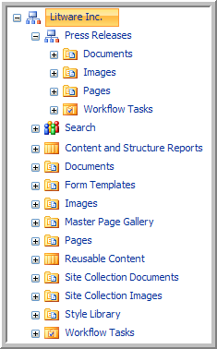
Architecture of a Publishing Site
Each site can have unique permissions
Each site has content galleries
Documents, Images & Pages
Root site has special galleries
Master Page Gallery
Reports
Reusable Content
Site Collection Documents & Images

Slide 14
ABC’s of Web Content Management
Authoring – empowering content owners
Web-based authoring experience
Word / InfoPath authoring experience
Branding – enforcing consistent user experience
Master pages & page layouts
Controlled Publishing – enforcing rules & policies
Controlling who can author content & where
Controlling who can approve & publishing

Slide 15
Authoring Content
Various methods to enter / edit content
Web-based authoring experience
Word / InfoPath authoring experience via Document Converters (extensible!!!)
Content types & page layouts
Content reports
Reusable content

Slide 16
Branding: Implementing Consistent UX
Common look & feel
Master pages, images & CSS
Create content page templates
Site columns & content types
Page layouts
Editable content regions
Field controls & Web Parts

Slide 17
Controlled Publishing
Granular permissions
History & versioning
Page scheduling
Out-of-the-box workflow
Custom workflow
Content deployment

Slide 18




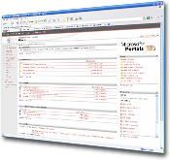





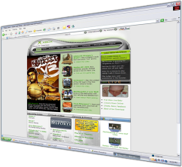



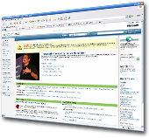




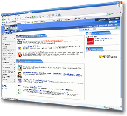

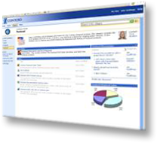

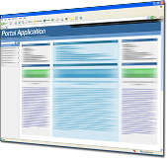
Single Infrastructure for Intranet, Internet, and Extranet Portals
Extranet
Enterprise
Internet
Division
Team
Individual

Slide 19
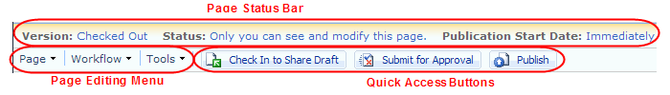
Page Editing Toolbar
Contains most common page authoring tasks
Creating / editing pages
Checking in / out pages
Starting & interacting with workflows
Three main sections:
Page Status Bar
Page Editing Menu
Quick Access Buttons

Slide 20
Content & Site Owner Tools
Manage Content & Structure Page
Site & content owner accessible only
Overhead view of entire site topology
Reports
Saved CAML queries
Reusable Content
Content fragments for inclusion in pages
Choice of inserting a copy or an auto-updating reference

Slide 21
DEMO: Creating A Publishing Site
Demo: Creating a Publishing Site
Creating standard Publishing site and taking a look around

Slide 22
Introducing Microsoft.SharePoint.Publishing.dll
PublishingSite
PublishingWeb
SPDocumentLibrary
SPList
PublishingPage

Slide 23
DEMO: MSFT.SharePoint.Publishing.dll
Demo: PublishingObjectModel
Displays information about a specified Publishing site
Displays all Page Layouts within a specified Publishing site
Displays all pages within a specified Publishing site

Slide 24
Summary
Overview of Office SharePoint Server 2007 components
Shared Service Providers
Forms Services
Enterprise Content Management
Overview of Web Content Management
Web Content Management terminology
Working with the Microsoft.SharePoint.Publishing namespace

