Slide 1
Authentication & Authorization
SharePoint Security Fundamentals

Slide 2
Agenda
Windows SharePoint Services security groups
Web Content Management security groups
Permission management & inheritance
Creating custom permission levels
WSS security architecture
Pluggable authentication
Alternate access mappings

Slide 3
Overview of Security & Permissions
Securable objects can be assigned permissions
Site collections
Sites
Lists & libraries
List items & documents
Use permission levels to group permission types
Assign permission levels to SharePoint groups
Use SharePoint groups to grant people rights
Assign users and groups to SharePoint groups

Slide 4
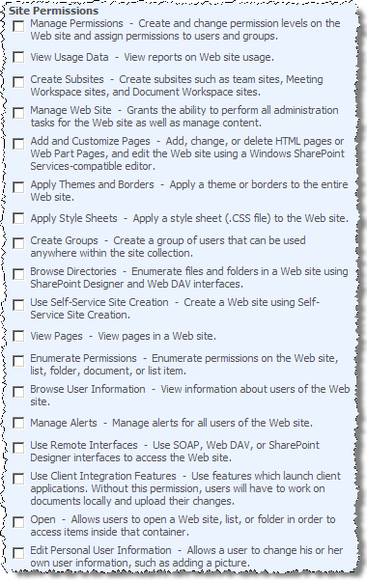
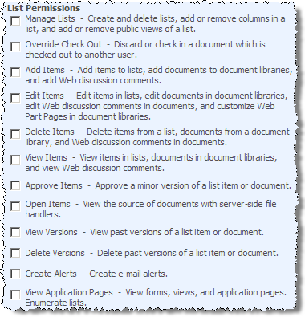
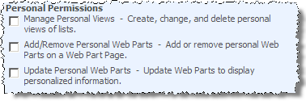
WSS 3.0 Permissions

Slide 5
WSS 3.0 Permission Levels
Limited Access:
Can view specific lists & libraries, list items, and folders when given permissions
Can’t be removed
Read:
Read only access… no edit rights
Contribute:
Can view, add, update & delete items in lists & libraries
Design:
Contribute rights + approve & customize
Full Control:
Unrestricted access

Slide 6
WSS 3.0 SharePoint Groups
Visitors
Granted permission level Read
Members
Granted permission level Contribute
Owners
Granted permission level Full Control

Slide 7
WCM Permission Levels
Same permission levels as WSS sites plus the following…
Approve:
Can edit & approve pages, list items & documents submitted for approval
Manage Hierarchy:
Can create & manage sites, pages, list items and documents
Restricted Read:
Can read pages & documents, but not previous versions or rights information

Slide 8
WCM SharePoint Groups
Same SharePoint groups as WSS sites plus the following…
Approvers
Granted Approve & Limited Access permission levels
Designers
Granted Design & Limited Access permission levels
Hierarchy Managers
Granted Limited Access & Manage Hierarchy permission levels
Quick Deploy Users
Granted Limited Access permission level
Restricted Readers
Granted Limited Access & Restricted Read permission levels
Style Resource Readers
Granted Read permission to Master Page Gallery & Restricted Read to Style Library
All authenticated users are members of this group

Slide 9
Permission Mgmt & Inheritance
By default, all SharePoint securable objects inherit permissions of their parent object
Administrators can:
Break inheritance & assign unique permissions to any securable object
Re-establish permission inheritances

Slide 10
Customizing Groups & Permission Levels
SharePoint Groups & Permission Levels can be created & customized via the browser UX or API
Important object model classes:
SPUser = SharePoint user
SPGroup = SharePoint group
SPRoleDefinition = Permission level
SPRoleAssignment = used to associate a user / group with a permission level (in conjunction with the following class…)
SPRoleDefinitionBindingCollection = similar to a join table… used to associate users / groups with permission levels

Slide 11
SharePoint Security via the API
SharePoint Site (SPWeb)
RoleAssignments
SPRoleAssignment
RoleDefinitionBindings
SharePoint Group
Permission Level (SPRoleDefinition)

Slide 12
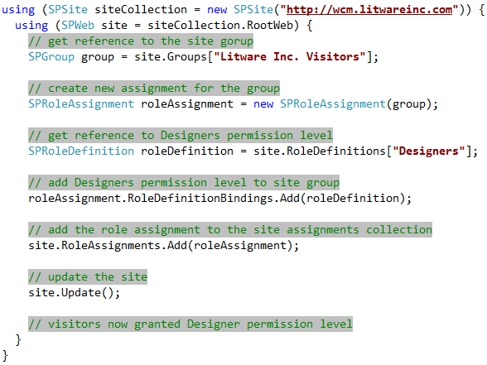
Adding Permission Levels To Groups

Slide 13
DEMO: Working with Permissions via API
Demo: CustomPermissionLevelFeature
Create a custom permission level with a Feature
Custom permission levels can be used as application roles

Slide 14
The “Lockdown Feature”
By default, all users in a SharePoint site can access the SharePoint-y pages
http://wcm.litwareinc.com/pages/forms/allitems.aspx
Not desirable in Publishing sites
Controlled by the “View Application Pages” right granted by “Limited Access”
SPBasePermissions.ViewFormPages
Feature ViewFormPagesLockdown removes this right from Limited Access
Automatically activated by Publishing Portal template

Slide 15
Policy for Web Applications
Allows farm administrators to specify which users have global rights to all sites in site collections within a Web application
Options:
Full Control
Full Read
Deny Read
Deny Write
Overrules any permissions set at a lower level
Example use: company facing litigation can deny an employee write access to a site collection

Slide 16
Pluggable Authentication
ASP.NET 2.0’s membership provider model available to all SharePoint sites!
Not restricted to Active Directory
Forms Based Authentication (FBA)
Including custom authentication providers
Anonymous Access

Slide 17
Alternate Access Mappings
Create multiple paths into a site collection
Up to 5 unique paths (one for each zone)
Possible uses:
Limit external access
Leverage existing internal authentication
Example:
http://internet.litwareinc.com
Anonymous Access + FBA against custom user store
http://extranet.litwareinc.com
Non-anonymous access + AD against corp AD

Slide 18






Alternate Access Mappings (Part 2)
Site Collection Litware Corp. Publishing Site
Web Application
http://extranet.litwareinc.com
Web Application
http://internet.litwareinc.com
Windows Authentication
No anonymous access
Forms Based Authentication
Anonymous access

Slide 19
Summary
Windows SharePoint Services security groups
Web Content Management security groups
Permission management & inheritance
Creating custom permission levels
WSS security architecture
Pluggable authentication
Alternate access mappings

