Slide 1
Creating Master Pages & Configuring Navigation
Creating Consistent User Experiences

Slide 2
Agenda
Master pages in Windows SharePoint Services 3.0
Page templates vs. page instances
Creating, editing & managing master pages
Office SharePoint Designer 2007
Visual Studio (Features & solutions)
WSS 3.0 & MOSS 2007 navigation
Managing & customizing navigation in Publishing sites

Slide 3
Master Pages in WSS 3.0
Recall two previous concepts:
Page templates vs. instances
Content pages vs. application pages
Master pages live within the Master Page Gallery
http://www.litwareinc.com/_catalogs/masterpage
Exists only in the top-level site within a site collection
Upon site provisioning, default.master added to Master Page Gallery as GhostableInLibrary
While living in the Master Page Gallery as uncustomized, the default.master on the file system is used

Slide 4
Master Pages in Publishing Sites
Publishing Portal site template provisions 8 additional master pages, specific to publishing sites
Provisioned using the PublishingLayouts Feature
BlueBand.master | BlueGlassBand.master
BlackSingleLevel.master | BlueTabs.master
BlackVertical.master | BlueVertical.master
BlackBand.master | OrangeSingleLevel.master

Slide 5
Creating & Editing Master Pages
Create & edit using:
Office SharePoint Designer 2007
Any text editor
All master pages in SharePoint must contain a minimum number of content placeholders
Can hide unused ones with <asp:panel visible=“false” runat=“server”>
Add master pages to Master Page Gallery using:
Office SharePoint Designer 2007
Initially added as customized
Features using <module> elements
Initially added as uncustomized instances based off file templates

Slide 6
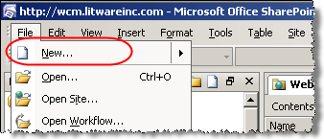
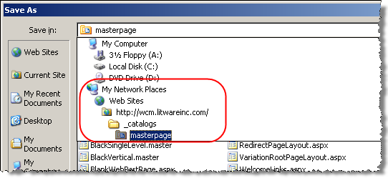
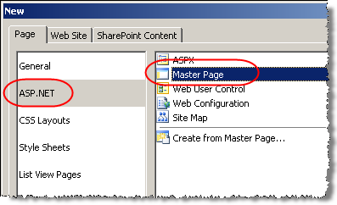
Creating Master Pages with SPD
In order for others to see and use it:
Check in
Publish a major version
Approve Publishing request
Create new ASP.NET master page
Add all necessary SharePoint content placeholders & branding markup to the master page
Save master page into
the Master Page Gallery
(http://[site]/_catalogs/masterpage)

Slide 7
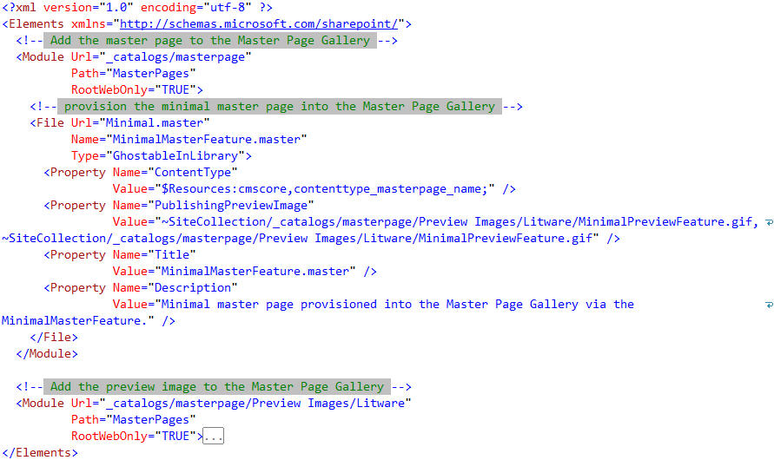
Creating Master Pages with Features

Slide 8
DEMO: Minimal Master Pages
Demo: Minimal.master
Creating a “minimal master”, or a master page with no branding using Office SharePoint Designer 2007
Demo: MinimalMasterFeature
Create & provision a minimal master page template & using a Feature
Create a Feature that adds the minimal master to all newly created sites via “Feature stapling”

Slide 9
Two Types of Master Pages
MasterUrl
In Publishing sites, used in all “SharePoint-y pages”
List pages: new / edit / display
On the Site Settings / Master Page configuration page, this is the System Master Page (the 2nd one)
CustomMasterUrl
In Publishing sites, used by all Page Layouts
On the Site Settings / Master Page configuration page, this is the Site Master Page (the 1st one)

Slide 10
Special Master Page Tokens
SharePoint uses tokens with the MasterUrl & CustomMasterUrl attribute in a page declaration to dynamically inject the appropriate master page URL
Dynamic tokens (whole string is the token):
~masterurl/default.master – replaced at runtime with the value in SPWeb.MasterUrl property
~masterurl/custom.master – replaced at runtime with the value in SPWeb.CustomMasterUrl property
Static tokens:
~sitecollection/[x].master & ~site/[x].master – replaced at runtime with the site-relative or site collection-relative master page

Slide 11
SharePoint Delegate Controls
Areas carved out on master pages or site pages, designated for dynamic content injection
Content registered for a specific delegate control done using Features
Content can be any type of control (including server control)
Sequences specified at registration time dictate priority over other registered controls
Developers can add delegate controls… no special registration necessary

Slide 12
SharePoint Navigation Basics
SharePoint leverages ASP.NET 2.0’s navigation provider model
Navigation data source
Navigation [rendering] control
ASP.NET 2.0 navigation provider model separates navigation data from rendering
Enables easy modification of rendering
SharePoint includes modified ASP.NET 2.0 menu navigation control: <sharepoint:aspmenu>
Like permissions, can optionally inherit from parent

Slide 13
Publishing Site Navigation
Simple navigation modifications via Site Settings
Change sorting (manual & automatic)
Add headings & pages
Include / exclude subsites & pages
Additional customization via properties on core navigation components
Three core components:
Navigation control: <SharePoint:AspMenu>
Data source properties: PortalSiteMapDataSource
Site map provider: PortalSiteMapProvider

Slide 14
DEMO: Examining Navigation Components
Demo: Touring the primary navigation components within a Publishing site

Slide 15
SharePoint:AspMenu
DataSourceID
ID of the data source providing nav hierarchy
Orientation
Horizontal | Vertical
StaticDisplayLevels
Number of hierarchy navigation levels to display
MaximumDynamicDisplayLevels
Maximum number of hierarchy navigation levels to display
DHTML flyouts

Slide 16
PortalSiteMapDataSource
ShowStartingNode
Include starting node in navigation data or not
StartFromCurrentNode
When true, data source uses own logic to determine where to start (leave set to true)
TreatStartingNodeAsCurrent
Which node is treated as the current node
Notes:
StartFromCurrentNode affects where the data source starts but things get a little bit interesting here. This property is set to "true" and the current node (i.e. the node representing the item currently being visited) is Web Site - 2. It seems to follow that the data source should start with Web Site - 2 and display the items beneath. However, we've noticed that the menu starts at the root Web site, NavigationExample. So what gives? This is where MOSS navigation starts handling things a little bit differently. By specifying StartFromCurrentNode="true", this is essentially a flag that tells the PortalSiteMapDataSource to apply its own concepts to determine where it should be starting. I'm going to wait until I get to the PortalSiteMapProvider before explaining how this process works, but for now suffice it to say that you should always specify StartFromCurrentNode="true" when using the PortalSiteMapDataSource.

Slide 17
PortalSiteMapDataSource (Part 2)
TrimNonCurrentTypes
Remove nodes directly in current node
TrimNonAncestorTypes
Remove nodes directly above or below current node
TrimNonAncestorDescentent
Remove nodes above or below current node
Possible Types:
Heading
Page
AuthoredLink

Slide 18
PortalSiteMapProvider
NavigationType
Global: includes links from TopNavigationBar collection
Current: includes links from QuickLaunch collection
Combined: acts like Global when site not set to inherit; acts like Current when site set to inherit
EncodeOutput
HTML encodes the navigation node title
DynamicChildLimit
Number of navigation nodes to include for flyouts

Slide 19
PortalSiteMapProvider (Part 2)
RequireUniqueKeysForNodes
IncludeSubSites & IncludePages
Always: ignore SPWeb’s settings, always include these types of navigation items
PerWeb: respects each SPWeb’s settings
Never: ignore SPWeb’s settings, never include these types of navigation items
IncludeHeadings & IncludeAuthoredLinks
Boolean flags to include / not include types of links

Slide 20
DEMO: Customizing the OOTB Nav.
Demo: Customizing the out-of-the-box navigation components
Navigation control (<SharePoint:AspMenu>)
Site map data source

Slide 21
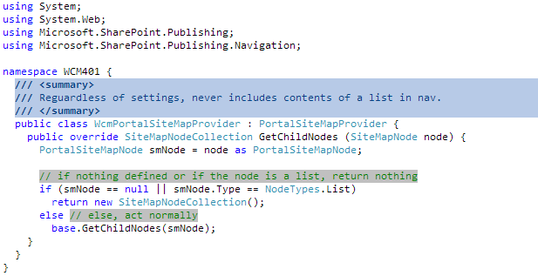
Customizing Navigation via API
What if PortalSiteMapProvider is not suitable?
Do not recreate a brand new site map provider
Subclass SharePoint PortalSiteMapProvider

Slide 22
Customizing Navigation via API (Part 2)
Manipulate navigation via SharePoint API
SPWeb.Navigation.QuickLaunchBar – provides a reference to the site’s Quick Launch navigation
SPWeb.Navigation.TopNavigationNode – provides a reference to the site’s Global Navigation (tabbed, horizontal navigation)
SPNavigationNode & SPNavigationNodeCollection – used to create navigation items (menu items)

Slide 23
Summary
Master pages in Windows SharePoint Services 3.0
Page templates vs. page instances
Creating, editing & managing master pages
Office SharePoint Designer 2007
Visual Studio (Features & solutions)
WSS 3.0 & MOSS 2007 navigation
Managing & customizing navigation in Publishing sites

