Slide 1
Creating Custom Page Layouts
Working with Page Templates

Slide 2
Agenda
Role of site columns & content types in Publishing sites
Creating, editing & managing page layouts
Office SharePoint Designer 2007
Visual Studio (Features & solutions)
Field controls & Web Parts
Customizing Rich HTML Editor control

Slide 3
Site Columns
Reusable column template for use within lists and content types
Specify:
Name & description
Data type
Site column group
Scoped at the site level
Available to child sites
Adding to a list / content type creates a copy
To manage, must have Web designer rights

Slide 4
Creating & Managing Site Columns
Create / manage many ways:
Browser-based user interface
SharePoint object model
Feature XML <Field>
Features & object model provide most control
Easy to version in virtually all source control systems
Highest level of reuse
Avoiding dreaded company_x0020_name in CAML

Slide 5
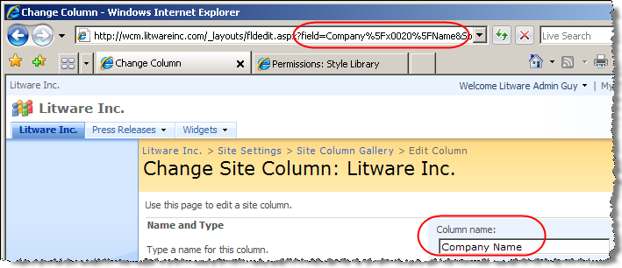
The Feared & Dreaded _x0020_ !!!
URL Encoded version of Company_x0020_Name

Slide 6
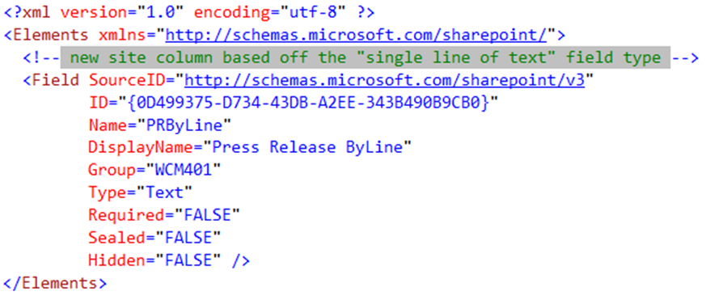
Creating Site Columns with Features

Slide 7
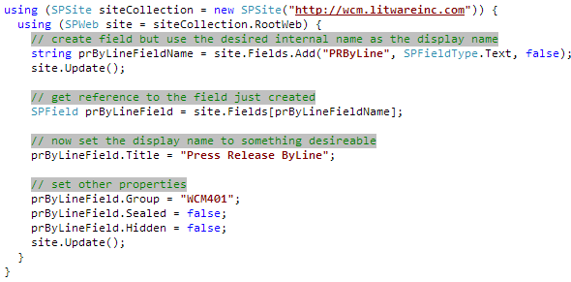
Creating Site Columns via API
Need a workaround to avoid the _x0020_ issue
Create field using the internal name & immediately update display name
Display Name
Field Type
Required

Slide 8
Content Types
Used to define a type of data
Enable storage of different types of content in same list or library
Specify:
Name & description
Site columns, workflows, event receivers, policies, etc.
Content type group
Scoped at the site level
Available to child sites
Adding to a list creates a copy
To manage, must have Web designer rights

Slide 9
Creating & Managing Content Types
Create / manage many ways:
Browser-based user interface
SharePoint object model
Feature XML <ContentType>
Features & object model provide most control
Easy to version in virtually all systems
Highest level of reuse

Slide 10
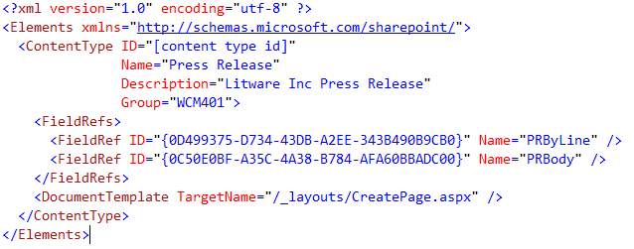
Creating Content Types with Features

Slide 11
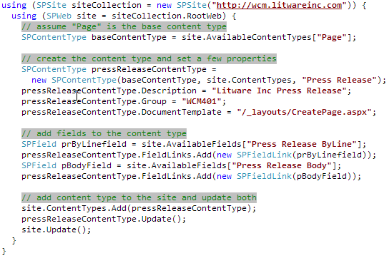
Creating Content Types via API

Slide 12
Site Columns & Content Types In Publishing Sites
Site columns & content types play a key role in Publishing sites
Both are used to define schema for content pages
Content types must inherit from the Page content type (which inherits from System Page)
[..]\FEATURES\PublishingResources\PublishingContentTypes.xml
0x010100C568DB52D9D0A14D9B2FDCC96666E9F2007948130EC3DB064584E219954237AF39
Page layouts must be associated with content types

Slide 13
Overview of Page Layouts
Combined with master page to define the rendering of a content page
Obtains master page from SPWeb.CustomMasterUrl
Hosts field controls and Web Part zones
Complies to the Page Layout content type
Has an associated content type
Dictates which content type the page layout is used for rendering
Can bind multiple page layouts to content type
Associated with exactly one content type

Slide 14
Page Layouts in Publishing Sites
Recall previous concept:
Page templates vs. instances
Page layouts live within the Master Page Gallery
http://www.Litwareinc.com/_catalogs/masterpage
Exists only in the top-level site within a site collection
Upon site provisioning, page layout added to Master Page Gallery as GhostableInLibrary
While living in the Master Page Gallery as uncustomized, the page layout on the file system is used

Slide 15
Components of Page Layouts
Field Controls (Module 8)
Field controls are bound fields within pages list item
Used to statically place content on a page
Content owners can NOT move or modify field controls
Developers can create custom field controls
Web Parts (Module 7)
Designers & developers place Web Part zones on page layouts
Allow content owners more control over content
Edit Mode Panel (Module 6)
Used to show / hide renderings in display / edit mode

Slide 16
Field Controls & Web Parts Compared
 | Field Controls | Web Parts
Content Storage | In a field (column) in the page’s underlying SPListItem | Within the Web Part data of the page
Personalization | No | Yes
Versioning | Versioning tied to page with complete history | Versioning tied to page without history
Who has ultimate control? | Page designer / developer | Page designer (in placement of Web Part zones); content owner in managing of zone’s contents (add/edit Web Parts within Web Part zone)
When to use? | Specific types of content must appear in specified places of a page; structured formatting / branding | Structure of content on page (in part of a page) isn’t important; let content owners have full control

Slide 17
Customizing Rich HTML Editor Control
Rich HTML editor control used by default with fields of type Publishing HTML
Developers can specify if the following are / aren’t allowed within the field:
Specify using attributes in markup (or with SharePoint Designer’s tool window)
Extensible – add custom buttons to floating toolbar
Module 6
HTML Tables | Formatting (bold, italic, etc.)
Hyperlinks | Access to raw markup
Images | Which CSS Classes Are Available
Font Family or Sizes | Reusable Content
Font Colors

Slide 18
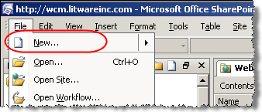
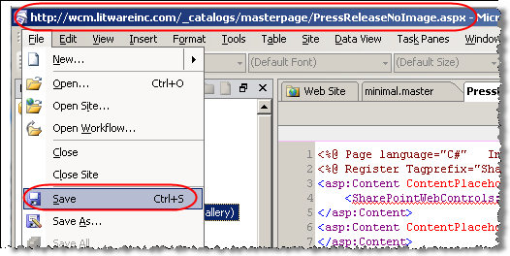
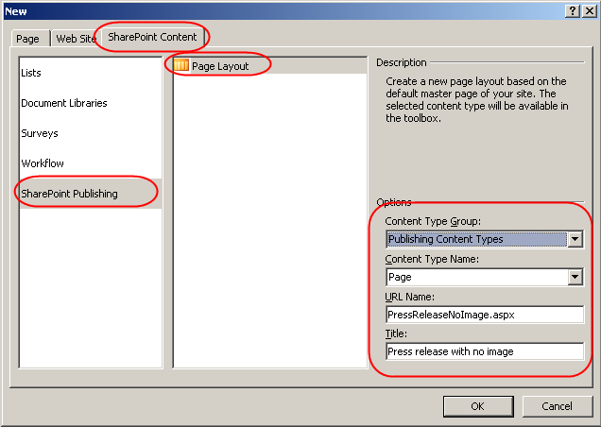
Creating Page Layouts with SPD 2007
In order for others to see and use it:
Check in
Publish a major version
Approve publishing request
Create new Publishing Page Layout
Add all necessary SharePoint field controls, Web Part zones & branding markup to the page layout
Save page layout into
the Master Page Gallery
(http://[site]/_catalogs/masterpage)

Slide 19
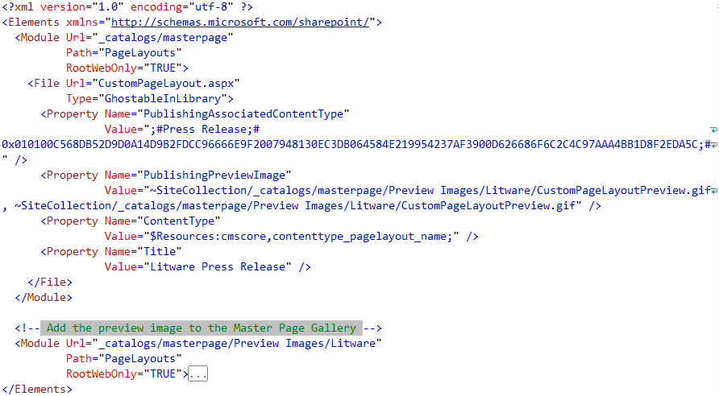
Creating Page Layouts with Features

Slide 20
DEMO: Creating Page Layouts
Demo: Creating content types & page layouts with the browser & SharePoint Designer interface
Create a new content type
Create a new page layout using SharePoint Designer
Add field controls, Web Part zones & Web Parts
Create new content page based on new page layout
Demo: PageLayoutFeature
Create new site columns, content type and page layout using a Feature instead of SharePoint Designer
Demo:
Modify which page layouts can be used within a subsite

Slide 21
Summary
Role of site columns & content types in Publishing sites
Creating, editing & managing page layouts
Office SharePoint Designer 2007
Visual Studio (Features & solutions)
Field controls & Web Parts
Customizing Rich HTML Editor control

