Slide 1
Extending the Out-Of-The-Box Authoring Experience
MOSS 2007 WCM Extensibility

Slide 2
Agenda
Custom actions (augmenting SharePoint menus)
Extensibility opportunities with Publishing sites
Leveraging the Edit Mode Panel
Extending the Rich HTML Editor control
Implementing Telerik’s RadEditor Lite
Extending the Page Editing Toolbar
Implementing an offline authoring experience
  Document converters

Slide 3
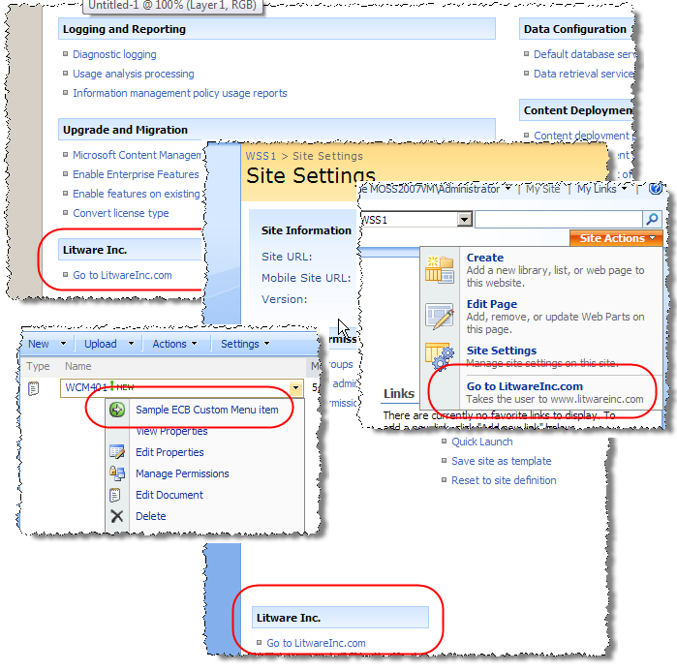
Augmenting SharePoint Menus
SharePoint menus
are easily
managed using
custom actions
in Features
<CustomActionsGroup>
<HideCustomAction>
<CustomAction>

Slide 4
Custom Actions
Areas affected by custom actions:
  Central Administration
  Site Settings
  Site Actions
  Edit Control Block (ECB)
  List menus (New | Upload | Actions)
  List form toolbars (New | Edit | View)
Custom Actions Can:
  Point to a URL, class or ASCX file
  Be associated with specific list types
  Security trimmed with rights assignments

Slide 5
Overview of Extensibility Options
Edit Mode Panel
  Useful to show certain elements in page layout files in different presentation modes (display | edit)
Rich HTML Editor field control
  Add new buttons to the authoring control
Page Editing Toolbar
  Can add / remove menu items from the Page Editing menu or Quick Access buttons area
Offline authoring capabilities
  Author pages using Word, InfoPath or another tool
  Upload to document library & pages generated automatically

Slide 6
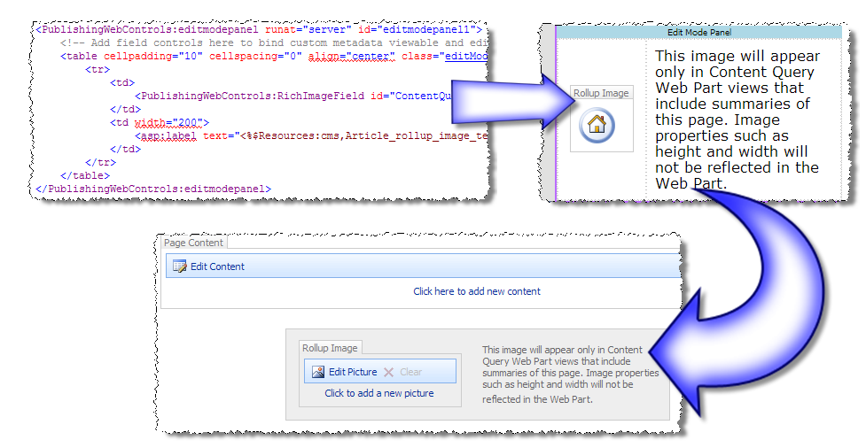
Leveraging the Edit Mode Panel
Edit Mode Panel:
  Control that contains other controls
  Renders contents in diff. states (display | edit) via PageDisplayMode
Possible uses:
  Article rollup image / keywords / metadata for the page

Slide 7
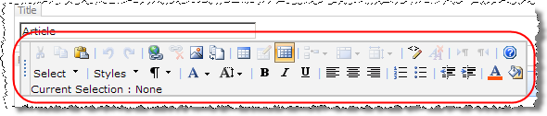
Rich HTML Editor Field Control
OOTB provides built-in buttons to
add & manage tables, links, formatting, images, etc.
Buttons can be enabled / disabled via markup
Custom buttons can be added
Custom styles can be specified, forcing content owners to use approved formatting (no free-form bold / italics / underline / font)

Slide 8
DEMO: Customizing the HTML Editor
DEMO: Customizing the Rich HTML Editor
field control
  Disabling certain buttons
  Designating specific CSS classes for use
  Adding custom buttons to the field control

Slide 9
Telerik’s RadEditor Lite
OOTB MOSS Rich HTML editor not cross browser capable (targeted for Internet Explorer)
Telerik’s RadEditor Lite
  Note: this is not the commercial full featured, RadEditor
  Fully cross browser
  Adds multiple undo levels
Customers with a MOSS license get
a RadEditor Lite for MOSS license
Get it from: http://www.telerik.com/sharepoint

Slide 10
DEMO: Implementing Telerik RadEditor
DEMO: Implementing the Telerik RadEditor
  Installation of the free Telerik RadEditor control
  Incorporating RadEditor as the HTML editor within page layouts

Slide 11
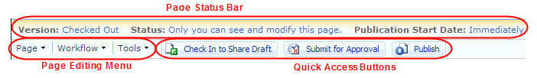
Extending the Page Editing Toolbar
Capability to add / remove items from the Page Editing Menu and / or Quick Access Buttons
How to customize:
  OOTB Editing Menu driven from XML files in
  ..\12\TEMPLATE\LAYOUTS\EditingMenu
  Problem is these are global to all sites on the server
  For site-by-site customizations, edit similar XML files in the site’s Master Page Gallery \ Editing Menu using SharePoint Designer

Slide 12

Customizing the Page Editing Menu
Deploy assembly containing class that inherits:
  Microsoft.SharePoint.Publishing
  .WebControls.EditingMenuActions
  .ConsoleAction
Add a reference to assembly containing
new command
  Similar to a ASPX / ASCX Register directive
Manipulate new / existing nodes within the <structure> section

Slide 13
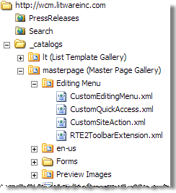
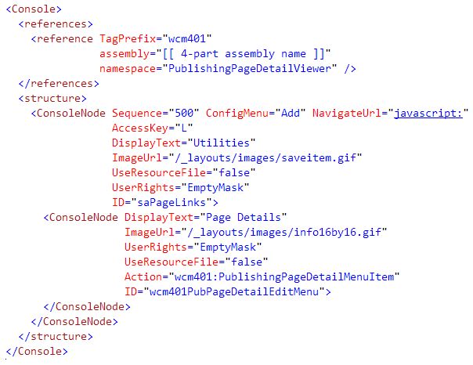
Customizing the Page Editing Menu

Slide 14

Customizing Quick Access Buttons
Deploy assembly containing class that inherits:
  Microsoft.SharePoint.Publishing
  .WebControls.EditingMenuActions
  .ConsoleAction
Add a reference to assembly containing
new command
  Similar to a ASPX / ASCX Register directive
Manipulate new / existing nodes within the <structure> section

Slide 15
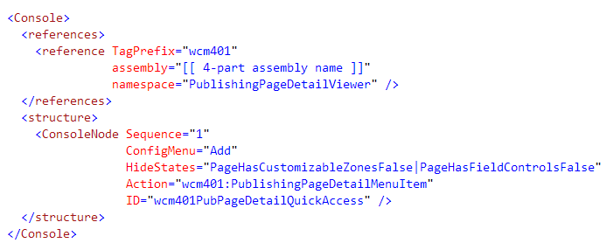
Customizing the Quick Access Buttons

Slide 16
DEMO: Page Editing Toolbar
DEMO: PublishingPageDetailViewer
  Adding a new menu action to the Page Editing menu
  Adding a new button to the Quick Access Buttons

Slide 17
Offline Authoring Capabilities
Content authors can author pages using
Word / InfoPath
  Once the document has been created, upload to a document library
  A registered document library picks up document & runs it through a document converter
  Document converter parses document, creating a content page in the configured /Pages library
  SharePoint creates an association between the document and content page for future updates
Document Converters included OOTB:
  Word, InfoPath or XML
Note: Microsoft calls this “smart client authoring”

Slide 18
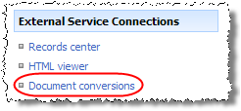
Setting up Document Converters
Configure two services on the SharePoint server:
  Document Converter Launcher Service
  Document Converter Load Balancer Service
Service setup & configuration:
  Central Admin -> Operations -> Services on server
Configure document conversions on
a per Web application
  Central Admin -> App. Management
Note: Document converters can not run on Windows
Active Directory Domain Controllers

Slide 19
Creating & Deploying Document Converters
Create a console application that does the
conversion work
  Must accept following input parameters:
    -in inFile
    -out outFile.html
    [-config configuration.xml]
    [-log logfile.xml]
Register custom converter with SharePoint
via a Feature
  Use the <DocumentConverter> node in a Feature elements manifest
  Must be scoped at the Web application level
Optionally create a custom ASPX for
converter-specific settings

Slide 20
Summary
Extensibility opportunities with Publishing sites
Custom actions (augmenting SharePoint menus)
Leveraging the Edit Mode Panel
Extending the Rich HTML Editor control
Implementing Telerik’s RadEditor Lite
Extending the Page Editing Toolbar
Implementing an offline authoring experience
  Document converters

