Slide 1
Leveraging Publishing & Custom Web Parts
Utilizing the OOTB WCM Web Parts and Creating Custom Web Parts

Slide 2
Agenda
Overview of Web Parts
Publishing Web Parts
Table Of Contents Web Part
Summary Links Web Part
Content Query Web Part
Creating custom Web Parts
Deployment of custom Web Parts

Slide 3
What is a Web Part?
ASP.NET 2.0 server control
Collection of controls to perform a specific function
Enables user to personalize their experience
Behavior
Content
Appearance
Two Web Parts can be connected to pass data between them
Example: List of Reports & Report Viewer

Slide 4
Possible Uses for Web Parts
Small functional components
Display contents of a list
Display an image
Part of a larger application
Entering sales orders
Window into another application
Microsoft SQL Server 2005 Reporting Services

Slide 5
Publishing Web Parts
Publishing sites have three additional Web Parts
Summary Links Web Part
Table of Contents Web Part
Content Query Web Part
All retrieve their structure as XML
All render presentation to HTML via XSLT
Developers can customize XSLT rendering
Tip: Content Query Web Part will eliminate need for most custom Web Parts

Slide 6
Summary Links Web Part
Allows content authors to manually create & manage headings and links
Supports multiple sorting options
Automatic (ascending / descending)
Manual
Also provided as a field control
Allows page designers / developers to restrict placement of Summary Links Web Part
Similar to the Links list (and associated Web Part), except more styling options
Ideal for providing extra links for a piece of content

Slide 7
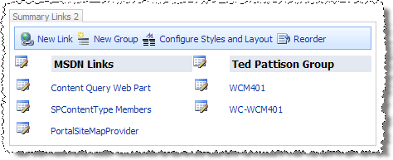
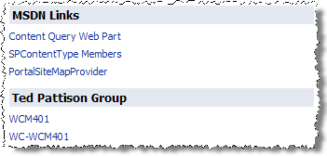
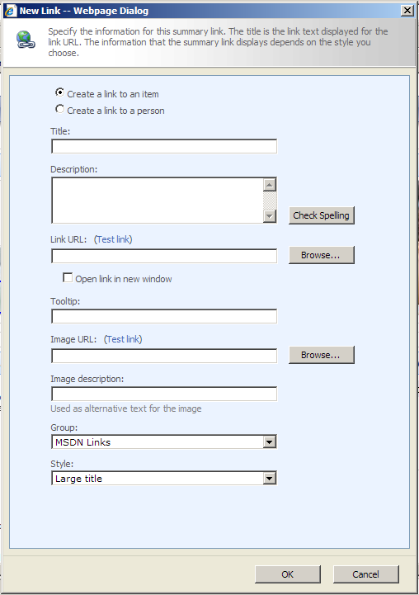

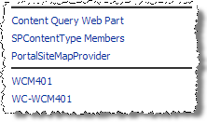
Summary Links Web Part (Part 2)
Edit Mode Experience
Display Mode Experience

Slide 8
Table of Contents Web Part
Displays pages from the current site
Optionally can include pages from child sites
Ideal for section welcome pages (homepage) showing
Helps keep site primary navigation from becoming cluttered with content pages

Slide 9
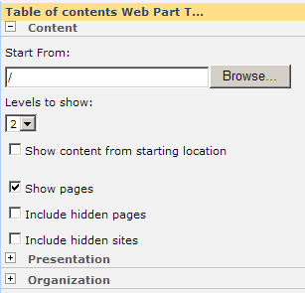
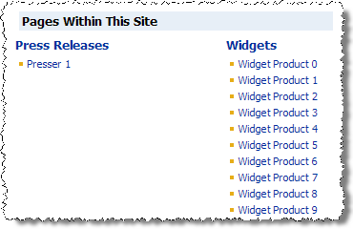
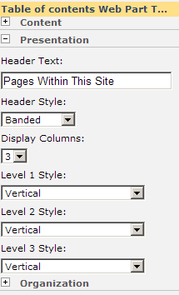
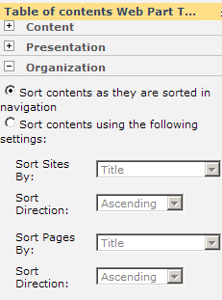
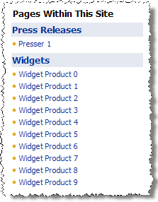
Table of Contents Web Part (Part 2)
Edit Mode Experience
Display Mode Experience

Slide 10
Content Query Web Part
Most powerful and flexible aggregation / rollup Web Part available in Publishing sites
Allows content author to specify:
Scope of query
Filtering by specific content type / list type
Filtering by field values
Grouping & sorting
Very performant with robust caching techniques leveraged within the Web Part

Slide 11
Advanced Customizing of the CQWP
Content Query Web Part provides many configuration options via the Web Part Task Pane
For advanced customization:
Export the CQWP to a *.webpart file
Modify CQWP’s public properties directly in the *.webpart file
Import *.webpart file
Use this technique to specify:
Specific CAML query to execute
Specify additional content fields to include in result set
Additional filtering capabilities

Slide 12
DEMO: Content Query Web Part
Working with the Content Query Web Part’s Task Pane
Viewing all available properties in the CQWP by exporting it to a *.webpart file

Slide 13
Styling the Publishing Web Parts
All Publishing Web Parts (Summary Links, Table of Contents, Content Query) return query results as XML, passing through XSL to generate HTML
MOSS includes many OOTB style sheets for use
All found in the Style Library in the top-level web:
http://.../Style Library/XSL Style Sheets
Instead of customizing the provided XSL style sheets, create new ones
Benefit: can be packaged in a Feature for easy deployment

Slide 14
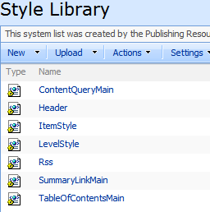
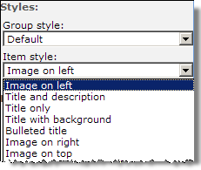
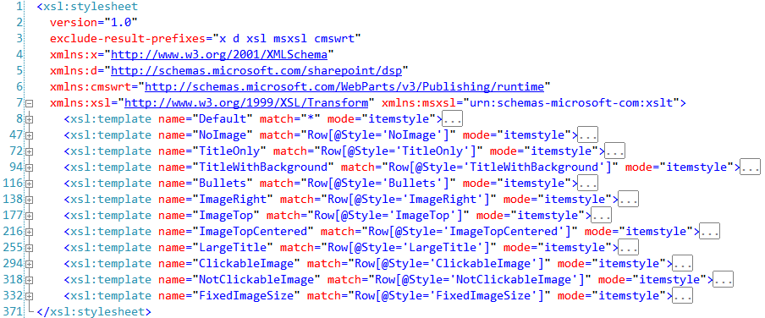
Styling Publishing Web Parts (Part 2)
ItemStyle.xsl

Slide 15
DEMO: Customizing Rendering of the CQWP
Create a new style sheet
Define a new rendering style
Configure Publishing Web Part to use new XSL style sheet

Slide 16
Custom Web Parts
Why would you need to develop Web Parts?
Frequently the provided Publishing Web Parts do not meet unique business needs
Want to provide content owners more flexibility in the layout of a page
Provide a personalized experience
Provide a mini-application (current weather applet)
Develop custom Web Parts as ASP.NET 2.0 Web Parts
WSS 3.0 API includes a Web Part class, but it is primarily there for backwards compatibility

Slide 17
Creating Custom Web Parts
Build a typical ASP.NET 2.0 server control:
Create a new class that inherits from: System.Web.UI.WebControls.WebParts.WebPart
Override CreateChildControls()
Used to add any child controls to the page such as buttons, textboxes, labels, etc.
Override RenderContents()
Renders the contents of the Web Part, inside the outer tags and Web Part chrome
Never override Render()!!!!
SharePoint overrides Render() to include the Web Part chrome and outer tags

Slide 18
Creating Custom Web Parts (Part 2)
Few extra steps to get an ASP.NET 2.0 Web Part working in SharePoint:
Sign the assembly (need a strongly named assembly)
Tell ASP.NET 2.0 & SharePoint Web Part is OK to run
System.Security.AllowPartiallyTrustedCallers
<SafeControl />
Create Web Part definition file (*.webpart) with the type name (ie: five-part class name) and default public property settings
[webroot]\wpcatalog
http://.../_catalogs/wp (Web Part Gallery)

Slide 19
Real World Deployment Story
Deploy using WSS solution packages
Microsoft Cabinet files with *.WSP extension
Solution packages contain:
Assembly containing Web Part
Any resources (images, CSS, etc)
Web Part definition file (*.webpart)
Web Part Gallery
wpcatalog
Manifest of the solution contents (manifest.xml)
Add solution package to SharePoint farm’s solution store & deploy (Central Admin / STSADM.EXE)

Slide 20
DEMO: Creating Custom Web Parts
Demo: Creating a custom Web Part
Demo: Deploying Web Parts
Automatically populate the Web Part Gallery
Add Web Part definition file to a single site collection
Add Web Part to all site collections in a web application

Slide 21
Summary
Overview of Web Parts
Publishing Web Parts
Table Of Contents Web Part
Summary Links Web Part
Content Query Web Part
Creating custom Web Parts
Deployment of custom Web Parts

