Slide 1
Performance Tuning Publishing Sites
Making SharePoint 2007 Internet Scalable

Slide 2
Agenda
Revisiting Windows SharePoint Services 3.0 architecture
What benefits ASP.NET 2.0 brings to the table
Web Content Management Publishing performance enhancements
Page output cache via profiles & policies
Object caching
Disk-based caching
IIS Static & Dynamic Compression
Page Payload Concerns & Techniques
Prescriptive guidance when coding against the SharePoint API
Working with SharePoint collections
Proper memory management techniques

Slide 3
Performance Benefits From ASP.NET 2.0
ASP.NET 2.0’s introduction of the VirtualPathProvider, adoption of Web Part framework, and others allow WSS 3.0 to be built on top of the .NET Framework 3.0, eliminating the ISAPI filter in WSS v2
Page output caching heavily leveraged by MOSS 2007

Slide 4
Improving Performance with Caching
Two biggest improvements WRT performance:
Minimize roundtrips to the database
Avoid initializing and executing the ASP.NET 2.0 page lifecycle
Caching helps this in two ways:
Avoiding dynamic code execution
Retrieve data / files from memory: RAM / HDD (disk)

Slide 5
Page Output Cache
Fastest type of caching
After ASP.NET 2.0 page lifecycle generates the HTML markup it is saved in RAM
Future requests bypass the ASP.NET 2.0 page lifecycle and instead used cached HTML
Publishing sites provide Web interface to create cache “profiles”
Profiles assigned to individual sites
Note: not enabled by default

Slide 6
Object Cache
Like output cache, provided by ASP.NET 2.0
Commonly used objects are stored in RAM
Master pages, page layouts, etc.
Cross-site queries (ie: CQWP queries) stored in RAM to eliminate future roundtrips to the site collection’s content database
Note: not enabled by default
Amount of memory configurable (100MB = default)
Tip: Use the ASP.NET 2.0 performance counter Cache Hit Ratio to determine effectiveness:
Increase configured memory if not exceeding 90%

Slide 7
Disk-Based Cache
Commonly requested static files (images, CSS, JS, etc) stored in libraries in the site are pulled from the content database on each request
Disk-based cache stores these files on the WFE server’s disk to eliminate future round trips
Can optionally configure the max-age HTTP header causing user’s browsers to not request the files for a specified duration
Configured via the Web app’s web.config

Slide 8
DEMO: MOSS Caching Capabilities
Page output caching
Creating and managing profiles
Managing policies
Object caching
Disk-based caching
Configuring WFE blob caching

Slide 9
Static & Dynamic Compression
When SharePoint installed, IIS is configured to compress static & dynamic files
Static: HTM, HTML, TXT
Dynamic: ASP, EXE
Example: core.js is 257 KB on disk, but IIS compresses to 54 KB before sent to client
IIS compression level is configurable

Slide 10
IIS 6 vs. IIS 7 Compression
 | IIS 6 | IIS 7
Default Static Comp. | 10 | 7
Default Dynamic Comp. | 0 | 0
Compress by File Type | YES | NO
Compress by MIME Type | NO | YES
Compress content before adding to page output cache | NO | Configurable
In IIS 7, compression (static & dynamic) is on / off & is enabled / disabled based on CPU utilization
In IIS 7, markup can be compressed before inserting into page output cache
Not enabled by default

Slide 11
Windows 2003 / IIS 6 Compression
Tip: Add .CSS & .JS to static file list:
CSCRIPT.EXE ADSUTIL.VBS SET W3Svc/Filters/Compression/DEFLATE/HcFileExtensions “htm” “html” “txt” “css” “js”
CSCRIPT.EXE ADSUTIL.VBS SET W3Svc/Filters/Compression/GZIP/HcFileExtensions “htm” “html” “txt” “css” “js”
Tip: Add .AXD & .ASPX to dynamic file list
CSCRIPT.EXE ADSUTIL.VBS SET W3Svc/Filters/Compression/DEFLATE/HcScriptFileExtensions “asp” “exe” “axd” “aspx”
CSCRIPT.EXE ADSUTIL.VBS SET W3Svc/Filters/Compression/GZIP/HcScriptFileExtensions “asp” “exe” “axd” “aspx”
Tip: Increase dynamic compression level to 9
CSCRIPT.EXE ADSUTIL.VBS SET W3Svc/Filters/Compression/DEFLATE/HcDynamicCompressionLevel “9”
CSCRIPT.EXE ADSUTIL.VBS SET W3Svc/Filters/Compression/GZIP/HcDynamicCompressionLevel “9”
Note: higher compression level = higher CPU use
Tip: Don’t compress images (already compressed)

Slide 12
Windows 2008 / IIS 7
Tip: Increase dynamic compression level to 9
<httpCompression>
<scheme dynamicCompressionLevel=“9” />
</httpCompression>
Tip: Change dynamic compression CPU utilization threshold range from 20-75%
APPCMD.EXE set config –section:httpCompression /dynamicCompressionDisableCpuUsage:75
APPCMD.EXE set config –section:httpCompression /dynamicCompressionEnableCpuUsage:20
Tip: Enable caching before insertion into page output cache
APPCMD.EXE set config –section:urlCompression /dynamicCompressionBeforeCache:true

Slide 13
Publishing Portal Page Payload

Slide 14
Limiting The Page Payload
Page payload is the combined file size of a single page request
OOTB, Publishing Portal homepage is 204k
Content + branding = 91k (44.6% of payload)
core.js accounts for 54k (26% of payload)
Can implement techniques to “lazy load” core.js or even fully suppress it!
Configure IIS dynamic compression
Build accessible (CSS based) sites for up to a ~50% reduction in payload
MSKB # 933823: Delay loading of core.js
http://www.andrewconnell.com/go/163

Slide 15
.NET Framework & IDisposable
Objects implementing IDisposable interface signal developers should call Dispose() as early as possible
Calling Dispose() typically releases unmanaged resources not seen by the .NET Garbage Collector

Slide 16
Properly Disposing SharePoint Objects
SPSite & SPWeb are small managed code wrappers to much larger unmanaged code blocks
.NET Garbage Collector does not release these objects from memory in a timely manner because of the larger unmanaged portion
Tip: Don’t rely on the .NET Garbage Collector, call Dispose() when finished using them
Under heavy loads, this can cause:
High memory use & OutOfMemory() exceptions
Frequent WSS application pool recycles
Application crashes

Slide 17
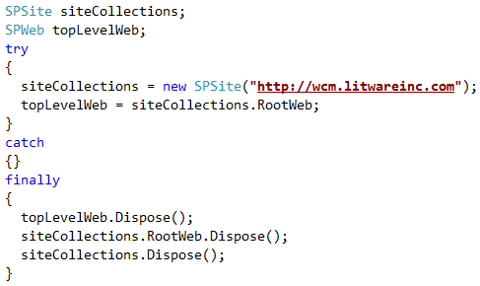
Properly Disposing SharePoint Objects
Tip: Utilize try-catch-finally statements, disposing within the finally block

Slide 18
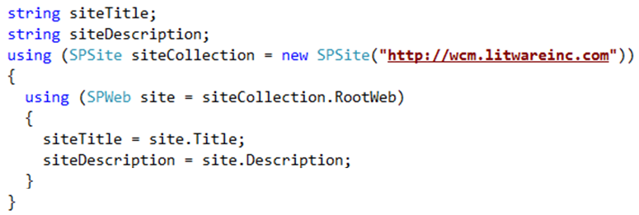
Properly Disposing SharePoint Objects
Tip: Utilize C#’s using() statements
Automatically calls Dispose()

Slide 19
Disposing Publishing Objects
PublishingSite
No need to dispose or close objects
PublishingWeb
Should call Close() as early as possible
Holds a reference to the associated SPWeb object
PublishingPage
No need to dispose or close objects

Slide 20
Avoid Unnecessary Creation / Disposal of Objects
Most SharePoint collections expose indexes
Using indexes on each call degrades performance
SharePoint has to hydrate an internal copy of the object on each call
Results in numerous unnecessary:
Creation / disposal of objects
Roundtrips to the SharePoint content database

Slide 21
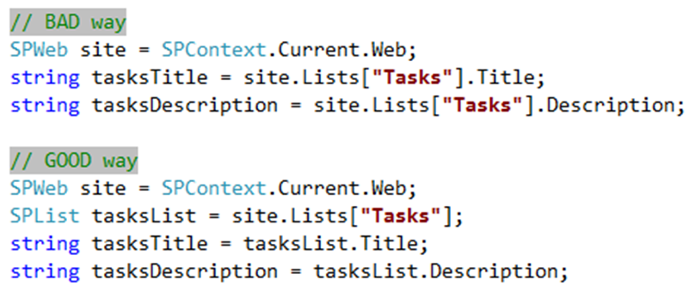
Properly Working With Collections
Tip: Create local copy of the object

Slide 22
Aggregating Data in MOSS Sites
Before you build a custom solution, evaluate the Content Query Web Part
Query builder (scope, filtering, grouping, rendering, etc)
Returns data as XML, uses XSLT to render as HTML
Sophisticated data caching mechanism for queries
PortalSiteMapProvider
Primarily used for navigation controls
Optimized to query data not only across lists, but across webs as well
Scope limited to the current site collection
Not to be used for infrequent queries or when underlying data frequently changes as it will be counter productive

Slide 23
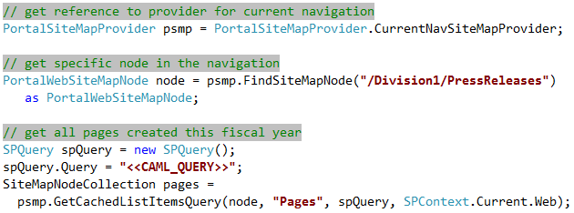
Using the PortalSiteMapProvider

Slide 24
SharePoint Capacity Considerations
Performance starts to degrade as the number of items in a collection approaches 2,000 items
Not a hard limit, just a recommendation
Performance degradation primarily limited to browser based list views and upgrades
Applies to…
Sites: number of subsites within a site
Lists: number of items / folders within one level of a list
Mitigate the issue by grouping items within containers
Group similar sites within one site
Group list items within folders
TechNet: Working with Large Lists in MOSS 2007
http://www.andrewconnell.com/go/160

Slide 25
Summary
Revisiting Windows SharePoint Services 3.0 architecture
What benefits ASP.NET 2.0 brings to the table
Web Content Management Publishing performance enhancements
Page output cache via profiles & policies
Object caching
Disk-based caching
IIS Static & Dynamic Compression
Page Payload Concerns & Techniques
Prescriptive guidance when coding against the SharePoint API
Working with SharePoint collections
Proper memory management techniques

