Slide 1
Understanding Workflow Foundation & Creating Interactive Workflows
Leveraging OOTB Workflows in SharePoint & Creating Workflow Templates Using Visual Studio

Slide 2
Agenda
Windows Workflow Foundation core concepts
What SharePoint brings to the Workflow Foundation
Workflow Forms in SharePoint
Out-of-the-box workflows in SharePoint
Workflow creation & development in SharePoint
Debugging workflows

Slide 3
Windows Workflow Foundation
Windows Workflow Foundation:
Development platform for building reactive, episodic programs
Runtime components that ship with the .NET Framework 3.0
Windows Workflow Foundation concepts:
Workflow runtime
Workflow instance
Activities

Slide 4
Workflow Runtime
Extends the capability of the CLR that provides ability to create objects in memory:
Adds persistence (serialization / deserialization) of long-running workflow instances
Adds scheduling to “wake up” sleeping (persisted) workflow instances
Adds concept of activities (like WinForm / ASP.NET UI controls)
Hosts workflow instances
Executing workflow programs

Slide 5
Workflow Activities
Activities are similar to Windows Forms / ASP.NET 2.0 controls:
Encapsulated logic that does a specific task
Not dependent upon other activities
Can be used in multiple workflows
Composite activities:
Can contain child activities (like composite controls)
Controls the execution of child activities
Workflow programs are actually composite activities
Examples: IfElse, While, Sequence

Slide 6
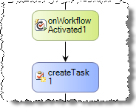
Types of Activities
Action activities (indicated as blue in designer):
Do actual work such as creating / updating tasks, executing code, etc.
Code event handlers execute BEFORE work is done
Event activities (indicated as green in designer):
Wait for an activity, causing the workflow to be persisted & an event is registered when to wake up
Code event handlers execute AFTER the event
Action Activity
Event Activity

Slide 7
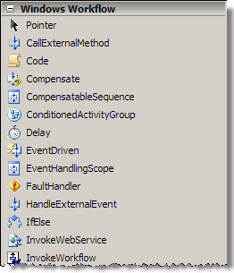
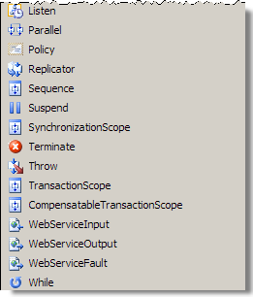
Workflow Foundation Base Activity Library
Activities included in Windows Workflow Foundation

Slide 8
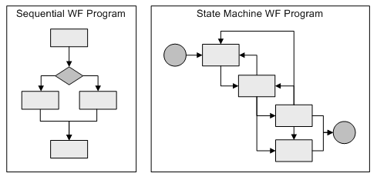
Types of Workflows
Sequential workflow:
Similar to a flow chart containing predefined paths of execution with a beginning & end
State machine workflow:
Based on concept of conditions & transition
No predefined path of execution
Path defined by the events during workflow execution

Slide 9
Developing Custom Workflows (VS2005)
What you need:
.NET Framework 3.0
Visual Studio 2005 Extensions for Workflow Foundation
http://shrinkster.com/QJK
Visual Studio 2005 Extensions for Workflow Foundation:
Adds the base activity library to Visual Studio 2005
Adds a workflow designer to Visual Studio 2005
View code behind & create event handlers
Set public properties on activities using the Visual Studio Property tool window
Adds capability to debug workflows

Slide 10
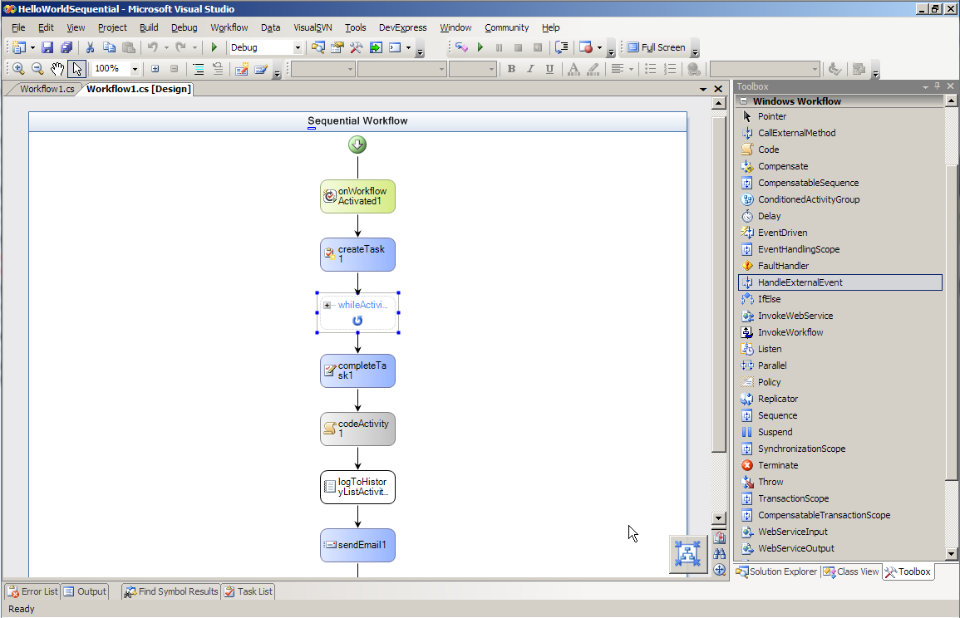
Visual Studio with VSeWWF Installed

Slide 11
Developing Custom Workflows (VS2008)
Visual Studio 2008
When Office tools (VSTO) optionally included in installation, new project templates added for creating workflows for use in SharePoint
Project templates facilitate ability to do F5 debugging
Wizard collects parameters for deploying, installing & activating Feature, creating the association and starting the debugger
Requires files to be in specific places in the project.
Requires .NET Framework 3.5 installed on target SharePoint servers

Slide 12
Workflow Foundation in SharePoint
WSS 3.0 acts as the hosting application for the Workflow Foundation runtime
Provides the persistence service to serialize & deserialize workflows to SharePoint content databases
Adds SharePoint specific activities to workflow engine
Adds a human element to workflows by incorporating tasks & forms
Workflows are associated with lists / content types
Workflow instances execute within the context of a list item / document

Slide 13
SharePoint Workflows Tasks
SharePoint workflows primarily revolve around tasks
Tasks created / updated / completed using provided SharePoint specific workflow activities
Tasks are visible & editable by users
Tasks edited through browser or Office 2007 clients
Certain activities listen for certain conditions on tasks
Multiple tasks created in one workflow kept in sync with correlation tokens
SharePoint includes multiple task related activities, including action & event activities

Slide 14
SharePoint Workflows History List
SharePoint workflows can log messages to a history log
Specific history log for each workflow instance
SharePoint specific activities make it easy to log messages to the history
Add messages to the history list using the LogToHistoryListActivity

Slide 15
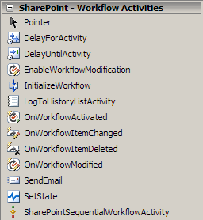
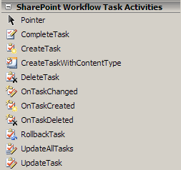
SharePoint Workflow Activity Library

Slide 16
OOTB SharePoint Workflows
Approval (MOSS only)
Used for document routing… approvers can approve / reject a document, reassign task, or request changes.
This is the “Parallel Approval” found on all /Pages lists
Collect Feedback (MOSS only)
Collects feedback by reviewers and sends to document owner when workflow completes
Collect Signatures (MOSS only)
Used to collect digital signatures

Slide 17
OOTB SharePoint Workflows (Part 2)
Disposition Approval (MOSS only)
Manages expiration & retention allowing participants to retain / delete expired documents
Three-state (WSS & MOSS)
Tracks items as they move through various states
Can be configured to react in different ways depending on the current state of the workflow
Available after activating a Feature

Slide 18
Core SharePoint Workflow Definitions
Workflow template
Assembly created using Visual Studio and deployed with a Feature
Contains all workflow logic & references to optional forms
Workflow association
Binding of workflow template to list / content type
When binding, specify a name to refer to
One template can be associated with the same list / content type multiple times
Workflow instance
Running workflow within the context of a list item / document

Slide 19
Forms in SharePoint Workflows
SharePoint workflows utilize forms to collect information from people interacting with workflow
Develop forms in one of two technologies:
ASP.NET 2.0 (ASPX pages)
InfoPath (rendered in InfoPath 2007 / browser)
Types of SharePoint workflow forms
Workflow association
Workflow initiation
Workflow modification
Workflow task edit

Slide 20
Creating Workflow Forms as ASPX Pages
Can run on all WSS 3.0 / MOSS 2007 installations
Should be deployed to subdirectory within [..]\12\TEMPLATE\LAYOUTS
Developed as application pages
Should inherit from LayoutsPageBase
Requires writing a significant amount of custom code in code behind of each form’s ASPX page
Provide no integration with the Office 2007 clients
You must account for all data passing between workflow & form, as well as creation of any lists

Slide 21
DEMO: LitwareWorkflows
Demo: LitwareWorkflows
Custom workflow template
Using Features for deployment
Workflow forms as ASPX pages
Examining the code behind of ASPX workflow forms

Slide 22
Creating Workflow Forms with InfoPath
Can run only on MOSS 2007 installations
Requires Forms Services
Deployed to a special library within Central Admin.
Provides a rich RAD experience
Rendered through browser / InfoPath 2007 client
Requires significantly less coding
Very possible to create zero-code InfoPath forms
Only code in the workflow obtaining values in form
Rich integration with Office 2007 clients

Slide 23
Building Workflows in SharePoint
SharePoint Designer 2007:
Workflows bound at design time… you are creating an on-the-fly association
No easy way to copy / export workflows
Limited to sequential workflows
No debugging support
Visual Studio:
Workflows built as template for deployment and reuse across multiple sites / environments
No limitations such as those that exist with SharePoint Designer 2007 developed workflows

Slide 24
Developing Custom Workflow Templates
What you need:
Everything you need to build workflows in Visual Studio 2005 with .NET Framework 3.0 (including VSeWWF)
WSS 3.0 SDK and / or MOSS 2007 SDK
WSS 3.0 SDK: http://shrinkster.com/QJM
MOSS 2007 SDK: http://shrinkster.com/QJN
WSS & MOSS SDK installs add Visual Studio workflow project templates specific to SharePoint
WSS templates designed for workflows w/o forms / ASPX forms
MOSS templates designed for workflows w/ InfoPath forms
OR Visual Studio 2008
No extra installation needed

Slide 25
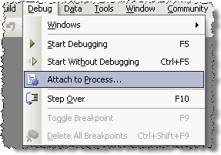
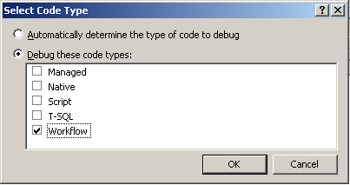
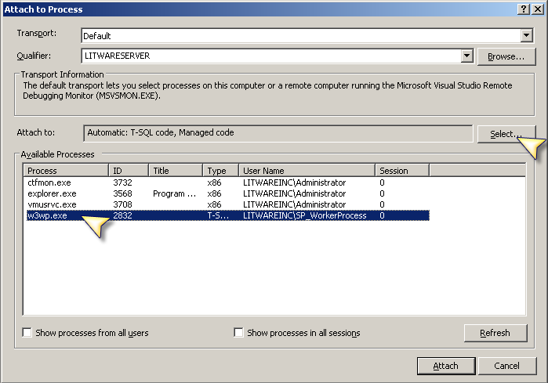
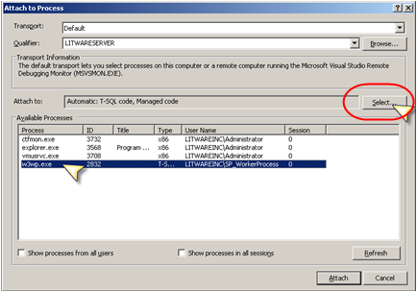
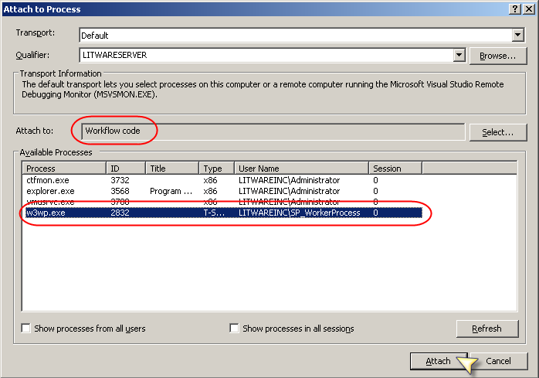
Debugging Custom Workflows
VSeWWF add debugging support to VS 2005
No F5 debugging… but it isn’t that bad
Manually attach to the workflow debugger
VS2008 does provide F5 debugging

Slide 26
Deploying Workflow Templates
Deployment of custom workflow templates to site collections is done with Features
Use different Feature definition & workflow element manifest file formats depending upon the forms technology used in the workflow

Slide 27
Deploying Workflow Templates Leveraging InfoPath Forms
Deployment of custom workflow templates done using Features
Feature definition - feature.xml
Uses specific Feature receiver to upload InfoPath forms
Property: GloballyAvailable = true
Property: RegisterForms = [path to IP forms]\*.xsn
Element manifest – typically workflow.xml
CodeBesideAssembly & CodeBesideClass: class that contains the workflow
Form URLs: stock ASPX pages that host the IP forms
Metadata: URNs of IP forms

Slide 28
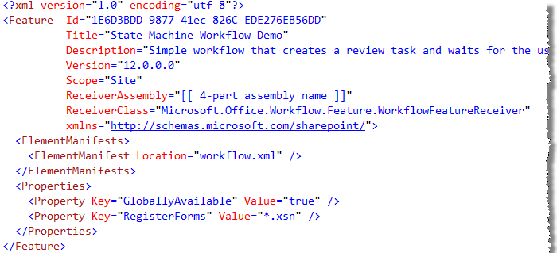
Feature.xml for Workflow with IP Forms
Assembly & Class of Feature Receiver that Uploads InfoPath Forms to Central Admin Library
Tells Feature Receiver Where To Find IP Forms w/I Feature Folder
Tells Feature Receiver IP Forms Should Go Into Central Admin Library

Slide 29
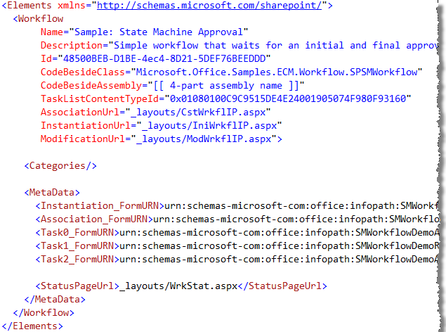
Workflow.xml for Workflow with IP Forms
Assembly & Class Containing Custom Workflow Template
URLs of ASPX Pages That Host IP Forms
Unique URN’s of IP Forms

Slide 30
DEMO: MajorityApprovalWorkflow
Demo: MajorityApprovalWorkflow
Custom workflow template that requires majority of people within a specific SharePoint group approve
Using InfoPath forms for approvers feedback collection
Using Features & solutions for deployment

Slide 31
Summary
Windows Workflow Foundation core concepts
What SharePoint brings to the Workflow Foundation
Workflow Forms in SharePoint
Out-of-the-box workflows in SharePoint
Workflow creation & development in SharePoint
Debugging workflows

