Slide 1
Content Deployment
Moving Content Between Environments

Slide 2
Agenda
Overview of content deployment
Paths & jobs
Deployment details
Content deployment process
Configuring content deployment via the browser-based user experience
Configuring content deployment via the SharePoint API
Connected servers
Disconnected servers

Slide 3
Motivation of Content Deployment
Founded on the concept that a single authoring environment would push site collection content to one (or more) destinations, such as…
Internal authoring environment, read only DMZ environment
Geo replication solution
Single master solution… content deployment is a one-way process only
Moves content, NOT code
Should be coordinated with WSS solution package deployment

Slide 4
Content Deployment Scenarios
Two-tier
Authoring -> Production
Three-tier
Authoring -> Staging -> Production
N-tier
Flexible deployment model
Content deployment is very flexible because the steps are the same for all site topologies

Slide 5
Content Deployment Paths & Jobs
Path:
Defines the relationship between two site collections
Site collections can reside in same or different farms
Associated with one or more jobs
Job:
Defines the schedule (when) content deployment is executed
Defines the scope such as entire site collection vs. collection of subsites

Slide 6
Deployment
Content deployment only deploys changes since the last successful deployment
Dependencies are automatically addressed and deployed
Page layout & Images
Quick Deploy Jobs
Special type of deployment job created for every path in a site collection that has Publishing feature enabled
Runs every 15 minutes (configurable with 5m or 10m)
Allows content owners to push a page into production quickly (such as an urgent press release)

Slide 7
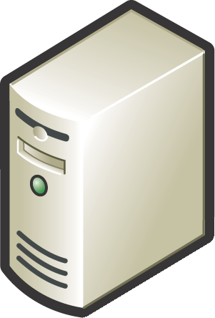
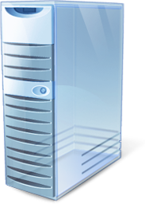


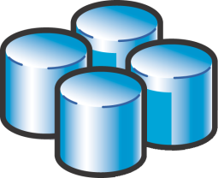
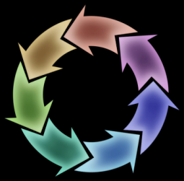
Content Deployment Process
1) Check change log on source server for content to package
2) Package changes on source server
3) Send package to destination server
?
!
5) Update change log on source server
4) Apply changes to destination server

Slide 8
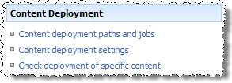
Configuring Content Deployment
Configure the source and destination server
Central Administration -> Operations
Allow incoming content deployment jobs?
Set import & export servers
Optionally enable encrypted connection (HTTP / HTTPS) between source & destination servers
ALWAYS use encryption!!!

Slide 9
Configuring Content Deployment (Part 2)
Configure temporary file location
Used to build package of exported content
Configure temp file location with the following permissions:
WSS_WPG & WSS_ADMIN_WPG: Read, List, and Read & Execute on system temp drive
WSS_ADMIN_WPG: Full Control on content deployment temp folder
Number of reports to retain on content deployment jobs

Slide 10
Content Setup and Configuration
Create a new destination site collection
Must create using the Blank Site template
Within Central Administration / Operations:
Create new path (from source -> destination)
Optionally deploy versions (or overwrite)
Optionally deploy security info
Create new job (schedule)
Optionally configure Quick Deployment job
Automatically created if source uses Publishing features

Slide 11
DEMO: Setting up Content Deployment
Demo: Using Content Deployment
Configuring Content Deployment settings on the server
Creating a Content Deployment Path
Creating a Content Deployment Job
Execute the Content Deployment Job

Slide 12
Content Deployment via the API
Microsoft.SharePoint.Publishing.Administration namespace contains content deployment classes
ContentDeploymentConfiguration
Use to get instances of content deployment on servers
ContentDeploymentPath[Collection]
Use to get references and create paths
ContentDeploymentJob[Collection]
Use to get references and create new jobs
ContentDeploymentJobType
Enumeration used to specify type of job

Slide 13
DEMO: Content Deployment via API
Demo: ConnectedServers
Creating & executing a content deployment job via API

Slide 14
API: Deployment Between Two Connected Servers
For deploying content between servers…
Configure source & destination farm properties
Create a new path:
Configure source & destination site properties
Save
Create a new job:
Configure the job & job type
Set the job’s Path to path previously created
Save
Run job
Optionally delete the path

Slide 15
API: Exporting Content with Disconnected Servers
Exporting content:
Configure export settings to export package via API
Run export to create a file (checks for exceptions & runs reports)
Configure export settings using SPExportSettings() & SPExport()
Site to export
Where to save the exported file (overwrite existing file?)
Include content versions & security in exported objects?

Slide 16
API: Importing Content with Disconnected Servers
Importing content:
Configure import settings to import package via API
Run import
Configure import settings using SPImportSettings() & SPImport()
Target site to import
Keep object ID’s, security, user & date/time info?
Update versions & include security?
Enable event receivers on import?
Significant performance hit if enabled

Slide 17
Content Deployment “Tips”
Ensure MOSS SP1 & Infrastructure Updates installed
Should be at least version 12.0.0.6318
All servers configured as export & import need to host an instance of Central Administration
Ensure sufficient disk space is available
Install required Features on destination server
Don’t activate custom Features manually on destination server
Don’t expect incremental deployment will deactivate Features in destination server
Ensure deployment jobs don’t run in parallel
Create site collection w/o applying template
STSADM.EXE –o createsite –url “http://foo” –ownerlogin “LITWAREINC\administrator” –owneremail “admin@litwareinc.com” –ownername “LitwareAdmin”

Slide 18
Content Deployment “Gotchas”
Don’t deploy one site collection to another within the same Web application
GUIDs are copied, not regenerated, breaking uniqueness within a content database
Don’t edit content on the destination server
Content deployment expects the destination server to be exactly as it left it
Don’t rename the “Pages” library

Slide 19
Summary
Overview of content deployment
Paths & jobs
Deployment details
Content deployment process
Configuring content deployment via the browser-based user experience
Configuring content deployment via the SharePoint API
Connected servers
Disconnected servers

