Slide 1
Implementing Multilingual Sites Using Variations
Creating Multilingual and Multidevice Targeted Websites

Slide 2
Agenda
Multilingual capabilities in MOSS 2007 WCM
Resource files
Variations
SharePoint language packs
Understanding variations
Variations labels
Customizing
Navigation experience & implications
Web Part personalization implications
Search implications

Slide 3
What does “Multilingual” Mean?
Managing content in various languages
Navigate a site in preferred language
Collaborate with people in different regions in different languages from within same application
Manage and administer personal site using preferred language
Search and browse content across organization in preferred language

Slide 4
Supported Multilingual Scenarios
Read & manage content, site navigation & search
Full experience OOTB, but customization for search required
Site admin
Fully OOTB
Site collection admin
Single language experience based on the site collection’s root web’s language setting
Farm administration
Single language experience, depending on installed SharePoint language pack

Slide 5
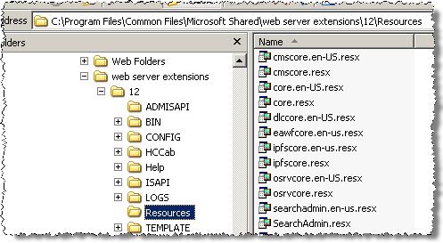

WSS Resource Files
Provide an easy way for localizing a solution
Special tokens used in XML files
Ability to target a specific token file

Slide 6
SharePoint Language Packs
SharePoint Language Pack
Designed for use in WSS v3 in stand-alone config
In farm configuration, same language pack must be installed on all farm servers
Server Language Pack
Designed for use in Office Server System 2007
MOSS 2007
Forms Server 2007
Project Server 2007
MOSS 2007 for Search
Includes all resources of SharePoint Language Pack (no need to install both)

Slide 7
SharePoint Language Packs (Part 2)
Users can specify language upon creation time of site collection or site
Sets the Language & Country ID (LCID) for whole site or site collection
Defines UI language
Defines text input interpretation
Defines locale specific data is displayed (currency, numbers, dates, etc.)

Slide 8
Variations
Enables site owners / admins to maintain a copy of content in different sites in a site collection
Each site copy represents a different locale
Variation involves creating a hierarchy of sites containing copies of the root site

Slide 9
Variation Process
Once variation configuration & labels are setup…
Create new page / site within source label
Once published, SharePoint creates copies in each variation label, but doesn’t publish them
Each site owner then:
Translates
Change page layout
Make other culture specific changes
Page then goes through it’s own workflow process

Slide 10
Variation Process Animation
Source Label
en-us
Target Label fr-ca
Page
Page
Target Label es-es
Page
Target Label ar-sa
Step 1 New Page is created and authored
Step 2 > Page is approved and published… v1.0
> Page is copied to all labels in draft form
Step 3 Content owners in each label translate the content and make necessary changes… content follows through all workflows, etc.
Step 4 Each time source page is updated, entire process repeats itself, overwriting target pages in labels.
Page

Slide 11
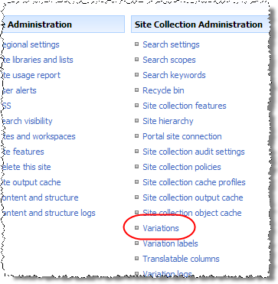
Configuring Variations in a Site Collection
From the top-level site within a site collection, Site Settings -> Variations
Variation Home (Container)
Automatic Creation
Recreate Deleted Target Page
Update Target Page Web Parts
Notification
Resources
Limit of only one variation hierarchy per site collection

Slide 12
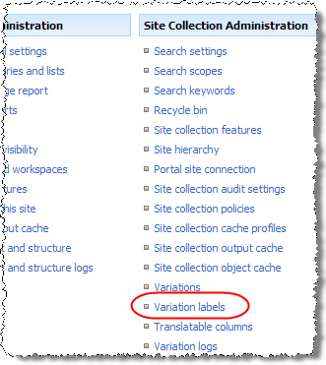
Creating Variation Labels
From the top-level site within a site collection, Site Settings -> Variation Labels
Create a label for each language
Specify:
Name (what appears in URL)
Display Name (what appears in navigation)
Locale (culture label applies to)
Hierarchy Creation (what to create when hierarchy is created)
Source Variation (exactly one label in a Variation config)

Slide 13
Variation Miscellaneous
Allows site owners to define and implement different master pages, page layouts, and images in each variation label
Translating content:
Not automatic
Can occur within site just like content authoring
Can be exported, translated by 3rd party, and imported
Automatic redirection logic:
Determined using HTTP header HTTP_ACCEPT_LANGUAGE value
Redirection logic can be customized (see MOSS SDK)

Slide 14
Navigation Experience
Control provided enabling people to navigate to different variation labels
Navigation control customizable by changing LabelMenuConfiguration property on VariationHierarchyDataSource control:
1 – user redirected to same page on selected label
2 – user redirected to default page on same path
3 – user redirected to default page of selected label

Slide 15
Web Part Personalization Experience
Some Web Parts are not aware of variations
WSS List Web Part is bound to a specific list by GUID
Custom Web Parts can also be affected… you need to account for this in your custom Web Parts
During variation setup & configuration, can set option to not synchronize Web Part to target label

Slide 16
Implications for Search
When a search is executed, query engine passes query to word breaker for specified language
Word breaker: breaks words into logical words / phrases
If not word breaker specified for the query’s language, neutral word breaker used (white spaces break words)
Next, results are passed through language specific stemmer (addresses singular / plural, past / present / future tense)
Search also uses a language specific dictionary and thesaurus

Slide 17
DEMO: Implementing Variations
Demo: Implementing variations
Configuring variation settings within a site collection
Create a new variation hierarchy with labels
Demonstrate automated content duplication
Translate localized content and customize layout

Slide 18
Summary
Multilingual capabilities in MOSS 2007 WCM
Resource files
Variations
SharePoint language packs
Understanding variations
Variations labels
Customizing
Navigation experience & implications
Web part personalization implications
Search implications

