Slide 1
Implementing and Customizing SharePoint Search

Slide 2
Agenda
Understanding Search in Office SharePoint Server 2007
Search & SSP’s setup, configuration and administration
Implementing and configuring search Web Parts
Customizing search results
Programmatically working with the search API

Slide 3
Office SharePoint Server 2007 Search
What can SharePoint search?
SharePoint site collections
File shares
HTTP accessible resources
Microsoft Exchange public folders
Search just works with little configuration & setup
Developers can extend search to:
Create custom results page experiences
Create custom controls that utilize the search API

Slide 4
Office SharePoint Search Components
Search Architecture
Index server
Query server
Shared Service Provider
Search Implementation
Protocol handlers
IFilters
Stemmers
Word breakers

Slide 5
Search Topologies
Base topology
Web front-end servers
App servers
Database servers
App servers
Indexer Service
Query Service
Notes:
Instructor Notes
The MOSS has some significant investments in their topology model. The base SharePoint topology consists of a load balanced web front end as well as application servers and backend databases. For Search specifically MOSS provides two application servers roles – indexer and query

Slide 6
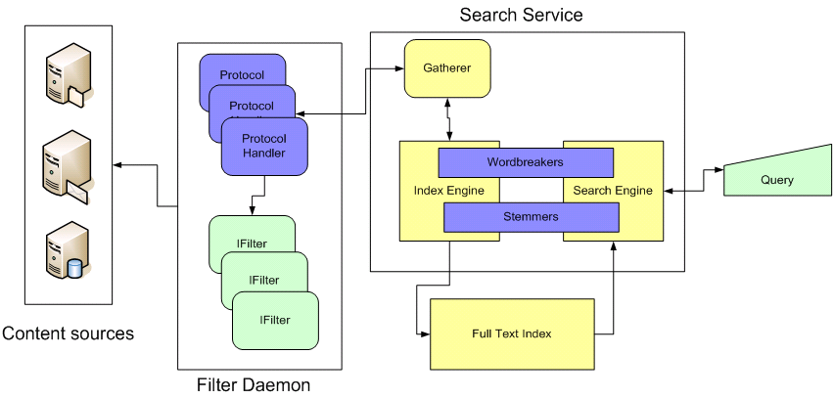
Search Architecture and Terminology
Key pieces to search infrastructure
The Gatherer
Content sources, protocol handlers and IFilters
Index Files
Notes:
Instructor Notes
Walk the students through the basic architecture of how search works with both WSS and MOSS. This will give you a chance to introduce the terminology and describe the process of building indexes from configured content sources.
Content source: This is the place where the content lives. A content source can be a WSS site or a Window File Share.
Protocol Handler: This is the code that allows the WSS/MOSS index service to reach across the network and retrieve the content to be indexed.
IFilter: A COM-based DLL able to parse a file and convert it into a UNICODE character array. You must have a IFilter for each type of file you want to search through. For example, Microsoft provides IFilters for Office documents and Adobe provides an IFilter for PDF files.
Gather: This is the main component responsible for retrieving content and moving it through the process to build indexes.
Workbreaker: Language-specific component that tokenizes text into words.
Stemmer: Language-specific component that find derivations of a word. For example, the stemmer will determine that running, runs and ran are all derivations of the word run that should be incorporated in search results.

Slide 7
SharePoint Search Concepts
Content Source
Search Scope
People search
Search Center (with & without tabs)
Search Web Parts
Best bets & keywords

Slide 8
DEMO: Search Administration
DEMO: Search Administration
Central Administration
Setting up search scopes & content sources
Setting and executing search schedules
Promoting fields to managed properties
Site Collection Search Settings

Slide 9
Anatomy of Search Center Results Page & Search Web Parts
Search Box
Search Summary
Search Action Links
Search Statistics
Search Paging
Search High Confidence Results
Search Core Results
Search Best Bets

Slide 10
Customizing Search Results
Search Core Results Web Part
Executes search & retrieves results via XML
Transforms XML via XSLT to HTML
Easiest way to customize results:
Execute search
Get XSLT from Search Core Results Web Part
Create new XSLT with SharePoint Designer using OOTB XSLT as baseline
Configure Web Part to use new XSLT

Slide 11
DEMO: Customizing Search Results
DEMO: Search Results
Customizing the OOTB search results using the Search Results Web Part
Trick: get the raw XML search results

Slide 12
Adding Additional Fields to Results
SharePoint’s search returns a set number of fields by default
These are the only fields that can be used in the XSLT transformation
Core Results Web Part can be customized to include additional fields
However, any managed property can be used in the XSL transformation as long as it is included in the list

Slide 13
Adding Pivots to Search Results
Pivots allow users to filter the results on specific criteria
For example, filter by:
File extension
Author
Current site

Slide 14
DEMO: Adding Fields and Pivots to Results
DEMO: Adding Fields and Pivots to Results
Creating a new managed property
Adding managed properties to the search result XML
Adding new fields to the search results
Adding search pivots

Slide 15
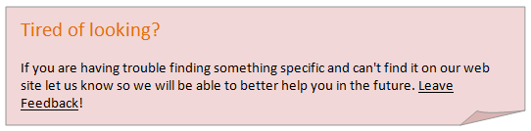
Handling Empty Search Results
The OOTB empty search results is usually not what customers want to display on their site
However it is customizable…
Developers can modify the XSLT dvt_1.empty template in the XSL search results transformation to display custom empty results

Slide 16
Working with the Search API
Developers can create custom search implementations using the OOTB search API
Two options:
Microsoft.Office.Server.Search.Query.KeywordQuery
Good for simple queries
Microsoft.Office.Server.Search.Query.FullTextSqlQuery
Ideal for complex queries
Both objects return a collection of objects:
Microsoft.Office.Server.Search.Query.ResultTableCollection

Slide 17
Working with the Search API
Note: FullTextSqlQuery is a heavy disposable object, so be aware of highly used
using (FullTextSqlQuery query = new FullTextSqlQuery(SPContext.Current.Site)) { query.QueryText = "SELECT Rank, Title Url FROM Scope() WHERE FREETEXT(defaultproperties,'sales proposal') ORDER BY Rank Desc",
ResultTableCollection results = query.Execute();
ResultTable relevantResults = results[ResultType.RelevantResults];
// do work with the results }

Slide 18
Summary
Understanding Search in Office SharePoint Server 2007
Search & SSP’s setup, configuration and administration
Search results page & search Web Parts
Customizing search results
Programmatically working with the search API

