Slide 1
Business Connectivity Services
Notes:
The module describes the basic architecture and enhancements to the Business Data Connectivity Service (BCS). You will learn how to create External Content Types and to configure them with profile pages to establish read/write connections to backend data sources. You will also learn how to expose External Content types in SharePoint sites using External Lists. The module will also teach you how to leverage the new OData support in the BCS to create connections to any OData-compatible data source on the Internet. Along the way you will learn to integrate the Secure Store Service when configuring BSC security with advanced techniques involving secondary security credentials and overcoming the double-hop authentication problem.

Slide 2
Agenda
BCS Overview & Architecture
External Content Types
OData Data Sources
BCS Configuration

Slide 3
Business Connectivity Services
Bring data from external systems into SharePoint and Office, interact with it, reuse it, and empower end users to gain insight into the underlying data in a reusable way.
Extend the reach of Enterprise Data
Centrally manage reusable connections
Easily create custom solutions
Notes:
Systems such as customer relationship management (CRM) and enterprise resource planning (ERP) have special roles that are not replaced easily by Microsoft SharePoint. As a result, strategies must be adopted to provide interoperability between SharePoint and these systems.In the absence of a strategy for integrating systems with SharePoint, many organizations duplicate information in SharePoint lists. Customer contact information, for example, may exist in a CRM system and also be entered into a contact list in SharePoint. Worse still, the data may be duplicated many times in different team sites by different groups. This kind of duplication leads to significant data maintenance issues because updates must be performed in many lists.
Along with these existing systems, custom applications, databases, and Web services are common within organizations. When a separate database is required, developers have historically created ASP.NET applications or custom Web Parts that act as front ends for the database to have the data appear in the SharePoint environment. However, these types of solutions generally offer little integration with SharePoint capabilities; they are largely limited to presenting data within a SharePoint Web page.
Business Connectivity Services (BCS) changes all the rules for integrating systems, databases, and Web services with SharePoint. Beyond simply bringing data into SharePoint for display, BCS allows for capabilities that simply can’t exist in an ASP.NET application or custom Web Part without a significant investment. These capabilities include enterprise search, External Data columns, user profile integration, client synchronization, offline support, and Microsoft Word integration.BCS is a set of out-of-box features, services and tools that streamline the creation of SharePoint Solutions with deep integration of External Data and Services. Power users, IT, Devs can create no code solutions using BCS.The basics of ECT store and BDC runtime are baked into SharePoint Foundation 2013.
Why BCS?
Integrate other Line of Business application systems with SharePoint sites.
Search for data in other systems via the SharePoint Search service.
Save the time, cost, and monotony of writing yet another data layer!

Slide 4
BCS Terminology
Business Data Connectivity (BDC): Service app controlling plumbing, runtime, connectivity
External System: Data source BCS can talk to
External Content Type (ECT): Definition of fields & operations to connect to external system
External Data: Data that resides in external sys.
External List: List based on external data
External Data Column: List column who’s source is external data
External Data Web Part: OOTB Web Parts that display external data

Slide 5
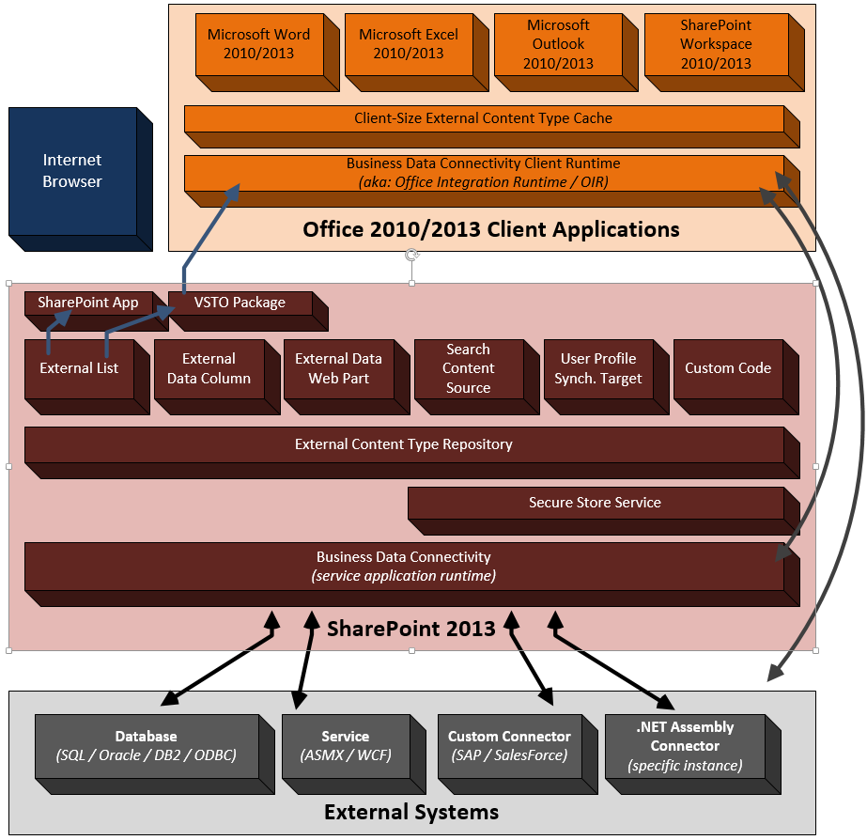
BCS Architecture

Slide 6
Agenda
BCS Overview & Architecture
External Content Types
OData Data Sources
BCS Configuration

Slide 7
External Content Types
Describe the schema of external data source
Describes operators / operations on external data
Creating External Content Types:
SharePoint Designer 2013
Visual Studio 2013
Can export/import external content types via the Business Data Connectivity service application
Notes:
ECTs define fields, operations, and filters to be used with the External Data and are the heart of the BCS infrastructure. As an example, consider a manufacturing database that contains product information.
An ECT named Product can be created that defines ProductID, ProductName, and ProductDescription fields. Furthermore, it might define operations for retrieving data based on a keyword query or exact product identifier. Defining ECTs is one of the primary activities involved in creating a BCS solution and may be performed in either Microsoft SharePoint Designer 2013 (SPD) or Microsoft Visual Studio 2012 (VS2012). ECTs are stored in a metadata catalog, which is part of the BDC Service Application and is available throughout the SharePoint farm

Slide 8
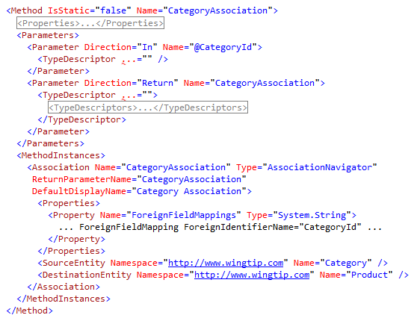
ECT Entity Relationships
Entities can have relationships with other entities
Options:
1:MANY
Self-referential
Reverse
Can be created in SPD2013 and further customized in the XML model
Notes:
BCS supports the definition of relationships between entities, which allows you to display relationships and navigate between entities within SharePoint. Within the SharePoint Designer, one-to-many, self-referential, and reverse associations are supported by the tooling. The most common type of association in BCS solutions is the one-to-many association, whereby a parent entity instance is related to many child entity instances. Self-referential associations are just like one-to-many relationships, except that a self-referential relationship uses the same ECT as both the parent and the child. Reverse associations return a single parent entity instance for a child entity instance. Reverse associations are not supported for tables and views, but they are supported for stored procedures and Web services because the reverse association is not inherent in the database schema. It must be programmed explicitly through a stored procedure or Web service.
The XML snippet shows a relationship between a Product entity and a Category entity.

Slide 9
External Lists
Expose external data as a native SharePoint list
Full CRUD-Q capability w/ familiar UI & navigation
Forms can be converted to InfoPath forms
Profile page available for each item in the list
Access via SharePoint object model (SPList)
New support for alerts (notifications)
Requires implementation of new operators
Some differences from traditional SP lists
Because SharePoint doesn’t “own” the data, some standard list functionality is not available with external lists
Notes:
External Lists can be created directly in SPD or in the browser using the Create menu in SharePoint. Once the new External List is created, it may be viewed in the browser. Because all the CRUDoperations were created, the resulting list supports editing, adding, and deleting items. The appearance of the External List closely resembles a standard SharePoint list. The Ribbon is functional, as well as the editcontrol block (ECB) associated with individual items. Any changes to items in the list will be reflected immediately in the External System. Just like “regular“ lists, External Lists may be taken offline through both the SharePoint Workspace 2013 and Outlook 2013.
While External Lists appear similar visually to standard SharePoint lists and are supported by a SPList object, they do have significant limitations that must be considered in any design. These limitations include lack of workflow support and several standard list features. The following lists some of the major limitations of External Lists.
Approval: Approval of items is not supported
Attachments: Attachments are not supported directly, but must be implemented using a StreamAccessor operation in a custom solution
Check-in/Check-out: Check-in and checkout of items are not supported
Content Types: Using standard site content types in External Lists is not supported
Drafts: Drafts of items are not supported
ECB: Send-To operations are not supported
Ribbon: Datasheet View is not supported
SPLINQ: Querying through LINQ to SharePoint is not supported
Templates: Document templates are not supported
Versioning: Versioning of items is not supported
Workflow: Starting workflows from items is not supported, but workflows can read or write to External Lists through the SPList object
Validation: Validation formulas are not supported

Slide 10
Surfacing External Data
External Data Columns
Add data from external content types to standard SharePoint lists
Can be made available as Content Controls in Word
Provided Web Parts
External Data Item
External Data List & External Data Related List
External Data Item Builder
Chart Web Part
Profile Page
External Data Search
Integrate External Data into search results
Inclusion in SharePoint Apps
Notes:
External Data Columns:
Along with using an ECT as the basis for a list, you can use an ECT as the source for a column in another list. This capability is known as an External Data Column. When you create an External Data Column for a list, you select the ECT to use as the basis for the column. You may then select one or more of the fields available in the ECT to display alongside the column you are creating. These additional fields are known as projected fields because they project data from the ECT into the parent list.
BCS Web Parts:
Another way you can use ECTs is through a set of Web Parts that ship with SharePoint Server 2013 known as External Data Web Parts (also called Business Data Web Parts). External Data Web Parts are designed specifically to display ECT data and relationships. The available parts include the Business Data List, Business Data Related List, and Business Data Item. These Web Parts display a list based on an ECT, a list based on an ECT association, or a single item, respectively.
Business Data Item: Displays details for a single external item
Business Data List: Displays list of external items
Business Data Related List: Displays a list of external items related to an item passed as input (typically selected in the Item or List web part)
Business Data Actions: Displays a list of actions for the selected external item
Business Data Item Builder: Retrieves input parameters from the URL/query string and passes them to parts on the page. This Web Part is not visible when the page is not in edit mode
Profile Page:
When SharePoint surfaces ECT data in lists and Web Parts, it does not necessarily show all the available fields and associations. For example, when an ECT is used as the source for an external column, only a single field is required for display. When users see partial ECT data, however, they are quite often interested in being able to see the data behind it. This is where profile pages enter the picture. A profile page is a dedicated page that shows all the ECT data for a specific record. This way, users can jump from partial ECT data to a complete view of the record.
External Data Search:
ECTs created with SPD already support indexing by SharePoint Search with no additional work. However, External Systems will be indexed only if you explicitly set up a content source that includes the ECT. Content sources can be created within the Search service application, where you will have the option to create a content source associated with an External System.
SharePoint Site/App – Sites and Apps can use external data. The primary way that users interact with external data is through an external list. External lists look and feel like standard lists, but they are backed by an ECT instead of a standard content type. Apps can also have ECTs defined within the app through a BDCM file. This file allows for app-level ECTs (discussed in detail later), which supports the isolation model of Apps. Exernal lists may be synchronized with Outlook through the automatic creation of a VSTO click-once package, which is downloaded to the client.

Slide 11
SharePoint Designer 2013 vs. VS2013
SharePoint Designer 2013
Creating ECTs to external databases and web services
Map operations for external systems
Reuse existing connections (custom connector)
Surface external data (external lists / Office clients)
Visual Studio 2012
Create.NET Assembly Connector
Create ECTs to OData source
Include ECTs within SharePoint Apps
Aggregate data across multiple external systems
Customizable data transformations
Notes:
Developers have two tools at their disposal in creating BCS solutions. SharePoint Designer 2013 is good for simple solutions that expose data from databases and Web services. While SharePoint Designer 2013 only supports designers for some operators, users can export the model as XML from the BDC service application and make manual edits to add additional operators. Visual Studio 2012 provides developers the ability to create custom connectors (for connecting to external systems such as PeopleSoft, SAP or SalesForce), ECTs based on OData sources, ECTs that support notifications, ECTs included in Apps or .NET Assembly Connectors (for connecting to specific instances of external systems).

Slide 12
Creating An External Content Type using SharePoint Designer 2013
Notes:
Demo1

Slide 13
Agenda
BCS Overview & Architecture
External Content Types
OData Data Sources
BCS Configuration

Slide 14
OData Data Source
Open Data Protocol (OData)
Protocol for performing CRUD operations on web data
Uses standard HTTP GET, POST, PUT, DELETE
Returns ATOM and JSON results
Provides easy cross-platform data access
Representational State Transfer (REST)
Architecture utilizing URIs to specify operations
Often used in conjunction with OData protocol
SharePoint 2013 Supports OData as a data source in addition to databases & services
Notes:
The Open Data Protocol (OData) is a web protocol for querying and updating data. OData applies web technologies such as HTTP, Atom Publishing Protocol (AtomPub) and JSON to provide access to information from a variety of applications, services, and stores. OData emerged organically based on the experiences implementing AtomPub clients and servers in a variety of products over the past several years. OData is being used to expose and access information from a variety of sources, including but not limited to relational databases, file systems, content management systems, and traditional web sites. Microsoft has released OData under the Open Specification Promise (OSP) to allow anyone to freely interoperate with OData implementations. We intend on working with others in the community to move the features of OData into future version of AtomPub or other appropriate standards.
Links to learn more:
Open Data Protocol site - http://www.odata.org/
Open Data Protocol by Example - http://msdn.microsoft.com/en-us/library/ff478141.aspx
OData Q&A - http://msdn.microsoft.com/en-us/data/ee844254

Slide 15
Example OData Sources
Microsoft SharePoint 2013
http://msdn.microsoft.com/en-us/library/ff798339.aspx
Microsoft Azure
http://msdn.microsoft.com/library/dd179355.aspx
Windows Azure Marketplace
http://services.odata.org/Northwind/Northwind.svc
SQL Server Reporting Services
http://technet.microsoft.com/en-us/library/ee240754.aspx
Notes:
OData producers are services that expose their data using the OData protocol. These are just some sample producers. A detailed list of producers can be found at http://www.odata.org/producers
SharePoint 2013 exposes OData through the ListData.svc service
Azure allows access to SQL Azure and structured storage through OData. You can configure OData services in your Azure account
Azure Marketplace exposes OData producers either for free or a fee. MSFT exposes a free OData source you can work with for testing
SQL Server Reporting Services for SQL Server 2008 R2 can expose report data as an OData source

Slide 16
Creating ECT’s with OData Data Sources
OData is an important protocol for services that was not previously supported by BCS
BCS can now access OData sources OOB just like WCF or SQL data sources
Visual Studio support for automatically generating BDC Metadata Models from an OData source
Not supported in SharePoint Designer
Supported in SharePoint Online
Improved sorting & filtering for External Lists
OData & SQL sources support both
WCF sources does not support sorting
Notes:
The key message here is that OData is now a first-class source for BCS models with support in SPD and VS. This makes it simple to create no-code solutions against OData sources.
BCS in SharePoint Online
BCS and SSS will be enabled at the tenant level for SharePoint Online
Improved Filtering
In SharePoint 2013, large recordsets were retrieved by BCS and then sorted/filtered locally. Instead of retrieving a large data set to filter and sort locally, we send the predicates to the external system there by retrieving only fewer records.
Sorting is only for OData/SQL, filtering is for all external systems

Slide 17
OData Sources
Creating External Content Types
<LobSystem Name="ODataWebNorthwindModel" Type="OData">
<Properties>
<Property Name="ODataServiceMetadataUrl" Type="System.String">
http://services.odata.org/Northwind/Northwind.svc/$metadata</Property>
<Property Name="ODataMetadataAuthenticationMode" Type="System.String">PassThrough</Property>
<Property Name="ODataServicesVersion" Type="System.String">2.0</Property>
</Properties>
<LobSystemInstances>
<LobSystemInstance Name="http://services.odata.org/Northwind/Northwind.svc">
<Properties>
<Property Name="ODataServiceUrl" Type="System.String">
http://services.odata.org/Northwind/Northwind.svc
</Property>
<Property Name="ODataServiceAuthenticationMode" Type="System.String">PassThrough</Property>
<Property Name="ODataFormat" Type="System.String">application/atom+xml</Property>
</Properties>
</LobSystemInstance></LobSystemInstances></LobSystem>
Notes:
This is a portion of a BDC Metadata Model showing how an OData source can be accessed
Type - This attribute must be set to ODATA when working with OData datasources.
ODataServiceMetadataUrl- Provides the end point of the metadata service.
ODataAuthenticationMode - The authentication mode used by the datasource to allow access and what type of access to the calling API.
ODataServicesVersion - The version of OData
ODataServiceUrl- The endpoint for the service
ODataFormat- The format for the returned data

Slide 18
External Content Types with OData Sources

Slide 19
Agenda
BCS Overview & Architecture
External Content Types
OData Data Sources
BCS Configuration

Slide 20
BDC Throttling & ECT Filters
BDC service application manages performance via throttle settings
External content types can implement filters
Enables limiting the amount of data returned by BCS
Type | Scope | Default | Max
Connections | Global | 100 | 500
Items | Database | 2000 | 25,000
Timeout | Database | 60 sec | 600 sec
Size | Service | 3 MB | 150 MB
Timeout | Service | 60 sec | 600 sec
Notes:
BCS implements limits on the number of connections that can be made to an External System. In addition, the BDC service application also implements five different throttle settings to limit the connections made and data returned from External Systems. The different types of throttle settings for the BDC service application are as follows:
Connections (global): Total number of connections allowed to External Systems
Database
Items: Number of rows returned from a database query
Timeout: Database connection timeout
Web Service (ASMX / WCF)
Size: Size of returned data
Timeout: Web service connection timeout
Throttle values can be viewed and changed using Windows PowerShell commands. Before you can change them, however, you must get a reference to the BDC service application. Exercise great care if you elect to change the throttle settings.

Slide 21

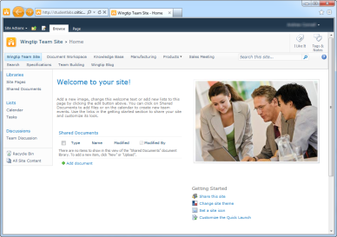

BCS Authentication & Authorization
Secure Store Service
Authentication
BDC Service Application
External Content Type Repository
Authorization
External List
Notes:
BCS security can be though of as breaking down into two different categories: authorization & authentication.
Authorization:
After creating an external content type, even if the user has rights to the underlying external data in the external system, the BDC service application runtime will deny access to the data. The reason for this is that each ECT in the External Content Type Repository has four types of permissions that can be applied to it. At a minimum the user requesting the data must have the Execute permission to execute methods defined in the ECT. Users can be granted access either by their specific account, membership to a group or even using claims.
Authentication:
Assuming the user requesting the external data is given access to the external data, they then need to be authenticated against the external system. There are three options for authentication covered later in the module.

Slide 22
BCS ECT Authorization Permissions
Available Permissions:
Edit: create, delete, update metadata objects
Execute: call external system (read)
Set Permissions: give permissions to other users
Selectable In Clients: accessible to clients applications like entity picker

Slide 23
BCS Authentication Overview
Popular Authentication Options | WCF Service Connector | Database Connector | .NET Assembly Connector
SQL Auth |  |  | Code-Based
UserName & Password |  |  | Code Based
NTLM Pass through
Claims Token |  |  | Code Based
OpenID / LiveID | Code Based |  | Code Based
Notes:
When connecting to back-end systems, BCS must deal with several different authentication scenarios. In the simplest case, BCS may be passing Windows credentials from the user through to the External System. However, most real-world applications have more complex requirements, such as proprietary authentication mechanisms, tokens, or claims. For BCS solutions to be secure, they must deal with these situations adequately.
BCS supports two authentication models: Trusted Subsystem and Impersonation and Delegation. In the Trusted Subsystem model, BCS uses a single account to access the External System regardless of the user identity. Under Impersonation and Delegation, BCS attempts to impersonate the user and access the External System. The AuthenticationMode element in the BDC Metadata Model determines how authentication is performed and has several different options.

Slide 24
Summary
BCS Overview & Architecture
External Content Types
OData Data Sources
BCS Configuration

