Slide 1
Topology and Farm Configuration
Notes:
This module begins by introducing farm topologies and discusses how to scale a SharePoint 2013 farm by adding additional web servers and application servers that are configured for specific server roles. The lecture will also discuss how to use the Central Administration site to perform day-to-day administrative activities such as configuring managed accounts and time jobs. This module also describes the essential administrative task of creating and configuring service applications within a farm and demonstrates how to accomplish this by hand in Central Administration as well as by writing PowerShell scripts.

Slide 2
Agenda
Farm Topologies
Caching and Request Management
Configuring Managed Accounts
Creating and Configuring Service Applications

Slide 3
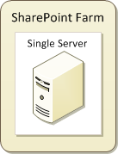
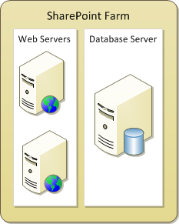
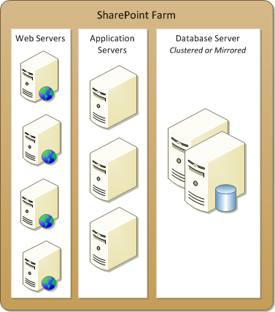
Topologies
SharePoint designed to scale from small to large
farm can be single-server deployment (easiest)
farm can run Web server(s) and database server
farm can offload processing to application server(s)
Topology 1
Topology 2
Topology 3
Notes:
A SharePoint farm can be single server or multi-server. Each SharePoint farm has only one configuration database.
Single-server farm
Installing SharePoint on a single server, is called a standalone installation. As a general rule, you can use a standalone installation of Windows SharePoint Services 3.0 to support up to 10,000 users, depending on your hardware configuration and the behavior patterns of your users.
A standalone installation can be appropriate if you want to evaluate SharePoint Products and Technologies or if you require a small, non-business critical deployment where high availability is not essential.
Small server farm
A small server farm deployment consists of a single combined front-end Web and application server and a single database server. The advantages over a single-server deployment are:
Contention for memory, processor time and disk access by the front-end Web and application server and the database server role is reduced.
Provide an additional layer of protection for your data by installing the front-end web server(s) in your perimeter network and the database server behind the second firewall in your internal network.
The disadvantage of this deployment model is that it does not provide any server-tier redundancy in case of hardware failures.
Medium server farm
A typical medium server farm may include: Two network load-balanced front-end Web servers; A dedicated application server; Two clustered or mirrored database servers.
To provide high availability for the database tier, you can also add a clustered or mirrored database server. At this stage, this is likely to be an availability consideration rather than a capacity consideration.
Large server farm
You can extend your server farm by adding a dedicated application server for search and index service, which should result in better performance. Additional servers can be added to which other application server roles can be allocated.

Slide 4



Server Roles in a SharePoint Farm
Web server
Generates HTML Provides the web interfaces for the users
Very little disk storage used
Microsoft recommends one web server per 10,000 users however, this number not accurate for many scenarios
Application server
Used to offload service application processing from web servers
Often requires large amounts of RAM and powerful processors
Database server
Runs SQL Server for all types SharePoint databases
Include configuration DB, content DBs and service application DBs
Often deployed using clustering or mirroring
Notes:
The Web Front Ends provide the web interfaces for the users. They use very little disk storage as they only store the files and settings required to route requests from clients to the appropriate sites in the database.
All site content and all configuration data is shared for all front-end Web servers in a server farm. To get the best performance and the best protection against hardware failure, you should configure Windows SharePoint
Services identically on all the front-end Web servers in your server farm.
Most changes to configuration settings in Windows SharePoint Services are replicated automatically. For example, when you change the e-mail server for SharePoint, you do this from within the SharePoint Central Administration or by using WindowsPowerShell. You make this change only once, the change is entered in the configuration database, and automatically applied to all servers in the server farm.

Slide 5
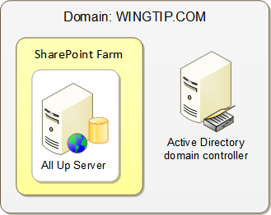
Single Server Farms
All server roles run on a single server
1 server = (web server + application server + DB server)
Useful for evaluation, testing and development
Used to create lab environment for this training class
Not scalable to most production environments
Notes:
In a single-server installation, all software components including SQL Server are installed on the same server.
The single-server approach limits the manageability and scalability of your solution, especially when SQL Server Express is used to store the databases. Installing SQL Server Standard or Enterprise edition makes the solution more scalable: you can move the databases to a separate database server in a later phase.
This configuration can be sufficient for evaluation or testing purposes but absolutely not recommended for production environments. Also keep in mind that it is painful to start with a single-server farm and reconfigure it to be a multi-server farm. Be wary of the proof-of-concept farm that becomes a production farm. Any production farm should begin it's life as a farm where the web server running SharePoint 2013 is a different machine than the machine running the configuration database.

Slide 6
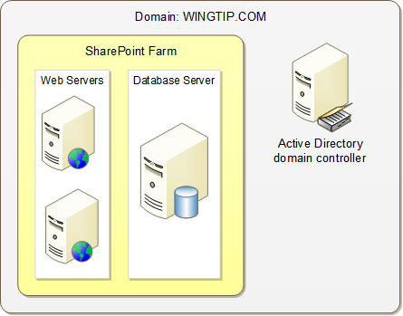
Two Tier Farms
Database role runs on a dedicated database server
Web servers provide web server role and application server role
Service applications run on web server computers
Additional web servers added as needed to scale up farm
Notes:
When you scale up from a small server farm, your first step will usually be to add either a dedicated search server, or a dedicated search server and an additional second front-end Web server. By adding the dedicated search server, you should see better performance but will continue to be vulnerable to a failure at the front-end Web tier, which is why you should also add the additional front-end Web server to the farm. You should configure network or hardware load-balancing to distribute incoming HTTP requests between the two servers. This helps to maximize the increase in capacity that you gain from the second server. It also provides high availability for the front-end Web tier in the event that one of the front-end Web servers fails.
Note that configuring a Web Front End server to be a query server is going to increase the storage requirements. This is due to the fact that the index files for search must reside on the Web server.

Slide 7
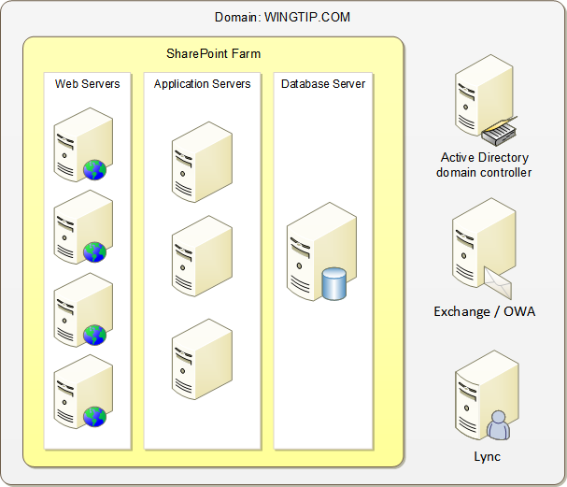
Three Tier Farms
Application servers added to create third tier
Used for environments with heavier service application usage
Offloads service application processing from web servers
Application servers often require more RAM and processing power
Notes:
How you distribute server roles between servers should depend on how people use your SharePoint farm, and you can only determine the optimal distribution of server roles through careful performance monitoring. In a small three-tier farm, all application roles are installed on the application server. You can scale out by adding more application servers and distribute the service applications over the different application servers.

Slide 8
Agenda
Farm Topologies
Caching and Request Management
Configuring Managed Accounts
Creating and Configuring Service Applications

Slide 9
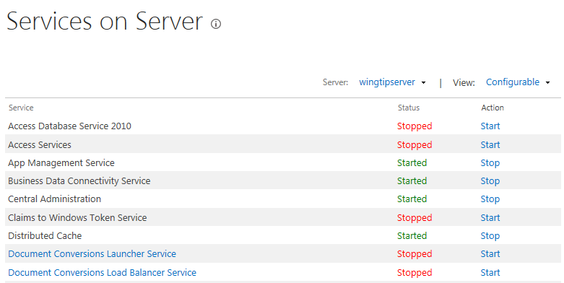
Distributed Cache Service (DCS)
SharePoint 2013 debuts Distributed Cache Service
Provides in-memory cache implemented at farm-wide scope
Built on Windows Server AppFabric Distributed Caching Service
DCS caches security tokens and social networking feeds
Enabled on all SharePoint servers by default

Slide 10
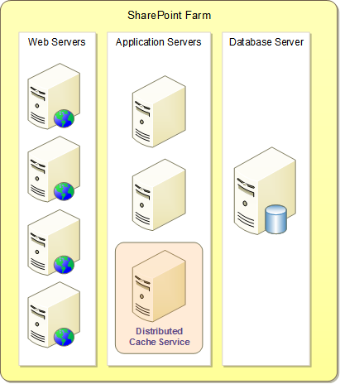
Adding a DCS Server to the Farm Topology
DCS service should be run on application server(s)
DCS should only be enabled on dedicated application servers
DCS should be disabled on majority of servers in farm
DCS servers should allocate 50% of RAM or more to DCS service
Notes:
Cache servers require ~50% of memory for overhead
Max recommended RAM per cache server is 16GB
You should allocate 2GB RAM to the OS
That leaves a maximum of 14GB for cache:
Sizing info will be available that will help you determine how much overall cache storage your farm requires
In the example above, take total storage required / 7GB = # of cache servers needed
There are hundred(s) of perf counters; there are also counts exposed via developer’s dashboard
# of reads
# of writes
# of hits
# of misses
time for read
time for write
Total I/O (how much data has been transferred in a given period of time)

Slide 11
Request Management in SharePoint 2013
Request Management Service (RM)
RM is a new service used to route and throttle incoming requests
RM is a logical service that spans all front end web servers
An example of RM at work
Incoming request arrives at web server
RM routes request to healthier web server

Slide 12
Request Management Scenarios
Examples of how RM can be used
Route majority of requests to healthier web servers
Prevent overloading of unhealthy web servers
Identify and block harmful or unwanted requests
Throttle lower-priority requests (e.g. requests from bots)
Route specific types of requests (e.g. searches) to specific server
Isolate traffic to troubleshoot errors on one specific web server
RM was not designed to replace traditional load balancers
Add complimentary routing/throttling logic into SharePoint pipeline
Eliminates need to configure external load balancers with extra complexity of SharePoint farm topology

Slide 13
Criteria for Routing and Throttling
Rules can match on the values of these properties
You can evaluate property values using these operators
URL | UrlReferrer | UserAgent | Host
IP | HTTPMethod | SoapAction | CustomerHeader
StartsWith | EndsWith | Equals | RegEx

Slide 14
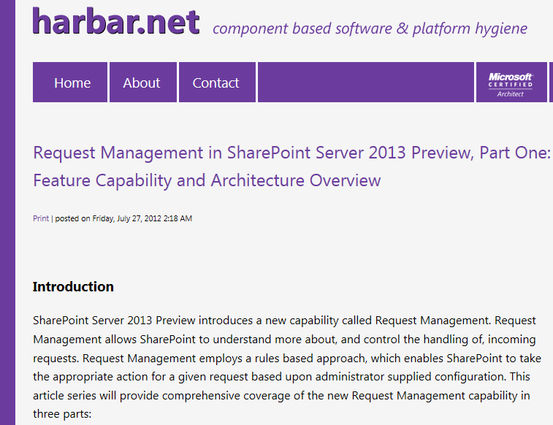
More Information on Request Management
Great article at http://www.harbar.net
Part 1: http://www.harbar.net/articles/sp2013rm1.aspx
Part 2: http://www.harbar.net/articles/sp2013rm2.aspx

Slide 15
Agenda
Farm Topologies
Caching and Request Management
Configuring Managed Accounts
Creating and Configuring Service Applications

Slide 16
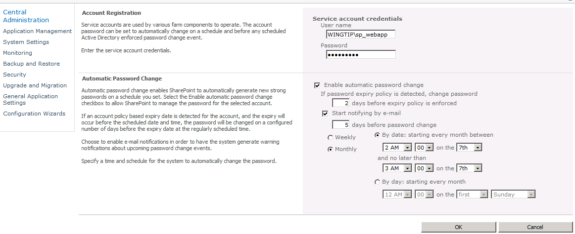
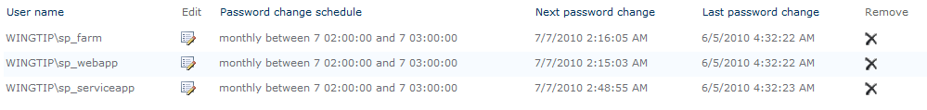
Managed Accounts
SPF allows you to register managed accounts
Provides assistance managing password changes
Create managed account for each Active Directory service account
Notes:
You need to register managed accounts with the farm to make the accounts available to multiple services. You can register a managed account by using the Register Managed Account page in the SharePoint 2010 Central Administration.
Use the Password Management Settings page of the SharePoint 2010 Central Administration to configure farm-level settings for automatic password changes. Farm administrators can configure the notification e-mail address that will be used to send all password change notification e-mails, as well as monitoring and scheduling options.

Slide 17
Creating Managed Accounts

Slide 18
Agenda
Farm Topologies
Caching and Request Management
Configuring Managed Accounts
Creating and Configuring Service Applications

Slide 19
Working with Service Applications
Not all service applications are created equal
Some (but not all) service apps have a database
Some (but not all) service apps can run on app server
Some (but not all) service apps work across farms
How do you create service application instance?
Create them using the Farm Configuration Wizard
Create them by hand in Central Administration
Create them using PowerShell scripting
Notes:
SharePoint 2013 offers a number of service applications. A service application provides a resource that can be shared across sites within a farm or, in some cases, across multiple farms.

Slide 20
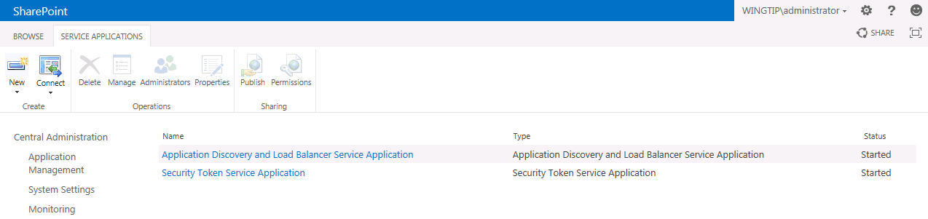
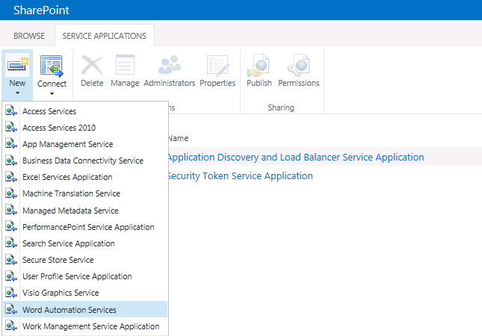
Creating Service Application Instances
Creating and managing service application instances
Two service application instances are created during SPF install these two service application instances cannot be modified
You can use New menu to create service application instances
Notes:
You can easily create and configure service application instances using the SharePoint Central Administration. Click the New button and select the service for which you want to create a new service application instance.

Slide 21
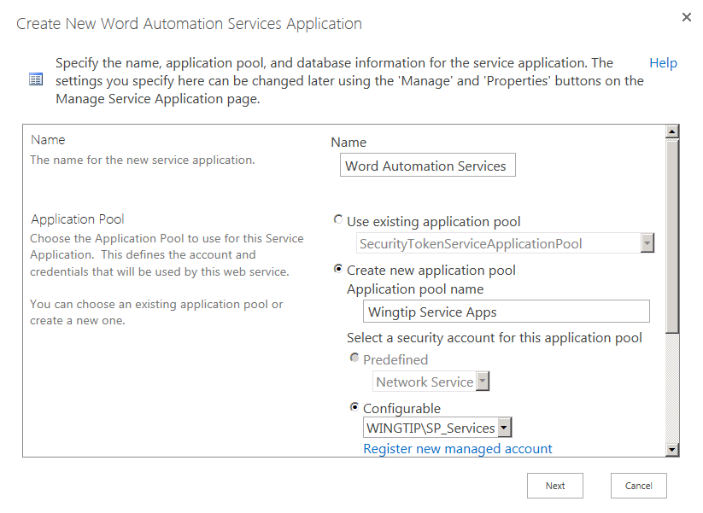
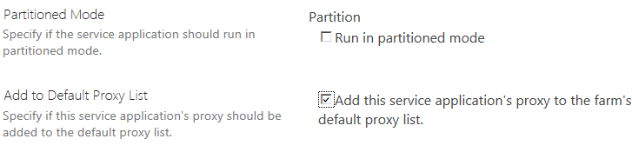
Creating a Service Application Instance
Create new service application using New menu
Dialog appears for you to fill in details of creation
Option to add service application to default proxy list
Notes:
Based on the service application instance you choose, you will be presented with a page where you can configure the different settings, like databases, managed accounts. Each type of service application has its own set of settings.

Slide 22
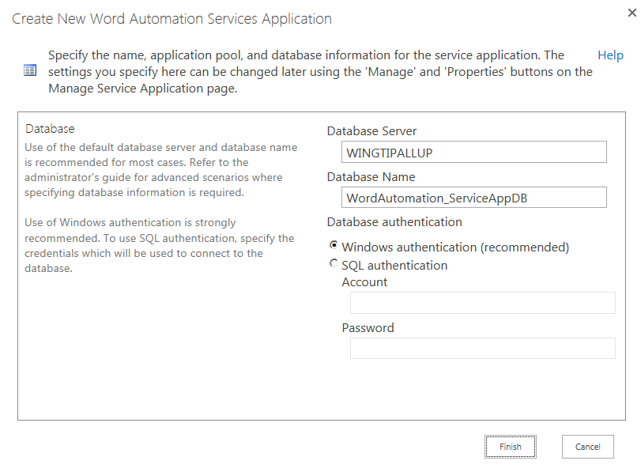
Service Application Database Creation
Database created along with service application
Notes:
Most of the service applications create their own database. This means that the farm administrator account gets configured with the dbowner role. You can choose to run all service applications under the same application pool, or under a new application pool. The application pool account is also configured on the database with the dbowner role.

Slide 23
Creating a Service Application By Hand in Central Administration

Slide 24
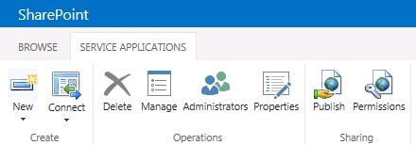
Service Application Management
Use ribbon buttons to configure service applications
Manage - navigate to main administrative page for service application
Administrators - set who can administrate/configure this service application
Properties - view and modify properties such as database location
Publish - configure service application for access by other farms
Permissions - configure which users can use this service application
Administrator
Permissions
User
Permissions
Notes:
The Service Applications page is accessible from SharePoint Central Administration > Application Management > Manage service applications. This page lists all service applications instances. Clicking the hyperlinked name of the service application brings you to a page where you can manage the service application instance. You can highlight the service application instance by clicking on the row of the service application instance. Once the instance is hightlighted, you can use the buttons on the ribbon to configure additional settings like administrators and permissions.

Slide 25
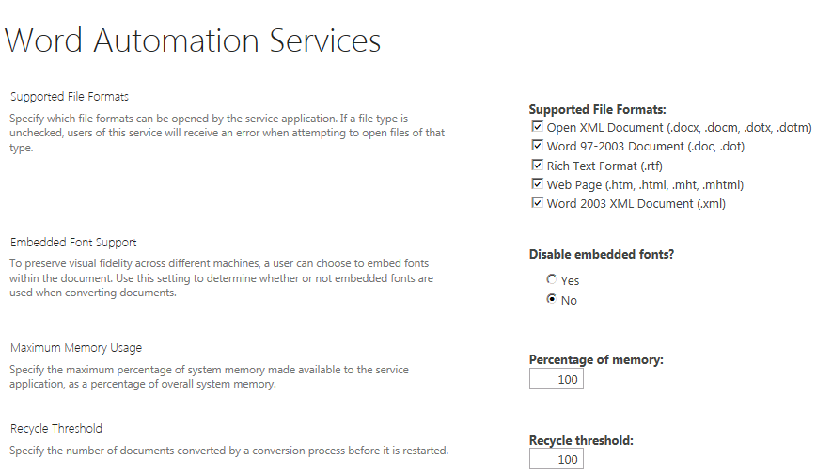
Configuring Service Applications
Manage button navigates to main admin page
This is main place to configure service applications
Each service application has its own custom settings
Notes:
There are 2 possible ways to navigate to the configuration page of the service application:
Clicking the hyperlinked name of the service application, or
Selecting the line of the service application and click the Manage button on the ribbon.
The different sections on this configuration page are different for each service application.

Slide 26
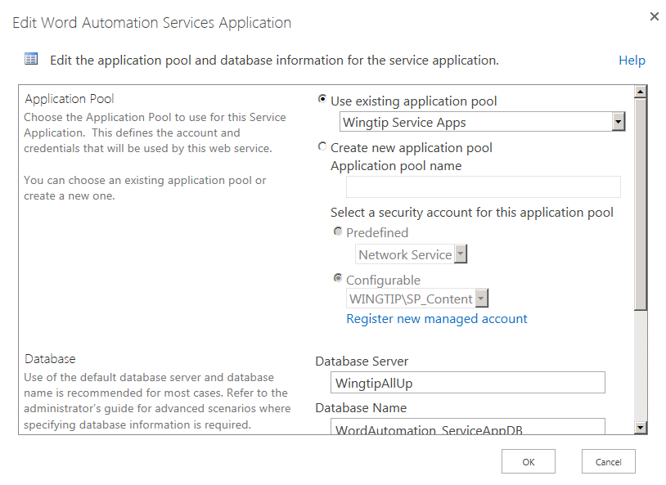
Service Application Properties
Used to configure app pool and database settings
Notes:
The Propertiesbutton brings you to the page where you can view and manage the service application properties. These properties are the application pool and database settings.

Slide 27
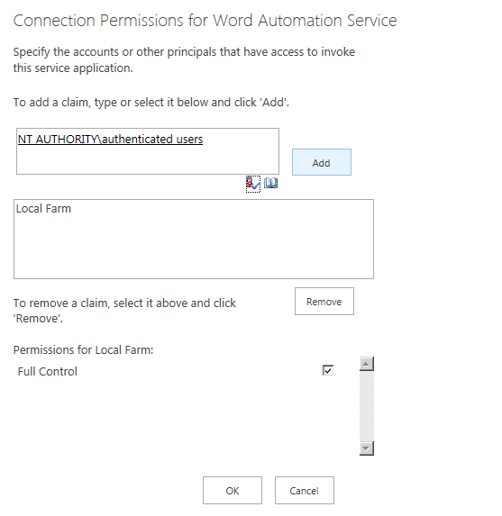
Configuring User Permissions
You must configure service app permissions
By default, users have no permissions for access
Notes:
The Permissions button brings you to the page where you can manage the permissions for the service application. By default, users have no permissions for access.

Slide 28
Delegated Administrators
Service applications can have their own security
You can assign SA admin permissions to users
Users don’t have to be configured as farm admins
Delegated Administrators is a SharePoint group
User is added to this group automatically when added to SA an administrator
Notes:
Service applications can have their own security. Farm administrators can delegate administration of a specific service application (like the User Profile service application, or the Managed Metadata service application) to a service application administrator. A service application administrator can perform all of the administrative tasks related to that service application, but cannot manage other service applications or settings contained in the SharePoint Central Administration.

Slide 29
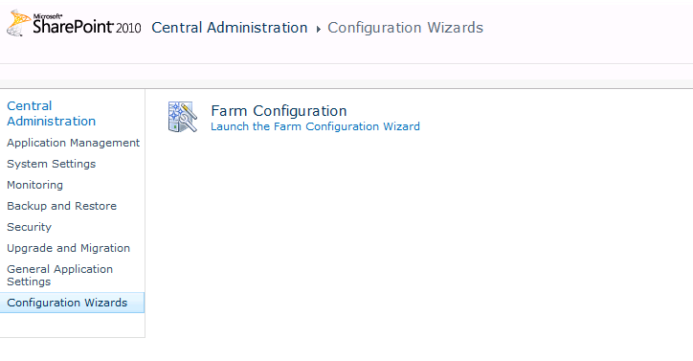
The Farm Configuration Wizard (FCW)
SPF provides Farm Configuration Wizard
Automatically creates/configures service applications
Creates a web application after creating service applications
Convenient for testing scenarios
Can be used in some but not all production scenarios
The alternative involves creating service applications by hand or using Windows PowerShell scripts
Notes:
You can launch the Farm Configuration Wizard from here. It helps you to create and configure the service applications.

Slide 30
Creating Service Applications using the Farm Configuration Wizard

Slide 31
Summary
Farm Topologies
Caching and Request Management
Configuring Managed Accounts
Creating and Configuring Service Applications

