Slide 1
Getting Started with SharePoint 2013
Notes:
This module introduces the basic architecture of SharePoint 2013 while highlighting the aspects of product which have been enhanced in this new release. There will also be a discussion about which features and services are available with SharePoint Foundation as well as the Standard Edition and Enterprise Edition of SharePoint Server 2013. The first module will conclude with an intensive primer on Windows PowerShell to ensure that all students have the basic skills required to read and write Windows PowerShell scripts which will be an essential skillset for later lectures and labs.

Slide 2
Student Questionnaire
Who are you?
What's your name? What company are you with?
What is your experience with...
Windows Server, Active Directory, SQL Server, IIS and ASP.NET
Did you use a previous version of SharePoint?
SharePoint 2001 - STS and SPS
SharePoint 2003 - WSS2 and SPS
SharePoint 2007 - WSS3 and MOSS
SharePoint 2010 – SPF and SPS
What SharePoint roles have you worked in?
User, Site administrator, Farm administrator, Developer

Slide 3
Agenda
SharePoint 2013 Architecture
What's New in SharePoint 2013
Windows PowerShell Primer
Lab Virtual Environment

Slide 4
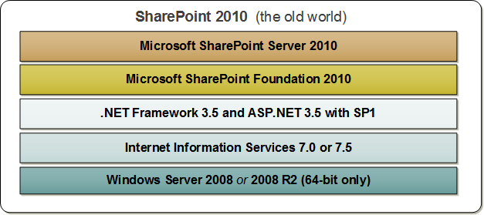
SharePoint 2010: The Predecessor
SharePoint 2010 includes two primary products
SharePoint Foundation (free)
SharePoint Server 2010 (server licenses and CALs)
SharePoint Server 2010 offers two editions
SharePoint Server 2010 Standard Edition
SharePoint Server 2010 Enterprise Edition
Notes:
SharePoint Foundation 2010 is the free version of SharePoint 2010.
SharePoint Server 2010 is the previous version of the SharePoint technology stack. There different SKUs for SharePoint Server 2010:
SharePoint Foundation 2010
SharePoint Server 2010 Standard
SharePoint Server 2010 Enterprise
SharePoint Server 2010 for Internet Sites, Standard
SharePoint Server 2010 for Internet Sites, Enterprise
SharePoint Server 2010 requires both server-side licenses and client access licenses (CAL). A server-side license is required for each server computer on which SharePoint is installed. A Standard Edition CAL is required for each authenticated user that uses SharePoint Server 2010. An addition Enterprise Edition CAL is required for users that utilize features that are part of the Enterprise SKU.
With SharePoint Server 2010, Microsoft introduced two “for Internet Sites” SKUs to provide a company with the ability to host publically facing sites that support anonymous access.
SharePoint 2010 Server only runs on 64-bit operating systems. SharePoint 2010 Server supports installation on a client OS for development. The supported clients OS’ included 64-bit version of Windows 7 and Windows Vista.

Slide 5
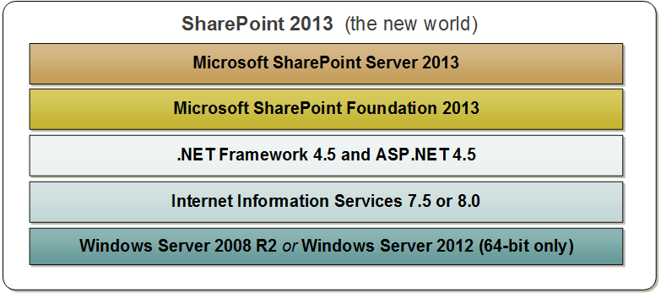
SharePoint 2013: The New Version
SharePoint 2013 offers same products and licensing
SharePoint Foundation 2013
SharePoint Server (Standard Edition or Enterprise Edition)
SharePoint 2013 updates underlying requirements
Window Server 2008 R2 or later
IIS 7.5, .NET Framework 4.5 and ASP.NET 4.5
Notes:
SharePoint Foundation 2013 is the free version of SharePoint 2013.
SharePoint Server 2013 is the new version of the SharePoint technology stack. There different SKUs for SharePoint Server 2013
SharePoint Foundation 2013
SharePoint Server 2013 Standard
SharePoint Server 2013 Enterprise
Like SharePoint Server 2010, SharePoint Server 2013 requires both server-side licenses and client access licenses (CAL). A server-side license is required for each server computer on which SharePoint is installed. A Standard Edition CAL is required for each authenticated user that uses SharePoint Server 2010. An addition Enterprise Edition CAL is required for users that utilize features that are part of the Enterprise SKU.
Note that with SharePoint 2013 Microsoft has discontinued the two “for Internet Sites” SKUs that were introduced with SharePoint 2010. A significant change here is that with SharePoint 2013, anonymous users are covered under the server-side license.
SharePoint 2013 only runs on 64-bit operating systems. No version of SharePoint 2013 supports installation on a client OS. However, you can run a 64-bit version of Windows 8 with Hyper-V which allows you to run 64-bit virtual machine’s with SharePoint 2013.

Slide 6
SharePoint 2013 and Office 365
SharePoint 2013 was designed for the “cloud”
Microsoft has made big investment with Office 365
SharePoint 2013 designed to work in hosting scenarios
Microsoft assumes role of SharePoint administrator companies don't require hardware or as much SharePoint expertise
Office 365
SharePoint sites
Notes:
SharePoint 2013 marked the first version of the product in which Microsoft shifted its focus to support hosting SharePoint in the cloud. Much of this has to do with Microsoft’s recent investments with Office 365 (aka SharePoint Online). A significant percentage of the investment that Microsoft has made to make SharePoint 2013 better than SharePoint 2010 revolves around making things work in cloud-based hosting scenarios.
With the SharePoint 2013 environment hosted within Office 365, Microsoft assumes role of SharePoint administrator. One important factor to note is that companies don't require hardware or as much SharePoint expertise to leverage SharePoint in their business.
In this training course, the focus will be on installing and configuring SharePoint 2013 in an on-premises environment as opposed to learning how to use SharePoint 2013 in Office 365.

Slide 7
SharePoint On-premises vs. Office 365
Two primary ways to utilize SharePoint 2013
On-premises farm deployments
Establish a company account in Office 365
On-premises farm deployments
You acquire your own hardware and software licenses
You deploy SharePoint on servers running on premises
Establish a company account in Office 365
Purchase Office 365 plan for hosting SharePoint sites
Microsoft provides hardware and manages deployment
Notes:
There are two primary ways in which a company can use SharePoint 2013. A company can install SharePoint 2013 on server computers which it controls. This type of SharePoint 2013 installation is known as an on-premises farm. Alternately, a company can establish an account in Office 365 which makes it possible to create and utilize SharePoint sites which make use of SharePoint services. Furthermore, there is nothing that prevents a company from using both approaches at the same time which involves one or more on-premises farms used in conjunction with a SharePoint presence in Office 365.
With an on-premises farm deployment, a company must acquire its own hardware and purchase licenses from Microsoft. The company must also maintain expertise within its IT staff to install SharePoint 2013 on servers running on premises. This is largely the focus of this training class.
When establishing a company account in Office 365, a company must purchase an Office 365 plan for hosting SharePoint sites which typically involves monthly per-user charges but eliminates the need to purchase SharePoint 2013 licenses. Microsoft provides the hardware and manages the SharePoint farm behind the scenes. A company will administrate its account at a higher level which is known as “tenancy level”. Therefore, the company will have one or more users who will play the role of tenancy administrator.

Slide 8
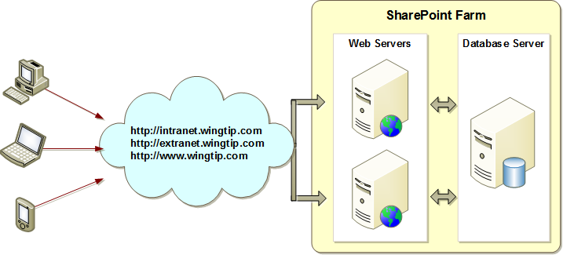
On-Premises Farms
SharePoint deployment based on farms
Farm consists of web server(s) and database server
Farm can be single server or multi-server
Each farm has exactly one configuration database
Single-server farm used for development/testing environments
Notes:
A SharePoint Farm is simply a collection of servers that have SharePoint installed on them and are all connected to the same configuration database (aka: the config DB).
A SharePoint farm typically consists of one or more web servers and a database server. The number of web servers required in the farm largely depends upon the number of users and other factors such as the processing requirements of the services being utilized. Each farm must run SQL Server on at least one server to run the databases required in a SharePoint environment. The first database that is created is called the configuration database.
In a development or testing environment, a SharePoint 2013 farm can be built entirely on a single server. This is the type of farm you will create and configure in the labs for this course. However, a single-server farm is not something which should be used in a production environment. For starters, a SharePoint 2013 farm in a production environment should always have a database server that is separate from the web server or web servers.

Slide 9
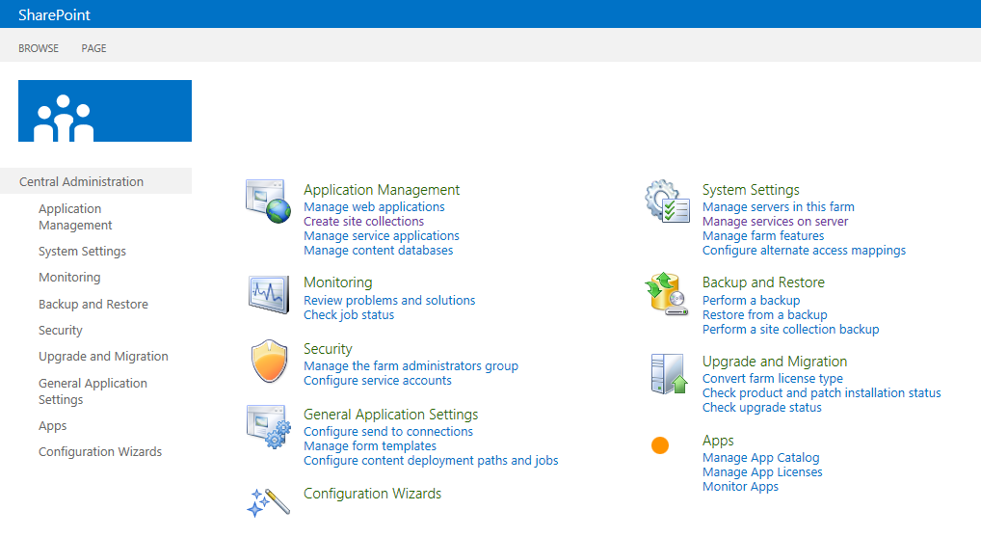
Central Administration
Primary tool of SharePoint Farm Administrators
Provides user interface to configure SharePoint farms
Notes:
Whenever you create a new SharePoint 2013 farm, SharePoint automatically creates a special site for farm administrators known as Central Administration. This site provides a user interface experience which makes it possible for SharePoint farm administrators to perform essential administration tasks such as creating web applications, service applications and site collections. If you plan on working with SharePoint 2013 in the role of a farm administrator, you must become familiar with Central Administration.
While Central Administration makes it possible to accomplish many types of administration tasks in SharePoint 2013, it is not a tool that is completely comprehensive. There are many important SharePoint 2013 administrative tasks that you either cannot or should not perform using Central Administration. As you will soon see, working with Windows PowerShell is usually the thing that allows you to fill in the gaps and get to functionality not available through Central Administration.

Slide 10
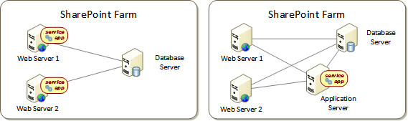
Service Applications
SharePoint 2013 supports service applications
Service application architecture provides efficient resource sharing
Farm administrator responsible for creating service applications
Service applications can run on web server or application server
Configuring location of service application is relatively easy to do
SharePoint Server 2013 ships with essential service applications search service, user profile service, managed metadata service, etc.
Notes:
Starting in SharePoint 2010, Microsoft introduced a new model based on Service Applications for sharing resources across sites and web applications. The service application model continues to be a central figure in the architecture for SharePoint 2013. Furthermore, the service applications model facilitates multitenant deployment in SharePoint 2013 which provides more flexibility in SharePoint farm topologies.

Slide 11
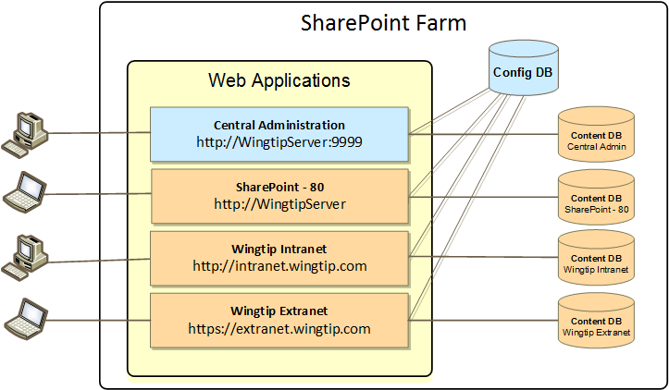
Web Applications
Web applications provide HTTP entry points
Web application used to creates sites accessible to business users
Web application implemented using one or more IIS Web sites
Web application stores site-specific data in content database
Web application defines scope for configuring user authentication
Notes:
SharePoint 2013 is primarily a web-based application which means it must provide HTTP entry points to its clients. SharePoint 2013 leverages the web server infrastructure of Internet Information Services (IIS) and IIS website to listen for incoming HTTP requests and to process them inside server-side processes that are launched on demand. SharePoint 2013 creates an abstraction on top of an IIS websites known as a web application. Therefore, a SharePoint web application provides an HTTP entry point into a SharePoint farm for browser-based clients as well as other types of clients such as Office application that communicate with a SharePoint farm using HTTP requests.
A web applications provides a scope for creating sites which are accessible to business users. In fact, ever SharePoint site must be created within the scope of a particular web application.
The content within a SharePoint site is stored within a SQL Server databases known as a content database. Therefore, ever web application must have at least one content database associated with it. However, there will often be more than one content database associated with a specific web application. In this training course, you will learn how to manage the association between web applications, content databases and site.
A web application defines a scope for configuring user authentication. For example, one web application might require integrated windows authentication and disable anonymous access. A second web application within the same farm could be configured to support other types of user authentication such as forms-based authentication (FBA) and/or to permit anonymous access.

Slide 12
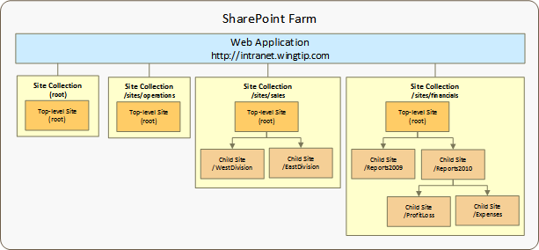
Site Collections and Sites
Sites are partitioned into site collections
Site collection provides scope for administrative privileges
Site collection always contains top-level site
Site collection may contain hierarchy of child sites
Web application can support 1000s of site collections
Notes:
All user-generated content resides in SharePoint sites. The primary types of content include items within lists and documents inside document libraries. However, there are other forms of user-generated content as well such as customization data and personalization data tracked by server-side web parts as well.
Sites are grouped into site collections. Whenever a site is created, it is always created within a scope of a specific site collection. Furthermore, each site collection is associated with exactly one content database which is used to store the content of all the sites inside.
Each site collection must have exactly one site referred to as the “top-level” or “root” site. The URL of the top-level site is always the same as the URL of the site collection. A site collection may additionally contain child sites below the root site. Child sites can be nested within other child sites within a site collection resulting in the creation of a site hierarchy. While SharePoint supports nested child sites more than 10 levels in depth, experience has taught the SharePoint community that creating deep site hierarchies can be very hard to manage and to scale.
A key reason why the SharePoint architecture requires that sites are always partitioned into site collections has to do with security. More specifically, site collections provide a scope for administrative privileges. If you are configured as the site collection administrator (aka site collection owner), you are guaranteed to have full administrative control over all the sites inside. Web application can support 1000s of site collections.

Slide 13
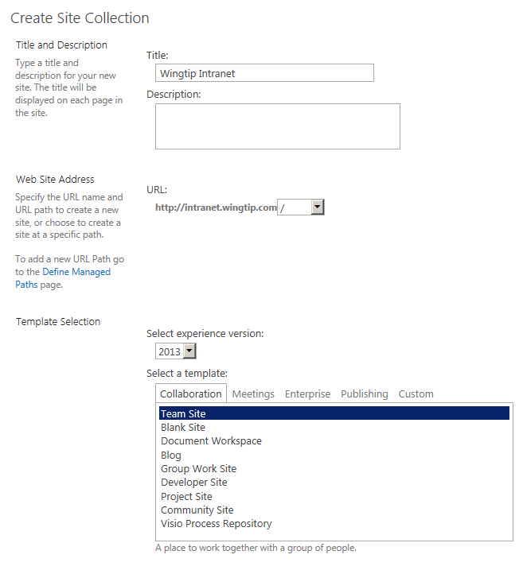
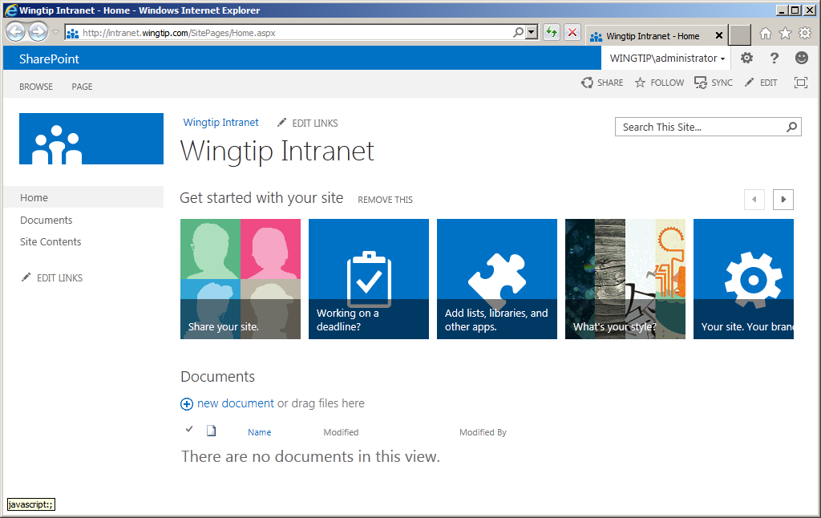
SharePoint 2013 Team Sites
Team sites provide support for collaboration
Same functionality as in earlier versions
SharePoint 2013 introduces new user interface design
Notes:
SharePoint 2013 is the fifth major version of the SharePoint technology stack. Each version has enhanced the product and made significant changes to account for changes in the IT industry. However, a few things are remained consistent across versions. One example of this is the site template for creating Team Sites which has been available since the very first version of SharePoint technologies released in 2001. Team sites are the most commonly-created type of site in all versions of SharePoint.
The new team site in SharePoint 2013 looks quite a bit different from SharePoint 2010. The master page has changed. The Site Actions menu has been moved from the left to the right. Much of the user interface has been redesigned around the new app model.

Slide 14
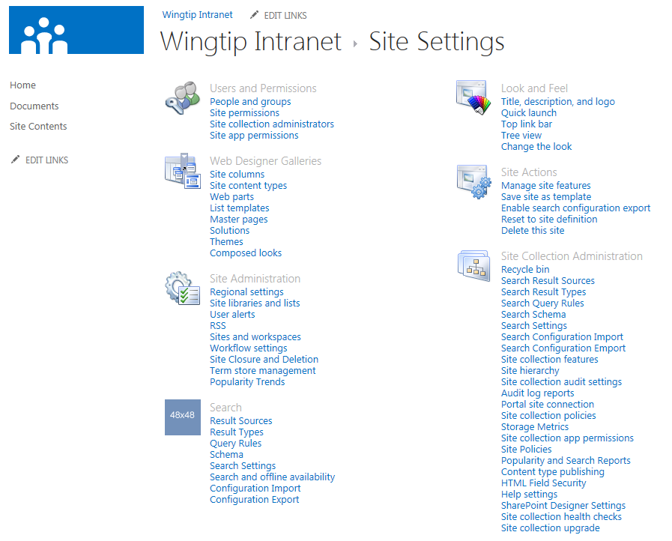
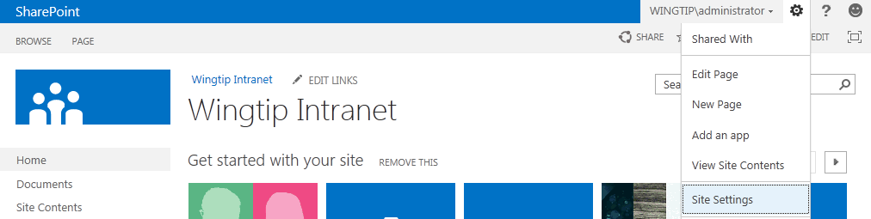
Site Settings
Primary tool of SharePoint site administrators
Provides user interface to configure SharePoint sites
Notes:
Certain users are given the role as “site administrator”. Quite often this means that the user has been assigned the permissions of a site collection administrator. In some scenarios, the IT staff within a company may elect to use a more elaborate security configuration where business users are never configured as site collection administrators, but instead they are assigned less-powerful administrative permissions on one or more sites within a site collection. In either case, these users will be responsible for certain administrative duties at the site level.
Each site contains a site settings page ([site_url]_layouts/settings.aspx) which provides links to administrative pages which make it possible to perform common administrative tasks at the site level. The site settings page of the top-level site also contains links to pages which are used to perform administrative tasks on the site collection as a whole.

Slide 15
Creating a new site collection using Central Administration

Slide 16
Agenda
SharePoint 2013 Architecture
What's New in SharePoint 2013
Windows PowerShell Primer
Lab Virtual Environment

Slide 17
SharePoint 2013 Architecture Changes
New platform-level services
Distributed Cache Service
Request Management Service
Changes to existing service applications
A few existing service applications are gone
A few new service applications have been added
A few existing service applications are very different
There is a new model for custom development
SharePoint 2013 introduces SharePoint apps
Notes:
SharePoint 2013 introduces several significant changes to the platform’s architecture. For example, there are two new
services which have been added to promote higher levels of scalability which as the distributed caching service and the request management service.
There has also been changes to the existing set of service applications that are part of SharePoint 2010. For example, some service applications have been removed in SharePoint 2013 while others have been added. Some service applications such as the Search Service have undergone a major redesign.
One of the biggest changes to the SharePoint platform is the introduction of the SharePoint app model which completely changes the strategy for developing custom software to extend SharePoint sites. While development techniques used to created custom solution in early versions of SharePoint are still supported, Microsoft is heavily pushing the new SharePoint app model because it works equally well in Office 365 and other hosting environment as it does in on-premises farms.

Slide 18
New Platform-Level Services
Distributed Cache Service
Provides farm-wide cache of data
Caches user authentication tokens and social feeds
Usually run on dedicated servers within a farm
Request Management Service
Provides new routing and throttling capabilities
Used to prioritize requests for certain types of users
Used to route certain request types to specific servers
Managed by adding rules using PowerShell
Notes:
SharePoint 2013 introduces two new platform-level services known as the Distributed Cache Service and the Request Management Service.
The Distributed Cache Service provides a farm-wide cache of data that is shared across all the servers in the farm. The are two primary types of data that is stored in the distributed cache: user authentication tokens and feeds generated by the social features of SharePoint Server 2013. Note that the Distributed Cache Service should not be configured to run on all the servers in a large farm. Instead, it should generally be configured to run on a single server or a pair of servers.
The Request Management Service provides SharePoint 2013 with new routing and throttling capabilities. For example, it can also route certain types of requests (e.g. searches) to specific servers in the farm. It can also evaluate the health of servers in the farm any dynamically adjust routing the route more request to health servers and few request to servers that are showing slow response times or other indicators of performance problems.
The only thing you can do with either of these services through Central Administration is to start and stop them on specific servers. All the configuration of both services must be accomplished through the use of PowerShell.

Slide 19
Retired Service Applications from 2010
Web Analytics is no longer service application
Analysis and reporting process rolled into search service
Office Web Apps (OWA) no longer a service application
Now a separate product running outside SharePoint
New OWA product integrates with SharePoint farm
OWA cannot be installed on the same servers as SharePoint
Notes:
There are two SharePoint 2010 services applications that that are no longer available in SharePoint 2013. These service applications are the Web Analytics Service and Office Web Apps (OWA).
The Web Analytics service is really still part of SharePoint Server 2013. However, it is no longer a stand-alone service application. Instead, the functionality of the Web Analytics Service in SharePoint 2010 has been rolled into the Search Service application.
In SharePoint 2010, Office Web Apps (OWA) is a service application that must be installed and configured within a SharePoint farm. The new version of the Office Web Apps is no longer tied to SharePoint. Instead, Office Web Apps is now installed as its own stand-alone product. Once you have installed Office Web Apps and created an OWA farm, you can create a connection between a SharePoint farm and the OWA farm. It is important to note that the Office Web apps product cannot be installed on the same servers on which you have installed SharePoint 2013.

Slide 20
New SharePoint 2013 Service Applications
App Management Service
Used to configure and monitor SharePoint apps
Machine Translation Service
Used to translate content from one language to another
PowerPoint Conversion Service
Used to convert PowerPoint slide into various file formats
Work Management Service
Used to aggregate all tasks assigned to user in My Site
Workflow Service
Used to manage the workflow runtime environment
Notes:
There are several service application that are introduced in SharePoint 2013 including the App Management Service, the Machine Translation Service, the Work Management Service and the Workflow Service.
The PowerPoint Conversion Service is simple service used to convert PowerPoint slide presentations in various file formats such as PPTX, PPT, PDF, BMP and JPG.
The App Management Service is a central figure in the new SharePoint app model. It used to track, configure and monitor SharePoint apps. It also assists with app security in that it helps to establish app identity and track app permissions.
The Machine Translation Service is used to translate content from one language to another such as English to Spanish. Behind the scenes, the Machine Translation Service interacts with the Bing translation service on the Internet to translate the actual content from one language to another. The Machine Translation Service adds value by providing a queuing and threading infrastructure to queue up hundreds or translation jobs which will be processed over a longer period of time.
The Work Management Service is used to aggregate all the tasks assigned to each user and synchronize them in a unified task list in each user’s MySite. This means the Work Management Service in effect performs a farm-wide synchronization of tasks for each user. Note that a SharePoint Server 2013 farm can be integrated with Exchange 2013 in such as way that the Work Management Service can synchronize tasks from an Exchange inbox and add them to the unified task list as well.
The Workflow Service is used to manage the new workflow runtime environment that has been created for SharePoint 2013.

Slide 21
Service Application Enhancements
Business Data Connectivity Service
New support for OData data sources
Managed Metadata Service
New uses for managed metadata and taxonomies
New eDiscovery features
User Profile Service
Enhancements to social features and microblogging
Search Service Application
Search architecture redesigned from SharePoint 2010
Notes:
This slides shows which of the existing service applications from SharePoint 2010 have been enhanced from SharePoint 2013.
The Business Data Connectivity Service has been enhanced to support external data sources that support the OData protocol. The Managed Metadata Service has been enhanced so that a taxonomies can be used for navigation as well as tagging. There is also a large number of new features which fall into the category of eDiscovery which assists with finding and managing content across SharePoint and Exchange as well as putting holds on content and printing it. The User Profile Service has been enhanced with new social features such as the ability to follow sites and documents as well as people and to participate in microblogging.
The Search Service in SharePoint 2013 hasn’t just been enhanced from the previous version. It has gone through a complete redesign from the ground up. In SharePoint 2010 you must choose between two different search platforms: SharePoint Search or FAST Search for SharePoint. In SharePoint 2013, SharePoint Search and FAST Search have been combined into a single, unified search platform. Therefore, you do not have to decide which search platform to use in SharePoint 2013. Furthermore, the new search platform is used by Exchange 2013 in addition to SharePoint 2013 which allows for a new level of integration between SharePoint 2013 and Exchange 2013.

Slide 22
SharePoint Apps
SharePoint 2013 debuts SharePoint App Model
New development platform to extend SharePoint sites
Alternative to farm solutions and sandbox solutions
What's different about the new model?
Apps are easier to discover and install
Apps available in Office Store and from ISVs
Apps never run code in SharePoint environment
Apps are authenticated and have their own permissions
Apps have much improved support for upgrade
Notes:
From the perspective of a developer, Microsoft has changed everything with SharePoint 2013. In previous versions of SharePoint, developer created farm solutions and sandbox solutions to extend the functionality and appearance of a SharePoint site. Starting with SharePoint 2013, Microsoft now strongly recommends that developers should create business solution for SharePoint using the new SharePoint app model.
There are many things that are very different about the new model when compared to the classic style of SharePoint development which involves developing farm solution and sandbox solutions. For example, SharePoint apps are published in a catalog which makes them much easier to discover, install and upgrade. Apps can be published by developers into the public Office Store where they can be purchased and installed by SharePoint users in Office 365 as well as in on-premises farms.
The custom code with an app never runs inside any of the SharePoint worker processes. App code runs either in the browser or within a external website which runs outside the SharePoint environment. The SharePoint app model was designed to provide app authentication so that apps can be recognized as first class security principals which can have their own configured set of permissions. This is a significant improvement over the limited security scheme used when deploying and configuring SharePoint solutions.

Slide 23
Agenda
SharePoint 2013 Architecture
What's New in SharePoint 2013
Windows PowerShell Primer
Lab Virtual Environment

Slide 24
PowerShell 101
What is PowerShell?
A modern replacement for the CMD (command) shell
A powerful scripting environment for administration
How do you use PowerShell?
From an interactive command window
By writing and executing scripts
Notes:
Over the last few years, PowerShell scripting has begun to replace older DOS-style batch files and VBScript files as the preferred way to manage and automate administrative tasks.
Cmdlets are callable functions.
Pipelining allows one Cmdlet to return an object as input to another.
PowerShell includes formatting features to display output using lists or tables.
PowerShell is based on a provider-based model based on Snap-ins.
SharePoint support is added through Microsoft.SharePoint.Powershell.dll

Slide 25


PowerShell Cmdlets
PowerShell libraries contain Cmdlets
Cmdlets are functions named using Verb-Noun format
Most cmdlets are defined to accept parameters
Notes:
Cmdlets perform an action and typically return a Microsoft .NET Framework object to the next command in the pipeline.
Windows PowerShell uses a verb-noun pair for the names of cmdlets. For example, the Get-Command cmdlet provided by Windows PowerShell is used to retrieve all the commands that are registered in Windows PowerShell. The verb part of the name identifies the action that the cmdlet performs. The noun part of the name identifies the entity on which the action is performed.

Slide 26
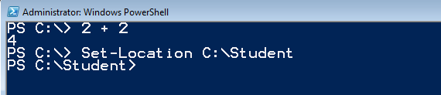


Windows PowerShell Console Window
Type in command or Cmdlet and press Enter
Pressing Enter key executes current line
Tab completion
Hitting Tab completes name of Cmdlet or parameter
Notes:
There is tab completion for the commands and for the members. For example you can type “Install-SP” and then press tab and it will cycle through the available commands. You can also use the tab key to add the parameters to the command.

Slide 27
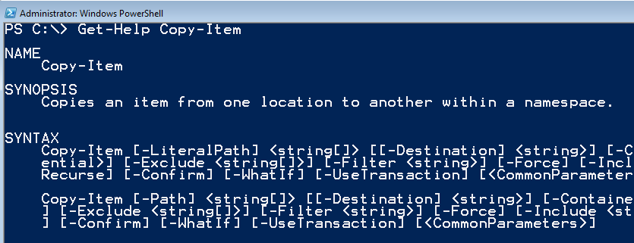

Getting Help on Cmdlet Syntax
Call Get-Help cmdlet passing cmdlet name
Additional parameters can be passed to Get-Help
Notes:
To get help for a command or concept, type "Get-Help" followed by the name of the command or concept help topic. To get a list of all cmdlet help topic titles, type "get-help *".
Get-Help also has a search feature that searches cmdlet help, provider help, and About help (HelpFile) topics. If you type "Get-Help" followed by the exact name of a help topic, or by a word unique to a help topic, Get-Help displays the topic contents. If you enter a word or word pattern that appears in several help topic titles, Get-Help displays a list of the matching titles. If you enter a word that does not appear in any help topic titles, Get-Help displays a list of topics that include that word in their contents.
Because the search feature does not search the help topics for functions and scripts, you must enter the exact name of the function or script to get its help topic.

Slide 28
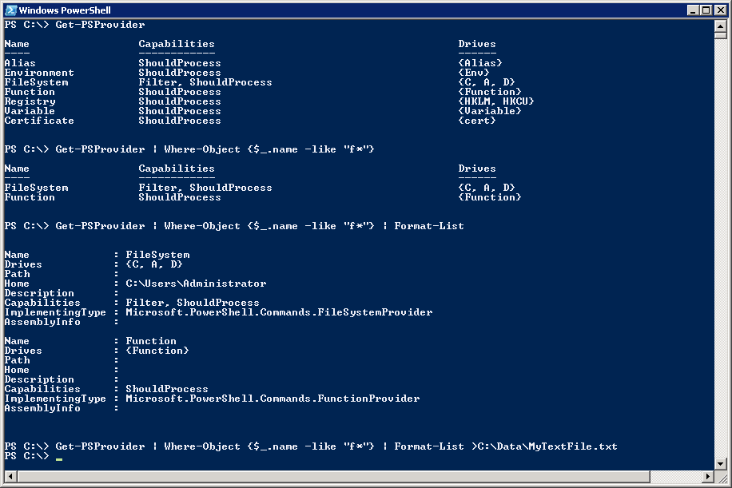
Getting Started with PowerShell
(1) Execute a Cmdlet
(2) Filter results using where clause
(3) Add formatting instructions
(4) Redirect output to new text file
Notes:
The first example shows calling a Cmdlet that takes no parameters
The second example adds filtering by adding a Where command
Where-Object {$_.name –like “f*"}
The syntax $_ refers to the object in question
$_.name refers to the object's name property
-like is the operator for like
The third example adds in formatting instructions
The last example redirects output so it is stored in a new text file.

Slide 29
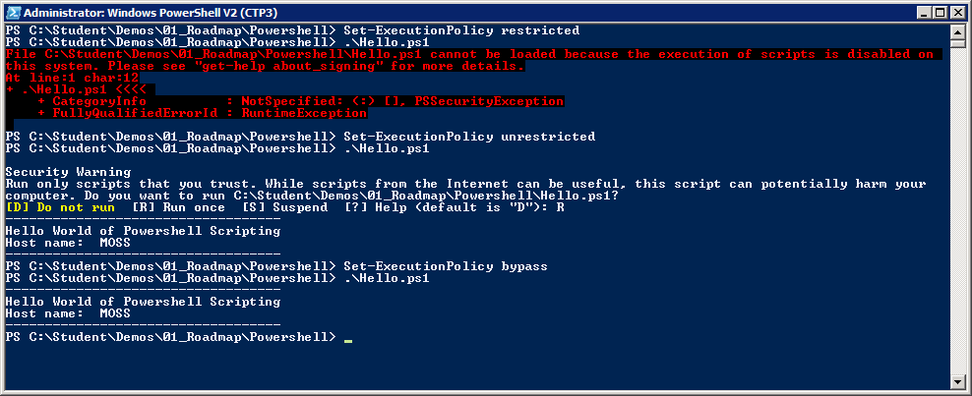
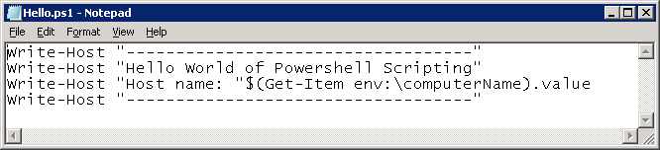
Scripts and Execution Policy
You can author PowerShell scripts
Scripts have *.ps1 extension
Local execution policy must be configured
Scripts will not execute under default execution policy of restricted
Scripts can execute under execution policy of unrestricted. Scripts that are not signed result in prompting user for permission to execute.
Scripts can execute under execution policy of bypass. This mode suppresses prompting user for permission to execute.
Notes:
By default, PowerShell does not allow script to run. The SharePoint Administrator must change execution policy to enable script execution
There are a number of settings that you can apply to Execution Policy:
restricted (default) – scripts prohibited from executing
unrestricted - scripts can execute. Scripts that are signed can run with user interaction. Scripts that are not signed result in prompting user for permission to execute.
bypass (developer mode) – scripts can execute and user interaction is suppressed.

Slide 30
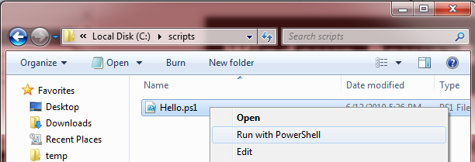
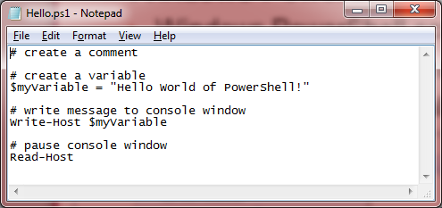
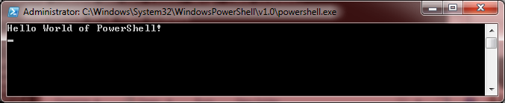
Windows PowerShell Scripting
Windows PowerShell Scripting Fundamentals
Host machine has a configurable execution policy
Execution policy must allow scripts to run
Right-click .ps1 file and select Run with PowerShell to execute
Script Editing Tools
Windows Notepad
Windows PowerShell ISE
Notes:
Windows PowerShell has security settings called the “execution policy”; the execution policy determines how (or if) PowerShell runs scripts. By default, PowerShell’s execution policy is set to Restricted; that means that scripts, including those you write yourself, won’t run. This execution policy can be changed to be able to run scripts. Scripts have the extension of .ps1.
The Windows PowerShell Integrated Scripting Environment (ISE) is a host application for Windows PowerShell. In Windows PowerShell ISE, you can run commands and write, test, and debug scripts in a single Windows-based graphic user interface.

Slide 31
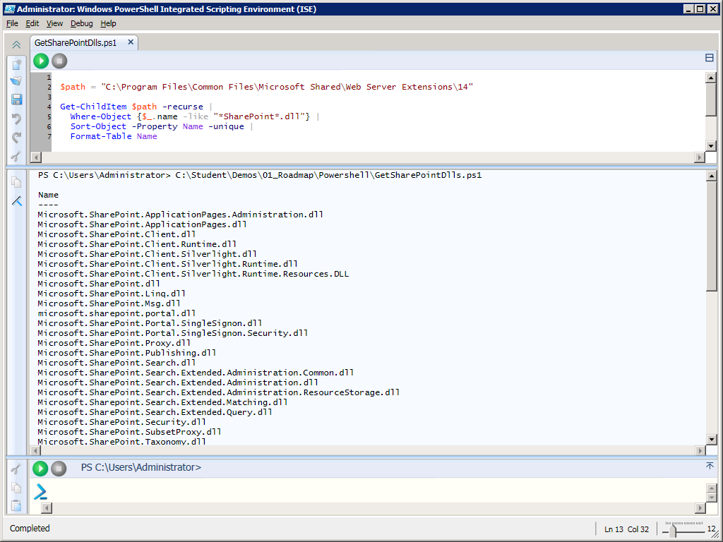
Editing Scripts using PowerShell ISE
Supports color-coding, IntelliSense and debugging
Notes:
With the initial release of PowerShell, administrators and developers usually resorted to writing scripts with Notepad. PowerShell 2 provides a nice development environment for writing PowerShell scripts named the PowerShell Integrated Scripting Environment (ISE).
This interface allows for multiline editing, tab completion, syntax coloring, selective execution, context-sensitive help, and support for right-to-left languages. You can use menu items and keyboard shortcuts to perform many of the same tasks that you would perform in the Windows PowerShell console.
When it comes to writing complex scripts with control of flow logic, it is really nice to be able to debug and single step through your code.

Slide 32
Scripting Syntax
Syntax | Description
# | Creates a comment
$ | Creates a variable
; | Denotes completion of cmdlet, continue to next one
| | Pipelines output of the preceding cmdlet to next cmdlet
ForEach-Object { } | For each object, execute all the commands within the { }.
Notes:
Windows PowerShell is fundamentally case insensitive. Every object and every cmdlet is case insensitive. Set-Location performs exactly the same action as set-location. However, where your data has case sensitive values, there are PowerShell operators to deal with it.
Variable names always start with a dollar sign ($) and can contain a mix of letters, numbers, symbols, or even spaces (though if you use spaces, you need to enclose the variable in braces)
$var = “Hello”
The pipe (|) symbol is used to pipe commands. The output of one command serves as input for the second command.
Get-Command -PSSnapin Microsoft.SharePoint.PowerShell | Out-Gridview
Get-SPWeb http://intranet.wingtip.com | get-member
Get-SPWeb http://intranet.wingtip.com | gm
ForEach-Object can be used to execute a loop
$Jobs = @(Get-SPTimerJob | Where-Object { $_.Schedule.Interval -le 5 -and $_.Schedule.Description -eq "Minutes" })
foreach ($job in $Jobs) {
Write-Host -foregroundcolor green $job.name
$Sched = $job.Schedule
$Sched.Interval= $Sched.Interval+30
$job.Schedule=$Sched
$job.Update()
}
Filtering example:
Get-SPTimerJob | Where-Object { $_.Schedule.Description -eq "Minutes" }

Slide 33
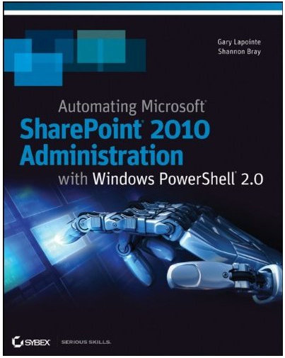
Recommended Reading on Resources
Automating SharePoint 2010 Administration with Windows PowerShell 2.0
Still a good resource and very applicable to SharePoint 2013 administration

Slide 34
Agenda
SharePoint 2013 Architecture
What's New in SharePoint 2013
Windows PowerShell Primer
Lab Virtual Environment

Slide 35
Course Lectures, Demos & Labs
Modules consist of:
Lecture + Demos
Hands-On Lab
Student.zip
Provided by instructor
Includes all files :
Any files / scripts needed for lab exercises
Solutions for lab exercises

Slide 36
Lab Virtual Environment
Each student should have their own VM environment
Based on a single VM image which runs in Hyper-V environment
Pre-lab setup of virtual machine:
VM built using Windows Server 2012 (WingtipServer)
Configured as Active Directory domain controller (wingtip.com)
SQL Server 2012 with SP1 installed and configured
SharePoint Server 2013 installed but not configured
Lab work in the course
You will create and configure a new SharePoint 2013 farm
You will create service applications and web applications
You will create site collections to test SharePoint 2013 functionality

Slide 37
Summary
SharePoint 2013 Architecture
What's New in SharePoint 2013
Windows PowerShell Primer
Lab Virtual Environment

