Slide 1
Health Monitoring and Optimization
Notes:
This module explores common popular tools and techniques used to monitor SharePoint 2013 farms and to optimize their performance. You will learn how to troubleshoot problems using the Developer Dashboard and how to read diagnostic information from ULS logs and the Logging Database. The module also discusses using the new Health Analyzer and configuring Usage Reporting.

Slide 2
Agenda
ULS Logging
Logging Database
Health Analyzer
Useful Debugging Tools

Slide 3
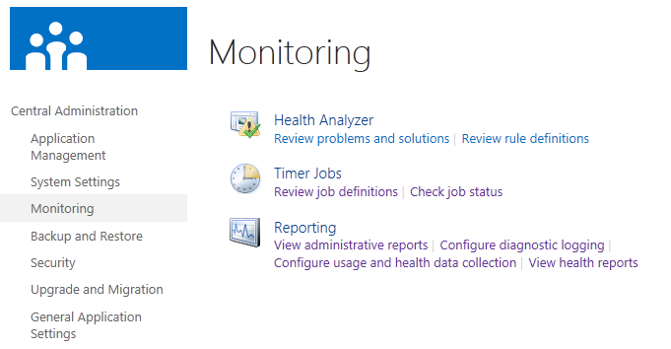
Health Monitoring Tools in SharePoint 2013
Tools for collecting health and usage data
ULS logs (aka. diagnostic logging)
Logging Database (aka. usage and health data collection)
Tools for reporting on health and usage data
Health Analyzer
Custom Reports

Slide 4
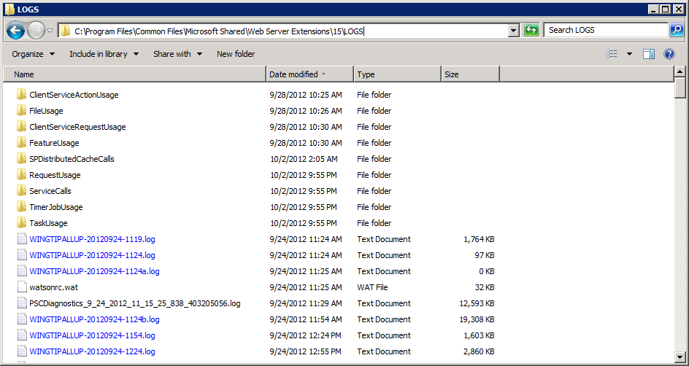
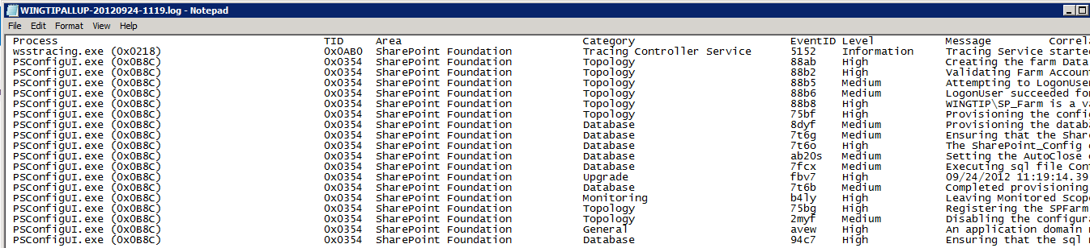
Unified Logging Service (ULS)
ULS is SharePoint's built-in diagnostic logging service
ULS logs stored as compressed text files
Log files stored in default location which is configurable
C:\Program Files\Common Files\Microsoft Shared\Web Server Extensions\15\LOGS
ULS logs notoriously hard to read using notepad.exe

Slide 5
Correlation IDs used in ULS Logs
ULS logging often adds Correlation IDs
Special GUID-based column added to log entries
Correlates all log events for a specific HTTP request
Correlates all log events for a specific timer job
Very helpful when troubleshooting errors
PowerShell can query log for specific Correlation ID

Slide 6
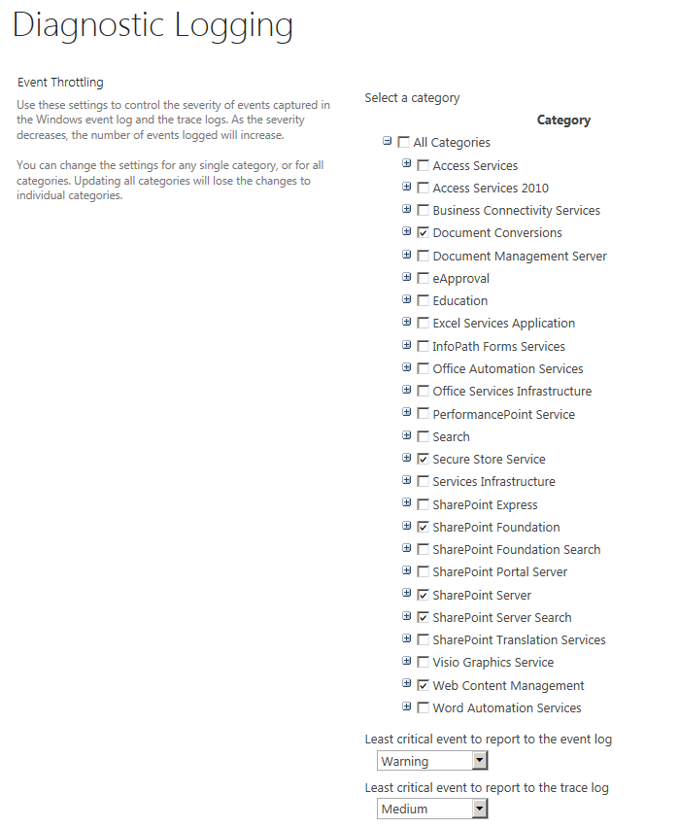
Configuring ULS Log Collection
You can configure what events are logged
Helpful when troubleshooting problems in production
Only enable logging on what you want to see

Slide 7
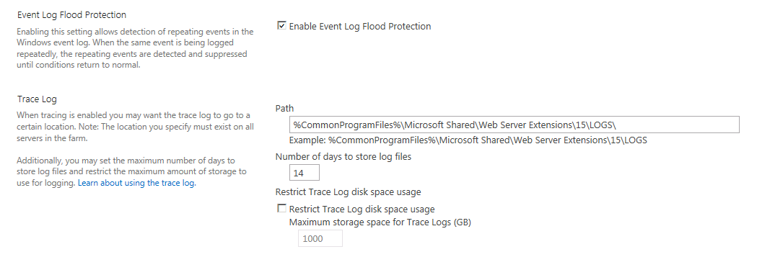
Event Log Flood Protection Configuration
Event Log Flood Protection
Used to keep logs from getting overloaded
Stops recording events when they begin repeating
Resumes recording when conditions return to normal

Slide 8
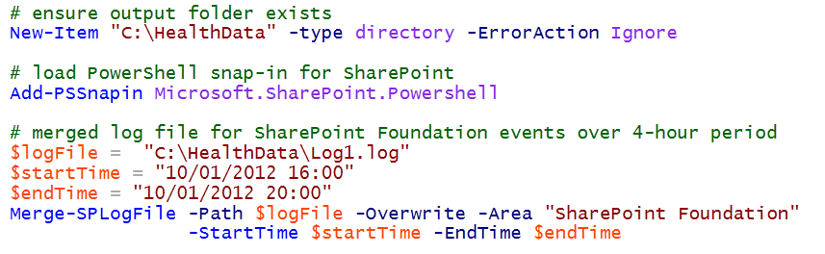
Merging ULS Logs in Production Farms
ULS logs tracked separately for each server
Logs on a specific server doesn't include all log entries
Merge-SPLogFile creates farm-wide log file
Parameters used to filter by area, time window, correlation ID, etc.

Slide 9
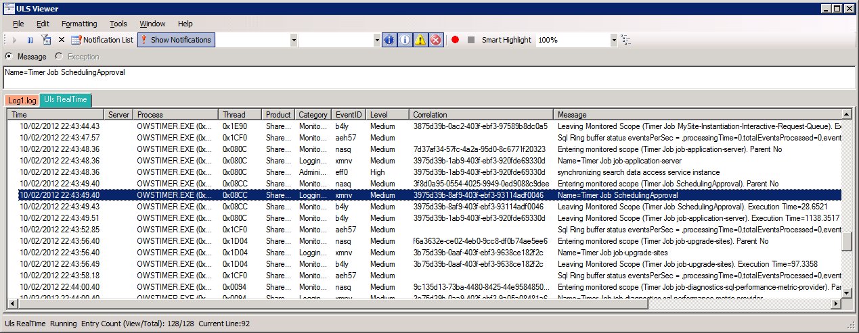
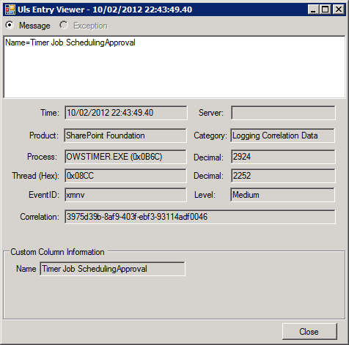
The ULS Log Viewer Utility
ULS Log Viewer utility available on MSDN site
ULS log files are not very readable
This utility makes inspecting log files much easier
Utility can open physical log files or raw log feed
Notes:
Can be used in production troubleshooting as it only reads logs. It does not affect system
One of the tool of choices for Microsoft Support when looking for problems.

Slide 10
Using the ULS Log Viewer

Slide 11
Agenda
ULS Logging
Logging Database
Health Analyzer
Useful Debugging Tools

Slide 12
The Logging Database
Specialized SQL database used to collect data
Logging database named WSS_Logging by default
Repository for all SharePoint-related event log entries
Aggregates health and usage data from many sources
ULS logs
Performance logs
Usage logs
SQL logs
How is the data in the logging database used?
Health Analyzer tool uses the logging database
SharePoint supports you accessing the logging database directly to create custom health reports

Slide 13
Data Collection with the Logging Database
You can configure what data is collected
Done by enabling/disable timer jobs
Configure data collection only for what you need
Enabling logging for all event types is very inefficient

Slide 14
The Logging Database
Logging DB collects all kinds of information
SQL Logging Database
Feature use | Page Requests
Search Queries | Site Inventory Usage
Timer Jobs | Rating Usage
Content Import Usage | Content Export Usage
Server Farm Health Data | NT Events
SQL blocked queries | SQL high CPU/ IO queries
Site Inventory | Search Crawl
Search Query statistics | Query click-through
Users’ ratings | …and more
Notes:
Feature use
Page Requests
Search Queries
Site Inventory Usage
Timer Jobs
Rating Usage
Content Import Usage
Content Export Usage
Server Farm Health data
...and more

Slide 15
Agenda
ULS Logging
Logging Database
Health Analyzer
Useful Debugging Tools

Slide 16
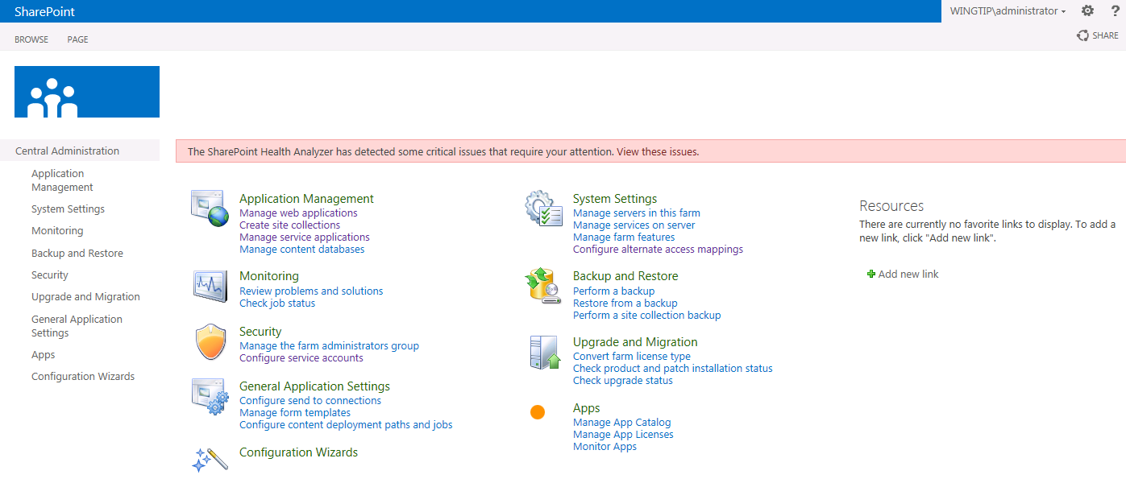
Health Analyzer
Tool which monitors health of the local farm
Rule-based system used to detect potential problems
Timer jobs run rule checks against logging database
Central Administration notifies you of rule violations
Notes:
The Health Analyzer is somewhat similar to what we had in previous versions with the BPA tool The only exception was that previously we had to load and run the tool from the each server and now this tool is built into the product and runs via a timer job.

Slide 17
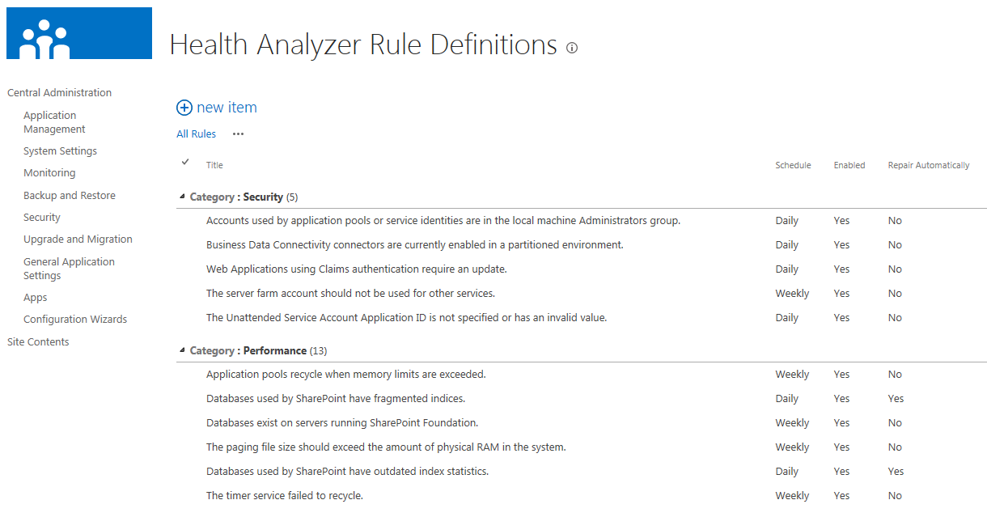
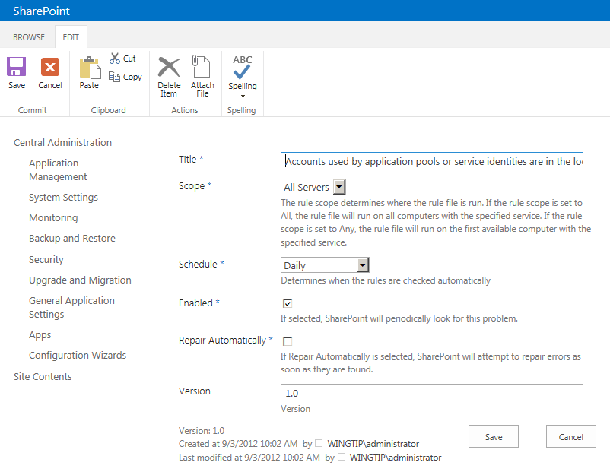
Health Rule Definitions
SharePoint adds rules out of the box
Rules can be enabled or disabled
Rules can be scheduled or run on demand
Rules can be configured to attempt repairs

Slide 18
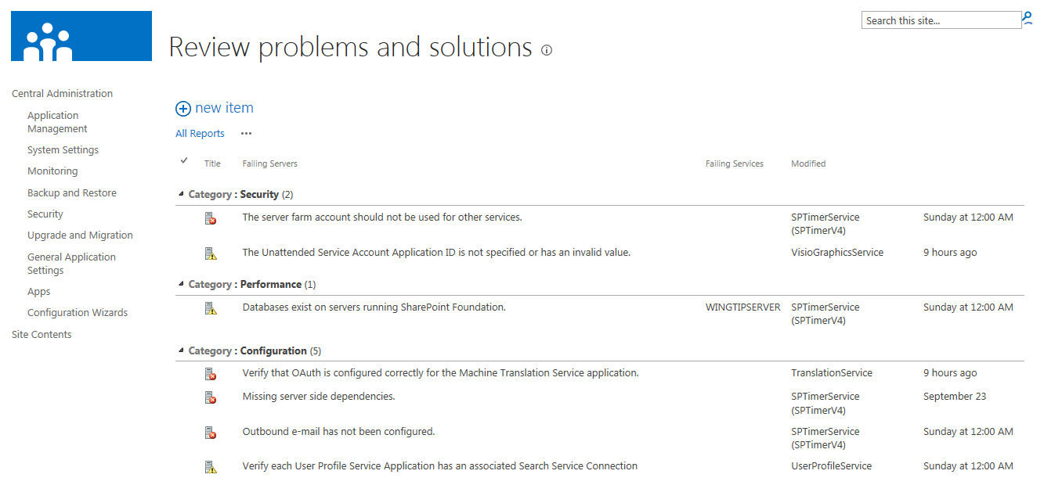
Health Analyzer Detected Problems
Potential problems logged to health reports list
List has title of Review problems and solutions
Problems also include advice for resolution

Slide 19
Examining SharePoint Health Rules

Slide 20
Cache Service Health
The following health rules have been created to help you track the Cache Service (look in the Availability section for most):
One of the cache hosts in the cluster is down (Availability)
Firewall client settings on the cache host are incorrect (Configuration)
Cache host is in throttled state (Availability)
The high availability node for SharePoint distributed cache is not available (Availability) – happens when there are less than 2 servers running the cache service
There exists at least one cache host in the cluster, which SP doesn't know about (Configuration) – happens when the cache service is disabled in SharePoint but AppFabricCaching Service is running on the machine
Cached objects have been evicted (Configuration) – indicates eviction happened across the cache cluster. Not bad in and of itself but may be a clue if it happens frequently and/or there are perf issues

Slide 21
Agenda
ULS Logging
Logging Database
Health Analyzer
Useful Debugging Tools

Slide 22
Useful Debugging Tools
The Developer Dashboard
The IE Developer Tools {F12}
Fiddler
SQL Profiler

Slide 23
Developer Dashboard Details
Introduced in SharePoint 2010
Showed only information about current request
SharePoint 2013 improvements
Shows requests from start of dashboard session
Surfaced as a popup window
Diagnostic data shown (per request):
Server Information | Service Calls
Scopes | ULS Entries (new)
SQL Queries from SharePoint API | Cache Calls (new)
SPRequests | Animation details (new)
Asserts | MDS details (new)

Slide 24
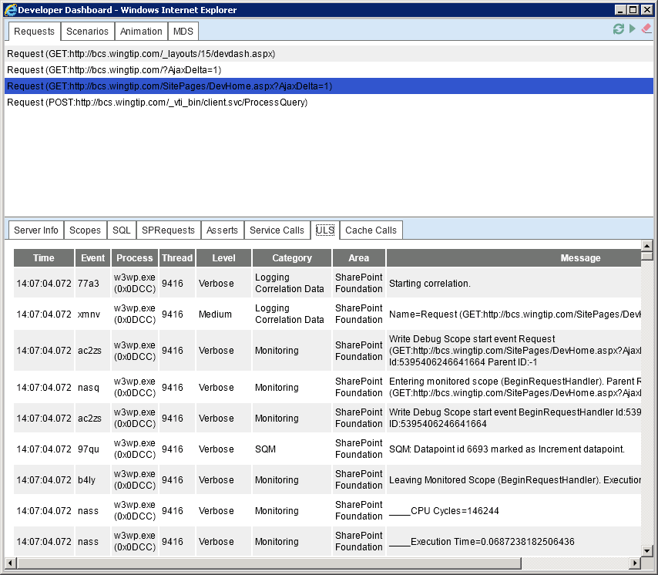
Developer Dashboard

Slide 25

Enabling & Using Developer Dashboard
Must be enabled via API:
Display mode OnDemand deprecated
Default = Off
Requires Usage & Health Data Collection Service Application instance, otherwise shows no data

Slide 26
Using the Developer Dashboard

Slide 27
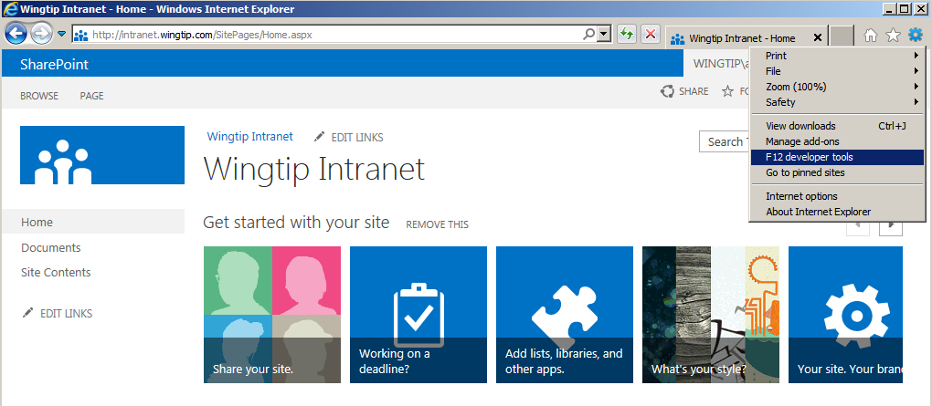
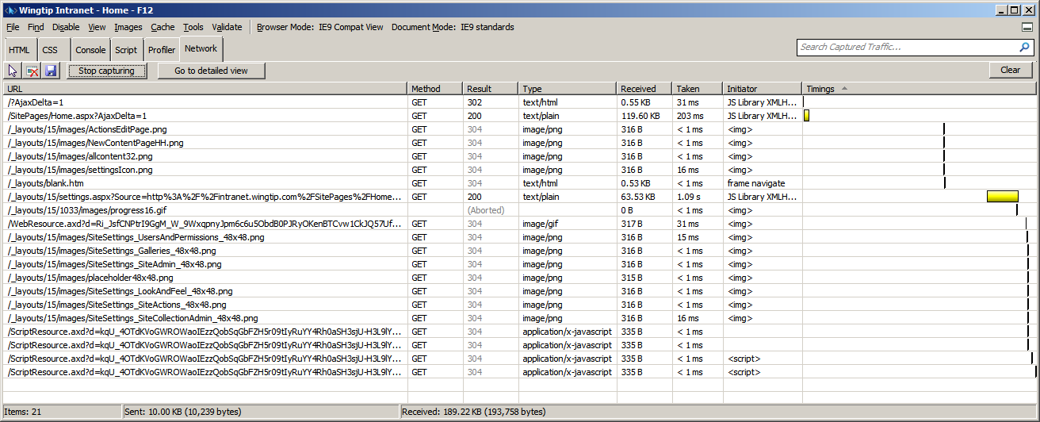
Using the IE Developer Tools
Debugging tool built into IE
Inspect HTML, CSS, JavaScript, HTTP requests
Notes:
Internet Explorer Developer Tools integrate with Internet Explorer and are easy to use. They provide a visual interface to help you inspect and debug HTML and CSS classes, and you can debug JavaScript. The debugger can be started and stopped, and they allow on-the-fly editing of the sources. Changes to the code can be saved.

Slide 28
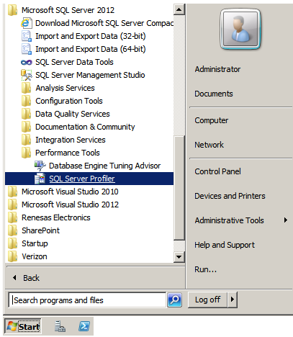
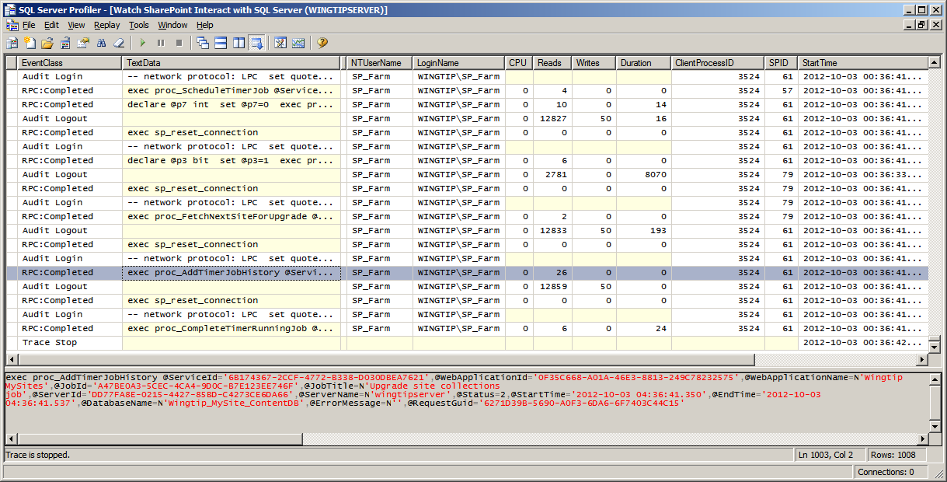
SQL Profiler
Analysis/Profiling tool built-in SQL Server
Monitor SharePoint interacting with SQL Server
Detect log in errors and access denied errors

Slide 29
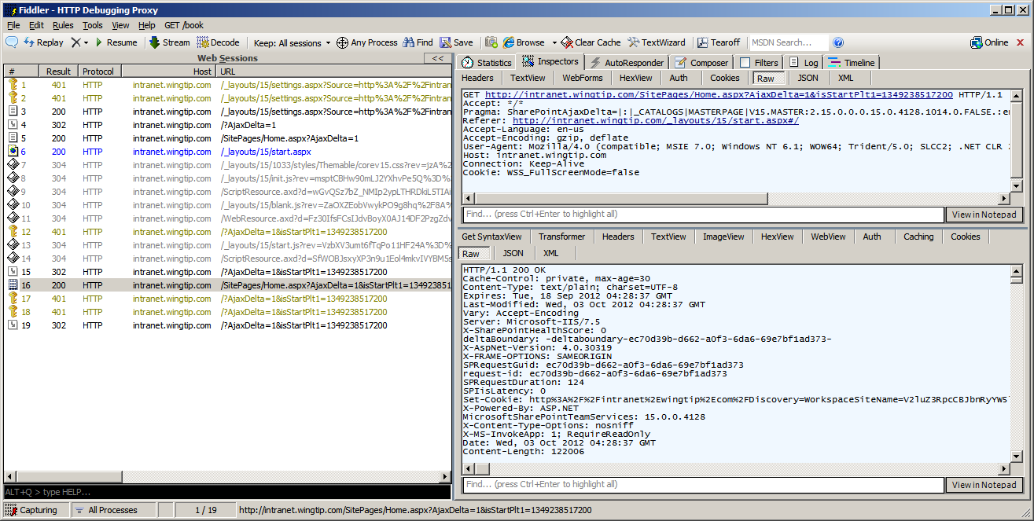
Fiddler
Fiddler is a popular HTTP debugging proxy
Free download available on Internet

Slide 30
Summary
ULS Logging
Logging Database
Health Analyzer
Useful Debugging Tools

