Slide 1
Installing SharePoint 2013
Notes:
This module steps through the details required to prepare for and install SharePoint Server 2013 in an on-premise environment. There will be an initial discussion of the hardware requirements and software requirements for installing SharePoint 2013. The lecture demonstrates how to create dedicated service accounts in Active Directory and how to run the SharePoint 2013 Prerequisite Installer. This module concludes by showing you how to install SharePoint 2013 and how to create a SharePoint 2013 farm and its configuration database.

Slide 2
Agenda
Hardware and Software Requirements
Creating Dedicated Service Accounts
Installing SharePoint Server 2013
Creating a new SharePoint 2013 Farm
Getting Around in Central Administration

Slide 3
Server Hardware Requirements
Microsoft's minimum recommendations
Network adapter speed should be >= 1GB
Deployment type and scale | RAM | Processor | Hard disk space
Single server farm for testing scenarios | 8 GB | 64-bit, 4 cores | 80 GB for system drive
Single server farm used for development with Visual Studio 2012 | 10 GB | 64-bit, 4 cores | 80 GB for system drive
Single server farm running all SharePoint Server 2013 services | 24 GB | 64-bit, 4 cores | 80 GB for system drive
Web server or application server in production farm | 12 GB | 64-bit, 4 cores | 80 GB for system drive
Database server in smaller deployment ( <1000 users) | 8GB | 64-bit, 4 cores | 80 GB for system drive
Database server in smaller deployment ( >1000 users) | 16GB | 64-bit, 8 cores | 80 GB for system drive
Notes:
Hardware requirements for the Web servers and application servers
Processor:
64 bit
4 cores
RAM:
4 GB for developers and evaluation purposes
8 GB for production environments
Hard disk
80 GB
Hardware requirements for the database servers:
Processor:
64 bit
4 cores for small deployments, 8 cores for larger deployments
RAM:
8GB RAM for small deployments, 16GB for larger deployments
Hard Disk:
80GB hard drive

Slide 4
Operating System Requirements
Operating system required for SharePoint 2013
64-bit version of Windows Server 2008 R2
64-bit version of Windows Server 2012
SharePoint 2013 cannot be installed on any client OS
Different from SharePoint 2010 which installs on Windows 7
SharePoint 2013 can be virtualized on Windows 8
Windows 8 supports running VMs in Hyper-V environment
VM can be created using Windows Server 2012
VM can be created using Windows Server 2008 R2
Notes:
For production environments you should install SharePoint 2013 on the 64-bit version of Windows Server 2008 R2 or Windows Server 2012.

Slide 5
Active Directory Domain Requirements
SharePoint farm should be create in AD domain
All servers in farm should be added to single domain
Domains accounts are created for service accounts
Never rely on local accounts for service accounts
No support for single label domain names
Domain name can be wingtip.com but not wingtip
Notes:
Before installing SharePoint 2013, Active Directory Domain services should be installed on a server within the farm’s network environment. That’s because a SharePoint farm should alwatys be built out within the Active Directory domain.
The necessary accounts for installing and configuring SharePoint 2013 and its application services should be created as Active Directory domain accounts. Never use local accounts on a server for installing or configuring the service accounts for a SharePoint farm.

Slide 6
SQL Server Requirements
Supported version of SQL Server (64-bit only)
SQL Server 2008 R2
SQL Server 2012
SQL Server 2012 with SP1 (required for new BI support)
SQL Server components to install
Database Engine (required)
SQL Server Analyses Services (SSAS) (optional)
SQL Server Reporting Services (SSRS) (optional)
Notes:
Before installing SharePoint 2013, you should install a supported version of SQL Server.
The SQL Server software must be the 64-bit version, but there are a number of versions that are allowed. SQL Server 2008 R2 is the minimum. You can also install SQL Server 2012 or SQL Server 2012 with SP1. During the beta period, you should install SQL Server 2012 with SP1 if you want to use the BI features of PerformancePoint 2013 and SQL Reporting Services.
When installing SQL Server, you should install at least the Database engine. Optionally you can also install SQL Server Analysis Services (SSAS) and/or SQL Server Reporting Services (SSRS).
Installing SQL Server Analysis Services (SSAS) provides the ability to create and run business intelligence (BI) objects such as cubes and key performance indicators. These BI objects can be consumed and leveraged using service applications in SharePoint Server 2013 such as Excel Services and PerformancePoint Services.
Installing SQL Server Reporting Services (SSRS) provides the ability to intergate SSRS reports to run inside SharePoint. Note that SSRS must be installed on the front end Web Server. This means you will often install the SQL Server DB engine and SSAS on the computer that plays the role of the database server but then you will install SSRS on a computer playing the role of the Web server.

Slide 7
Virtualization with SharePoint 2013
SharePoint 2013 can run in virtual machine (VM)
VM can be created using Hyper-V, VMWare, etc.
Early versions of Hyper-V use older .vhd format
Recent versions of Hyper-V use newer .vhdx format
Minimum virtualization setup
Cutting edge virtualization setup
Windows Server 2008 Host
Windows Server 2008 R2 Host
Windows 8 Host
Windows Server 2012 Host
Hyper-V Environment
Hyper-V Environment
SharePoint Server 2013
SharePoint Server 2013
SQL Server 2008 R2
SQL Server 2012 with SP1
Windows Server 2008 R2
Windows Server 2012
VM using .vhd format
VM using .vhdx format

Slide 8
Agenda
Hardware and Software Requirements
Creating Dedicated Service Accounts
Installing SharePoint Server 2013
Creating a new SharePoint 2013 Farm
Getting Around in Central Administration

Slide 9
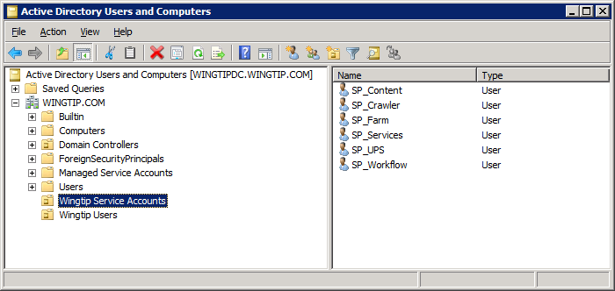
Creating SharePoint Service Accounts
You should create dedicated service accounts
Optionally, create an Organizational Unit (OU) in Active Directory to isolate dedicated service accounts
Notes:
Windows Server 2008 R2 automatically creates Managed Service Accounts Organizational Unit. It provides valuable built-in behavior for managing service accounts. While, this new Windows Server feature is not covered in this training class, it can be valuable if you learn how to properly use it. It should also be stressed that you should not use the Managed Service Accounts Organizational Unit unless you completely understand how it works.

Slide 10
Creating Service Accounts using a Windows PowerShell Script

Slide 11
Creating Dedicated Service Accounts
SP_Farm
account used by Central Administration privileged processes
SP_Services
account is used to run service applications
SP_Content
account is used for web applications which serve up user content
SP_UPS
account used by User Profile Synchronization service
SP_Crawler
account used by the search service to crawl content
SP_Workflow
account user by Workflow Manager to configure workflow services

Slide 12
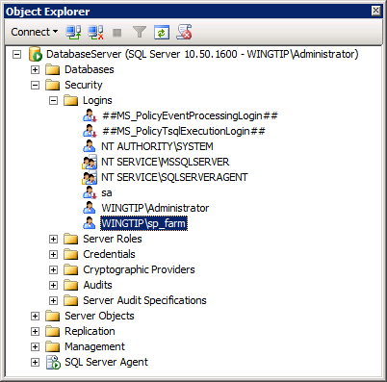
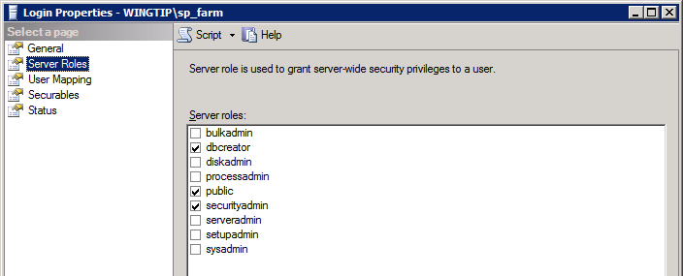
Domain Accounts Required for Install
Install User Account (e.g. WINGTIP\Administrator)
Must be member of local Administrators group on each server
SQL Server login in roles of dbcreator and securityadmin
You must configure SQL security settings for install account
Server Farm Account (e.g. WINGTIP\SP_Farm)
SharePoint automatically configures SQL security settings
Automatically added to SQL roles of dbcreator and securityadmin
Account becomes database owner of configuration database
Notes:
The install account must be member of the local Administrators group. This is the account you are logged in as when you install SharePoint 2013.
You provide SharePoint with the name and password of the Server Farm account when you create a new farm. When you install SharePoint 2013, it automatically creates a SQL Login for the farm account and adds it into the SQL Server roles of dbcreator and securityadmin. Note that the farm account is used to create the configuration database and content database. Therefore, the farm account becomes the database owner of all the SQL Server databases created by SharePoint 2013.
Steps to follow prior to the installation of SharePoint 2013:
Create the necessary accounts in Active Directory.
From SQL Management Studio add a new SQL Login for the install account (WINGTIP\Administrator).
Configure install account to be in SQL Login Server roles of dbcreator and securityadmin
In the lab, you will use the WINGTIP\Administrator account as the install account. Note that with the two VMs you are using this week that SQL Server was installed using WINGTIP\Administrator. That means the WINGTIP\Administrator is already in the role of the SQL Server system administrator and already has all the required permissions in SQL Server. This means there is no requirement for configuring SQL Server security before you install SharePoint Server. However, you should be prepared to follow these steps when installing SharePoint 2013 in an environment where the SharePoint farm account has not already been configured to be the SQL Server system administrator.

Slide 13
Agenda
Hardware and Software Requirements
Creating Dedicated Service Accounts
Installing SharePoint Server 2013
Creating a new SharePoint 2013 Farm
Getting Around in Central Administration

Slide 14
SharePoint Server Install Files
SharePoint Server 2013 installation files
Extract from SharePointServer.exe if required
C:\Install\SharePointServer.exe /extract:C:\Install\SharePoint2013
Locate the two main EXEs for installation
PrerequisiteInstaller.exe
Setup.exe
Notes:
The SharePoint Server 2013 installation files are compressed in a .exe file. You can extract them by double-clicking the exe, or by executing a command which gives you control over where you extract the files.
There are 2 files that need to be executed for installing SharePoint 2013:
PrerequisiteInstaller.exe
Setup.exe

Slide 15
Running PrerequisiteInstaller.exe
Prerequisite Installer ensures these items are installed
Microsoft .NET Framework 4.5
Windows Management Framework 3.0
Application Server Role, Web Server (IIS) Role
Microsoft SQL Server 2008 R2 SP1 Native Client
Windows Identity Foundation
Microsoft Sync Framework Runtime v1.0 SP1 (x64)
Windows Server AppFabric
Cumulative Update P1 for Microsoft AppFabric 1.1
Microsoft Identity Extensions
Microsoft Information Protection and Control Client
Microsoft WCF Data Services 5.0
Notes:
Notes about running PrerequisiteInstaller.exe
The PrerequisiteInstaller installs all prerequisite software prior to installing SharePoint 2013. You can find more about the prerequisite software here: http://technet.microsoft.com/en-us/library/cc262485.aspx#section5
The server should be connected to the Internet when running PrerequisiteInstaller.exe, because it download the required software prior to installing it.
Reboot the server machine after running PrerequisiteInstaller.exe (even though you are not prompted to do so)
PrerequisiteInstaller.exe does not work on Windows 7 so prerequisites must be installed by hand.

Slide 16
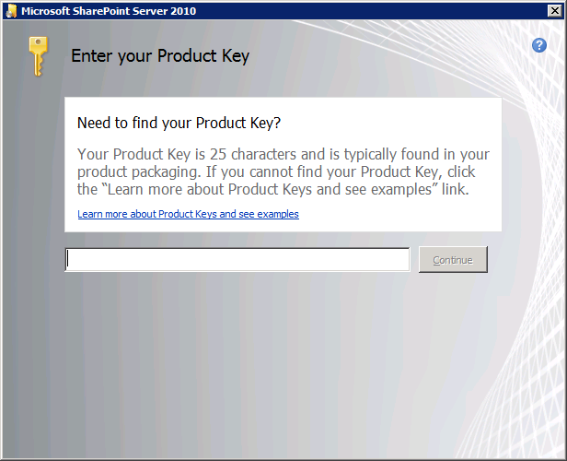
Running Setup.exe
Setup.exe begin the installation process
You will be prompted for product key
Choose product key for appropriate version
SharePoint Server 2013 Enterprise Client Access License features
SharePoint Server 2013 Standard Client Access License features
Notes:
After installing the prerequisites and rebooting the server, you are ready to run the setup.exe to start the installation of SharePoint 2013.
Beware of requesting the product key for the appropriate version.

Slide 17
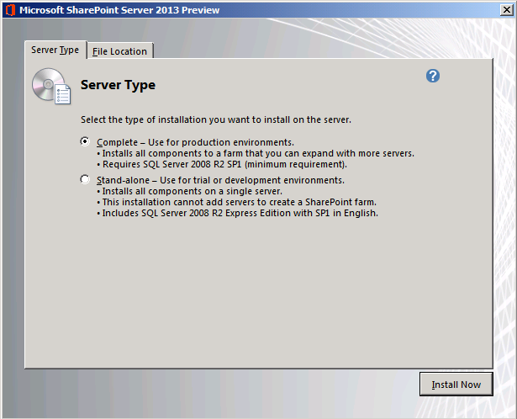
Server Type
Complete used in vast majority of scenarios
Installs all components
Gives you maximum configuration flexibility
Stand-alone should not be used
It installs and uses local SQL Server Express
It uses local accounts instead of domain accounts
Notes:
When choosing for the Farm Install, you can choose between Complete and Standalone. It is recommended to choose the Complete install because it installs all components.
Note that it is possible to install just Web server components using Windows PowerShell scripting.

Slide 18
Agenda
Hardware and Software Requirements
Creating Dedicated Service Accounts
Installing SharePoint Server 2013
Creating a new SharePoint 2013 Farm
Getting Around in Central Administration

Slide 19
After The Installation Is Complete
After install, how do you create the farm?
Using the SharePoint Products Configuration Wizard
Using PSCONFIG.EXE
Using PowerShell cmdlets
Installation adds SharePoint PowerShell snap-in
Snap-in allows you to automate configuration steps Often done using PowerShell scripting
Notes:
When the installation completes, you are asked if you want to start the Configuration Wizard. You can start it from within the last page of the Installation Wizard or by using the PSCONFIG.EXE.

Slide 20
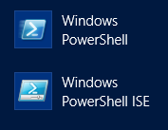
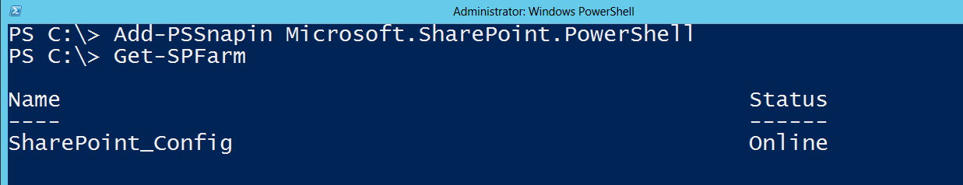

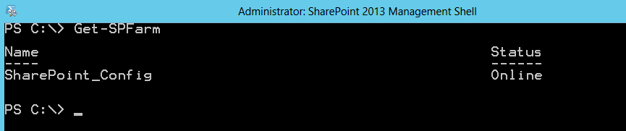
The SharePoint 2013 PowerShell Snap-in
SharePoint 2013 includes PowerShell cmdlet library
Deployed using snapin Microsoft.SharePoint.PowerShell
Snap-in explicitly loaded using Add-PSSnapin cmdlet
Snap-in loaded for you with SharePoint 2013 Management Shell
Notes:
SharePoint Server 2013 adds many PowerShell cmdlets for SharePoint administration through a PowerShell snap-in provider named Microsoft.SharePoint.PowerShell. The SharePoint cmdlets cannot be called until the SharePoint snap-in has been loaded. If you use a standard PowerShell console windows of the PowerShell ISE, you must explicitly load the snap-in using a call to Add-PSSnapin. When you start the SharePoint 2013 Management Shell, the snap-in is automatically loaded behind the scenes as the console windows is initialized.

Slide 21
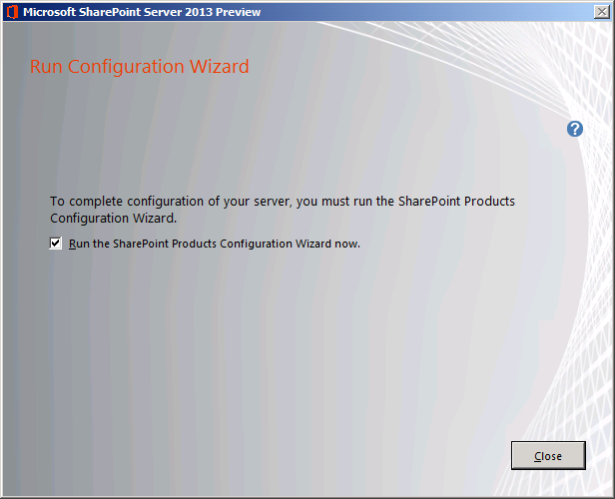
SharePoint Products Configuration Wizard (Part 1)
Run the Configuration Wizard after installation
Wizard assists you to create a new farm
Farm creation requires new configuration database
Notes:
The Configuration Wizard will walk you through the creation of the different parts that make up the new SharePoint 2013 farm and configuration database.

Slide 22
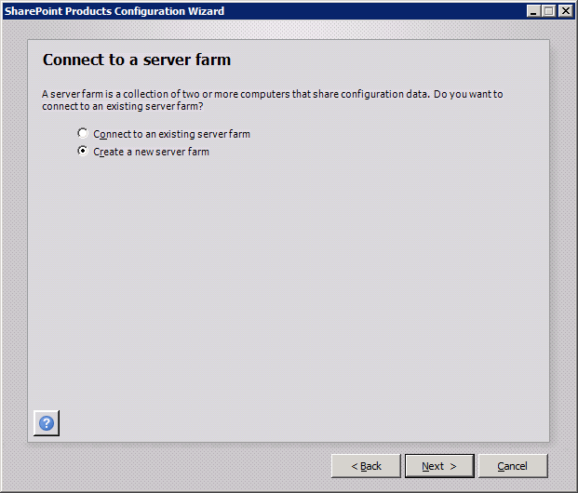
SharePoint Products Configuration Wizard (Part 2)
Select Create a new server farm
This begins process to create configuration database
Only done on first Web server in farm
Other Web servers use Connect to existing farm option
Notes:
When the Configuration Wizard runs on the first server, choose Create a new server farm. This creates the configuration database. When you install and configure SharePoint 2013 on additional web servers, you can choose the Connect to exsiting server farm option.

Slide 23
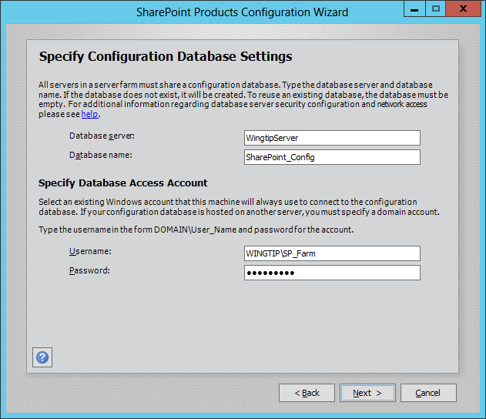
SharePoint Products Configuration Wizard (Part 3)
Specify Configuration Database Settings
Database Server Name
Database Name
User name for farm account
Password
Notes:
You will be asked to specify the database server (on which you installed SQL Server) and a name for the configuration database.
You must also specify the name of the farm account and the password.

Slide 24
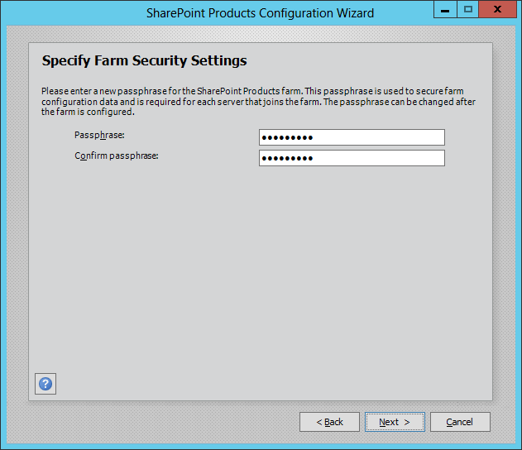
SharePoint Products Configuration Wizard (Part 4)
SharePoint 2013 requires farm passphrase
Featured introduced with SharePoint 2010
Used to control adding/removing Web servers in farm
Notes:
The farm passphrase is a new feature in SharePoint 2013. It is required when adding or removing a server from the farm.

Slide 25
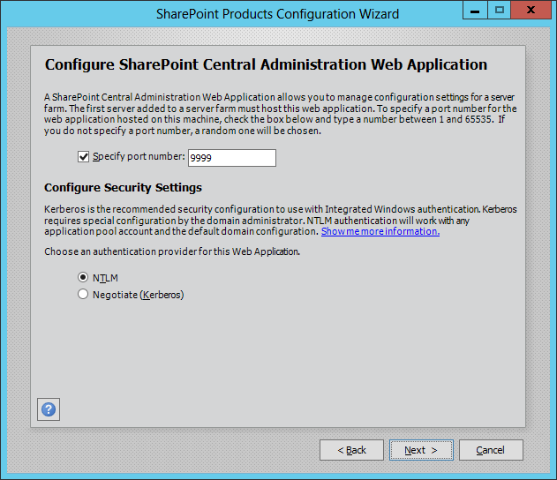
SharePoint Products Configuration Wizard (Part 5)
Specify port number for Central Admin access
Choose between NTLM and Kerberos
Note - this choice only affects Central Administration
Notes:
The next page in the wizard asks you to specify a port number for the SharePoint Central Administration.
Besides that you should also configure security settings. Both NTLM and Kerberos are used with Integrated Windows authentication in Classic Mode.
NTLM credentials are based on data obtained during the interactive logon process and consist of a domain name, a user name, and a one-way hash of the user's password. NTLM uses an encrypted challenge/response protocol to authenticate a user without sending the user's password over the wire. Instead, the system requesting authentication must perform a calculation that proves it has access to the secured NTLM credentials. NTLMrequires re-authentication when accessing a new network resource.
Kerberos, relies on a ticketing system where a client and server access a trusted authority which responds to client requests and grants tickets that the client can use to access network resources. Kerberos does not require re-authentication for accessing multiple resources.

Slide 26
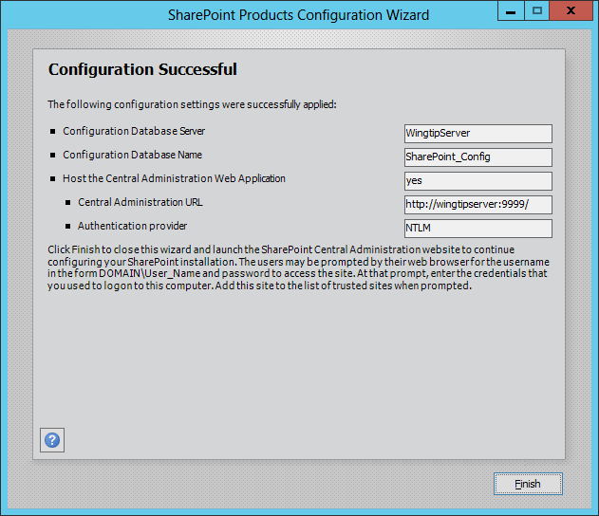
SharePoint Products Configuration Wizard (Part 6)
Success!
Farm and configuration database have been created
You can now access Central Administration
Notes:
When you arrive at this page, the SharePoint 2013 installation and configuration was successful. From here you can access the SharePoint Central Administration.

Slide 27
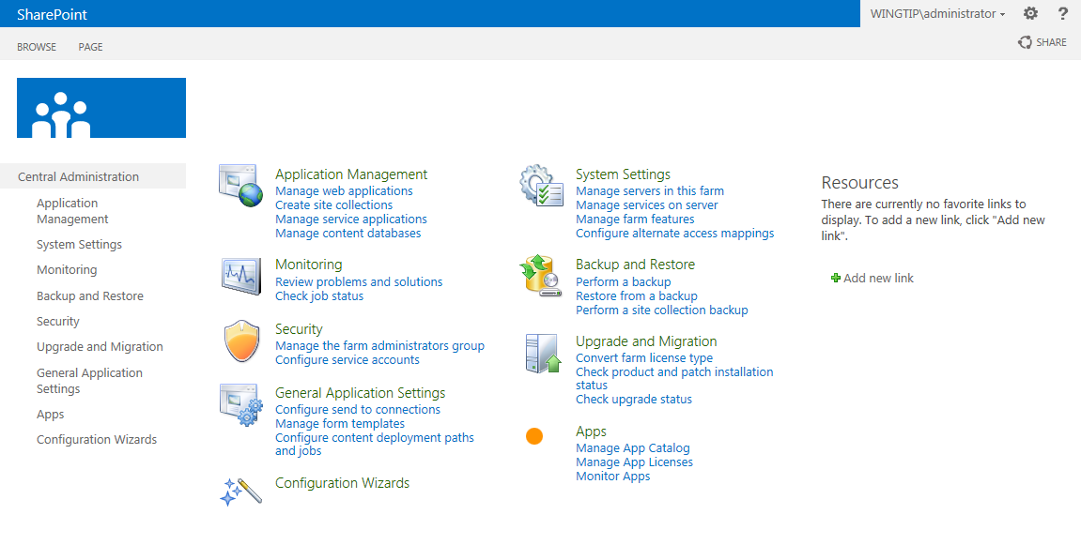
Central Administration
Welcome to your new home
Notes:
This is the new layout of the SharePoint 2013 Central Administration. The home page displays a better overview of the different management tasks. Each hyperlink brings you to a page where you can configure details of your SharePoint farm.

Slide 28
Agenda
Hardware and Software Requirements
Creating Dedicated Service Accounts
Installing SharePoint Server 2013
Creating a new SharePoint 2013 Farm
Getting Around in Central Administration

Slide 29
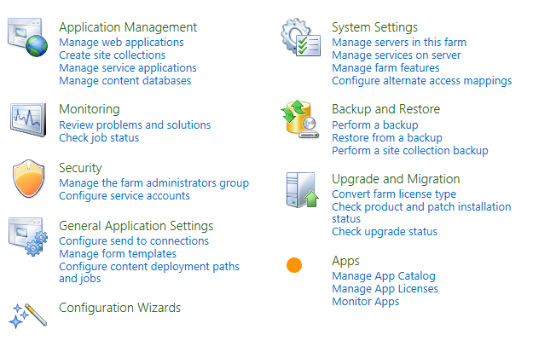
Central Administration
Site for Administrators to make farm wide settings
Home page has sections broken out by functionality
Notes:
This is the home page of the SharePoint 2013 Central Administration. It contains links to different administration pages, divided in sections by functionality. Each section title is also a link which brings you to another page containing links again divided in sections by functionality.
You also find the section titles in the Quick Launch on the left of the page.

Slide 30
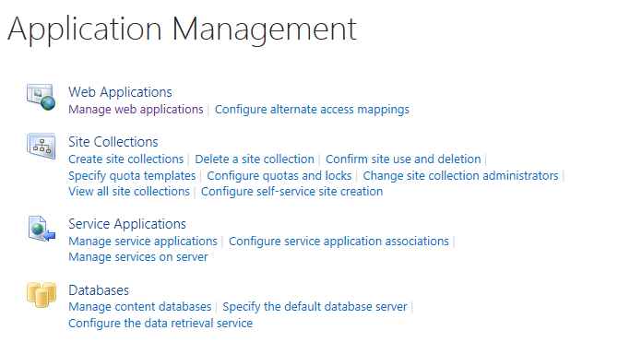
Application Management
Top-level manage of applications and content
Web Application
Site Collections
Service Applications
Content Databases
Notes:
The Application Management page contains different sections to manage web applications, site collections, service applications and content databases.

Slide 31
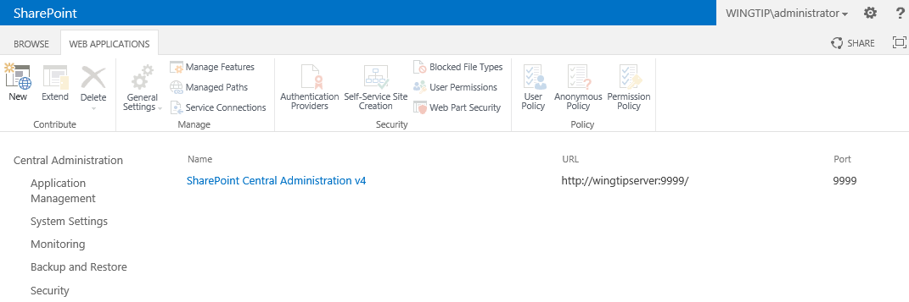
Web Application Management
Web application page allows you to…
Inspect and configure existing Web applications
Create new Web applications
Web Application for Central Administration is created when farm is created
Notes:
The Manage web applications hyperlink brings you to a page where you can manage existing web applications and create new web applications The page contains a contextual ribbon .

Slide 32
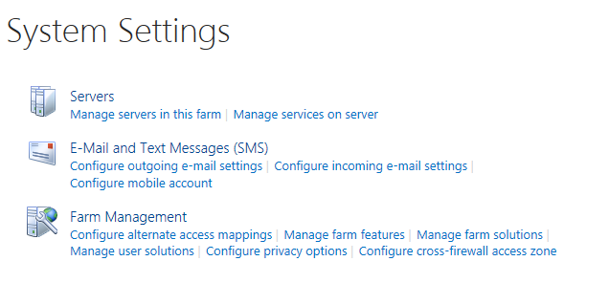
System Settings
System Settings page allows you to…
Inspect and configure servers in farm
Inspect, configure and create application services
Configure farm e-mail settings
Navigate to other farm management pages
Notes:
The System Settings page allows you to manage servers in the farm, application services, e-mail settings, configure alternate access mappings, manage farm features, farm solutions, user solutions.
Also here the page is divided into sections based on functionality.

Slide 33
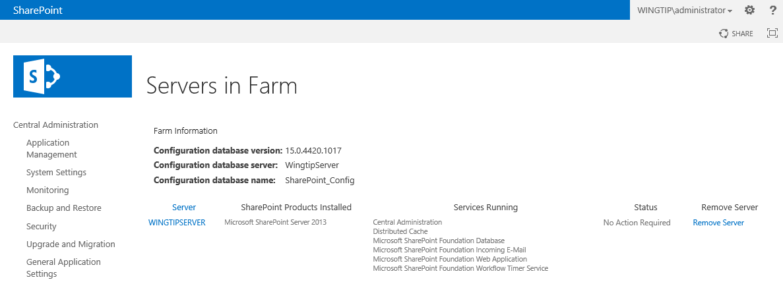
Servers in Farm
Servers in Farm page allows you to see…
Database Server(s)
Web Server(s)
Application Server(s)
Notes:
Clicking the Manage servers in this farm hyperlink brings you to a page where you can view and manage all the servers that make up the SharePoint farm. Click the hyperlink with the server name brings you to a page with more detailed information about the server. You can also remove a server from the farm.

Slide 34
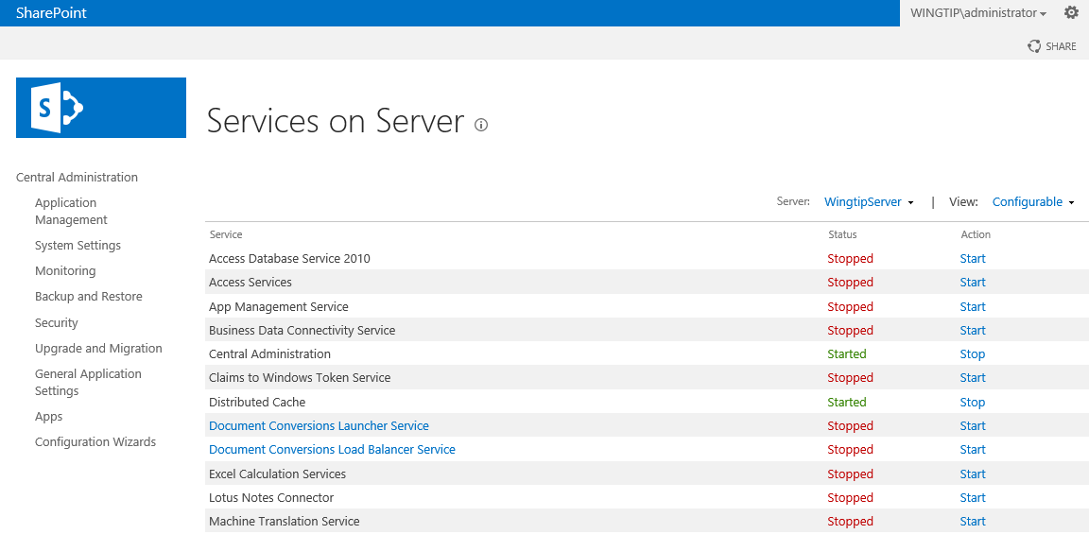
Services on Server
SharePoint Server 2013 installs many services
Complete install adds services for Web server(s)
Complete install adds services for Application server(s)
Many of the services provided must be configured
Many (but not all) services list here are service applications
Notes:
Clicking the Manage services on server hyperlink on the System Settings page, brings you to this page where you can see which services are installed on the server. From here you can start and stop services.
When configuring a SharePoint 2013 farm using Central Administration, you can choose to configure all available services or only a few of them. It is better to install only those you need from the beginning and install other services when needed.

Slide 35
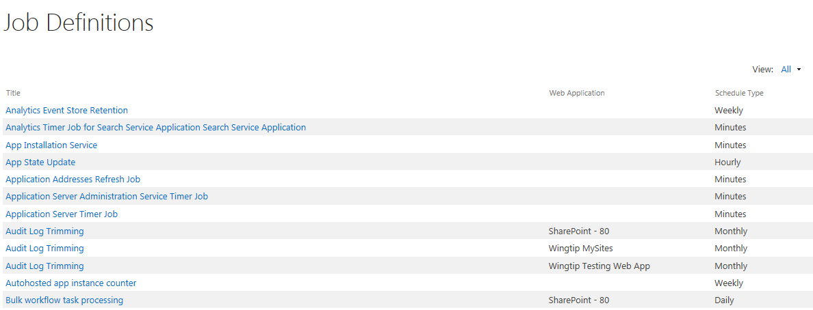
Timer Jobs
SharePoint Foundation supports timer jobs
Timer jobs used to automate administrative tasks
Job definition can be scheduled or run immediately
Job history shows what time jobs have runs
Notes:
The Timer Job infrastructure is an essential part of the SharePoint platform. It provides many different timer jobs that perform ongoing maintaince tasks related to keep the farm in good health. Here is a sampling of timer jobs included with SharePoint 2013.
Application Addresses Refresh Job
Audit Log Trimming
Delete Job History
Document ID enable/disable job
Document ID assignment job
Enterprise Server Search Master Job
Health Analysis Job
InfoPath Forms Services Maintenance
Password Management
Prepare query suggestions
Product Version Job
Query Logging
Secure Store Service Timer
Solution Daily Resource Usage Update
State Service Delete Expired Sessions
Timer Service Recycle
Web Analytics Trigger Workflows Timer Job
Windows SharePoint Services Usage Data Import
Windows SharePoint Services Usage Data Processing
Word Conversion Timer Job
Workflow

Slide 36
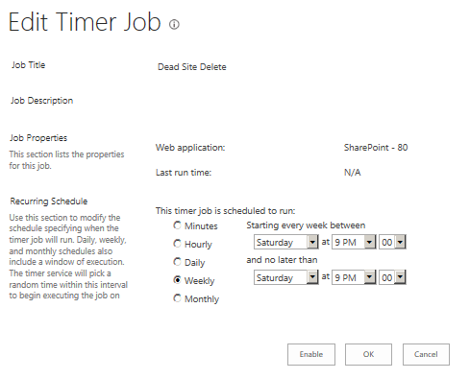
Timer Job Definitions
SharePoint 2013 provides built-in job definitions
You can manually run a job definition on demand
You can configure scheduling of a job definition
You can enable/disable a job definition
Notes:
When you open the Job Definitions page, you get a list of all job definitions. On top of the page you have two dropdowns that can help you filter the list of job definitions.
From here you can also manage the job definitions. The hyperlinked names of the job definitions bring you to the page where you can view and/or modify the schedule of the timer job.
Notice also the Timer Links section in the Quick Launch that allows you to manage all jobs from this single page, so you don’t need to navigate back to the Central Administration to switch to another page.

Slide 37
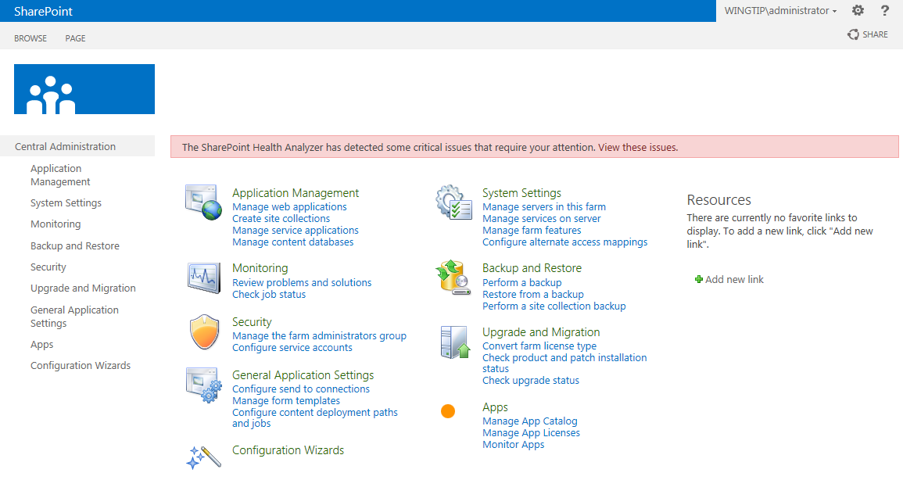
Health Analyzer
Installation enables health rule checks
Health checks are run using timer jobs
Central Administration provides notifications when there are problems or potential problems

Slide 38
Getting Around in Central Administration

Slide 39
Summary
Hardware and Software Requirements
Creating Dedicated Service Accounts
Installing SharePoint Server 2013
Creating a new SharePoint 2013 Farm
Getting Around in Central Administration

