Slide 1
Configuring SharePoint Server 2013 Search
Notes:
Previous versions of SharePoint included various search implementations between SharePoint search & FAST search. In SharePoint 2013 Microsoft has merged their search implementations into a single, unified search architecture. This module introduces the new search architecture of SharePoint 2013 and discusses how to use the new search features. In this module students will learn about the search architecture as well as how to leverage it in custom solutions.

Slide 2
Agenda
SharePoint 2013 Search Overview
Configuring Search
Executing Search Queries
Rendering Results
Custom Entity Extraction

Slide 3
Search Landscape in SharePoint 2010
 | SharePoint Search | FAST Search
Focus | Enterprise search | Search application platform
Strengths | Ease of deployment, Low TCO | Scale, Extensibility
Limitations | Limited extensibility | Complex deployment, Costly maintenance
Products | SharePoint Foundation SharePoint Server Search Server | FAST Search for SharePoint FAST Search for Internet Sites
Notes:
Just a reminder of what products we had in SharePoint 2010

Slide 4
Search in SharePoint 2013
Single Extensible Search Platform
FAST Search Engine
SharePoint Content Crawler
Used by both SharePoint 2013 and Exchange 2013
Notes:
The point here is that the search products are all unified under a single search product

Slide 5
Social integration with search
People finding experience
Front door to the Office social network
Better expertise & interest search
Email mining
“Address book style” search
Phonetic name matching
Nickname matching
Relevance models tuned for people search
Improved Discussion and Social Data Search
Notes:
Note: Email Mining
Back in the early days of SharePoint 2007 there was a quiet product that was being considered for launch called Knowledge Networks. One of the add ins that KN brought was a client side application that would go through your email headers and look at who you were talking to about with different topics. The tool was not actually indexing the content of the mail but actually just looking at the conversation points which when used with People Search would tell the person running the query …. Im searching for this person… but I see this other person also has some experience with my query. Thus bringing the concept of social distance through returned search results into the picture.
KN never made it to market but instead Microsoft rolled portions of this tool directly into SharePoint 2010. Also note that in the previous version (KN) you could have return results for people outside your organization. This capability has appeared to be removed in 2010 so you can now only find people within your own organization… or if you are federating with another company you would find their information as well

Slide 6
Social integration with search
Social behavior drives search quality
Search click through behavior drives relevance ranking
Query suggestions mined from search logs
Social tagging influences relevance ranking
Self search - to drive people to participate content

Slide 7
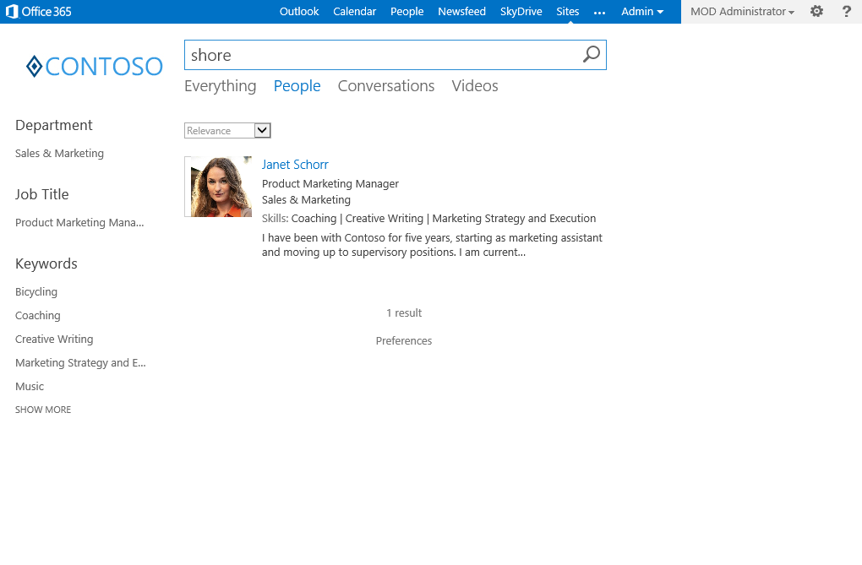
People Search
Phonetic Name Matching
Notes:
This slide demonstrated Phonetic Name Matching with “shore” finding “Schorr”.

Slide 8
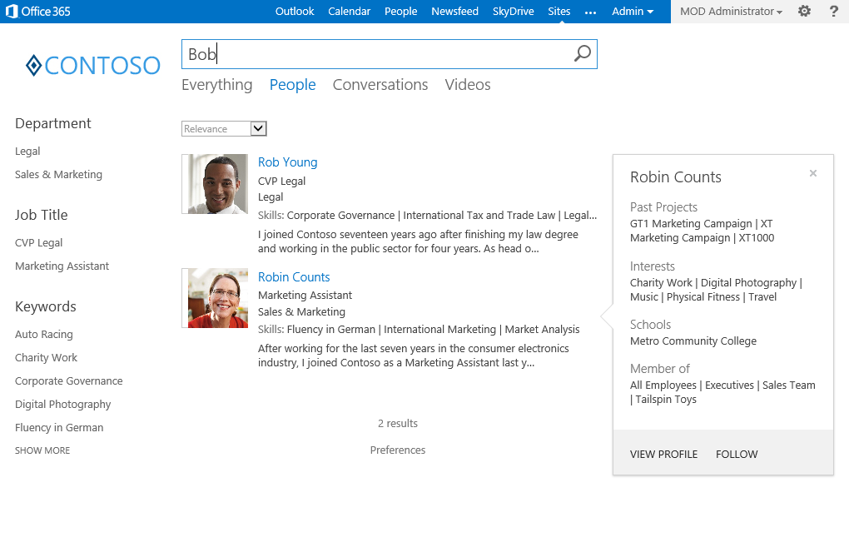
People Search
Nickname Matching
Notes:
Nickname matching helps to use “Bob” to find “Robert” and “Robyn”

Slide 9
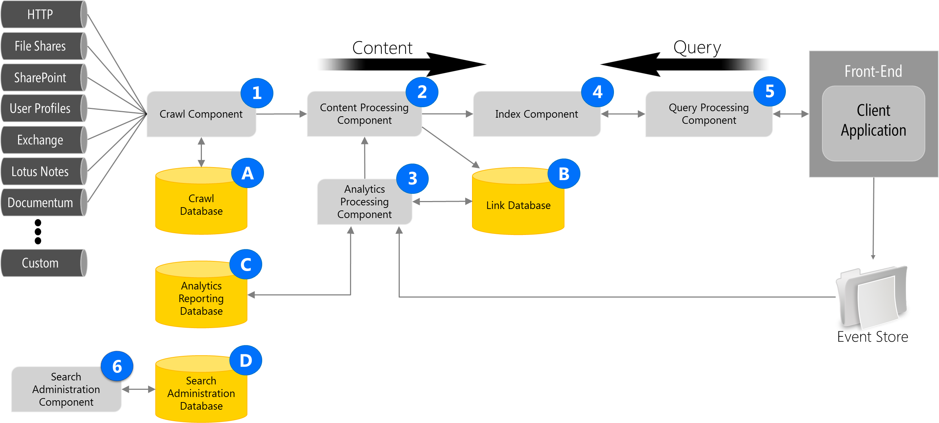
Search Architecture
Notes:
FAST really didn't crawl, it allowed push into index (Content API), while SharePoint crawled
In SharePoint 2013, the Content API is out. Now the crawler runs continuously. Continuous focuses on a small number of things to be efficient.
Continuous crawl is for the SharePoint index only and makes use of the change log to pick up changes.
Continuous crawls run in parallel and do not wait for previous threads to complete so it updates quickly
Continuous crawls do not retry errors from previous crawls, incremental is used for that
Security changes are included
Full and Incremental crawls still exist, they would be used:
Full is still required under the same conditions as SharePoint 2010
(http://technet.microsoft.com/en-us/library/cc262794(office.12).aspx)
Incremental is required for security changes
Continuous for changes noticeable by end users
Don't really need a dedicated server for continuous, but you could. Depends on resource usage.
Managed Properties – Still exist. Can create a site columns and have a managed property created. Administer at the Site Collection level. On-line you can do it at the tenant admin level.
Architecture
Crawl and Connectors - .NET Assembly Connectors and Parsers. Allows for connection to a system and crawling a system
Content Pipeline – just the functionality of bringing content in through crawl.
Web Service Callout – Synchronous call to a web service for additional content processing
CTS Runtime – processes contents. No real extensibility story.
Analyzer - Process user behavior (click analysis). Supports things like recommendations based on behavior. There is an extensibility story for that.
Indexing Engine – Indexes content
Query Engine – executes queries
Query Pipeline – just the functionality for processing queries.
IMS Runtime – processes queries. No real extensibility story.
REST Service – Execute queries through REST
Client Framework – Execute queries through CSOM

Slide 10
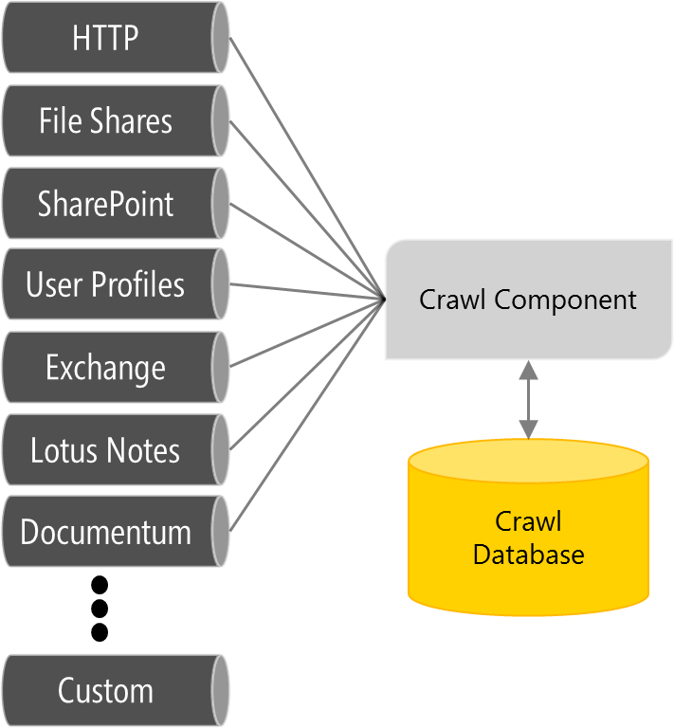
Crawling the Content
Crawl role responsible for crawling content sources
crawled items = actual content and associated metadata
Uses connectors to retrieve data from content sources
Not responsible for document parsing (that comes later)
Crawl Database is used by the crawl component
store information about crawled items and to track crawl history
tracks information such as last crawl time and the type of update

Slide 11
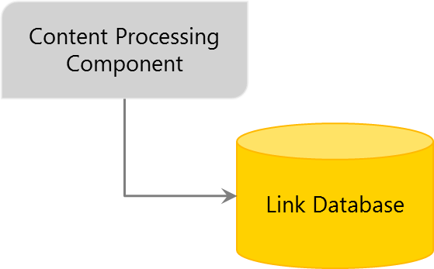
Content Processing
Content Processing Component
Processes crawled items and feeds them to index component
Includes parsing documents with Format Handlers and iFilters
Includes property mapping
Linguistic processing (language detection and entity extraction)
Writes information about links and URLs to the Link Database
Generates phonetic name variations for people search

Slide 12
Parsers
New parsing features
Automatic file format detection
Deep link extraction for Word and PowerPoint formats
Visual metadata extraction: titles, authors and dates
High-performance format handlers for HTML, DOCX, PPTX, TXT, Image, XML and PDF formats
IFilter API still supported
Allows support for file formats that do not have format handlers
New Montage, Visio and OneNote IFilters
Notes:
Automatic File Format Detection
OOB, Parsers can actually detect more formats than are supported by the available format handlers. For this reason, the IFilter API is still supported. The Ifilter can call a generic Format Handler to plug into the parsing architecture.
Deep Link Extraction
Deep Link extraction means that anything in the document formatted as a header (or slide title) is pulled out and displayed as a link in the hover panel. This allows you to preview the paragraph (or slide) that is most relevant to your search.
Visual Metadata Extraction
Extracts the title, author, and date based on the document and not the metadata because the metadata is often wrong

Slide 13
Parsers
Format Handlers and IFilters
Notes:
This shows how the parsers can detect formats that have a format handler and ones that do not. Ifilters are used where there is no specific format handler.

Slide 14
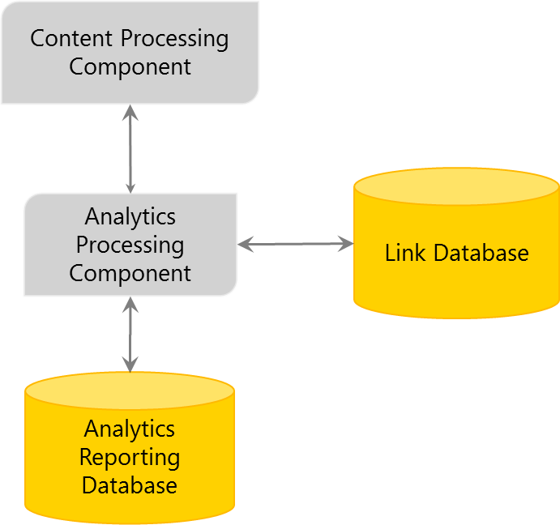
Analytics Processing Component
Search Analytics
analyzes crawled items
analyzes how users interact with search results.
Usage analytics
analyzes usage events (e.g. page views) from event store
APC sends results to the Content Processing Component
results then included in the search index

Slide 15
List of Sub Analyses
Search Analytics
Link and Anchor text analysis
Click Distance
Search Clicks
Deep Links
Social Tags
Social Distance
Search Reports
Usage Analytics
Recommendations
Usage Counts
Activity Ranking

Slide 16
Index Component
Used in both feeding and query processes:
Feeding: receives processed items from the content processing component and writes those items to index files
Query: receives queries from the query processing component and provides results sets in return
It also physically moves around indexed content when the index architecture is changed by the Search Administration Component

Slide 17
Agenda
SharePoint 2013 Search Overview
Configuring Search
Executing Search Queries
Rendering Results
Custom Entity Extraction

Slide 18
Configuring Search
Steps to be completed
Create the Search Service Application
Configure the Crawl Account
Configure Content Sources
Optional tuning with crawl rules
Optional tuning with crawler impact rules
Configure and map managed properties
Configure Search Results with Display Templates

Slide 19
Agenda
SharePoint 2013 Search Overview
Configuring Search
Executing Search Queries
Rendering Results
Custom Entity Extraction

Slide 20
Executing Queries: Query Languages
Keyword Query Syntax
Preferred method
FAST Query Language
Still available
SQL Query
Removed from the Product
Notes:
KQL – All the basics. Simpler syntax. Now supports proximity queries like “NEAR”. The point is that KQL is really the language to use. FQL can be used if enabled by PowerShell

Slide 21
Executing Queries: KQL
 | Keyword | Example | Description
General | Text | Training | Search for items containing “Training”
 | Wildcard | Train* | Search for items like “Training” and “Trainer”
 | Phrase | “Training Room” | Search for the exact phrase
Documents | IsDocument | Training IsDocument:1 | Returns documents containing “Training”
 | FileExtension | Training FileExtension:docx | Returns Word documents containing “Training”
 | Author | Author:Cox IsDocument:1 | Returns documents authored by “Cox”
 | Title | Title:Training IsDocument:1 | Returns documents with “Training” in the title
People | Lastname | Lastname:C | Returns all people whose last name starts with “C”
Tasks | contentClass | contentClass:STS_ListItem_Tasks | Returns all task items
Events | contentClass | contentClass:STS_ListItem_Events | Returns all calendar events
Notes:
KQL – All the basics. Simpler syntax. Now supports proximity queries like “NEAR”. The point is that KQL is really the language to use.

Slide 22
Executing Queries: REST → Request
Keywords
http://server/site/_api/search/query?querytext='{KQL Query}‘
Selecting Properties
http://server/site/_api/search/ query?querytext='test'&selectproperties='Title,Rank'
Sorting
http://server/site/_api/search/query? querytext='test'&sortlist='LastModifiedTime:descending'
http://server/site/_api/search/query? querytext='test'& sortlist='LastModifiedTime:descending,Rank:ascending'
Notes:
REST interface allows for querying
Permissions
Scope: http://sharepoint/search
Right: QueryAsUserIgnoreAppPrincipal

Slide 23
Agenda
SharePoint 2013 Search Overview
Configuring Search
Executing Search Queries
Rendering Results
Custom Entity Extraction

Slide 24
Result Rendering
Result Sources
Analogous to a Scope in SharePoint 2010
Query Rules
Allow for the customization of returned results
Result Types
Determines which template to display
Display Template
The visual display of a control, group or single result
SPNavigation Provider
Replaces the tabs lists in previous versions of Search Center
Notes:
Result Sources
With search result sources, you can give users the ability to simultaneously search content in the search index of the local search service, as well as in other sources, such as internet search engines. In SharePoint Server 2010, these were known as federated locations.
Query Rules
Query rules let you customize the search experience for the kinds of queries that are important to your users, without any custom coding. For example, if your users frequently search for PowerPoint slides, you can use query rules to recognize these queries by tracking keywords such as "slides" or "ppt", or by learning the queries where users commonly click on PowerPoint files in the results. Then, when the user performs these queries, you can do any of the following:
• Return a special result linking to a search vertical customized for displaying PowerPoint files.
• Show a block of results with only PowerPoint files.
• Change the search results so that PowerPoint files are ranked higher in the results.
Result Types
Result types define how to display a set of search results based on a collection of the following:
Rules Determines when to apply a result type, based on the specified conditions. Rule conditions can be joined together by using equality, comparison, and logical operators.
Properties Determines the list of managed properties for the result. You must add managed properties to the list before you map it to a display template.
Display templates Defines the visual layout of the result type.

Slide 25
Result Sources
Select a Source
Local SharePoint Index
Remote SharePoint Index
OpenSearch
Exchange
Apply a Query Transformation
{searchTerms} contentclass:sts_listItem_genericlist
path:http://contososerver/searchsamples/Lists/Glossary
Notes:
Result Sources allow you to use Federated Locations as a source, but utilize a Query Transformation to narrow the search against the source. You can search something very narrow, like a list, or broad like a site collection.

Slide 26
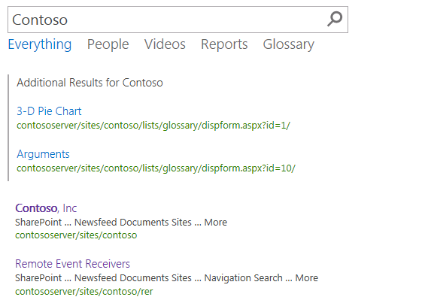
Query Rules
Applied to a Result Source
Processed under given conditions
Keyword Query matches
Topic Category
Promoted Results
Result Blocks

Slide 27
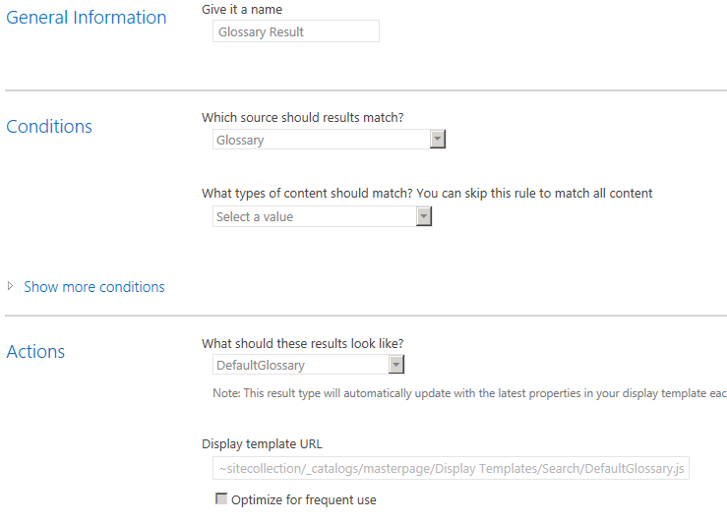
Result Types
Bound to a Result Source
Defined by a Rule
Associated with a Display Template

Slide 28
Display Templates
Determines how Result Types appear
Created as an HTML file with special references to the Managed Properties
<div id="Header">
_#= ctx.CurrentItem.ProductOWSTEXT =#_
</div>

Slide 29
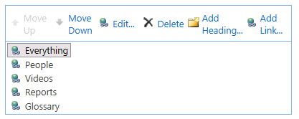
Search Verticals: Search Navigation
Utilizes the SPNavigation Provider
Search Center
Site Settings
Search Settings

Slide 30
Agenda
SharePoint 2013 Search Overview
Configuring Search
Executing Search Queries
Rendering Results
Custom Entity Extraction

Slide 31
Custom Entity Extraction
Activate refiners based on custom dictionaries
12 custom extractor “slots” you can use:
 | Case insensitive | Case sensitive
Word matching | 5 word extractors | 1 word exact extractor
Substring matching | 5 word part extractors | 1 word part exact extractor
Notes:
Extensibility point for the customers. Plug your own dictionary into the system. Dictionary is a simple text file. First line is title. Then a list of terms . You can have a comma after the term to normalize the term. Import the dictionary in with the PowerShell cmdlet.
You use this capability when you want to refine by something that doesn’t have a managed property defined. For example, say you have a corpus of medical documents and you want to refine by the commercial name of various medicines. However, no one included a metadata property for that. So you want to extract that information from the document itself. You could then define a dictionary like this:
MedicalDictionary
Advil
Lipitor
Ambien

Slide 32
Custom Entity Extraction: Setup
Import your dictionary using the PowerShell cmdlet
Import-SPEnterpriseSearchCustomExtractionDictionary
Enable a custom extractor for certain managed properties on the Search Schema UI
Initiate full crawl
Edit the refinement web part to display your custom extractor
Notes:
Once the dictionary is defined, you must use PowerShell to import it into one of the 12 available “slots”. The slots are defined using magic words like
Microsoft.UserDictionaries.EntityExtraction.Custom.Word.1
The only way to find these magic words is to type in nonsense into the cmdlet. Then the error message spits out the possible values.
Once the dictionary is loaded into a slot, you must enable entity extraction for the managed property. This is done using a simple check box on the property. Usually you will enable it on the body of the document.
Finally, you must add the custom refiner to the refiner web part on the search page.

Slide 33
Content Processing
Crawl
Content Processing
Index
Document Parsing
Content Enrichment
Word Breaking
Custom Entity Extraction
Custom Web Service

Slide 34
Summary
SharePoint 2013 Search Overview
Configuring Search
Executing Search Queries
Rendering Results
Custom Entity Extraction

