Slide 1
Configuring Security and Authentication
Notes:
This module discusses the SharePoint 2013 options for configuring user authentication and discusses why Microsoft has deprecated Classic Mode authentication in favor of newer Claims-based security model. You will learn how to configure user Windows authentication using Kerberos, NTLM and Basic Authentication as well as how to configure FBA where user names and passwords can be maintained in a SQL Server database. You will also learn the skills required to leverage the Windows Azure Access Control Service (ACS) to configure an on-premise farm to support authentication through external identity providers such as Windows Live and Facebook.

Slide 2
Agenda
Application Pools and Service Accounts
User Authentication in SharePoint 2013
Configuring Authentication Providers
Configuring Web Applications

Slide 3
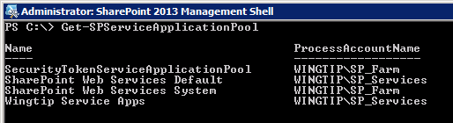
Application Pools
SharePoint has two types of application pools
Service application pools
Web application pools
Each application pool configured with an identity

Slide 4
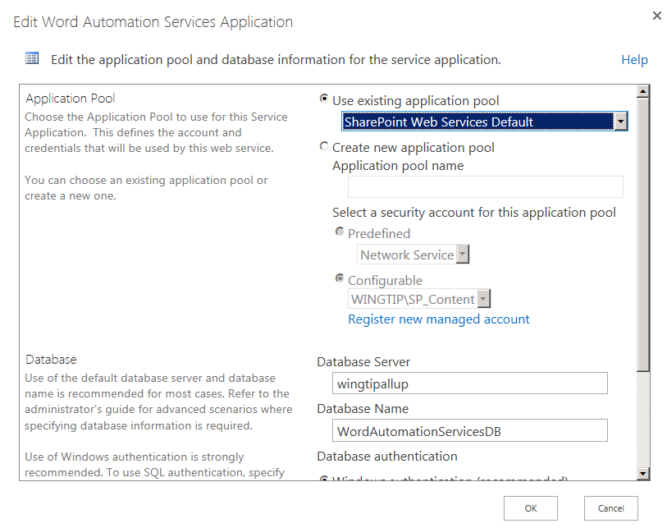
Configuring Service Application Pools
Service application run in service application pools
FCW creates a pool named SharePoint Web Services Default
You can create new pool when creating a new service application
You can configure a service application to use a different pool

Slide 5
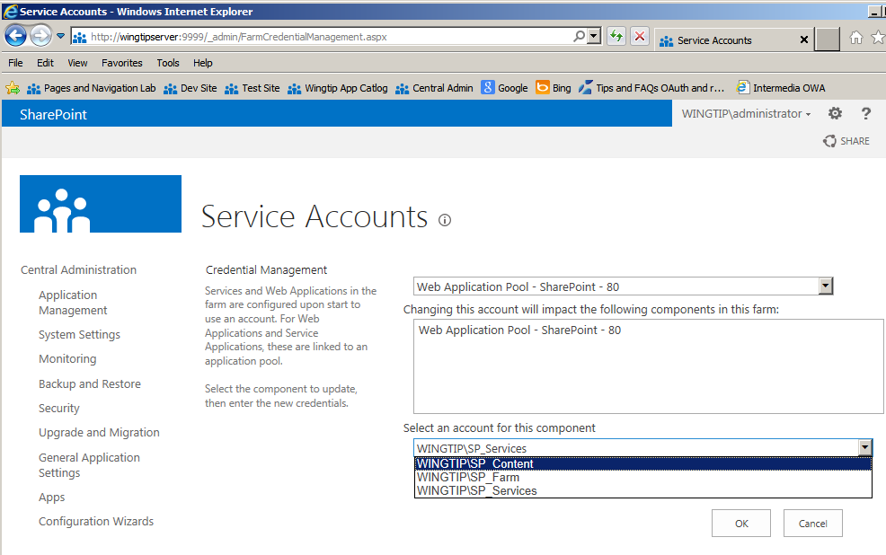
Configuring Web Application Pools
Web application pools configured using service accounts
Web applications should not use service application accounts
Farm Configuration Wizard creates an issue because it creates a web application with same account as service applications
You should configure web application pool with a different account

Slide 6
Agenda
Application Pools and Service Accounts
User Authentication in SharePoint 2013
Configuring Authentication Providers
Configuring Web Applications

Slide 7
Security 101
Authentication and Identity
Authentication creates identity for security principal
Identities stored in user accounts repository
Authentication performed using credentials
Authentication produces some form of badge
Authorization and Access Control
Subsystem used to define security policy
Privileged users configure ACLs on objects
Subsystem enforces policy at run time
Notes:
SharePoint 2013 does not implement its own system for authentication or identity management, but instead relies solely on external systems, whether Microsoft Windows or non-Windows authentication.
Although SharePoint doesn’t perform authentication, it does manage user identities and perform authorization. After authentication, SharePoint maintains a user security token. SharePoint is able to read the groups and membership roles of the current user very efficiently at run time by examining this token. As of SharePoint 2010, the preferred format for user authentication token is Security Assertion Markup language (SAML). This is the type of authentication token used when an web application is running in claims-mode.
SharePoint supports the assignment of permissions to security principals. There are two types of security principals: users and groups. SharePoint checks the user’s security token against binary access control lists.

Slide 8
SharePoint Authentication
SharePoint relies on external components
Windows Authentication authentication managed by Windows Server and IIS
Forms Based Authentication (FBA) authentication managed by ASP.NET and an authentication provider
Claims Authentication authentication managed by a security token service (STS)
SharePoint creates profile for external identities
Identity tracked per site collection in User Info List
Identity tracked on wider scale using User Profile
Notes:
SharePoint 2010 does not implement its own system for authentication sub-system or offer any services for identity management. Instead relies solely on external systems, whether Microsoft Windows, ASP.NET or some of the new available identity management services made available under the new claims-based security model.
Although SharePoint doesn’t perform authentication, it does manage user identities and perform authorization. After authentication, SharePoint tracks each user by using a user security profile stored within the current site collection. SharePoint supports the assignment of permissions to security principals. There are two types of security principals: users and groups. SharePoint checks the user’s security token against binary access control lists.

Slide 9
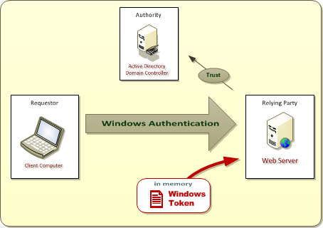
Windows Authentication
Active Directory plays role of Identity Provider
Identities can only established using Windows accounts
OK for intranets scenarios where users are employees
Bad for scenarios which require external users Windows accounts must be created/managed in Active Directory for partners, customers, etc.
Notes:
Windows authentication takes place when users authenticate against the Web server using their Active Directory user accounts. This scenario is very common and well suited for SharePoint farms where all employees already have their own Active Directory account. Windows authentication is less suited for SharePoint farms which must support external users such as partners, vendors and customers.
Windows authentication can be accomplished with several different authentication protocols.
NTLM
Kerberos
Basic
Digest
Client-side SSL certificates
Once a user has authenticated against a Windows account, IIS and Windows Server 2008 respond by creating a Windows security token inside the IIS application pool where the request is running. In a SharePoint server-farm environment, it might be necessary to create same Windows security token and several of the front end Web servers.
Note that SharePoint 2003 supported Windows authentication but nothing else. This is fine for internal sites that were only accessible to employees. However, it did not provide a way to use an identity provider other than Active Directory and therefore was not a good candidate for creating external facing sites for users which did not possess Active Directory accounts.

Slide 10
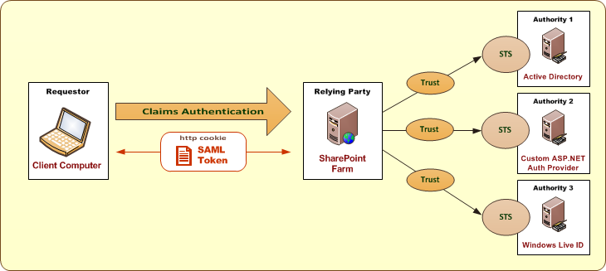
Claims-based Authentication introduced in SharePoint 2010
Based on emerging WS-* security standards
Designed to decouple authorities from relying parties
Authority provides security token service (STS)
STS creates and signs SAML-based security tokens SAML = Security Assertion Markup Language
SAML token used to establish claims-based identity
Notes:
The central concept is that a SharePoint 2010 farm isn’t hard-coded to a specific set of identity providers such as AD and ASP.NET authentication providers. Instead, you can configure trusts in a SharePoint 2010 farm and use any identity provider that you’d like. That is, as long as the identity provider has been designed and implemented in accordance with emerging Internet security standards that are collectively known as the WS-* Security Standards. The actual names of these standards include WS-Security, WS-SecurityPolicy, WS-Trust and WS-Federation.
When customers attempt to log into your web site, they will be redirected to the site for either LiveID or OpenID and prompted to enter their credentials. After they authenticate against the external identity provider, they will then be redirected back to your web site with an established identity. The best part about this approach is that it can be entirely accomplished through configuration, without having to write a single line of custom code.

Slide 11
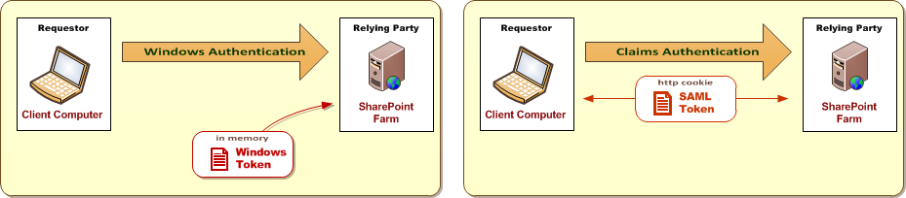
Claims Authentication vs. Classic Authentication
What's the same between these two modes?
Both support for Windows auth using NTLM, Kerberos or Basic
Both support SSL and Anonymous Access
What is different?
Classic mode relies on cached Windows security tokens
Classic Mode only supports Windows authentication
Claims Mode relies on cached SAML tokens
Claims mode supports all available types of authentication
Notes:
Classic Mode Authentication: It refers to the integrated windows authentication.
Claims Based Authentication: SharePoint 2010 is built on Windows Identity Foundation. It enables authentication from windows as well as non-windows based systems. This also provides the capability to have multiple authentication in a single URL.

Slide 12
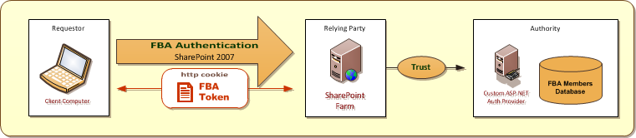
Forms-Based Authentication (FBA)
SharePoint 2007 Introduced Support for FBA
Built on top of FBA support introduced in ASP.NET 2.0
Based on pluggable authentication provider model
FBA Benefits
User accounts can created and managed in custom repository
Authentication token passed via HTTP cookies
FBA Drawbacks
SharePoint provides no support for creating/managing FBA users
FBA token not based on standard – cannot be used across apps
Notes:
SharePoint 2007 introduced support for forms-based authentication. This support in SharePoint 2007 was built on top of the underlying ASP.NET for FBA that was introduced in ASP.NET 2.0. The implementation of FB A changed quite a bit with SharePoint 2010 when FBA support was integrated into the claims security mode. Note that classic authentication mode does not support FBA in either SharePoint 2010 or SharePoint 2013.
When the ASP.NET team designed their support for FBA, they built the architecture on top of a pluggable component an ASP.NET authentication provider. The key concept is that one ASP.NET authentication provider can be substituted for another without affecting applications. The authentication provider is hidden under a configuration layer.

Slide 13
Agenda
Application Pools and Service Accounts
User Authentication in SharePoint 2013
Configuring Authentication Providers
Configuring Web Applications

Slide 14
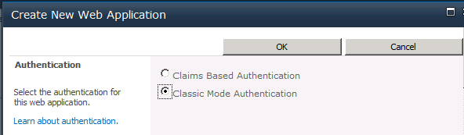
Web Applications and User Authentication
In SharePoint 2010, you selected the authentication mode
Claims Based Authentication or Classic Mode Authentication
In SharePoint 2013, you are not given a choice
Central Admin always selects claims-based mode
Classic mode web apps can only be created using PowerShell
Notes:
When creating a new SharePoint web application you are asked to choose an authentication provider.

Slide 15

Integrated Windows Authentication
Benefits
Works well inside LAN
Drawbacks
Can only be used reliably for users inside LAN
Doesn't work through firewalls for Internet users
Choices for Integrated Windows Authentication
Negotiate (Kerberos)
NTLM
Notes:
Windows Server supports two different protocols for performing integrating Windows authentication. The older protocol is NTLM and dates back to the days of LAN Manager. The new recommended protocol is Kerberos.
When you want to use Kerberos, you select Negotiate. This means that the client and server will try to authenticate using Kerberos. However, if either the client or server do not support Kerberos, it falls back on using NTLM.

Slide 16
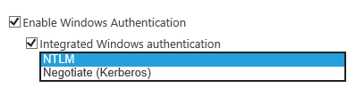
NTLM versus Kerberos
NTLM
Easier to set up
Does not support delegation of credentials
Kerberos
Requires extra set up work
Reduces traffic from Web server to domain controller
Can be configured to support delegation of credentials
Notes:
Both of these protocols are used with Integrated Windows authentication in a classic challenge/response scheme.
NTLM relies on IIS generating a token with a challenge, sending it to the client, the client responding with a token, and a domain controller validating that response. NTLM requires user names and passwords to be encrypted before they are transmitted, and also requires re-authentication (a new token) when accessing a new network resource.
Kerberos relies on a ticketing system where a client and server access a trusted authority called a Key Distribution Center (KDC), which responds to client requests and grants tickets that the client can use to access network resources. Kerberos does not require re-authentication for accessing multiple resources.
NTLM can cause performance issues because NTLM-based authentication inherently requires multiple round trips between IIS and a domain controller for many SharePoint usage scenarios, such as a Web application accessing a SharePoint Web Part or custom Web service. In terms of security, a ticket-based system (Kerberos) with explicit delegation of network resources is more secure by design than only encrypting user credentials. It is also faster because it uses a single ticket to access multiple network resources.

Slide 17
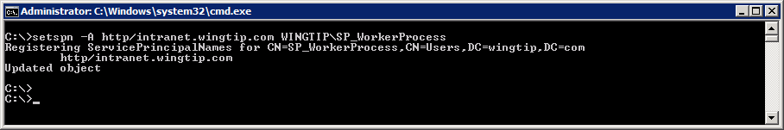
Setting Up Kerberos
Make sure all server clocks are synced
Authentication breaks if clocks > 5 minutes apart
Requires configuration with SETSPN.EXE utility
Registers service provider to support Kerberos ticketing
Notes:
The process of configuring Kerberos authentication for any service installed on a host computer running Windows Server 2008 R2 or Windows Server 2012 includes creating a Service Principal Name (SPN) for the domain account used to run the service on the host.
Steps to take:
- Configure Kerberos authentication for SQL communications
Create the SPNs for your SQL Server service account
Confirm Kerberos authentication is used to connect servers running SharePoint Server 2010 to SQL Server
Create Service Principal Names for your Web applications using Kerberos authentication
Deploy the server farm

Slide 18
Creating a new Web Application in Central Administration

Slide 19
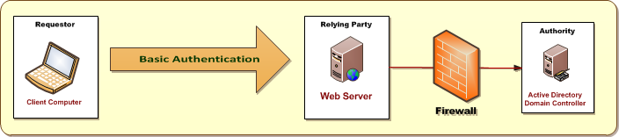
Basic Authentication
Basic Authentication used in legacy scenarios
Provides Legacy Support for older browsers
Can be used in Classic Mode or Claims Mode
User name & password sent to Web server in clear text
SSL used to encrypt user name & password as they pass over the Internet
Notes:
Basic authentication requires previously assigned Windows account credentials for user access. Basic authentication enables a Web browser to provide credentials when making a request during an HTTP transaction. Because user credentials are not encrypted for network transmission, but are sent over the network in plaintext, using basic authentication over an unsecured HTTP connection is not recommended. If you choose to use basic authentication, you should always enable Secure Sockets Layer (SSL) encryption.

Slide 20
Configuring FBA using a SQL Database
Configuring FBA requires authentication provider
AspNetSqlMembershipProvider included with ASP.NET
Can be used to track members and roles in SQL Server
Steps to make FBA work with an ASP.NET app
Create FBA database using aspnet_regsql.exe
Configure DB permissions for required accounts
Modify web.config file for the following
Web application which is required to support FBA
Web application for Central Administration
Local security token service (STS) on SharePoint web servers

Slide 21
Creating Trusts
You can create trusts to external identity providers
Windows Azure Access Control Service (ACS)
Windows Live
Single Sign-on
Others are available as well
Notes:
The central concept is that a SharePoint 2010 farm isn’t hard-coded to a specific set of identity providers such as AD and ASP.NET authentication providers. Instead, you can configure trusts in a SharePoint 2010 farm and use any identity provider that you’d like. That is, as long as the identity provider has been designed and implemented in accordance with emerging Internet security standards that are collectively known as the WS-* Security Standards. The actual names of these standards include WS-Security, WS-SecurityPolicy, WS-Trust and WS-Federation.
When customers attempt to log into your web site, they will be redirected to the site for either LiveID or OpenID and prompted to enter their credentials. After they authenticate against the external identity provider, they will then be redirected back to your web site with an established identity. The best part about this approach is that it can be entirely accomplished through configuration, without having to write a single line of custom code.

Slide 22
Agenda
Application Pools and Service Accounts
SharePoint 2013 Authentication Options
Configuring Authentication Providers
Configuring Web Applications

Slide 23
Configuring Web Applications Overview
Ensure DNS is properly configured
Domains must resolve to IP address on web server
Can be done using DNS Manager
Add registry entries to disable loopback checks
Loopback checks prevent ability to access sites
Only an issue when using browser on web server
Obtain and install certificates to configure SSL
Self-signed certificates can be used while testing

Slide 24
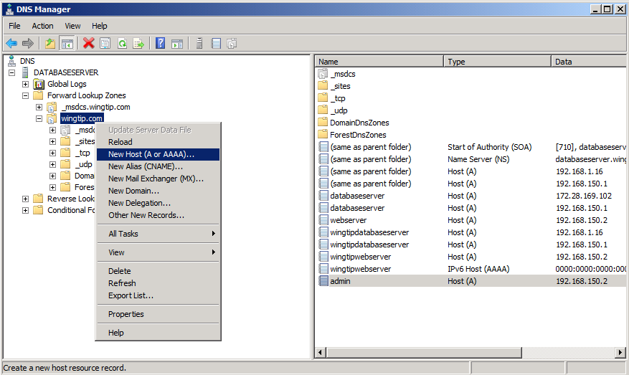
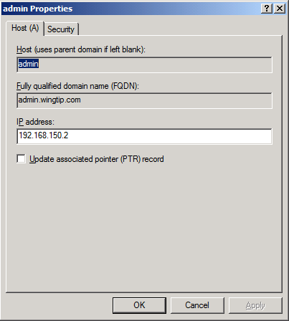
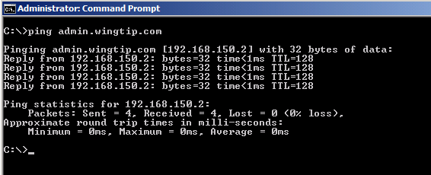
Adding A Records to DNS
New host DNS name requires an A Record
A Record used to resolve domain name to IP address
You can test A Record using ping utility
Notes:
If you want to configure access to a Web application through a specific DNS name, you must ensure that there are DNS settings that redirect requests targeting that DNS name to the IP address of the Web server. You do this by creating a DNS A Record which resolve domain name such as http://intranet.wingtip.com to IP address such as 192.168.150.1.
Once you create a new A Record, you can test it by bring up a command prompt and running the ping command.

Slide 25
Dealing with the Loopback Check
Windows Server has built-in loopback check
Security feature to protect Web server from attack
Web server not allowed to send HTTP requests to self
Loopback check causes problems in testing
Registry keys used to disable loopback check
Use BackConnectionHostNames key in production
Use DisableLoopbackCheck key on test server
Details at http://support.microsoft.com/kb/896861
Notes:
Note that this topic is only relevant to testing machines when you need to access sites through the browser while running on the Web server. Windows Server has security features based on a built-in loopback check. The idea of this security feature is that it protects Web server from attack by preventing the Web server from resolving IP addresses that point back to itself. While this is a valuable defensive mechanism on a production Web server, it causes a problem when you are configuring SharePoint and accessing sites through the browser on a single VM.
Since the loopback check causes problems in testing on a single VM, you can disable it in testing scenarios. You can add the DisableLoopbackCheck register entry to disable loopback check. Note that this should only to be done on test machines, never on production Web servers.

Slide 26
Secure Sockets Layer (SSL)
SharePoint farms often required to support SSL
SSL allows browser to authenticate Web server.
SSL encrypts data between browser and Web server
Common scenarios where SSL is used
Basic Authentication
Forms-based Authentication
Claims-based Identity Providers
Notes:
It is common to configure access to SharePoint sites using SSL to encrypt data as it is passed between the browser and the Web server. Configuring SSL also allows browser to authenticate the Web server. The most common scenarios where you will be required to configure SSL include when you use Basic Authentication, Forms-based Authentication and Claims-based Identity Providers.

Slide 27
Certificates and CAs
Certificate Authorities (CAs) issue certificates
CAs are set up in hierarchies
Client browser must trust issuing CA or a parent
Well-known CAs used for Intranet sites
Self-signed Certificates
Commonly used to configure SSL for testing
IIS creates self-signed certificate with machine name
SharePoint installs tools for building test certificates
Notes:
In order to configure SSL you must obtain a certificate from a Certificate Authorities (CA). For real world scenarios you will obtain a certificate by making a certificate request to a CA such a VeriSign, Thawte or GoDaddy. For testing scenarios, you can use a utility that is part of the IIS Resource Kit named SELFSSL.EXE that will allow you to create a certificate for an URL such as https://intranet.wingtip.com.

Slide 28
Creating a Web Application that Supports SSL

Slide 29
Summary
Application Pools and Service Accounts
SharePoint 2013 Authentication Options
Configuring Authentication Providers
Configuring Web Applications

