Slide 1
SharePoint 2013 Service Applications
Notes:
The module discusses three essential service applications of SharePoint Server 2013 standard edition including Business Connectivity Services (BCS), the Managed Metadata Service (MMS) and the User Profile Service.

Slide 2
Agenda
Service Application Overview
Business Connectivity Service (BCS)
Managed Metadata Service (MMS)
User Profile Service (UPS)

Slide 3
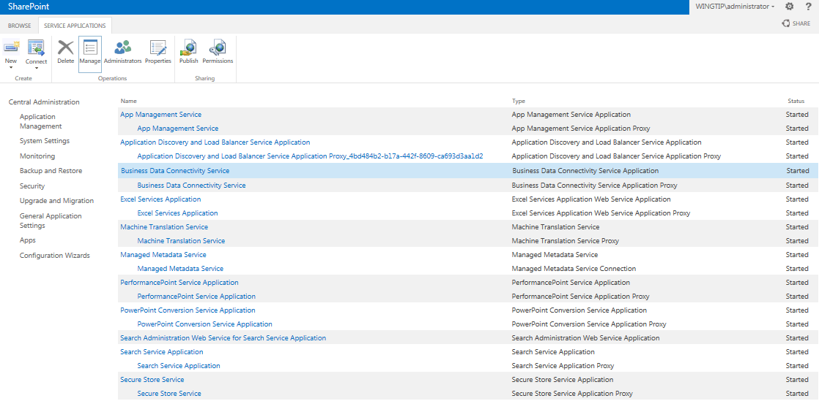
Creating Service Applications (SAs)
SharePoint Server 2013 powered by service applications
Farm administrator creates service application instances
Service application administration often delegated to other users

Slide 4
SAs in SharePoint Foundation
Security Token Service Application
State Service
App Management Service Application
Site Subscription Settings Service Application
Usage and Health Data Collection Service Application

Slide 5
SAs in SharePoint Server Standard Edition
Business Data Connectivity Service (BCS)
Secure Store Service (SSS)
Managed Metadata Service (MMS)
User Profile Service Application (UPA)
User Profile Service Synchronization (UPS)
Search Service
Word Automation Service
PowerPoint Conversion Service
Machine Translation Service
Work Management Service

Slide 6
SAs in SharePoint Server Enterprise Edition
Excel Services
PerformancePoint Service
Visio Graphics Service
Access Services

Slide 7
Agenda
Service Application Overview
Business Connectivity Service
Managed Metadata Service
User Profile Service

Slide 8
Business Connectivity Services
Bring data from external systems into SharePoint and Office, interact with it, reuse it, and empower end users to gain insight into the underlying data in a reusable way.
Extend the reach of Enterprise Data
Centrally manage reusable connections
Easily create custom solutions
Notes:
Systems such as customer relationship management (CRM) and enterprise resource planning (ERP) have special roles that are not replaced easily by Microsoft SharePoint. As a result, strategies must be adopted to provide interoperability between SharePoint and these systems.In the absence of a strategy for integrating systems with SharePoint, many organizations duplicate information in SharePoint lists. Customer contact information, for example, may exist in a CRM system and also be entered into a contact list in SharePoint. Worse still, the data may be duplicated many times in different team sites by different groups. This kind of duplication leads to significant data maintenance issues because updates must be performed in many lists.
Along with these existing systems, custom applications, databases, and Web services are common within organizations. When a separate database is required, developers have historically created ASP.NET applications or custom Web Parts that act as front ends for the database to have the data appear in the SharePoint environment. However, these types of solutions generally offer little integration with SharePoint capabilities; they are largely limited to presenting data within a SharePoint Web page.
Business Connectivity Services (BCS) changes all the rules for integrating systems, databases, and Web services with SharePoint. Beyond simply bringing data into SharePoint for display, BCS allows for capabilities that simply can’t exist in an ASP.NET application or custom Web Part without a significant investment. These capabilities include enterprise search, External Data columns, user profile integration, client synchronization, offline support, and Microsoft Word integration.BCS is a set of out-of-box features, services and tools that streamline the creation of SharePoint Solutions with deep integration of External Data and Services. Power users, IT, Devs can create no code solutions using BCS.The basics of ECT store and BDC runtime are baked into SharePoint Foundation 2013.
Why BCS?
Integrate other Line of Business application systems with SharePoint sites.
Search for data in other systems via the SharePoint Search service.
Save the time, cost, and monotony of writing yet another data layer!

Slide 9
BCS Terminology
Business Data Connectivity (BDC): Service app controlling plumbing, runtime, connectivity
External System: Data source BCS can talk to
External Content Type (ECT): Definition of fields & operations to connect to external system
External Data: Data that resides in external sys.
External List: List based on external data
External Data Column: List column who’s source is external data
External Data Web Part: OOTB Web Parts that display external data

Slide 10
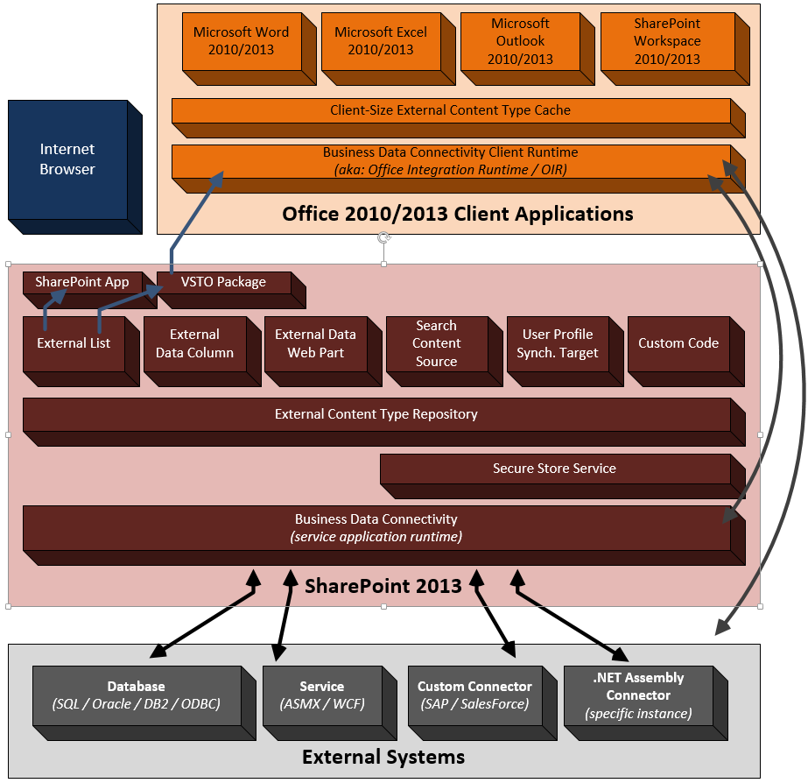
BCS Architecture

Slide 11
External Content Types
Describe the schema of external data source
Describes operators / operations on external data
Creating External Content Types:
SharePoint Designer 2013
Visual Studio 2013
Can export/import external content types via the Business Data Connectivity service application
Notes:
ECTs define fields, operations, and filters to be used with the External Data and are the heart of the BCS infrastructure. As an example, consider a manufacturing database that contains product information.
An ECT named Product can be created that defines ProductID, ProductName, and ProductDescription fields. Furthermore, it might define operations for retrieving data based on a keyword query or exact product identifier. Defining ECTs is one of the primary activities involved in creating a BCS solution and may be performed in either Microsoft SharePoint Designer 2013 (SPD) or Microsoft Visual Studio 2012 (VS2012). ECTs are stored in a metadata catalog, which is part of the BDC Service Application and is available throughout the SharePoint farm

Slide 12
External Lists
Expose external data as a native SharePoint list
Full CRUD-Q capability w/ familiar UI & navigation
Forms can be converted to InfoPath forms
Profile page available for each item in the list
Access via SharePoint object model (SPList)
New support for alerts (notifications)
Requires implementation of new operators
Some differences from traditional SP lists
Because SharePoint doesn’t “own” the data, some standard list functionality is not available with external lists
Notes:
External Lists can be created directly in SPD or in the browser using the Create menu in SharePoint. Once the new External List is created, it may be viewed in the browser. Because all the CRUDoperations were created, the resulting list supports editing, adding, and deleting items. The appearance of the External List closely resembles a standard SharePoint list. The Ribbon is functional, as well as the editcontrol block (ECB) associated with individual items. Any changes to items in the list will be reflected immediately in the External System. Just like “regular“ lists, External Lists may be taken offline through both the SharePoint Workspace 2013 and Outlook 2013.
While External Lists appear similar visually to standard SharePoint lists and are supported by a SPList object, they do have significant limitations that must be considered in any design. These limitations include lack of workflow support and several standard list features. The following lists some of the major limitations of External Lists.
Approval: Approval of items is not supported
Attachments: Attachments are not supported directly, but must be implemented using a StreamAccessor operation in a custom solution
Check-in/Check-out: Check-in and checkout of items are not supported
Content Types: Using standard site content types in External Lists is not supported
Drafts: Drafts of items are not supported
ECB: Send-To operations are not supported
Ribbon: Datasheet View is not supported
SPLINQ: Querying through LINQ to SharePoint is not supported
Templates: Document templates are not supported
Versioning: Versioning of items is not supported
Workflow: Starting workflows from items is not supported, but workflows can read or write to External Lists through the SPList object
Validation: Validation formulas are not supported

Slide 13
Surfacing External Data
External Data Columns
Add data from external content types to standard SharePoint lists
Can be made available as Content Controls in Word
Provided Web Parts
External Data Item
External Data List & External Data Related List
External Data Item Builder
Chart Web Part
Profile Page
External Data Search
Integrate External Data into search results
Inclusion in SharePoint Apps
Notes:
External Data Columns:
Along with using an ECT as the basis for a list, you can use an ECT as the source for a column in another list. This capability is known as an External Data Column. When you create an External Data Column for a list, you select the ECT to use as the basis for the column. You may then select one or more of the fields available in the ECT to display alongside the column you are creating. These additional fields are known as projected fields because they project data from the ECT into the parent list.
BCS Web Parts:
Another way you can use ECTs is through a set of Web Parts that ship with SharePoint Server 2013 known as External Data Web Parts (also called Business Data Web Parts). External Data Web Parts are designed specifically to display ECT data and relationships. The available parts include the Business Data List, Business Data Related List, and Business Data Item. These Web Parts display a list based on an ECT, a list based on an ECT association, or a single item, respectively.
Business Data Item: Displays details for a single external item
Business Data List: Displays list of external items
Business Data Related List: Displays a list of external items related to an item passed as input (typically selected in the Item or List web part)
Business Data Actions: Displays a list of actions for the selected external item
Business Data Item Builder: Retrieves input parameters from the URL/query string and passes them to parts on the page. This Web Part is not visible when the page is not in edit mode
Profile Page:
When SharePoint surfaces ECT data in lists and Web Parts, it does not necessarily show all the available fields and associations. For example, when an ECT is used as the source for an external column, only a single field is required for display. When users see partial ECT data, however, they are quite often interested in being able to see the data behind it. This is where profile pages enter the picture. A profile page is a dedicated page that shows all the ECT data for a specific record. This way, users can jump from partial ECT data to a complete view of the record.
External Data Search:
ECTs created with SPD already support indexing by SharePoint Search with no additional work. However, External Systems will be indexed only if you explicitly set up a content source that includes the ECT. Content sources can be created within the Search service application, where you will have the option to create a content source associated with an External System.
SharePoint Site/App – Sites and Apps can use external data. The primary way that users interact with external data is through an external list. External lists look and feel like standard lists, but they are backed by an ECT instead of a standard content type. Apps can also have ECTs defined within the app through a BDCM file. This file allows for app-level ECTs (discussed in detail later), which supports the isolation model of Apps. Exernal lists may be synchronized with Outlook through the automatic creation of a VSTO click-once package, which is downloaded to the client.

Slide 14
SharePoint Designer 2013 vs. VS2013
SharePoint Designer 2013
Creating ECTs to external systems (databases / Web services)
Map operations for external systems
Reuse existing connections (custom connector)
Surface external data (external lists / Office clients)
Visual Studio 2012
Create .NET Assembly Connector
Aggregate data across multiple external systems
Customizable data transformations
Create Custom Connectors
Create ECTs to OData source
Include ECTs within SharePoint Apps
ECTs that support Notifications / External Events
Notes:
Developers have two tools at their disposal in creating BCS solutions. SharePoint Designer 2013 is good for simple solutions that expose data from databases and Web services. While SharePoint Designer 2013 only supports designers for some operators, users can export the model as XML from the BDC service application and make manual edits to add additional operators. Visual Studio 2012 provides developers the ability to create custom connectors (for connecting to external systems such as PeopleSoft, SAP or SalesForce), ECTs based on OData sources, ECTs that support notifications, ECTs included in Apps or .NET Assembly Connectors (for connecting to specific instances of external systems).

Slide 15
Creating & Using External Content Types
Notes:
Demo1

Slide 16
OData Data Source
Open Data Protocol (OData)
Protocol for performing CRUD operations on web data
Uses standard HTTP GET, POST, PUT, DELETE
Returns ATOM and JSON results
Provides easy cross-platform data access
Representational State Transfer (REST)
Architecture utilizing URIs to specify operations
Often used in conjunction with OData protocol
SharePoint 2013 Supports OData as a data source in addition to databases & services
Notes:
The Open Data Protocol (OData) is a web protocol for querying and updating data. OData applies web technologies such as HTTP, Atom Publishing Protocol (AtomPub) and JSON to provide access to information from a variety of applications, services, and stores. OData emerged organically based on the experiences implementing AtomPub clients and servers in a variety of products over the past several years. OData is being used to expose and access information from a variety of sources, including but not limited to relational databases, file systems, content management systems, and traditional web sites. Microsoft has released OData under the Open Specification Promise (OSP) to allow anyone to freely interoperate with OData implementations. We intend on working with others in the community to move the features of OData into future version of AtomPub or other appropriate standards.
Links to learn more:
Open Data Protocol site - http://www.odata.org/
Open Data Protocol by Example - http://msdn.microsoft.com/en-us/library/ff478141.aspx
OData Q&A - http://msdn.microsoft.com/en-us/data/ee844254

Slide 17
OData Sources
Creating External Content Types
<LobSystem Name="ODataWebNorthwindModel" Type="OData">
<Properties>
<Property Name="ODataServiceMetadataUrl" Type="System.String">
http://services.odata.org/Northwind/Northwind.svc/$metadata</Property>
<Property Name="ODataMetadataAuthenticationMode" Type="System.String">PassThrough</Property>
<Property Name="ODataServicesVersion" Type="System.String">2.0</Property>
</Properties>
<LobSystemInstances>
<LobSystemInstance Name="http://services.odata.org/Northwind/Northwind.svc">
<Properties>
<Property Name="ODataServiceUrl" Type="System.String">
http://services.odata.org/Northwind/Northwind.svc
</Property>
<Property Name="ODataServiceAuthenticationMode" Type="System.String">PassThrough</Property>
<Property Name="ODataFormat" Type="System.String">application/atom+xml</Property>
</Properties>
</LobSystemInstance></LobSystemInstances></LobSystem>
Notes:
This is a portion of a BDC Metadata Model showing how an OData source can be accessed
Type - This attribute must be set to ODATA when working with OData datasources.
ODataServiceMetadataUrl- Provides the end point of the metadata service.
ODataAuthenticationMode - The authentication mode used by the datasource to allow access and what type of access to the calling API.
ODataServicesVersion - The version of OData
ODataServiceUrl- The endpoint for the service
ODataFormat- The format for the returned data

Slide 18
Example OData Sources
Microsoft SharePoint 2013
http://msdn.microsoft.com/en-us/library/ff798339.aspx
Microsoft Azure
http://msdn.microsoft.com/library/dd179355.aspx
Windows Azure Marketplace
http://services.odata.org/Northwind/Northwind.svc
SQL Server Reporting Services
http://technet.microsoft.com/en-us/library/ee240754.aspx
Notes:
OData producers are services that expose their data using the OData protocol. These are just some sample producers. A detailed list of producers can be found at http://www.odata.org/producers
SharePoint 2013 exposes OData through the ListData.svc service
Azure allows access to SQL Azure and structured storage through OData. You can configure OData services in your Azure account
Azure Marketplace exposes OData producers either for free or a fee. MSFT exposes a free OData source you can work with for testing
SQL Server Reporting Services for SQL Server 2008 R2 can expose report data as an OData source

Slide 19
External Content Types with OData Sources

Slide 20
Agenda
Service Application Overview
Business Connectivity Service
Managed Metadata Service
User Profile Service

Slide 21
Managed Metadata Service
Managed Metadata Service Application
Term Store
Content Type syndication
SharePoint Metadata Manager
Notes:
Managed Metadata service application:
Admins define term store (taxonomy).
Admins define the location of the Enterprise Content Type site collection hub.
Metadata Manager = utility used to manage the term store.
Admins can import a CSV file that contains a taxonomy into a new term store.
SharePoint 2010 now has a Managed Metadata field type that’s bound to a term set and used in tagging of List Items.

Slide 22
Enterprise Content Types
Content types often scoped at site level
Cannot see the same set across site collections
MMS allows syndication of “enterprise” content types
Define one site collection as the content type hub
Enterprise content types are read only in sites
Sites can have enterprise and local content types in sites
Local content types can inherit from enterprise content types
Notes:
Enterprise Content Types allow for consistent content types across multiple SharePoint site collections, web applications and farms.
In the Managed Metadata Service you can define a site collection that will serve as a central repository of content types.
Content types that are syndicated can’t be changed in the child sites, but site owners can create new content types that extend them to implement changes.

Slide 23
Managed Metadata Improvements
Metadata leveraged in various ways throughout SharePoint 2013
New pages introduced so not everyone has to use Term Store Manager to modify taxonomies
Permissions for groups
SharePoint 2010 allowed read
SharePoint 2013 supports read/write
Numerous features based on taxonomy targeting WCM scenarios
Ability to flag a term set’s “intended use”
Taxonomy API exposed via CSOM

Slide 24
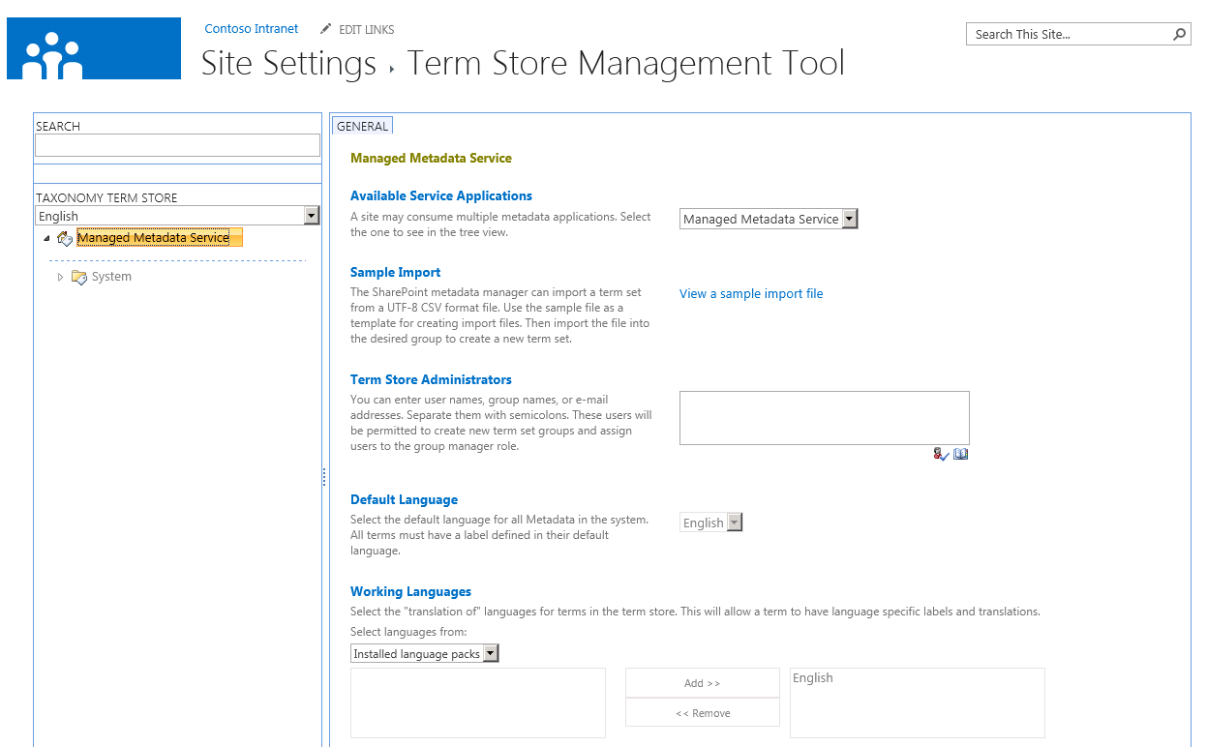
Enterprise Metadata Management
Metadata as enabler for different functionalities
Navigation, term and search driven pages, etc.
Numerous new capabilities for term store manager to enhance term usage models
Multilingual improvements & new capabilities
Dataview editing support included

Slide 25
Document Sets
Each document set has:
List of available content types allowed within it
Default content automatically added to the set
Can create shared columns (defined in document set’s content type) that are pushed down across all content in set
Welcome page acts as the homepage for doc sets
Customizable Web Part Page displaying the document set’s properties
Notes:
A Document set is a content type that contains other content types, so a document set can only be created on a document library that is content type enabled.
The Document set content type is represented as a folder.
The Welcome page is a Web Part page that can be customized. From here you can manage the properties of the document set and upload documents using the buttons on the ribbon.
Content in shared columns is pushed down to each item in the set.

Slide 26
In Place Records Management
MOSS 2007 records management functionality no longer tied to Records Center site template
Site Collection Feature: In Place Records Management
Define who can & can’t declare records
Notes:
Records management capabilities are no longer required for a specific site template… they have been refactored to Features. This allows for activation of the features in standard SharePoint sites, and not only in a site based on the Records Management site template.
Records can now be created side by side with other documents in the same library.
SharePoint 2010 makes it possible to apply different policies (i.e. retention schedules) depending if the item is a record or a document.

Slide 27
Unique Document ID Service
New site collection Feature: Document ID Service
Adds unique ID for all documents throughout the site collection
Documents can be retrieved regardless of the current of future location based on their unique ID
Notes:
Newto SharePoint 2010 is the ability to assign a document a unique ID, which will be unique to the site collection.
This ID when used in conjunction with a specific URL (by sticking the ID on the query string) will take people to the document regardless if it is moved within the same document library or across libraries within a site collection.

Slide 28
Content Organizer
Users typically need a good understanding of the site / library structure to know where to save documents
Advanced routing - users upload to sites
Routing rules will determine where the document is saved
Routing rules defined by site administrators
Adds capability for documents to be sent to Record Center automatically on a schedule
Notes:
The Content Organizer feature is a new routing feature that:
Allowsusers to automatically route documents to different libraries and folders within those libraries based on well defined routing rules.
Allowsusers to find the document in the future because the upload form displays the URL to the document that has been routed.
Adds capability for documents to be automatically sent to a Records Center based on a schedule.

Slide 29
SharePoint 2013 & Exchange ECM Big Bets
eDiscovery
In place holds in SP & Exchange
Integrated, enterprise wide case management
Site Mailboxes
Work on mail and documents together
SharePoint & Outlook desktop client
Meet Compliance Demands
Retention/compliance across stores
Notes:
In the SharePoint 2013 and Exchange releases, Microsoft is banking on two major investment areas to their ECM offering. These two areas are eDiscovery & Site Mailboxes.

Slide 30
eDiscovery
eDiscovery is the process of finding content relevant to a specific topic
For example: legal action / litigation
Companies also employ internally
Ensure they are in compliance
Ensure the appropriate policies are in place
Ensure they understand their IT & content sources
Notes:
An ECM implementation has two sides to the solution: (1) getting content classified and into the system and (2) being able to find and act on the content that is in the system. eDiscovery addresses the latter part of this need. eDiscovery is the process of finding relevant content, typically in responding to addressing a legal even, reviewing that content and exporting it for further use.

Slide 31
eDiscovery Process
Preserve
Create Case
Apply Hold
Search
Query
De-duplicate
Review
Visualize
Read
Export
Save as PDF/TIFF
Print
Discovery accounts for ~35% of total litigation costs in the US (Gartner) and is one of the top drivers for moving email and documents into third party archiving solutions. Given the growth of this area, pure-play discovery software and discovery-enabled are expected to be a $2.1b business by 2013. - Gartner

Slide 32
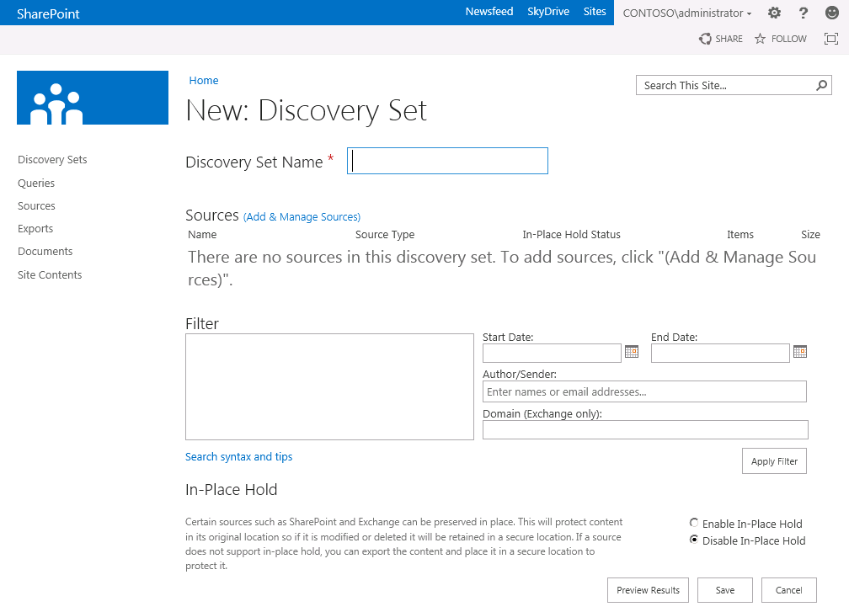
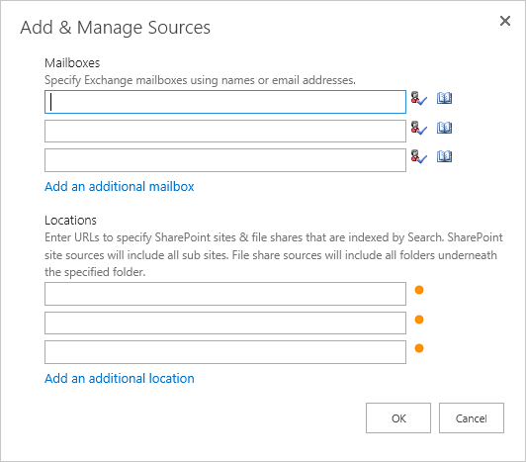
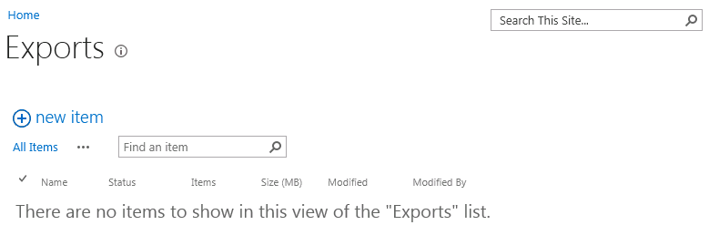
Add, Manage & Export Discovery Sets
Notes:
Enterprise-wide eDiscovery
With SharePoint Server 2013 you can centrally manage eDiscovery across multiple SharePoint farms, Exchange servers, and file shares. From one discovery center you can:
Create a case, define a query, and search SharePoint Server 2013, Exchange Server, and file shares throughout the enterprise for content that matches the query.
Export all of the content that was identified.
Preserve items in place in SharePoint Server 2013 or Exchange Server.
Track statistics related to the case.
To implement eDiscovery across the enterprise, you first select one farm to host the discovery center. The Search Service application that is associated with this farm becomes the central Search Service application, for eDiscovery purposes. You create a proxy to the central Search Service application in each SharePoint Server farm that contains discoverable content, and configure the central Search Service application to crawl file shares that contain discoverable content. SharePoint Server 2013 automatically discovers the connection to Exchange Server. Any content from SharePoint Server 2013, Exchange Server, or a file share that is indexed by the central Search Service application or by Exchange Server can be discovered from the discovery center.
Discovery Export
SharePoint Server 2013 includes the Discovery Download Manager, a Microsoft Windows® 7 application that you can use to export the results of an eDiscovery search for later import into a review tool. The Discovery Download Manager can export all of the content that is associated with a discovery case, including:
Documents: Documents are exported from file shares. Documents and their versions are exported from SharePoint Server 2013.
Lists: If a list item was included in the eDiscovery query results, the entire list is exported as a comma-separated values (.csv) file.
Pages: SharePoint Server 2013 pages, such as wiki pages or blogs, are exported as MIME HTML (.mht) files.
Exchange objects: Items in an Exchange Server 2013 mailbox, such as tasks, calendar entries, contacts, email messages and attachments, are exported as a personal storage (.pst) file.
An XML manifest that conforms to the Electronic Discovery Reference Model (EDRM) specification provides an overview of the exported information.

Slide 33
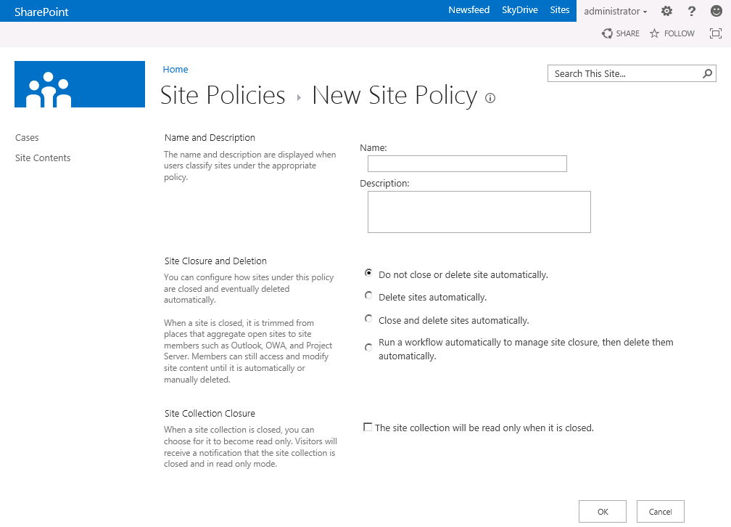
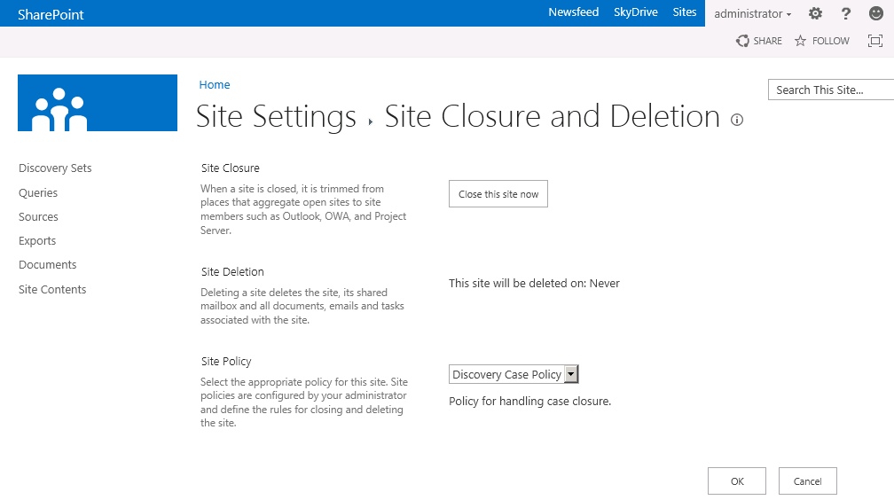
Site Based Compliance & Preservation
Compliance officers create policies, which define:
The retention policy for the entire site and the Site Mailbox, if one is associated with the site
What causes a project to be closed
When a project should expire
Notes:
Compliance features of SharePoint Server 2013 have been extended to sites. You can create and manage retention policies in SharePoint Server 2013, and the policies will apply to SharePoint sites and any Exchange site mailboxes that are associated with the sites.
Compliance officers create policies, which define:
The retention policy for the entire site and the site mailbox, if one is associated with the site.
What causes a project to be closed.
When a project should expire.
When a project begins, the project owner creates a SharePoint site and an Exchange site mailbox. The project owner selects the appropriate policy template, and invites team members to join the project. As the team adds documents to the site, sends email messages, and creates other artifacts such as lists, these items automatically receive the correct retention policies. When the work has been completed, the project owner closes the project, which removes the project's folders from the team members' Outlook user interface. After a certain period of time, as specified by the policy, the project expires, and the artifacts associated with the project are deleted.
In SharePoint Server 2013, content that is placed on hold is preserved, but users can still modify it. The state of the content at the time of preservation is recorded. If a user modifies the content or even deletes it, the original, preserved version is still available. Regular users see the current version of the content; compliance officers who have permission to use the eDiscovery features of SharePoint Server 2013 are able to access the original, preserved version.
Preserving content is similar to placing it on hold, with the following enhancements:
Documents, list items, pages, and Exchange Server 2013 mailboxes can be preserved.
Preservation is done at the level of a site. Preserving a site preserves the contents of the site.
Users can continue to work with content that is preserved. The content remains in the same location, and users can edit, delete, and add new content.
A user with the permission to perform eDiscovery can access the original version of preserved content.
You do not have to preserve an entire site or mailbox. You can specify a query to define the hold scope, and preserve only the content that matches the query.

Slide 34
Site Mailbox: Exchange & SharePoint
Documents are stored in SharePoint
Emails are stored in Exchange
Site Mailboxes can receive emails and have their own email address
Easy access to both from Outlook and SharePoint
Unified compliance policy applies to both
Notes:
Make sure to explain that
You will get access to docs and emails for a project together in Outlook
That the actual docs remain on SharePoint
All changes to documents (edits, deletes) happen right on SharePoint even if started from Outlook

Slide 35
Agenda
Service Application Overview
Business Connectivity Service
Managed Metadata Service
User Profile Service

Slide 36
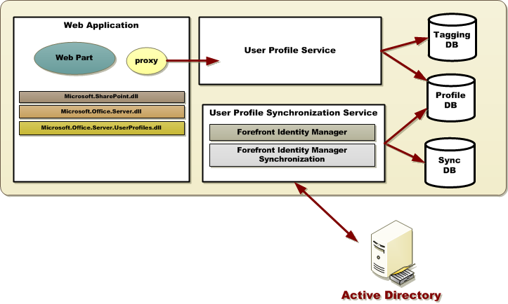
User Profile Service Application Architecture

Slide 37
User Profile Service Application Storage
User Profile DB
Profile and Activity Feed
Social Data DB
Tags, Keywords, Comments, Bookmark, Ratings
Mainly stores GUID (to the taxonomy term) or the note or rating, URI, Profile ID, Timestamp, URI disambiguation info
Term values for use on the Newsfeed and Tags & Notes Page
Sync DB
Staging sync data for AD, LDAP, BCS

Slide 38
Social Features
Newsfeed, Sites, and OneDrive (aka My Site)
My Likes
My Tasks
OneDrive Pro
Microblogging
Following
Mentions
Likes
Communities

Slide 39
Architecture
Personal Site
App Fabric Cache
Microfeed
Social
OneDrive Pro
Profile DB
System
User
Sites
Docs
People
Tags
Notes:
The data sources used for the social features are:
Microfeed List – Contains all the activity around a user. Activities may be user generated (post) or system generated (profile change)
Social List – contains the list of all things that a person is following (i. e., documents, people, sites, tags)
Profile Database – contains profile information, followed people, and tags
App Fabric Cache - Used to store the latest activities so they may be displayed quickly on the What’s New page.
SkyDrive – personal document library
This means that you need a My Site to participate in many social capabilities.
Sites have both Social quota and Content quota. Some social activity counts as content, some content counts against social.

Slide 40
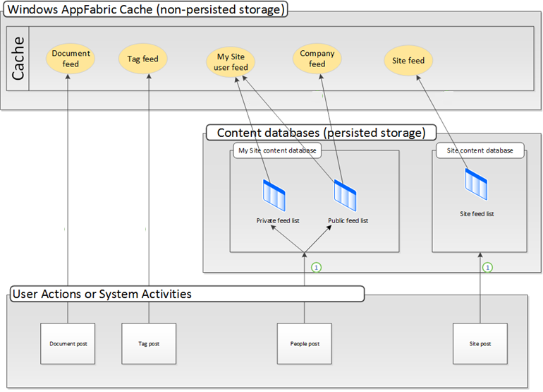
App Fabric Cache
Notes:
App Fabric Cache - Used to store the latest activities so they may be displayed quickly on the What’s New page.
Document and Tag Activities are written only to the cache
People and Site activities are written to persistent storage, then the cache
The App Fabric Cache is load balanced across all WFEs so it doesn’t matter what WFE the user lands on.

Slide 41
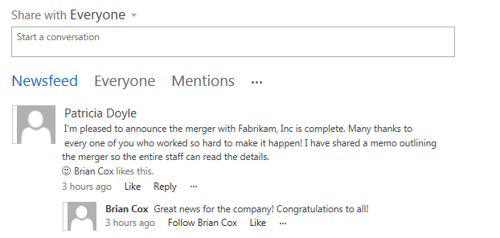
Newsfeed
Private view
Updates on things you follow
New Posts from Others
Profile changes
Changes to followed documents
Things tagged with followed tags
Mentions
My Activities
My Likes

Slide 42
OneDrive for Business
Single personal library
All: provides an overall view of documents in the library
Personal: shows documents in the library that have not be shared with anyone
Recent: provides a view of the library grouped by dates
Shared by me: provides the ability to show who can access to what in the library
Shared with me: provides the ability to show all documents that have been shared with you across people’s libraries
Notes:
Shared with me view
It looks like a form view but, in reality, it uses Search underneath to aggregate content
there’s a lag time (default 15 minutes) before the document appears in the view.
The query is smart in gathering the information: it looks for all documents that contain “IsMyDocuments” managed property.
This essentially returns all documents in Skydrive Pro.
Search does security trimming, so it only returns documents which the querying user has permission to view

Slide 43
Folder Sync
Provides access to your OneDrive documents in the Windows Explorer.
Makes your documents accessible online, offline or in-between and your changes are automatically synced
Overlays on files and folders so you can easily tell if your content is in sync.
Based on SharePoint Workspace which, has been redesigned to use OneDrive for Business library
Notes:
Folder sync works with SharePoint Workspace which has been redesigned to sync with the Skydrive Pro folders.

Slide 44
Microfeed List
Microfeed List: contains all activity around the user
Store user generated activities (i.e. Microblogging posts) and system generated activities (e.g. Notification of a change in profile or following changes)
Users and administrators control which system generated activities are showed in as activity feeds via privacy settings in policies
Majority of user activities are available to all authenticated users
Same for system activities
Activities related to content sensitivity are security trimmed
(e.g. following a document)
Every time a new system activity or user activity happens a new entry is created in this list and in the Windows Server AppFabric Cache*
*exceptions apply

Slide 45


Microblogging Feed Flow
User Generated
System Generated
Microfeed
Microfeed
Public
Private

Slide 46
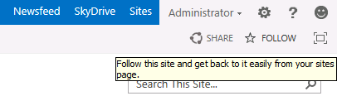
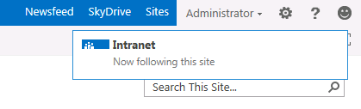
Following - Sites
In 2013 user can follow...
People
Sites
Documents
Tags
Following has a common UI experience

Slide 47
My Tasks
Single view of tasks across SharePoint, Project, and Exchange
Enterprise Search gathers SharePoint tasks
Connects to Project and Exchange for other tasks
New “Work Management” Service Application performs aggregation
Hidden List caches data
New items can also be added
Updates are reflected back to original task
Notes:
My Tasks is a single view of all tasks assigned to you across SharePoint, Project & Exchange. A new Work Management service application aggregates content from across all three sources and stores the data in a hidden list.

Slide 48
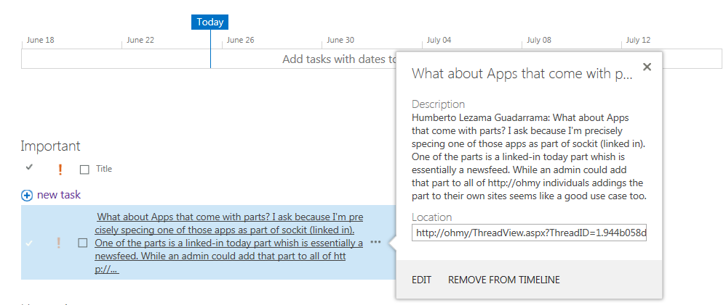
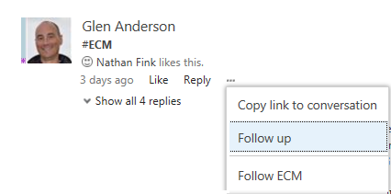
My Tasks
Single aggregated view of all tasks for a user
Spans SharePoint sites, Exchange and Project server
Aggregation implemented by Work Management Service
WMS uses hidden list in user personal site
Users can also create new personal tasks stored in that list
WMS provides ability to write sync task updates
WMS not federated and must be run in the My Site content farm
Integrated with newsfeed with ability to follow up conversations trough the My Tasks list.

Slide 49





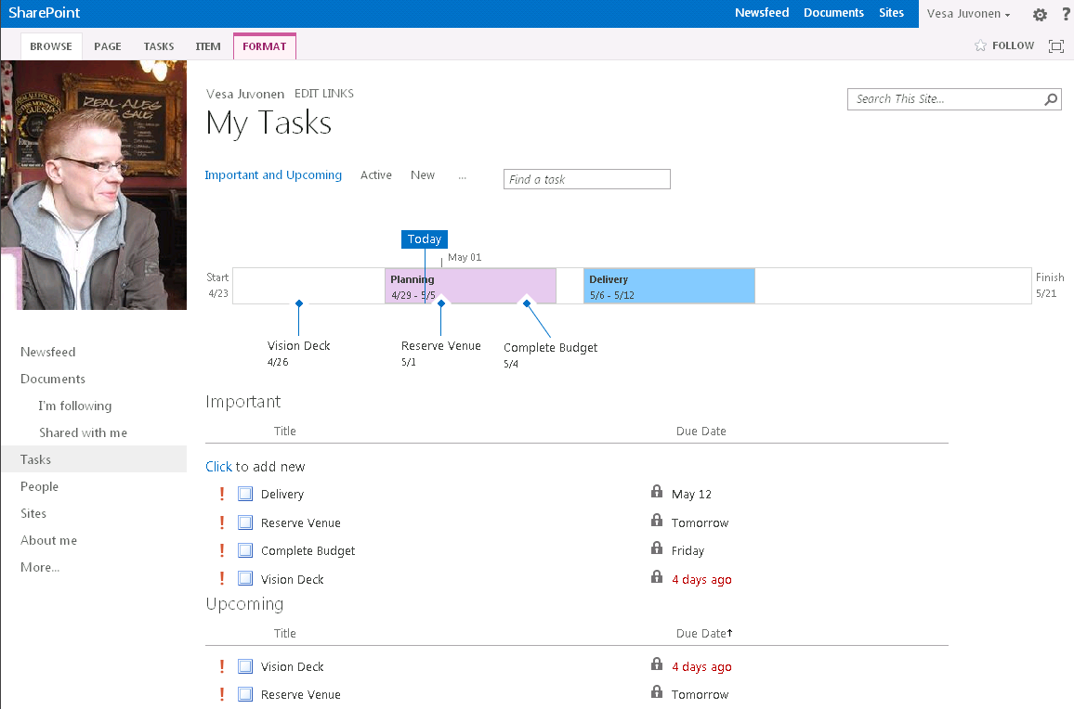





Tasks Architecture
WFE
App Server
Back end
Project Service
Project DB A
Code Behind
Work Management Service
1
Project DB B
1
WM Provider
Content DB A
Task Cache
2
Content DB B
Important: the WM SSA only contact Search, My site and Project SSAs that are in the same proxy group

Slide 50
Summary
Service Application Overview
Business Connectivity Service
Managed Metadata Service
User Profile Service

