Slide 1
Managing Site Collections
Notes:
This lecture begins by discussing the standard site templates available in SharePoint 2013 for creating various types of sites such as Team Sites, Blank Site and Publishing Sites. You will learn about capacity planning strategies which can be used to prevent site collections and content databases from growing too large. The module also discusses how permissions and access control are managed within the context of a site collection and then demonstrates the best practice technique of configuring permissions in terms of SharePoint groups. This lecture also introduces the essential concepts of SharePoint tenancies and site subscriptions and shows how creating and configuring SharePoint tenancies provides new options for configuring and managing sites.

Slide 2
Agenda
Governance
Site Templates
Site Collection Security
Site Columns and Content Types
Understanding Tenancies

Slide 3
What is Governance?
A set of policies, roles and responsibilities
Designed to let IT and business divisions work together
Designed in accordance with business goals
Benefits to creating a Governance plan
Scalable growth of business content in SharePoint
Consistency in all SharePoint sites across Enterprise
Minimal pain upgrading to a new version of SharePoint
Notes:
Too many organizations have installed SharePoint and thought that it was the magic genie which will fix all their problems. The “pilot” suddenly turns into a production system and as time goes by, users will find interesting ways to ‘solve’ some problem using SharePoint. (e.g. How many times have we heard of the scenario where a user calls up because their SharePoint site is ‘broken’ after they are ‘messing around with SharePoint Designer’.) The SharePoint farm will grow very organically; yielding islands of inconsistent information, branding, and customizations.
A Governance plan one of the most crucial (and often one of the most overlooked) aspects of setting up a SharePoint farm.

Slide 4
Creating a Governance Plans
What should it include?
Information architecture design
SharePoint Hosting plan
Policies for user customization
Strategy for Branding Sites
Plan for End User Training
Notes:
Sounds like a lot of work? Well, it is. But you are saving yourself 10x more work if you ever need to upgrade your farm. Also just as important is the creation of the Governance Plan is the communication of it to end users. This isn’t to say that every single person in your organization needs to fully understand the do’s and don’ts in your company’s SharePoint environment, but the content owners – be it site collection or site owners need to understand and be aware of any changes.
Don’t know who your content owners are? Or who a site was created for? SharePoint Foundation has some nice events such as WebAdding or WebProvisioned that you can extend to help with that.

Slide 5
Site Collections and Governance
Partitioning content using site collections
Separation of security
A scope for assigning administrator permissions
A scope for assigning permissions to users
Site collections can be assigned quotas
Smallest unit for controlling storage database
Notes:
Once the web application is created you can start creating site collections. Each web application can consist of more than one site collection and each web application has a root site collection.
Site collections represent a scope for administrative privileges. You can assign a user as a site collection administrator. That user has full administrative permissions within any existing site and any future site created inside that site collection. To each site collection within the web application you can assign a different user as site collection administrator.
In a large intranet, you need to be able to maintain control over your server resources and carefully monitor areas such as storage space. You must be able to ensure that one site collection cannot use so many resources that other site collections can no longer function. Windows SharePoint Services allows you to specify quota for site collections, so that you can manage your site and server resources.
When a web application is created, it gets its own content database. Within that content database can live one or more site collections. If a site collections grows quickly, it can be moved to a different content database. Sites within a site collection cannot be moved to another content database.

Slide 6
Agenda
Governance
Site Templates
Site Collection Security
Site Columns and Content Types
Understanding Tenancies

Slide 7
Understanding the Templates
Site Collection is just a container
Templates need to be assigned to the Site Collection
Different SKUs = Different OOTB Templates
Notes:
A site collection is a collection of sites. SharePoint provides site templates in the following categories: collaboration, meetings, and custom. When you create a site collection, you select the template that matches what you want the site to do.

Slide 8
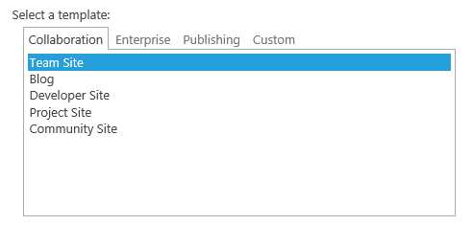
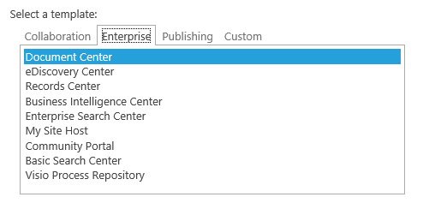
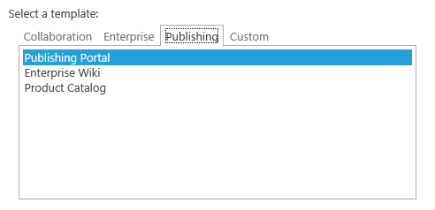
Out-of-the-box Site Templates
Notes:
The Collaboration tab offers a number of templates like the team site, blank site, document workspace, blog, etc. Each template comes with a number of specific features, document libraries and lists.
The Enterprise tab offers templates for a wide range of centers. Each template offers a different set of features, document libraries and lists.
The Publishing tab contains templates for Internet facing sites that allow for branding and easy customization.

Slide 9
Site Template Names
Title | Name | Category
Team Site | STS#0 | Collaboration
Wiki Site | WIKI#0 | Collaboration
Blog | BLOG#0 | Collaboration
Developer Site | DEV#0 | Collaboration
Community Site | COMMUNITY#0 | Collaboration
Document Center | BDR#0 | Enterprise
eDiscovery Center | EDISC#0 | Enterprise
Records Center | OFFILE#1 | Enterprise
Business Intelligence Center | BICenterSite#0 | Enterprise
Enterprise Search Center | SRCHCEN#0 | Enterprise
My Site Host | SPSMSITEHOST#0 | Enterprise
Community Portal | COMMUNITYPORTAL#0 | Enterprise
Publishing Site | BLANKINTERNET#0 | Publishing
Enterprise Wiki | ENTERWIKI#0 | Publishing
Product Catalog | PRODUCTCATALOG#0 | Publishing
Blank Site | STS#1 | Hidden
Document Workspace | STS#2 | Hidden

Slide 10
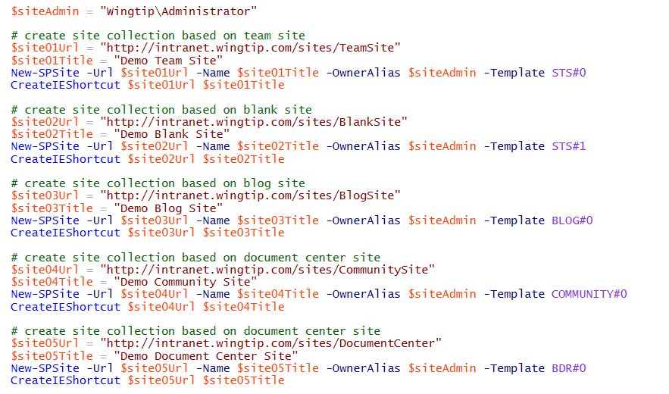
Using a Site Template Name

Slide 11
Agenda
Governance
Site Templates
Site Collection Security
Site Columns and Content Types
Understanding Tenancies

Slide 12
Configuring Site Collection Security
User permissions configured within site collection
Membership and permissions tracked in content DB
Configuration in one site collection can’t effect another
Configuring security within a site collection
Create SharePoint groups for user roles
Assign permissions to groups
Add users and external groups to SharePoint groups
Notes:
Permissions control access to your sites and site content. You can manage permissions by using Microsoft SharePoint Server 2010 groups, which control membership, and fine-grained permissions, which help to secure content at the item and document level. This section describes permissions for sites and site content and provides considerations for choosing permissions.
Inheriting permissions is the default behavior and is the easiest way to manage a group of Web sites. However, sub sites can have their own specific set of permissions.
You can also edit the permissions at document library level, which breaks the inheritance from the site. However, the inheritance is broken only for the specific securable object for which you changed permissions; the rest of the site's permissions are unchanged. You can resume inheriting permissions from the parent list or site at any time.
If you are using fine-grained permissions, you should use groups to avoid having to track individual user accounts. For example, because people move in and out of teams and change responsibilities frequently, tracking those changes and updating the permissions for uniquely secured objects would be time-consuming and error-prone. These groups can be SharePoint groups as well as Active Directory groups.

Slide 13
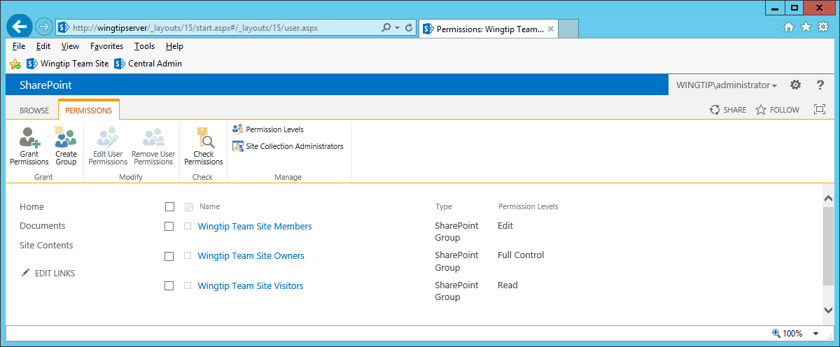
SharePoint Groups
Three Main Groups
Owners – Full Control
Members – Add / Edit / Delete
Visitors – Read Only
Don’t modify existing groups!
Create new groups instead.
Notes:
When a site is created there are three main groups defined.
The Owners group has Full Control permissions. This permission level contains all permissions. This permission level cannot be customized or deleted.
The Members group can add, edit, and delete items in existing lists and document libraries. This permission level is also called the Contributor permissions set.
Visitors group has read only permissions. Users and SharePoint groups with this permission level can view items and pages, open items, and documents.
You can add users to these groups. If you need groups with specific permissions that differ from the three default groups, you better create new groups instead of modifying the default groups.

Slide 14
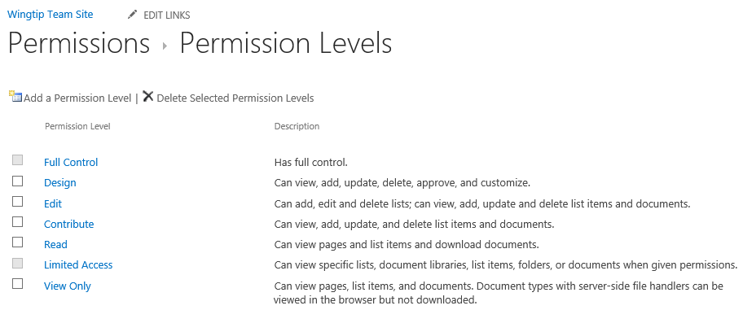
Permission Levels
Permissions assigned using permission levels
Permission level is a named set of permissions
Site collection has standard permission levels
Custom permission levels can be added

Slide 15
Securable Objects
Site collection contains securable objects
Sites
Lists and document libraries
Items and documents
Securable objects structured in hierarchy
Top-level site is at top of hierarchy
All other objects below in the hierarchy
At first, only top-level site has unique access control list
Inheritance broken to assign unique permissions

Slide 16
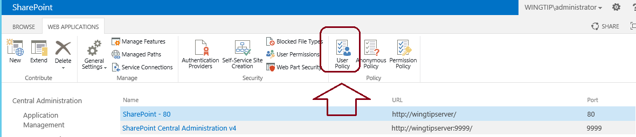
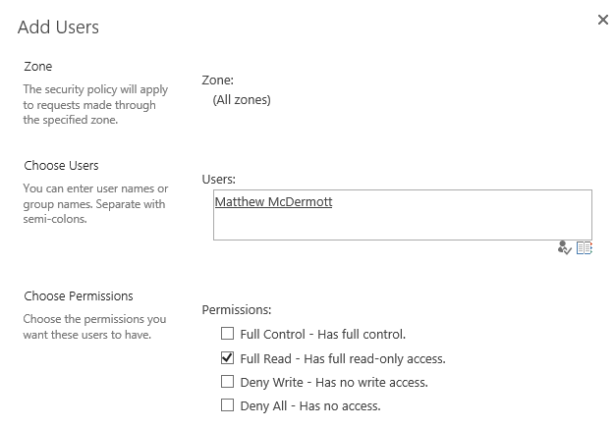
User Policy a Web Application Level
User policy can be used to assign permissions
Assigned at the web application level
Provides permissions to all sites within web application
User policy always overrides site collection security

Slide 17
Agenda
Governance
Site Templates
Site Collection Security
Site Columns and Content Types
Understanding Tenancies

Slide 18
Site Columns
Reusable column template for use within lists and content types
Specify:
Name & description
Data type
Site column group
Scoped at the site level
Available to child sites
Adding to a list / content type creates a copy
To manage, must have Web designer rights
Notes:
Lists store data in columns, also referred to as fields. You can create the fields in the context of your list, but you can also create site columns that can be reused in multiple lists.
Site columns are created at the level of the site collection and are available to all the sub sites. When creating a site column you have to specify a name, a data type and the name of a group.

Slide 19
Creating & Managing Site Columns
Create / manage many ways:
Browser-based user interface
SharePoint Designer 2013
SharePoint object model
Feature XML <Field>
Notes:
You can create site columns in many different ways:
Createthem in the user interface: navigate to the Site Settings page of the root site and click the Site Columns hyperlink under the Galleries group.
Use SharePoint Designer 2010.
Use the SharePoint object model to create a site column programmatically.
Use CAML to create a site column declaratively using the <Field> element.

Slide 20
Content Types
Used to define a type for item or document
Enable storage of different types of content in same list
Specify:
Name & description
Parent Content Type
Content type group
Scoped at the site level
Available to child sites
Notes:
Content types are designed to help users organize their SharePoint content in a more meaningful way. A content type is a reusable collection of columns, a data structure, that can be applied to several lists or document libraries in the site collection.
You can also apply more than one content type to the same list or library, enabling users to store multiple different types of content in the same list or library.
Each content type can include different columns for gathering and storing item metadata, and can have different workflows assigned to them.
Contenttypes are defined at site collection level but are available to all sites and sub sites in the site collection.

Slide 21
Creating & Managing Content Types
Create / manage many ways:
Browser-based user interface
SharePoint Designer 2013
SharePoint object model
Feature XML <ContentType>
Notes:
As with site columns, you can create site columns in many different ways:
Createthem in the user interface: navigate to the Site Settings page of the root site and click the Content Types hyperlink under the Galleries group.
Use SharePoint Designer 2010.
Use the SharePoint object model to create a content type programmatically.
Use CAML to create a content type declaratively using the <ContentType> element.

Slide 22
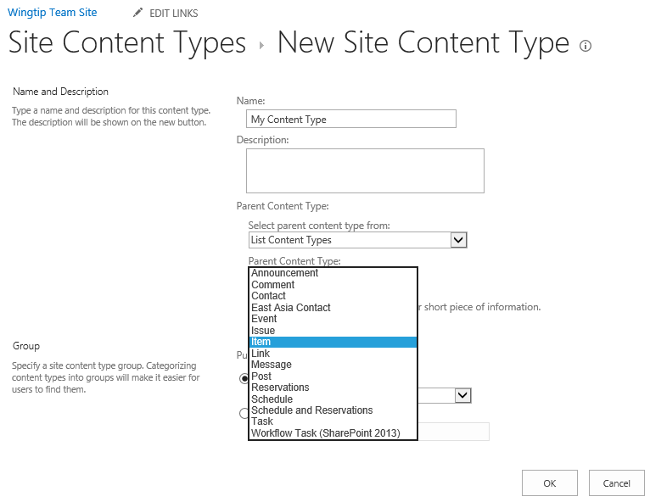
Inheriting Content Types
Content types create using parent content type
You should learn the standard, built-in content types
You must inherit from a content type to create one
Notes:
You can define a content type with several columns and use it as a base for other content types. More specific content types can inherit the base content type and add more specific columns to it.

Slide 23
Agenda
Governance
Site Templates
Site Collection Security
Site Columns and Content Types
Understanding Tenancies

Slide 24
Office 365 and SharePoint Tenancies
Office 365 hosting based on tenancies
Customer see tenancy as top-level management scope
Tenancy abstracts away farm and web application
SharePoint Tenancy is a set of site collections
Unit of provisioning for customers in Office 365
SharePoint tenancy provides Admin site collection
Tenancy administrator can create new site collections
Tenancy administrator configures services

Slide 25
Multi-Tenancy Defined
Ability to efficiently host multiple customers
All customers share same farm and web application
Provide each customer with isolated data and services
Scenarios include:
Office 365
Other hosting companies
Rarely used in On-Premises Deployments
It makes things very hard to manage
Everything must be done with PowerShell
Notes:
Multi-tenancy is the isolation of data, operational services and management.
Hosting – think of companies such as RackSpace that offer Hosting to customers for their SharePoint Portal without the burden of hosting it internally.
Think about the Flat/Apartment Building analogy
▪Multiple tenants share same infrastructure (the building, the doors)
▪Some services are shared but have no data (entry phone, refuse collection)
▪Some services are shared (electricity, phone) but data is partitioned (meter readings, billing)
▪Some shared services are a free for all (car parking)
SharePoint 2010 comes with some new features to support hosting environments. The core multi-tenant infrastructure is not turned on by default. It requires a custom service application to be provisioned, and once that's done you can begin configuring the different pieces of multi tenancy:
Multi tenant administration sites
Multi tenant member sites
Feature packs

Slide 26
Site Subscriptions
Multi-tenancy relies on site subscriptions
Each site subscription has a subscription ID
Site collections grouped together by subscription ID
Site collections known as member sites
Subscription ID used to map features and services
Subscription ID used to partition service data

Slide 27
Roles
Hosting company
Manages the farm-level settings and hardware
Controls database configurations
Installs all new approved features and solutions
Can brand the Tenant Administrator pages
Hosted company administrator
Purchases space, features, and bandwidth from hosting company
Controls the architecture of customer sites but not the content
Reviews usage statistics
Hosted company
Owns site collection
Installs or removes features and solutions
Configures features and services
Reviews usage statistics

Slide 28

Creating a Site Subscription
You create a site subscription to create a tenancy
New site Subscription is nothing more than a GUID
Site subscription has a collection of site collections
Site subscription can have an admin site collection
Site subscription can have feature pack
Site subscription created using PowerShell
No support in Central Administration

Slide 29
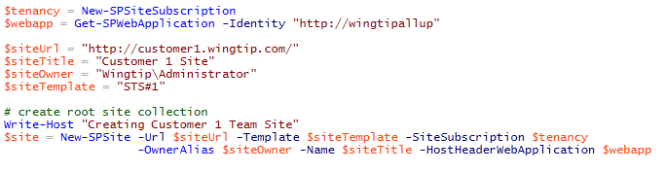
Creating a Member Site
Site collections can be added to site subscription
New-SPSite has -SiteSubscription parameter

Slide 30
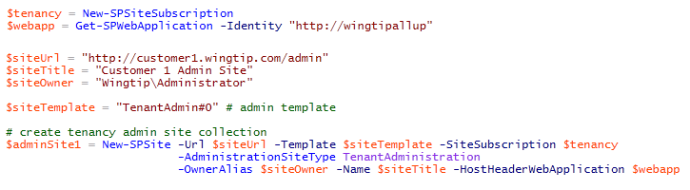
Creating a Tenant Admin Site Collection
Site subscription can have a tenant admin site
Site collection created with TenantAdmin#0 template
Must use -AdministrationSiteType parameter

Slide 31
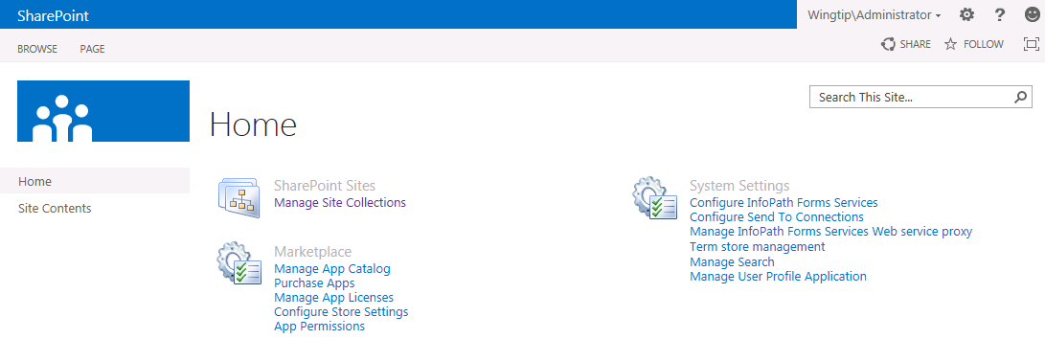
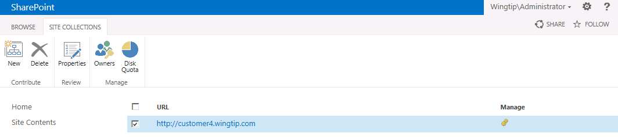
Tenant Admin Site

Slide 32
Tenancies in Hosting Scenario

Slide 33
Summary
Governance
Site Templates
Site Collection Security
Site Columns and Content Types
Understanding Tenancies

