Slide 1
Upgrading Content from SharePoint 2010
Notes:
This module focuses on what is required to upgrade content from SharePoint 2010 farms to SharePoint 2013. You will learn how to use the database attach strategy to migrate site content from a SharePoint 2010 farm to a SharePoint 2013 farm. You will also learn which SharePoint service applications offer a strategy to migrate their content and which do not. The module also introduces the concepts and mechanisms involved with the Visual Upgrade feature which allows users to begin working migrated sites using the SharePoint 2010 UI mode and then after a time to switch over to the standard UI mode of SharePoint 2013.

Slide 2
Agenda
Upgrade Concepts and Terminology
Upgrading Content using Database Attach
UI Modes and Site Collection Upgrade

Slide 3
History of SharePoint Upgrade Support
Upgrading from SharePoint 2003 to SharePoint 2007
Database attach
In-place upgrade
Gradual upgrade
Upgrading from SharePoint 2007 to SharePoint 2010
Database attach
In-place upgrade
Upgrading from SharePoint 2010 to SharePoint 2013
Database attach
Do you notice a trend?
Database attach is now the only supported upgrade technique

Slide 4
Upgrading Content Overview
Upgrading SharePoint 2010 content overview
Backup SQL databases in SharePoint 2010 farm
Install SharePoint 2013 and create new farm
Restore SharePoint 2010 DBs in SharePoint 2013 farm
Upgrade DBs to update their table schemas for SharePoint 2013
Mount upgrade content databases to existing web applications
SharePoint 2013 cannot be installed with previous version
Best to obtain separate hardware for new SharePoint 2013 farm
Reusing hardware from SharePoint 2010 farm is tricky
Backup content from SharePoint 2010 farm
Reformat hard disk or uninstall all SharePoint 2010 products
Install SharePoint 2013 and create new farm
Upgrade and mount content DBs

Slide 5
Database Attach Upgrade
Database attach support for the following databases
Content databases
Project databases
Search admin database
Profile database
Social database
Managed Metadata database
PerformancePoint database
BCS database
Secure Store database (passphrase required)

Slide 6
No Database Attach Upgrade Support
Configuration database
Search index databases
Sync database

Slide 7
Authentication Support for Upgrade
Windows Classic Support (Legacy)
SP2013 supports this with some issues
Windows Claims Support
2010 supports this with a few exceptions
Outlined in claims migration document
Migration before upgrade recommended
Forms Auth Support
No changes from 2010
Add provider with same name before database attachment
Web Application authentication mode mismatches
Database attach in SP2013 detects mismatched auth support
Test-SPContentDatabase in SP2013 also detects this
Fix before attaching is recommended approach
Notes:
Claims migration document:
http://technet.microsoft.com/en-us/library/hh487289.aspx

Slide 8
Claims Migration Best Practices
Should not group both events together
Prevent errors that are hard to troubleshoot
Ideally migrate to claims before upgrade
Determine authentication mode mismatches
Use Test-SPContentDatabase to find mismatches
If partial migration within DB database, solve that before continuing
If misconfigured web application, fix before doing database attach/upgrades
Ensure all external data source/web services work as expected after claims migration

Slide 9
Agenda
Upgrade Concepts and Terminology
Upgrading Content using Database Attach
UI Modes and Site Collection Upgrade

Slide 10
Upgrading Content Overview
Backup SQL databases in SharePoint 2010 farm
Backup all content DBs
Backup service application DBs that support upgrade
Create new SharePoint 2013 farm
Configure service applications
Create web application(s) to host upgraded sites
Migrate content to new SharePoint 2013 farm
Restore SharePoint 2010 DB backups in SharePoint 2013 farm
Upgrade DBs (updates database schema for SharePoint 2013)
Mount content DBs to restore sites in existing web applications
Configure service applications to use upgraded DBs

Slide 11
Test-SPContentDatabase
Finds issues between content DB and web application
Can test a database not connected to the farm
Can test a database already connected to the farm
List out issues including orphans
Missing referenced server side customizations:
Missing Features
Missing Templates/Site Definitions
Missing Web Parts

Slide 12
Mount-SPContentDatabase
Initiates Content Database upgrade
Runs internal consistency/orphans check
Runs web application compatibility checks
Customization references
Web parts
Features
Site Definitions
Event handlers
Authentication/security migration references
Installed to reference auth provider mismatch

Slide 13
Repair-SPContentDatabase
Runs repair operations on content DB
Correlated with Test-SPContentDatabase cmdlet
Fixes internal consistency between tables data
Orphaned webs
Orphaned lists
Orphaned items

Slide 14
Upgrade-SPContentDatabase
Used to upgrade a Content Database
Mainly after applying patches to initiate build to build upgrade
Can also be used to resume failed version upgrade after mounting database
Can be used in parallel with other Content Database upgrades
Defaults to doing build to build upgrade on all child site collections
Does not have option to do version upgrade of all site collections
Can be set to not include child site collections (-NoB2BSiteUpgrade)
Improve B2B database upgrade speed
Allows upgrading site collections later
Has option to use SQL snapshot if available (-UseSnapShot)
Provides read only copy of content via snapshot while upgrading writable copy of database behind the scenes

Slide 15
Agenda
Upgrade Concepts and Terminology
Upgrading Content using Database Attach
UI Modes and Site Collection Upgrade

Slide 16
Upgrade Improvements Overview
Upgrade features new to SharePoint 2013
Deferred Site Collection Upgrade
Site Collection Health Checks
Upgrade Evaluation Site Collections
Enriched logging of upgrade process
Site collection upgrade throttling

Slide 17
Deferred Site Collection Upgrade
Allows 2010 site collections to run unchanged in 2013
SharePoint 2013 can run sites in SharePoint 2010 UI mode
SharePoint 2013 provides SharePoint 2010 root directory (\14)
Site Collection Upgrade replaces Visual Upgrade
Visual Upgrade in SharePoint 2010 was not reliable
SharePoint 2010 UI mode in SharePoint 2013 is far more stable
Existing SharePoint 2010 customizations should work as expected
All upgraded site collections initialized in 2010 UI mode
Site collections must be upgraded to enter 2013 UI mode
Upgrading involves creating copy as opposed to in-place upgrade
Upgrading large site collections can take considerable processing

Slide 18
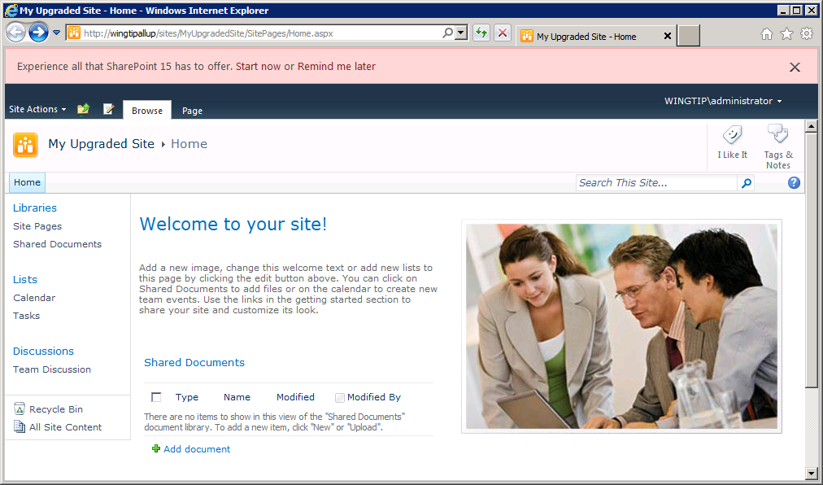
User Notifications of Upgrade Availability

Slide 19
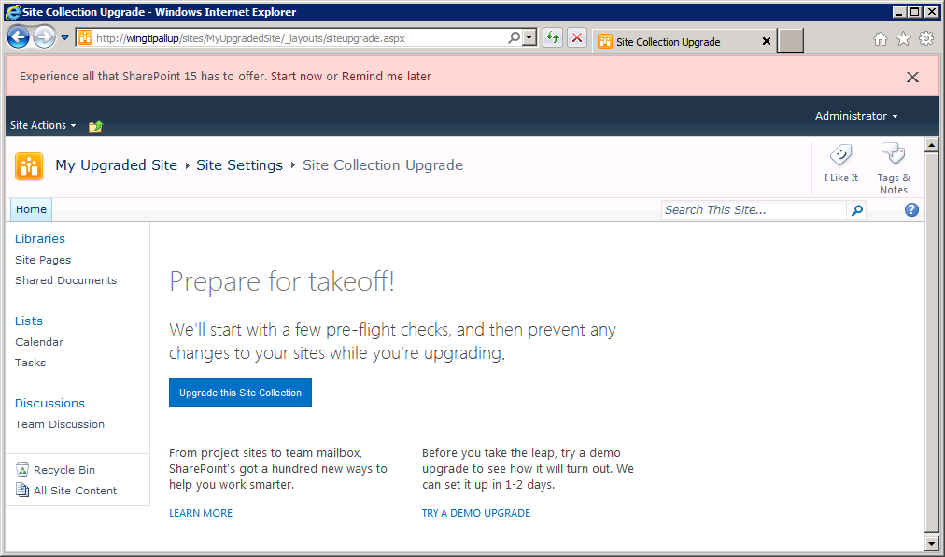
User Can Initiate Site Upgrade Process

Slide 20
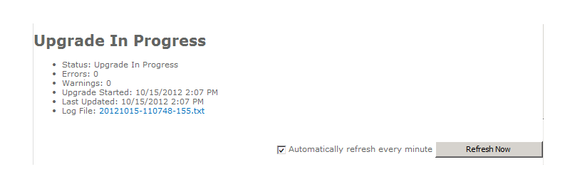
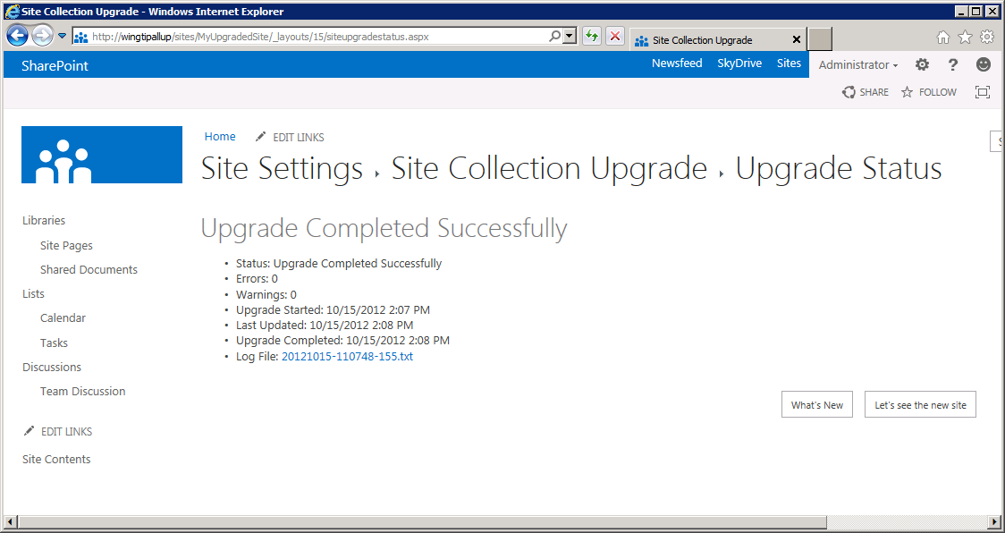
Notifications During Upgrade
User can see upgrade status progressing
User notified when upgrade is complete

Slide 21
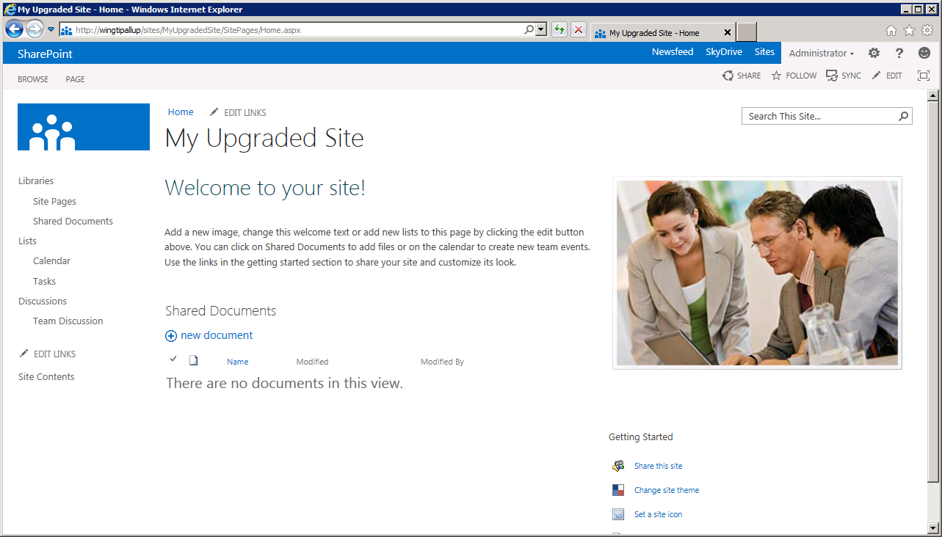
Upgrade Site

Slide 22
Site Collection Health Checks
You can run rules to detect issues with site collections
Health checks look for common known issues:
Blocking upgrade issues (missing templates in 15 folder)
Post upgrade issues such as customized (Un-ghosted) files
Site collection level scoped tool
UI exists for Site Collection Admins
PowerShell cmdlet for Farm Admins
Runs automatically before site collection upgrade
Prevents upgrade if blocking issues detected

Slide 23
Upgrade Evaluation Site Collections
Allows upgraded preview of existing site in 15 mode
Makes side by side copy of existing site collection
Takes advantage of SQL Snapshot capability if present
Causes no read-only outage as source is snapshot
Available in SQL Enterprise and SQL Developer editions
Otherwise uses site collection backup process
Causes read-only outage during copy
Occurs in scheduled Timer Job process
Considered an expensive operation
Sends email notification when copy/upgrade is completed
Requester and all site collection administrators
Email is optional if request occurs via PowerShell

Slide 24
Site Collection Upgrade Throttling
Prevents overload from self-service upgrade
Throttles limit the number of simultaneous upgrades
Throttles supported at level of application pool and content DB
Upgrade requests queued and processed by upgrade timer job
Application pool level throttle (Web application property)
Default is 5 concurrent site collection upgrades
Serves as server-level throttle for most environments
Content Database level throttle (Content DB property)
Default is 10 concurrent site collection upgrades
Content size throttle (Web application property)
Prevents self service upgrade process for oversized sites
Default is site collection < 10MB and has <10 subwebs

Slide 25
Upgrade Logging
Changed to ULS format
TSV format allows improved parsing
Can be imported into Excel
Includes Correlation ID
Per SPSite logs available to Site Collection admins
Uses separate logging level control than rest of upgrade
Shows reduced set of information by default
Created for both B2B and V2V upgrades
Stored as content within Site Collection
Maintenance Logs library created as Gallery
Maintenance Logs secured to Site Collection Admins only
Hidden feature activates during first upgrade

Slide 26
Site Collection UI Modes
SharePoint 2010 (14) UI Mode
Uses legacy 14 mode JS and CSS
Uses legacy _layouts and _controltemplates directories
Uses existing 14 features, web parts, and site definitions
No 15 features can be enabled/activated on a 14 mode site
Existing 2010 (and earlier) solutions can be deployed to 14 directories
New 15 solutions cannot be deployed to 14 directories
SharePoint 2013 (15) UI Mode
Uses new 15 mode JS and CSS
Uses new _layouts\15 and _controltemplates\15 directories
Mainly uses new 15 features and web parts
Can use existing 14 features and web parts
Can only use 15 directory installed site definitions
Existing 2010 (and earlier) solutions can be deployed to 15 directories
New 15 solutions can only deployed to 15 directories

Slide 27
Getting In The Mode
All existing site collections are in 14 mode
When performing database version upgrade
Only possible to force all sites to 15 mode using PowerShell
Not recommended just after database attach though, for perf and experience
Get-SPSite | Upgrade-SPSite –VersionUpgrade
New site collections can be created in 14 or 15 mode
Always available to farm administrators
Available by self-service site creation
Only if CompatibilityRange property set to allow it
Existing 14 mode site collections can be upgraded to 15 mode
Always available to farm administrators
Available by self-service site collection upgrade
Only if CompatibilityRange and SPSite.AllowSelfServiceUpgrade allow
Only for site collection admins

Slide 28
CompatibilityRange Property
Property for web applications and tenancies
Used to determine possible mode for new site collections
Used to determine if site collections can be upgraded
WebApplication.CompatibilityRange
Acts as global value unless overridden at tenancy level
MaxCompatibilityLevel: 15
MinCompatibilityLevel: 14
DefaultCompatibilityLevel: 15
SPSiteSubscription CompatibilityRange values
Used by SPO to control upgrade
Both farm admin level and tenant admin level control values
There is no default value it inherits web application value
Upgrade control can be overridden at SPSite level
SPSite.AllowSelfServiceUpgrade
Notes:
For the Web Application
$webapp = Get-SPWebApplication http://intranet.wingtip.com
$webapp.CompatibilityRange.MinCompatibilityLevel = 15
$webapp.Update()
Alternatively:
$webapp = Get-SPWebApplication http://intranet.wingtip.com
$webapp.CompatibilityRange = [Microsoft.SharePoint.SPCompatibilityRange]::NewVersion
$webapp.Update()
More Web App Properties
AllowSelfServiceUpgradeEvaluation
MaxSizeForSelfServiceEvalSiteCreationMB
For a Site Collection
AllowSelfServiceUpgrade
InheritAllowSelfServiceUpgradeSetting
InheritAllowSelfServiceUpgradeEvaluationSetting
CanUpgrade
NeedsUpgrade
http://technet.microsoft.com/en-us/library/jj219599.aspx

Slide 29
Unsupported In 14 Mode
All new SP2013 specific features
Upgrade SPSite to 15 mode first
2010 Web Analytics
Existing features must be removed
New web analytics features supported only in 15 mode
2010 Office Web Applications (WAC)
Replaced with SP2013 WAC for both 14 and 15 mode
PowerPoint Broadcast sites must be removed
No replacement available, use Lync instead
Project Web Access Sites (PWA Template)
Must upgrade to 15 mode to use
Project Sites (PWS) supported in both 14 and 15 mode

Slide 30
Summary
Upgrade Concepts and Terminology
Upgrading Content using Database Attach
UI Modes and Site Collection Upgrade

